Slide 1
PyGame
Vishal Yelisetti

Slide 2
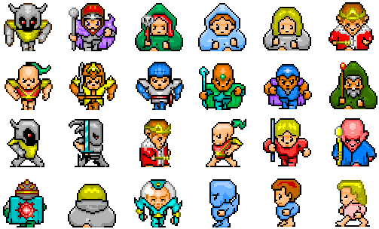
Sprites
Computer generated graphics that moves on the screen
Working with the update and draw section

Slide 3
Sprite group
Collection of sprites
Enables all sprites all act at the same time
# sprite group
all_sprites = pygame.sprite.Group()
#update section
all_sprites.update()

Slide 4
What makes a sprite
Self.image
What the sprite looks like
Self.rect
Rectangle that encloses the sprite
Where the sprite is?
What it ran into?
Moving the sprite around

Slide 5
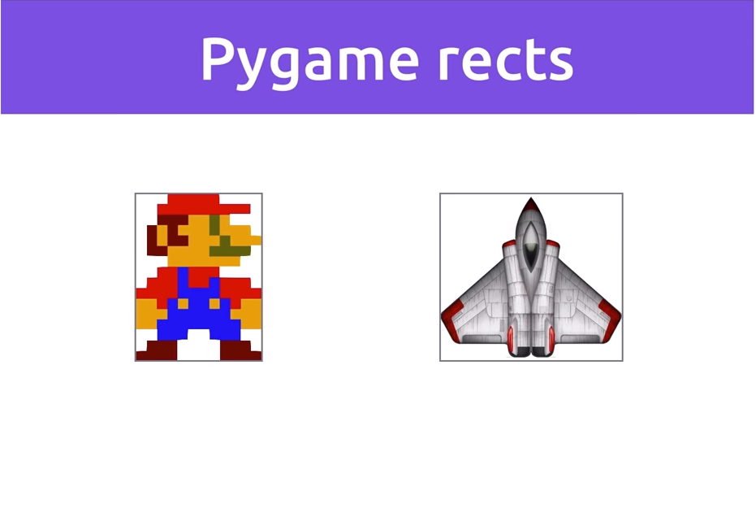
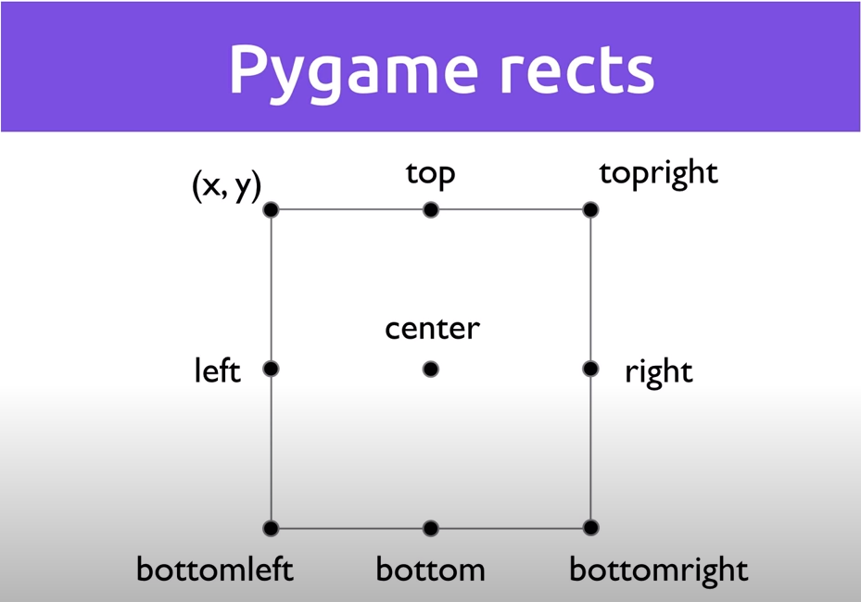
Pygame rects

Slide 6
Resources
Game Development 1-2: Working with Sprites - YouTube

