Slide 1
SEIS 763 – Machine Learning Final Project
Jared Anderson, Andrew Oveson, and Vishal Yelisetti
Notes:
Vishal

Slide 2
Agenda
Project Introduction
Methodology
Modeling Results
Discussion & Future Research
Notes:
Vishal

Slide 3
The Dataset
Marriage Trends in India: Love vs. Arranged – Kaggle
“The dataset aims to provide valuable insights into changing marriage patterns, the role of tradition vs. modernity, and their impact on marital outcomes. Researchers, sociologists, and data analysts can use this dataset to study relationship trends, predict marriage success, and analyze social influences on marriage in India.” ^{(Ak0212)}
Dataset Shape: (10000, 18)
Ak0212. Marriage Trends in India: Love vs. Arranged. Kaggle, https://www.kaggle.com/datasets/ak0212/marriage-trends-in-india-love-vs-arranged.
Notes:
Vishal

Slide 4

Problem Statement
Can we predict whether a marriage will end in divorce based on factors like age at marriage, education level, caste match, religion, parental approval, urban/rural setting, dowry exchanged, marital satisfaction, and income level?
Notes:
Vishal

Slide 5
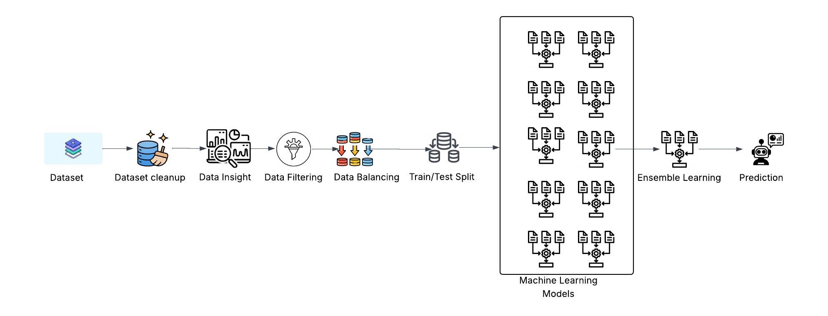
Methodology
Notes:
Vishal

Slide 6
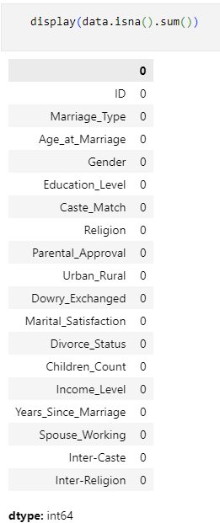
Data Cleanup
Pre-cleaning is expected to have been completed
No missing values
Clean Headers
Minimal “dirty data”
20% Parental approval “Partial”
10% Dowry exchange “Not Disclosed”
Notes:
Vishal

Slide 7
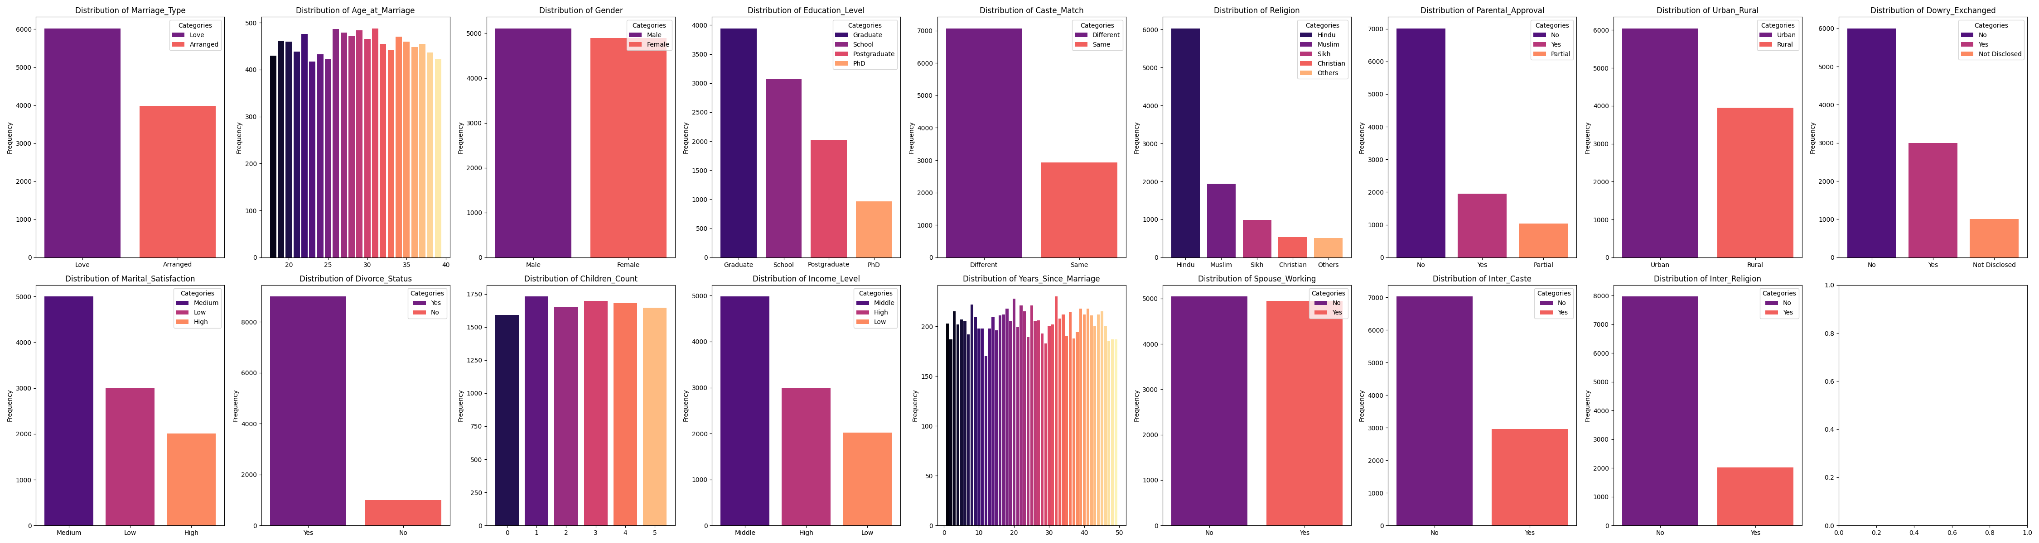
Data Insights
Categorical Columns:
['Marriage_Type', 'Gender', 'Education_Level', 'Caste_Match', 'Religion', 'Parental_Approval', 'Urban_Rural', 'Dowry_Exchanged', 'Marital_Satisfaction', 'Divorce_Status', 'Income_Level', 'Spouse_Working', 'Inter_Caste', 'Inter_Religion’]
Numeric Columns:
['Age_at_Marriage', 'Children_Count', 'Years_Since_Marriage']
Notes:
Jared

Slide 8

Initial Hypotheses About the Data
Certain variables would be deemed unnecessary:
Years since Marriage
Marriage Type
Inter_Religion
Variables that may matter:
Age at Marriage
Inter-Caste or Inter-Religion Marriages
Education Level
Children Count
Years Since Marriage
Employment Status
Gender
Odd that personal traits such as Height, weight were not accounted for in the data
Notes:
Jared

Slide 9
The Dataset – One-Hot Encoded Variables
2 | 3 | 4 | 5
Marriage Type (L/A) | Income Level (H/M/L) | Education Level | Religion
Gender (M/F) | Marital Satisfaction (H/M/L)
Caste Match (Y/N) | Parental Approval (Y/N/P)
Rural/Urban (R/U) | Dowry Exchanged (Y/N/U*)
Spouse Working (Y/N)
Inter-Caste (Y/N)
Inter-Religion (Y/N)
'Age_at_Marriage',
'Marriage_Type_Love',
'Caste_Match_Same',
'Parental_Approval_Yes',
'Dowry_Exchanged_Not Disclosed', 'Dowry_Exchanged_Yes',
'Marital_Satisfaction_Low', 'Marital_Satisfaction_Medium',
'Income_Level_Low', 'Income_Level_Middle',
'Inter_Caste_Yes',
'Children_Count',
'Years_Since_Marriage',
'Gender_Male',
“Education_Level_PhD','Education_Level_Postgraduate', 'Education_Level_School',
'Religion_Hindu', 'Religion_Muslim’, 'Religion_Others', 'Religion_Sikh', 'Parental_Approval_Partial',
'Urban_Rural_Urban',
'Spouse_Working_Yes',
'Inter_Religion_Yes’,
Notes:
Jared

Slide 10
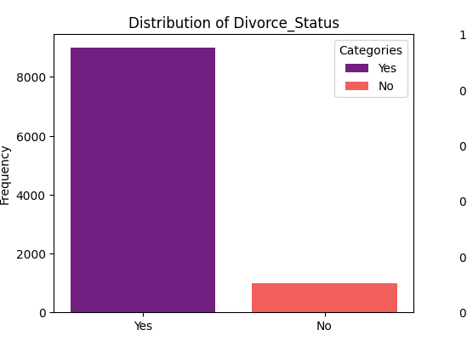

Data Balancing – Class Imbalance
The data features a 9 to 1 split along the dependent variable
Use SMOTE to address this
Notes:
Jared

Slide 11
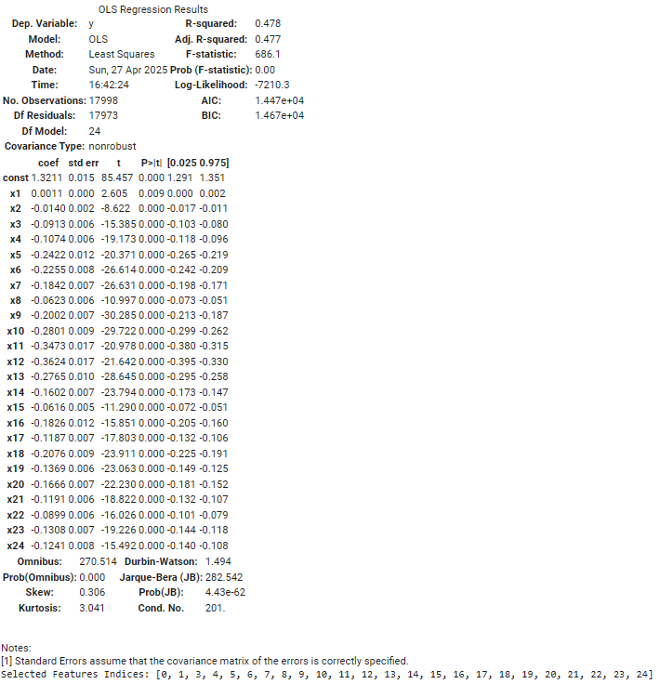
Data Filtering – Backwards Elimination
After One-Hot Encoding our categorical values, backwards elimination found only “Years_Since_Marriage” to be unimportant
Notes:
Jared

Slide 12
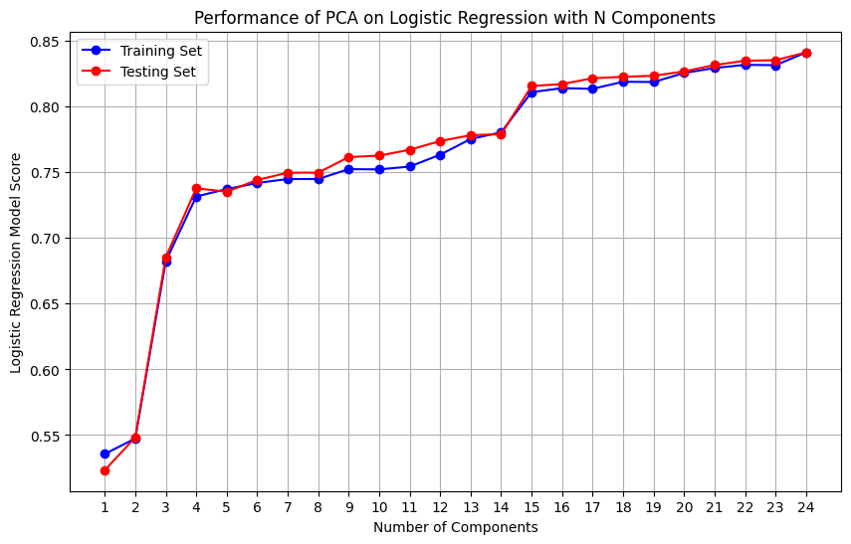
Data Filtering – Dimensionality Reduction
Dimensionality reduction did not necessarily improve model accuracy for our data.
Continued using the full dataset.
For the sake of completeness, used PCA with 15 components alongside each classifier
For most models, PCA caused worse performance.
Notes:
Jared

Slide 13
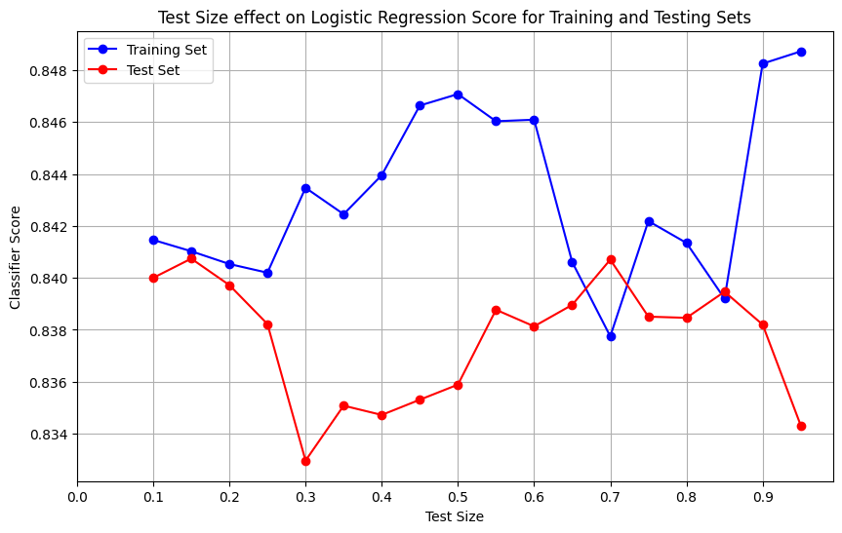
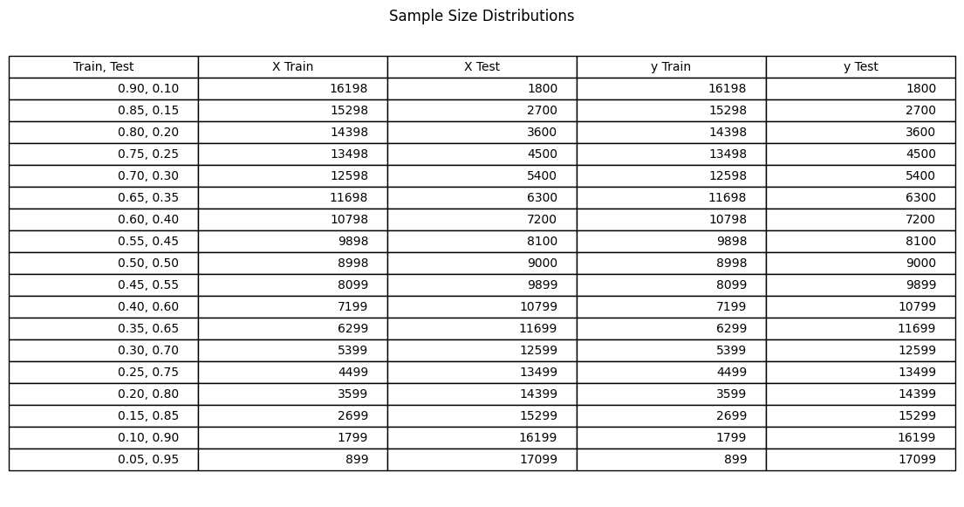
Data Preparation – Train/Test Split
Notice the range of the graph is 0.833 – 0.849. This indicates a very minor difference in model performance based on training vs. testing set size. We moved forward with 0.15 as the testing set size.
Notes:
Jared

Slide 14
Why No Validation Set?
A validation set is not always necessary, particularly in situations where model selection and hyperparameter tuning are not crucial, or when computational resources are limited
Train/Test split was consistent
Modeling results were generally high
Notes:
Andrew

Slide 15
Machine Learning Models
In Order of Experimentation:
Logistic Regression
Random Forest
Support Vector Classifier (RBF & Polynomial)
Decision Tree
Gaussian Naïve Bayes
Adaptive Boost
Gradient Boost
Extreme Gradient Boost
k-Nearest Neighbors
Voting Classifier
Initial Hypothesis:
Decision Tree will have the best model performance
k-NN will have good performance assuming good clustering of data
Notes:
Andrew

Slide 16
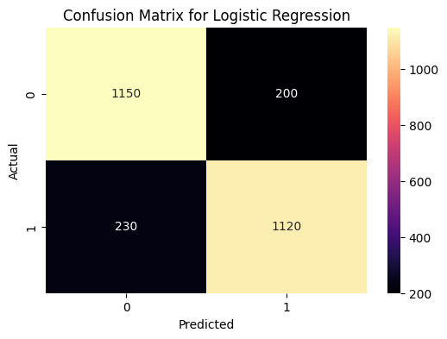
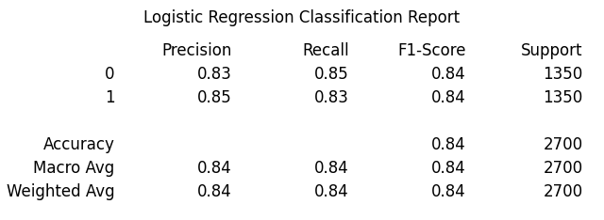
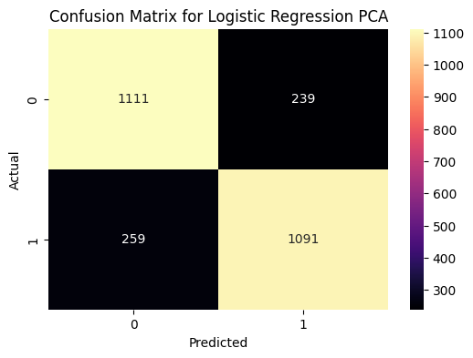
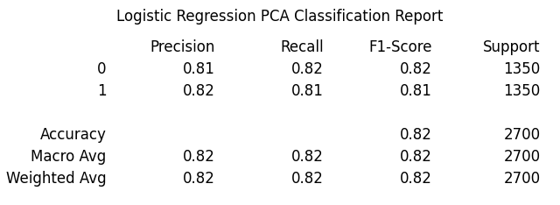
Classifiers – Logistic Regression
Notes:
Andrew --

Slide 17

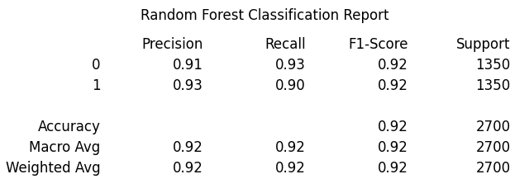

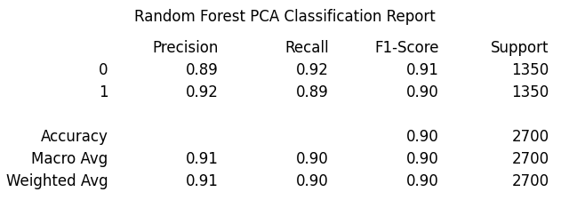
Classifiers – Random Forest

Slide 18
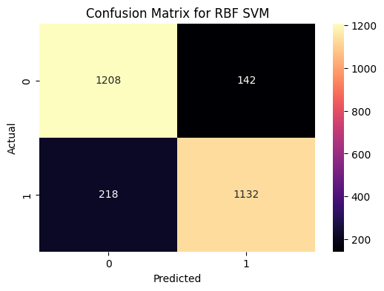
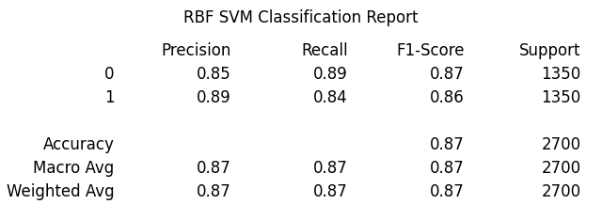
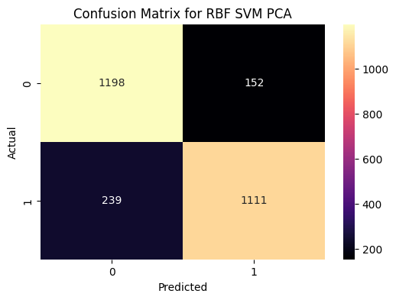
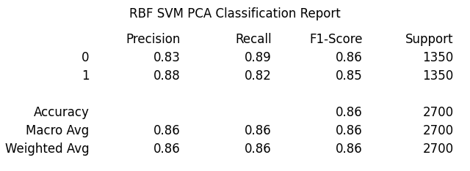
Classifiers – Support Vector Classifier (RBF)

Slide 19
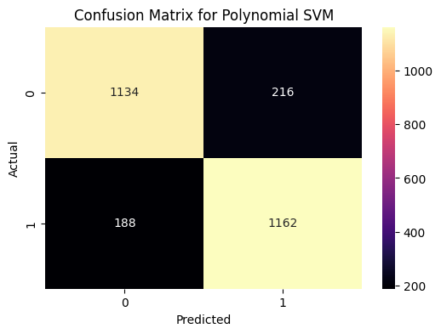

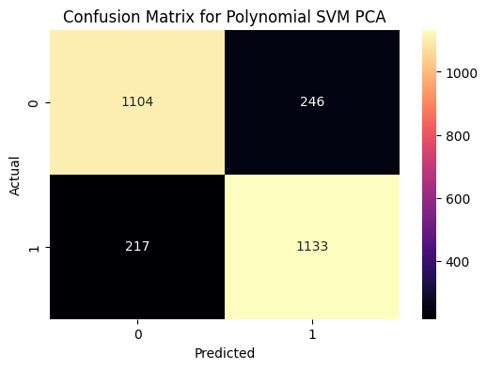
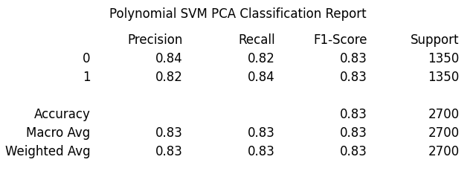
Classifiers – Support Vector Classifier (Poly)

Slide 20
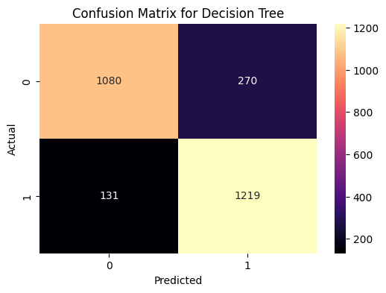
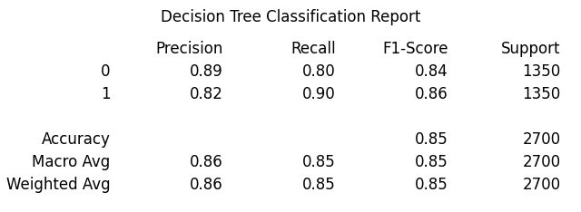
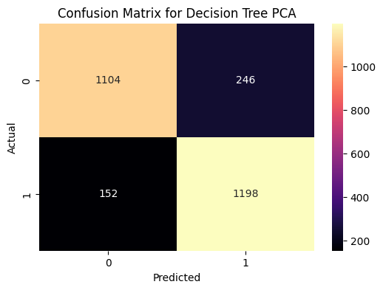

Classifiers – Decision Tree

Slide 21
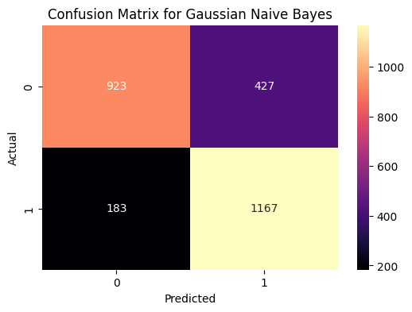
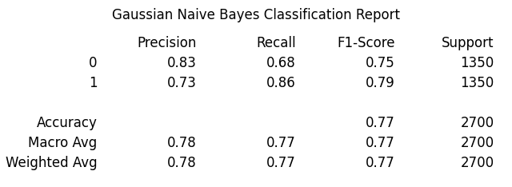
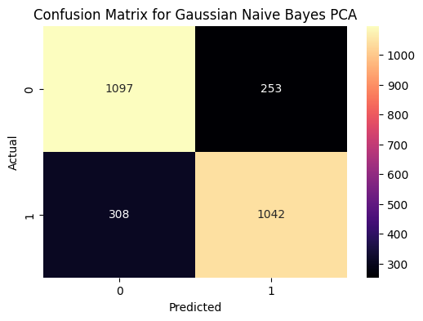
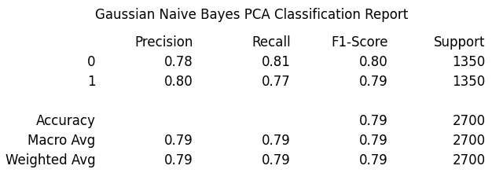
Classifiers – Gaussian Naïve Bayes

Slide 22


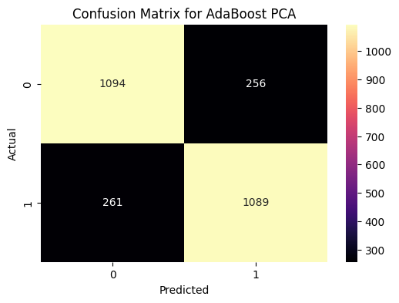

Classifiers – Adaptive Boosting

Slide 23
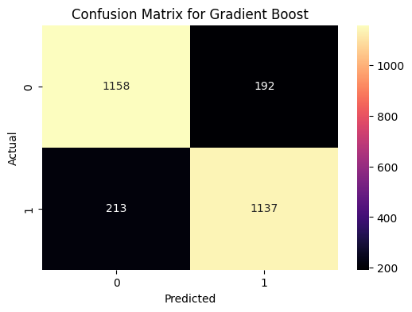


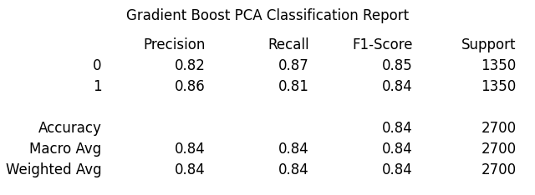
Classifiers – Gradient Boost

Slide 24


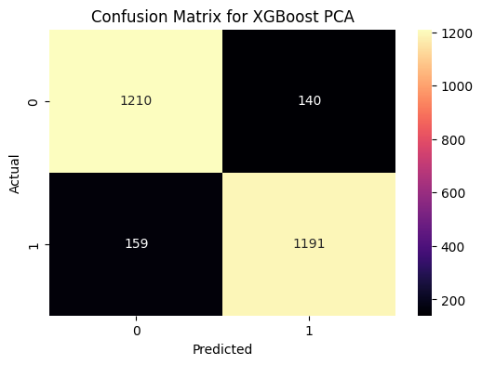
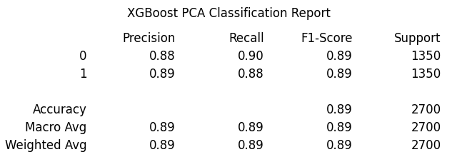
Classifiers – Extreme Gradient Boost

Slide 25
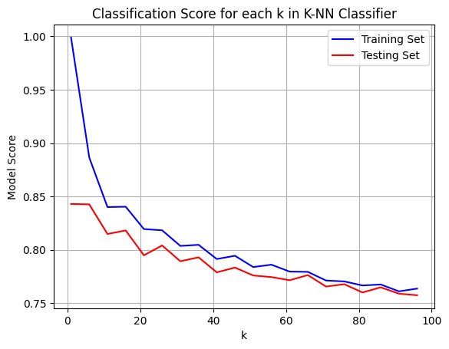
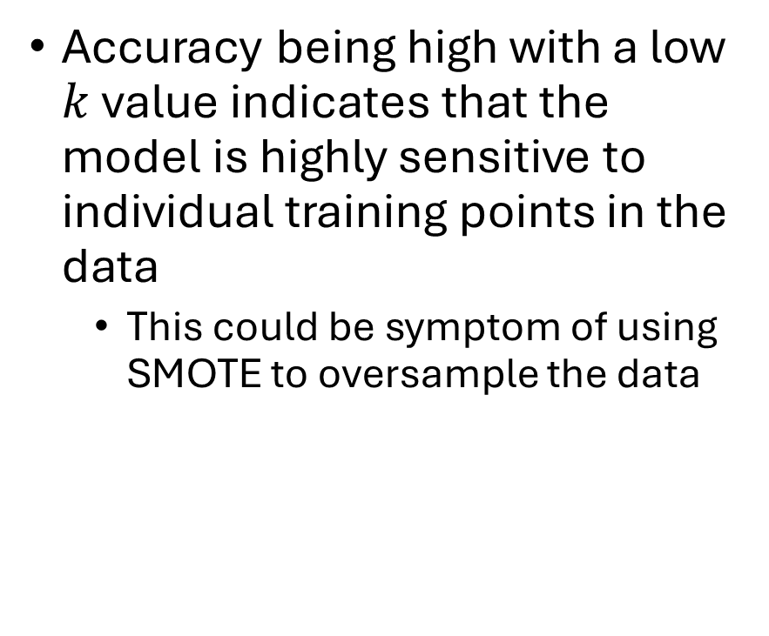

Classifiers – $k$-Nearest Neighbors
Accuracy being high with a low $k$ value indicates that the model is highly sensitive to individual training points in the data
This could be symptom of using SMOTE to oversample the data

Slide 26
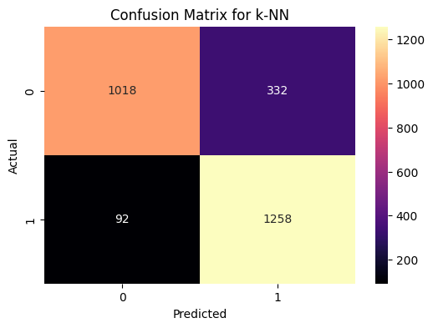
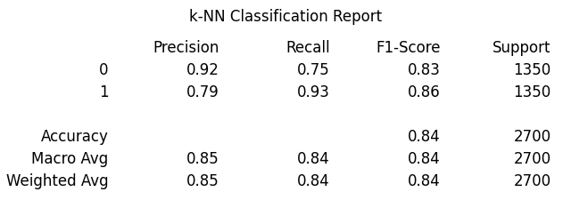
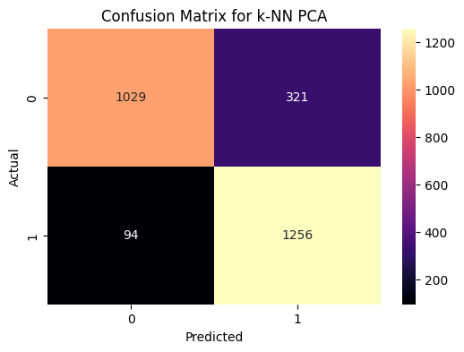
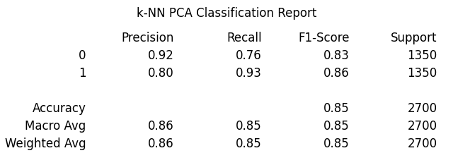

Classifiers – $k$-Nearest Neighbors

Slide 27

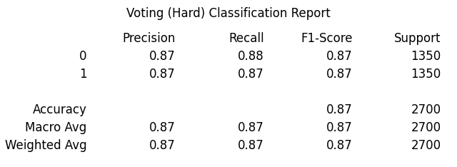
Classifiers – Hard Voting Classifier

Slide 28
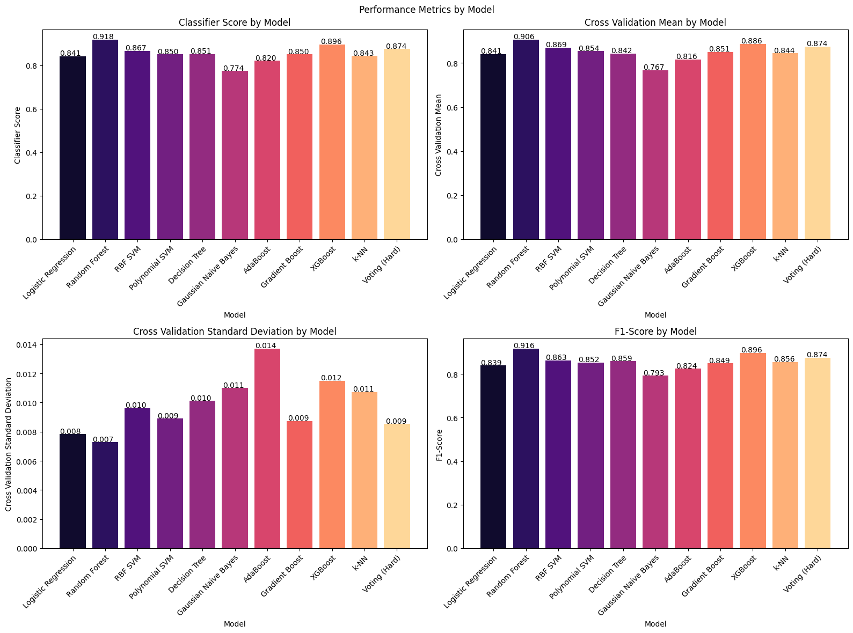
Overall Model Performance
Notes:
Andrew

Slide 29
Conclusion
Modeling Performance vs. Complexity
Ensemble methods are ideal, but power-hungry
Logistic Regression still provides solid results
New Instance(s) Predicted:
Vishal will have a long & happy marriage!
Created a new instance to create a “mismatched marriage”
Notes:
Vishal

Slide 30
Further Research
Adding external data to the dataset
Doing a bit more Feature Engineering
Balance the dataset
Create a Validation set
Play around with test sizes more
Apply Future Machine Learning Techniques such ANN/CNN on the dataset to feed into Matchmaking/Dating Websites
Notes:
Vishal

Slide 31
Questions?

