Slide 1

Question Answering on SQuAD
Piero Castriota
Yellam Naidu Kottavalasa
Usha Padma Rachakonda

Slide 2
Introduction
The ability to understand and interpret natural language is a critical component of many AI systems.
Question-answering systems provide accurate and relevant answers to user questions, making them a crucial component of many modern applications, including chatbots, search engines, and virtual assistants.
To develop effective Question-answering systems, Natural Language models must be trained on high-quality datasets.

Slide 3
Dataset
{"data": [{"title": "University_of_Notre_Dame", "paragraphs": [{"context": "Architecturally, the school has a Catholic character. Atop the Main Building's gold dome is a golden statue of the Virgin Mary. Immediately in front of the Main Building and facing it, is a copper statue of Christ with arms upraised with the legend \"Venite Ad Me Omnes\". Next to the Main Building is the Basilica of the Sacred Heart. Immediately behind the basilica is the Grotto, a Marian place of prayer and reflection. It is a replica of the grotto at Lourdes, France where the Virgin Mary reputedly appeared to Saint Bernadette Soubirous in 1858. At the end of the main drive (and in a direct line that connects through 3 statues and the Gold Dome), is a simple, modern stone statue of Mary.", "qas": [{"answers": [{"answer_start": 515, "text": "Saint Bernadette Soubirous"}], "question": "To whom did the Virgin Mary allegedly appear in 1858 in Lourdes France?", "id": "5733be284776f41900661182"}, {"answers": [{"answer_start": 188, "text": "a copper statue of Christ"}], "question": "What is in front of the Notre Dame Main Building?", "id": "5733be284776f4190066117f"}, {"answers": [{"answer_start": 279, "text": "the Main Building"}], "question": "The Basilica of the Sacred heart at Notre Dame is beside to which structure?", "id": "5733be284776f41900661180"}, {"answers": [{"answer_start": 381, "text": "a Marian place of prayer and reflection"}], "question": "What is the Grotto at Notre Dame?", "id": "5733be284776f41900661181"}, {"answers": [{"answer_start": 92, "text": "a golden statue of the Virgin Mary"}], "question": "What sits on top of the Main Building at Notre Dame?", "id": "5733be284776f4190066117e"}]}
The Stanford Question Answering Dataset (SQuAD) is a popular benchmark dataset for evaluating the performance of question answering systems.
The dataset consists of more than 100,000 question-answer pairs, covering a diverse range of topics such as science, history, and literature.
Each question-answer pair is associated with a corresponding passage of text that provides the necessary context for answering the question.

Slide 4
Exploratory Data Analysis
Exploratory analysis of the SQuAD dataset can involve examining the distributions of answer and question lengths.
This analysis can provide insights into the complexity of the dataset and help inform the design of natural language models.
We analyzed the distributions of the lengths of the answer and question on both the training and validation sets.
We found that the distributions varied significantly between the training and validation sets, indicating potential differences in the complexity and composition of the two sets.

Slide 5
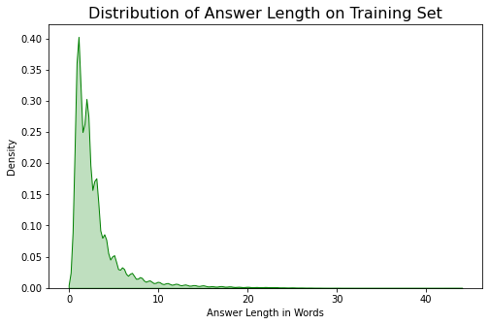
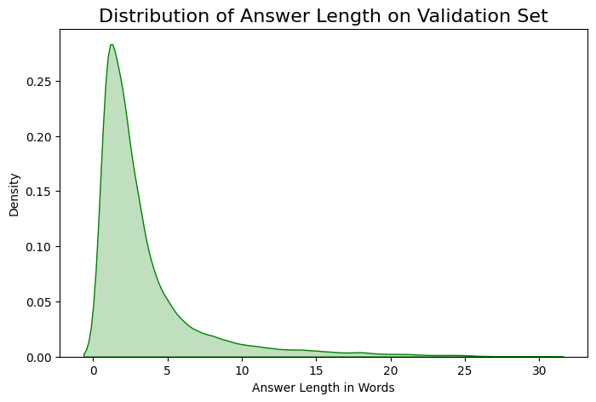
Figure 1: Distribution of the answer’s length(in words) on training and Validation set.

Slide 6
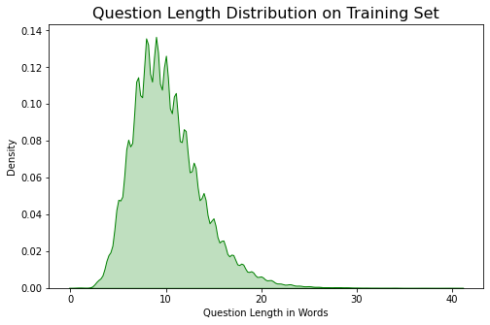
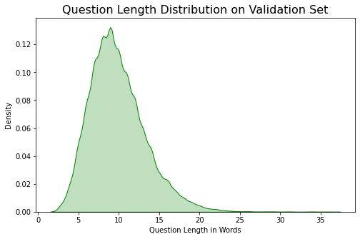
Figure 2: Distribution of the question’s length(in words) on training and Validation set.

Slide 7
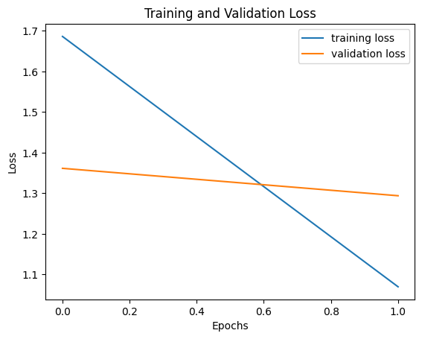
Models
1. ELECTRA (google/electra-base-generator)
The ELECTRA model stands for "Efficiently Learning an Encoder that Classifies Token Replacements Accurately”, It is a pre-training method for language models that aims to improve efficiency while maintaining or improving performance.
It uses a generator-discriminator framework to train the language model. The generator creates "fake" tokens based on a corrupted version of the original text, while the discriminator tries to distinguish between real and fake tokens.
We used google/electra-small-generator model, which has 12 layers, this is a smaller version of the ELECTRA model, which is known for its pre-training efficiency and has achieved state-of-the art results in several natural language processing tasks.
Figure 3: training and validation loss of google/electra-small-generator model.

Slide 8
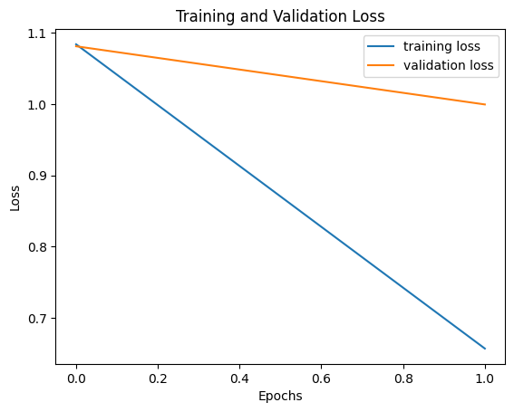
2. ALBERT (albert-base-v2)
ALBERT (A Lite BERT) is a transformer-based neural network architecture introduced in 2019. It is designed to be a smaller and more efficient version of BERT), while maintaining or even improving its performance on NLP tasks.
We used the "base" version of ALBERT, called albert-base-v2, which has 12 transformer layers, the same number as the "base" version of BERT.
ALBERT uses innovative parameter reduction techniques and self-supervised pre-training to achieve state-of-the-art performance on a wide range of NLP tasks.
Figure 4: training and validation loss of albert-base-v2 model.

Slide 9
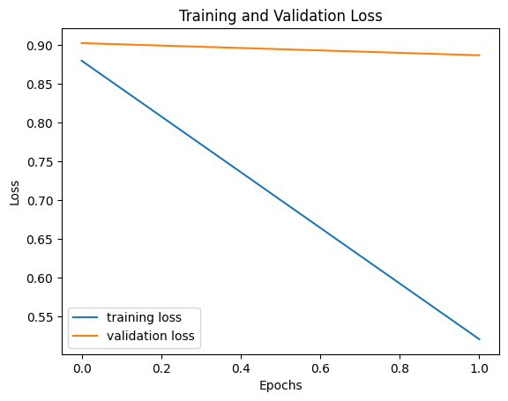
3. DistilBERT (distilbert_base_uncased_distilled_squad)
DistilBERT is a pre-trained transformer-based language model developed by Hugging Face based on the BERT architecture. It has been distilled from the original BERT model to be smaller and faster while retaining most of its accuracy.
We used the distilbert-base-uncased-distilled-squad, fine-tuned on the Stanford Question Answering Dataset (SQuAD), and is designed specifically for question-answering tasks.
It has been trained on a large corpus of text data and has learned to map natural language questions to their corresponding answers in context.
Figure 5: training and validation loss of distilbert-base-uncased-distilled-squad model.

Slide 10
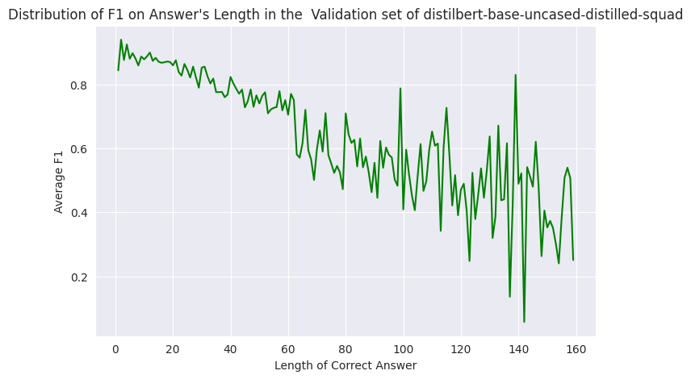
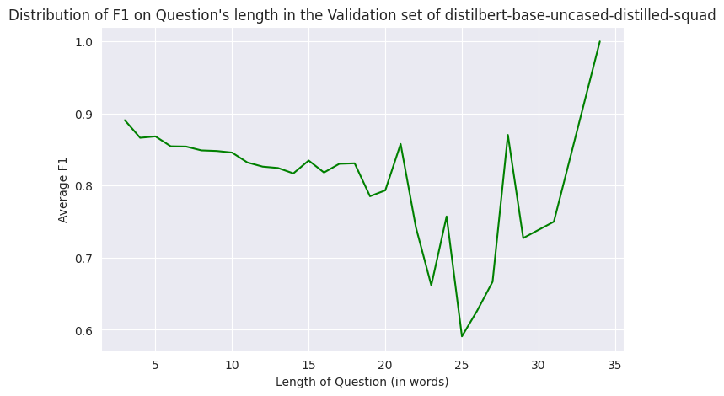
Results
We evaluated the performance of three different models: google/electra-base-generator, albertbase-v2, and distilbert-base-uncased-distilled-squad. We measured performance in terms of F1 score, exact match, and total matches.
We generated graphs that compared the average of f1 on answers and questions length of the three models. These graphs can help us to identify any patterns or trends in the model's performance based on the length of answers or questions. Here we show the best model results on answer and question lengths.
Figure 6: average of f1 on answers and questions length of distilbert-base-uncased-distilled-squad model.

Slide 11
The results of each model on the validation set are represented in the following table.
Model | Loss | Exact Score | F1 Score
google/electra-base-generator | 1.06 | 57.69 | 73.68
albert-base-v2 | 0.65 | 64.89 | 80.45
distilbert-base-uncased-distilled-squad | 0.52 | 69.36 | 84.19

Slide 12
Error Analysis
Analyzing the performance of the models and identifying factors that affect the model’s accuracy is good practice.
We analyze the types of errors the model made in predicting the answer, such as incorrect word choice, missing information, or irrelevant information. This helps to improve their performance.
Here we show examples of the errors made by the DistilBERT model in predicting the answer:
Context: Until recently, in most critical writing the post-punk era was "often dismissed as an awkward period in which punk's gleeful ructions petered out into the vacuity of the Eighties". Contemporary scholars have argued to the contrary, asserting that the period produced significant innovations and music on its own[ …. ]
Question: What did Nicholas Leonard say united post-punk?
Answer: cerebral, concocted by brainy young men and women interested as much in disturbing the audience, or making them think, as in making a pop song
Predicted Answer: avant-garde
Error Type- 1

Slide 13
Error Type- 2
Context: On the eastern front, progress was very slow. The Russian army was heavily dependent upon its main magazines in Poland, and the Prussian army launched several successful raids against them. One of them, led by general Platen in September resulted in the loss of 2,000 Russians, mostly captured, and the destruction of 5,000 wagons. Deprived of men, the Prussians had to resort to this new sort of warfare, raiding, to delay the advance of their enemies. Nonetheless, at the end of the year, they suffered two critical setbacks. The Russians under Zakhar Chernyshev and Pyotr Rumyantsev stormed Kolberg in Pomerania, while the Austrians captured Schweidnitz. The loss of Kolberg cost Prussia its last port on the Baltic Sea. In Britain, it was speculated that a total Prussian collapse was now imminent.
Question: What was the size of one of the Prussian victories against the Russians?
Answer: . One of them, led by general Platen in September resulted in the loss of 2,000 Russians, mostly captured, and the destruction of 5,000 wagons
Predicted Answer: 5,000

Slide 14
Conclusion
Based on the analysis conducted, we concluded that the DistilBERT (distilbert-base-uncased-distilled-squad) model is the most suitable for our task. This model achieved the highest exact score of 69.36 and F1 score of 84.19 among the three models applied.
It is also important to consider factors such as parameter settings, computational resources, training time, optimizers, and ease of use when selecting a model.
Finally, it is important to emphasize that the results are specific to the dataset and task that were used. Other datasets or tasks may require different models or parameter settings, and it is always important to evaluate the performance of a model on a new task or dataset before drawing any conclusions about its effectiveness.

Slide 15


