Slide 1
Fuel Efficiency Based on Price
By: Bhargav Yellepeddi & Neel Rajan

Slide 2
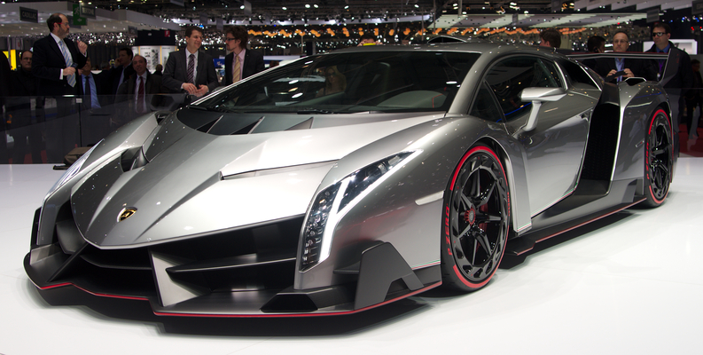
Description
Dataset
CSV file from Kaggle
Contains details on cars
Fuel Type, MPG, Price, etc.
Goal
Find relationship between Price and City-MPG
We predict that the more expensive the car, the less efficient it will be
Benefits
Gain a better understanding purchasing vehicles
More expensive car ≠ Most mpg

Slide 3
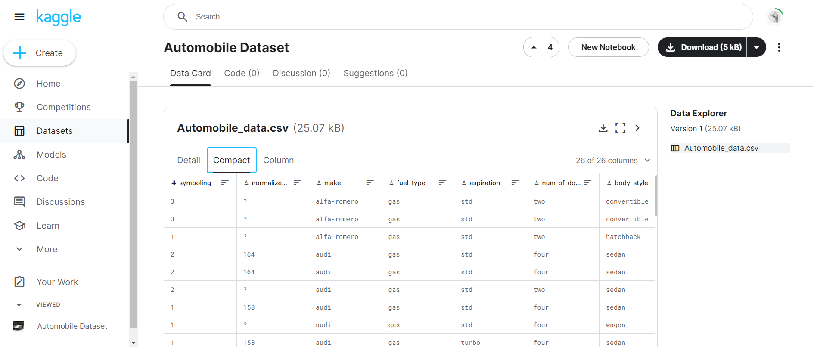
Gathering Data
Automobile Dataset
Kaggle
Link
Data Cleaning
Remove null data points
Replace null data points with medians.
Remove Diesel Vehicles
Will be focusing on gasoline vehicles only.

Slide 4
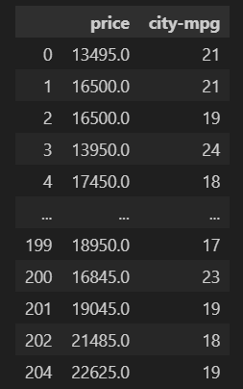
Exploring Data
Hypothesis Statements:
We predict that the higher the price of a vehicle, the lower mpg it will give
H0: β1 = 0
HA: β1 ≠ 0
Patterns
Overall, there seems to be a negative relationship between price and city-mpg.
Few Outliers due to Luxury Cars, ex. Audi.
Graphs on next slides.
Problems
Data focuses on average cars.
Ex. No high HP.
Anomaly: One V12 Engine

Slide 5
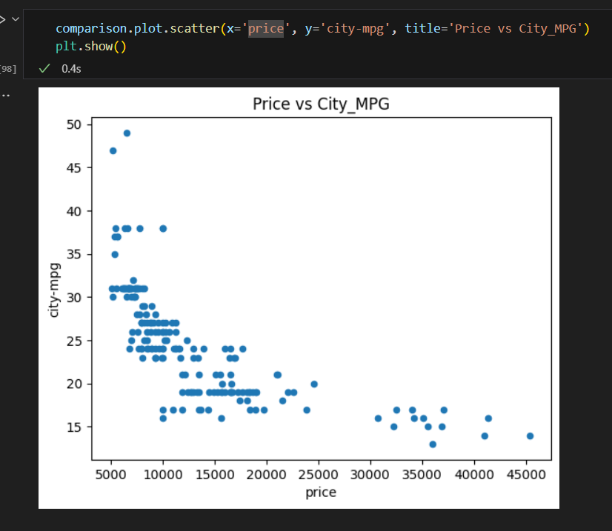

Slide 6
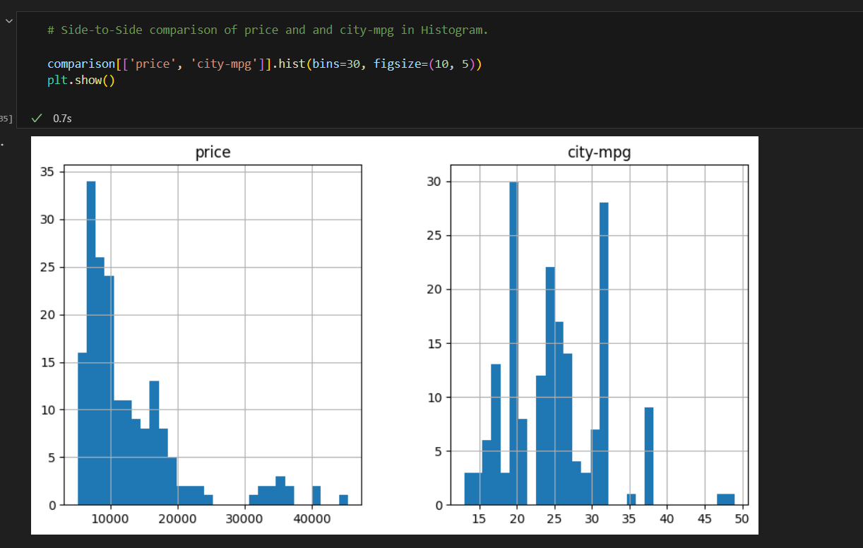

Slide 7
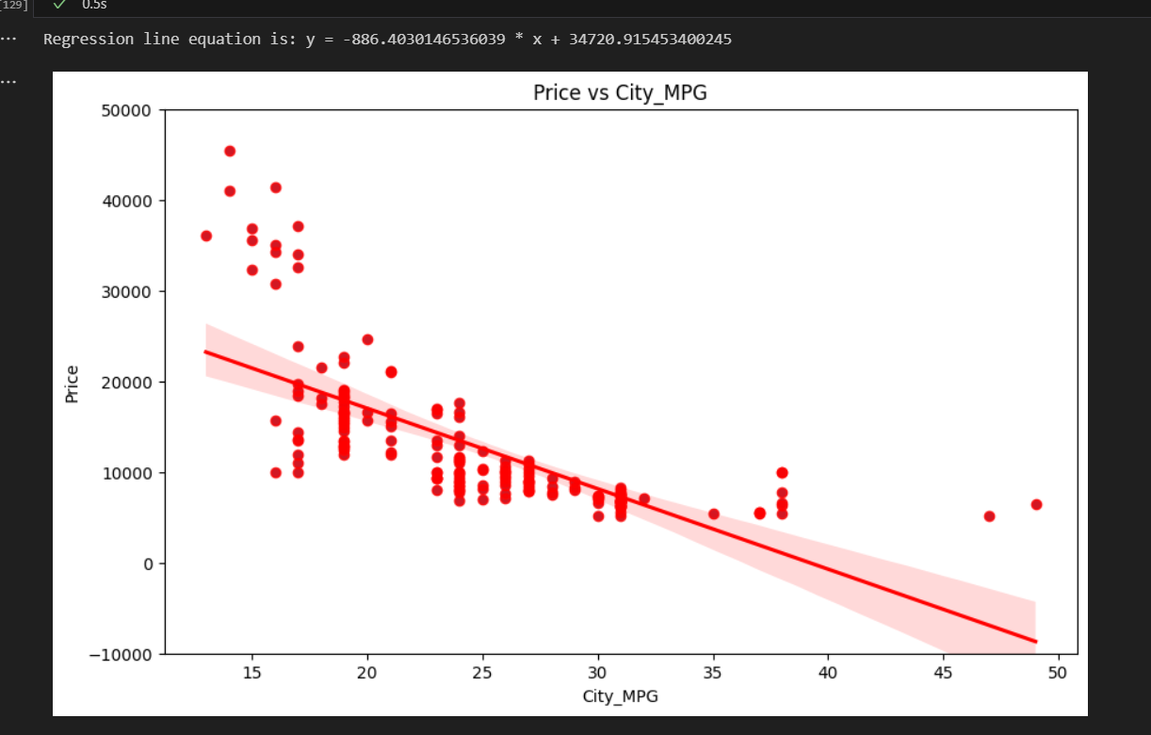

Slide 8
Data Modelling
Polynomial Regression Model
Selection Process:
Coefficient of determination: 0.67
Non-linear data for polynomial regression
Linear Regression Rejected: R^2 = 0.46
Model Training:
Model Creation: gathered data into polynomial features
Model Training: used the fit method to identify relationship pattern
Prediction: after the model predicts it compares prediction to actual values
Evaluation: R^2
Improvement:
Train Model on Larger Datasets

Slide 9
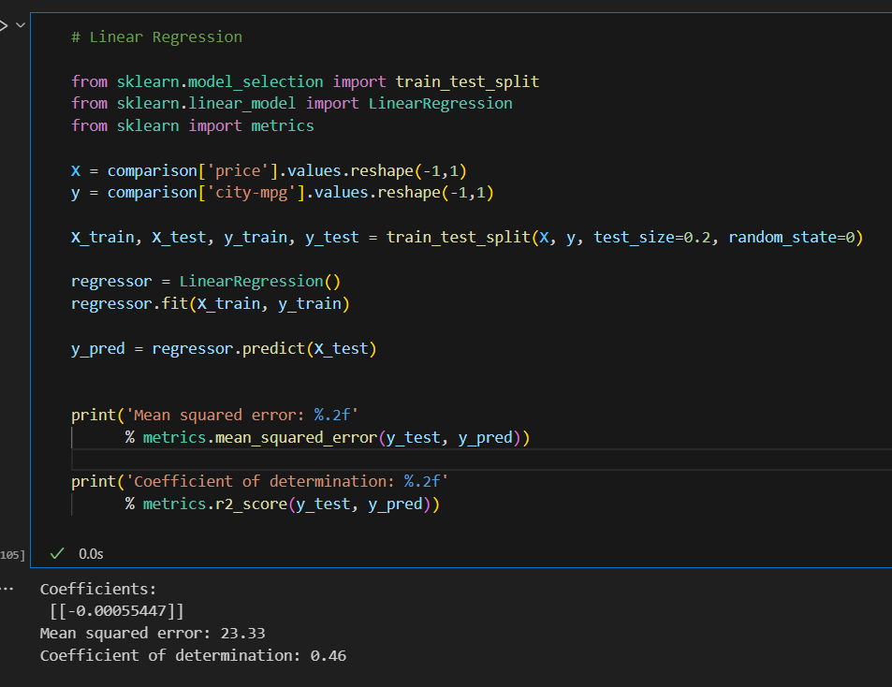
Linear Regression Model: Rejected

Slide 10
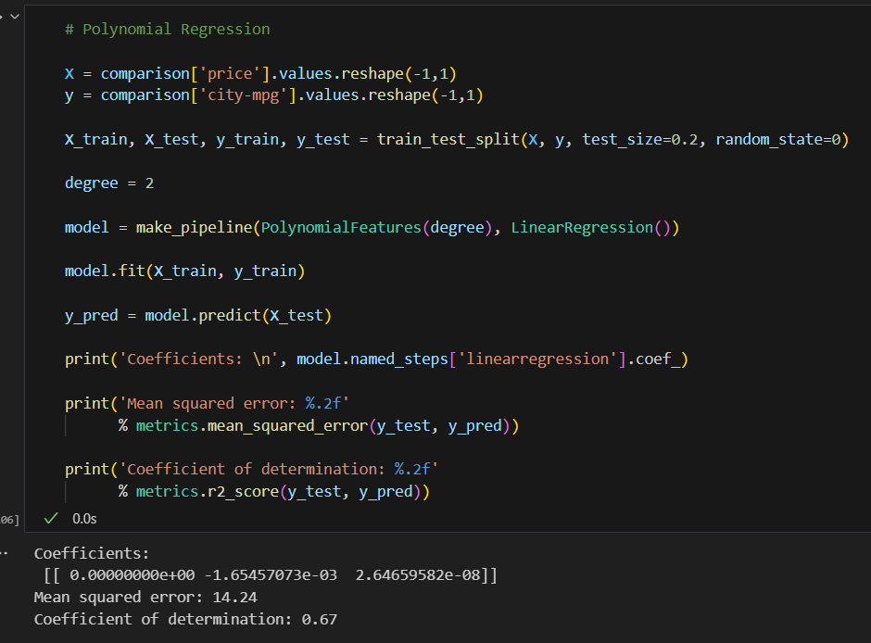
Polynomial Regression - Highest Coefficient of Determination: Chosen Method

Slide 11
Communicating Data
Applications:
Can be used to predict city mpg for a car up to $45,000
Model trained on limited Data
Model can be improved
Train on Larger Data
Benefits
Automotive Customers
Can assist with Vehicle Purchases
Environment
Sustainability through efficiency.
Informs government policy on fuel.
Demonstrates practical machine learning application.

Slide 12
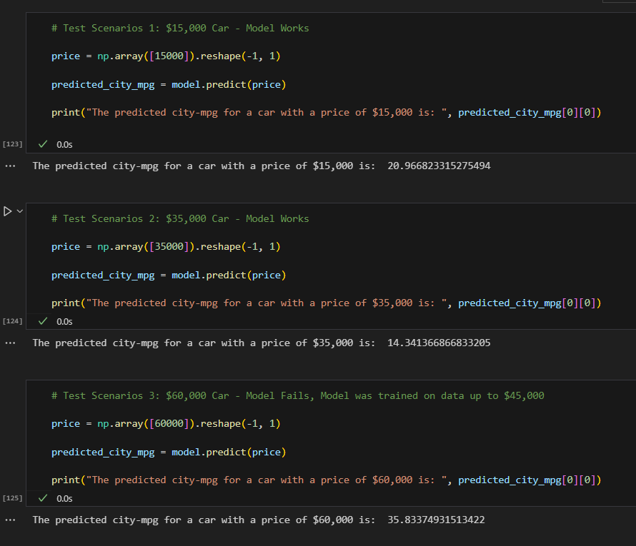
Actions/Applications

Slide 13
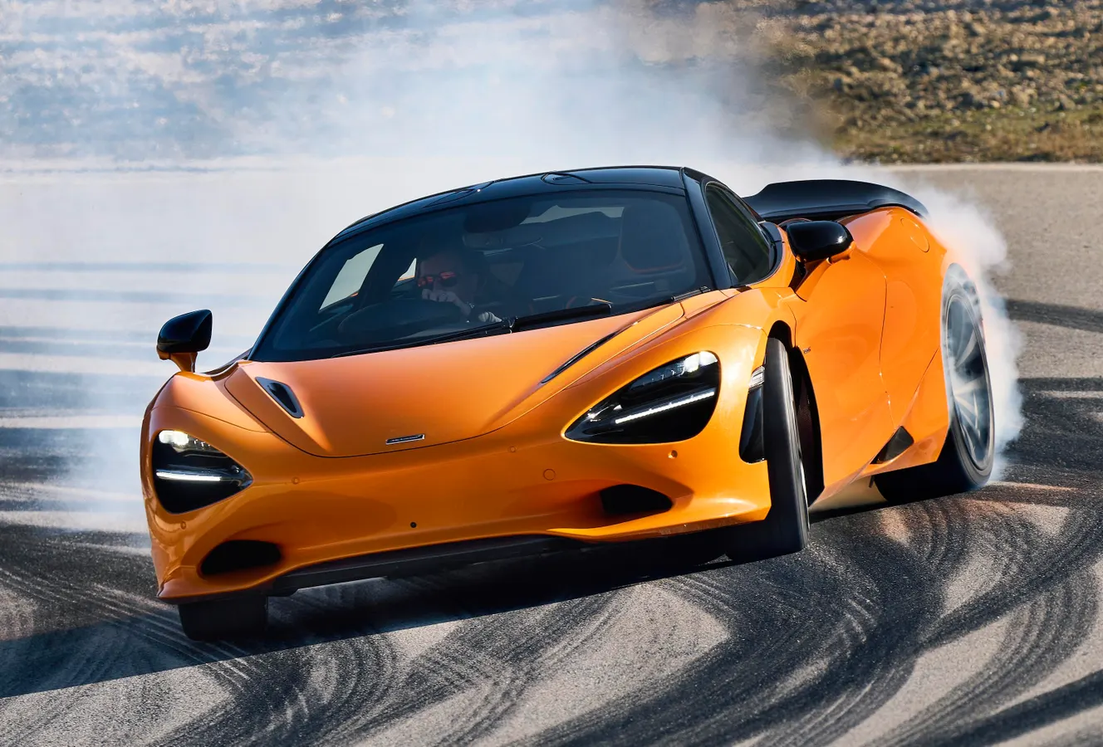
Conclusion
Reject the Null, Alternative Hypothesis is True
Trends suggest that the higher the price, the lower the city mpg.
We were correct
Model is accurate up to $45,000
Dealerships can utilize the model for cheaper vehicles

