Slide 1

Relational Database Normalization
Presented by:
Raymond Delgado

Slide 2
Topics Covered
Types of entities
Types of relationship
Types of Keys
Normal Forms 1-3
Case study: How to normalize an unnormalize table

Slide 3

Learning Objectives
Know the different types of entities, relationships, and keys
Define Normal Forms 1—3
Able to transform an unnormalize database into normal form 3.

Slide 4
Types of Entities
Entity
Any object that we want to store information about.
Ex: person, places, things, or events which are relevant to the database.
Also known as Fundamental entity
An entity that depends on another entity for parts of its primary key (discussed later).
Ex: A student’s hobby is dependent on the student.
Attributive
Entity
An entity that serves as a connection between two entities with a many-to-many relationship(see next slide).
Ex: A Student's enrollment into a course
Associative
Entity
Notes:
This is for Kimia

Slide 5
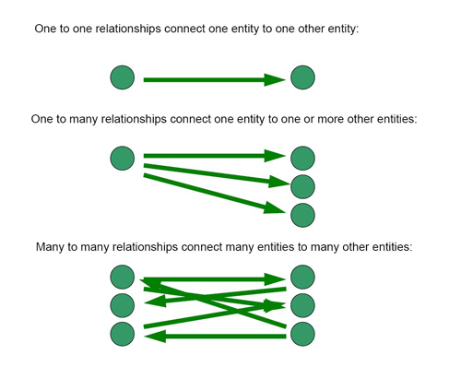
Types of Relationships

Slide 6
Types of keys
Primary Key: A unique field that identifies a certain record. Must be unique and not null
Candidate Key: Any field or collection of fields that could serve as the primary key
Foreign Key: The primary key of a different table used to establish relations between tables.
Composite Key: Two or more fields that are used to identify a row in a table.

Slide 7
1st Normal Form
First step to making a proper normalize database
1st normal form: No repeating groups/Multivalued Attributes in the database
Repeating Groups/ Multivalued Attributes: Set of related fields or values that occur multiple times in one record
Process: Remove the repeating groups and/or multivalued attributes and place them into a new entity

Slide 8
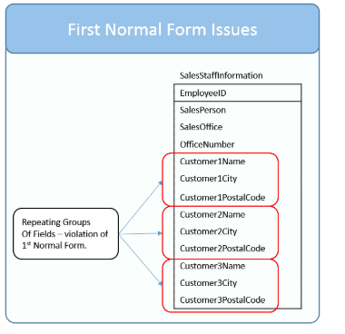
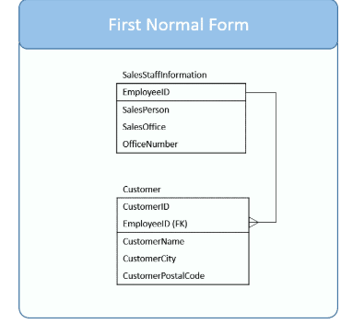
Transformation from non-normal to 1st form

Slide 9
2nd Normal Form
2nd Normal Form: Must be in 1st normal form & cannot have partial dependencies
Partial Dependency: An attribute is functionally dependent on part of a record's key, not the whole key.
Process: create a new entity. Convert attributive entity to an associative entity.

Slide 10
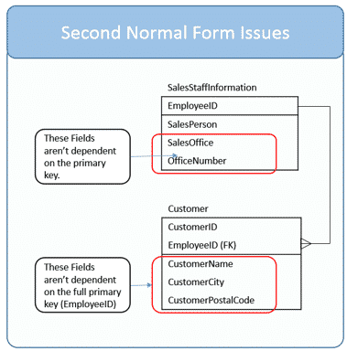
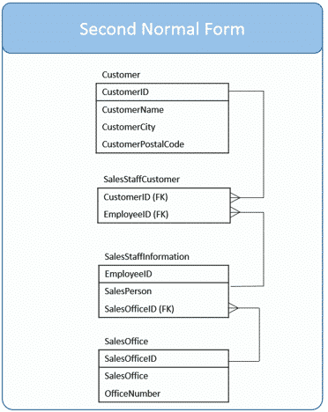
Transformation from 1st to 2nd

Slide 11
3rd Normal Form
3rd Normal Form: Must be in 2nd normal form & cannot have any transitive dependencies
Transitive Dependency: A non-key field is dependent on another non-key field.
Process: Create a new entity

Slide 12
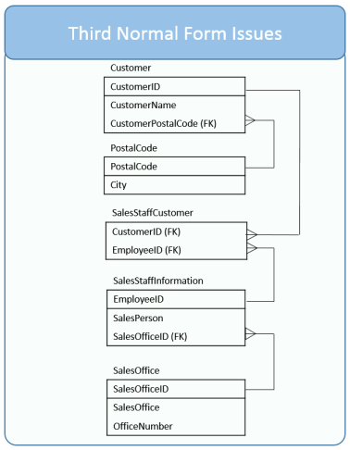
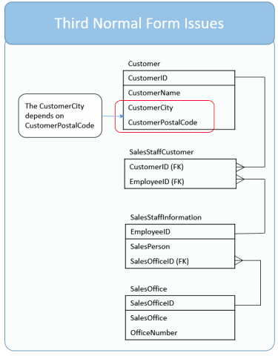
Transformation from 2nd to 3rd

Slide 13
Please Note:
The following example focuses on how to normalize an unnormalize table
Meaning, this example does not represent a finish database.
The SQL statements lack key features, most notable the needed constraints

Slide 14
Student
CIN
First_Name
Last_Name
School_ID
School_address
Skill
How_hard_is_skill
Case Study: Normalize this Student Table

Slide 15
SQL Statement to create the Student Table
CREATE TABLE IF NOT EXISTS student (
cin INTEGER PRIMARY KEY,
first_name TEXT,
last_name TEXT,
school_id INTEGER,
school_address INTEGER,
skill TEXT,
how_hard_is_skill TEXT
)
;

Slide 16
SQL Statement to insert data into the Student Table
INSERT INTO student (cin,
first_name,
last_name,
school_id,
school_address,
skill,
how_hard_is_skill)
VALUES('123456789',
'Tom',
'King',
'145789022',
'2259 NotReal Ave.',
'English Java SQL',
'VE E H'); ​
INSERT INTO student(cin,
first_name,
last_name,
school_id,
school_address,
skill, how_hard_is_skill)
VALUES('222444666',
'Sam',
'Pam',
'100200300',
'1234 Fake St.',
'Python',
'VH');
INSERT INTO student (cin,
first_name,
last_name,
school_id,
school_address,
skill, how_hard_is_skill)
VALUES('111222333',
'Kate',
'Late',
'999888777',
'4321 Noname Ave.',
'HTML',
'E');

Slide 17

The Unnormalize Student Table

Slide 18
Student
CIN
First_Name
Last_Name
School_ID
School_address
Student_has_skill
CIN
Skill
How_hard_is_skill
Knows
Is known by
Normal Form 1: Move repeating groups to an attributive entity

Slide 19
SQL Statements to revise the Student Table
DROP TABLE IF EXISTS student;
CREATE TABLE IF NOT EXISTS student_fn(cin INTEGER PRIMARY KEY, first_name TEXT, last_name TEXT, school_id INTEGER, school_address INTEGER);
INSERT INTO student_fn (cin, first_name, last_name, school_id, school_address) VALUES('123456789’, 'Tom’, 'King’, '145789022’, '2259 NotReal Ave.');
INSERT INTO student_fn(cin, first_name, last_name, school_id, school_address) VALUES('222444666’, 'Sam’, 'Pam’, '100200300’, '1234 Fake St.');
INSERT INTO student_fn (cin, first_name, last_name, school_id, school_address)
VALUES('111222333’, 'Kate’, 'Late’, '999888777’, '4321 Noname Ave.');

Slide 20
SQL statement to student_has_skill_table
CREATE TABLE IF NOT EXISTS student_has_skill(cin INTEGER, skill TEXT, how_hard_is_skill TEXT);

Slide 21
SQL statement to insert data into the Student_has_skill table
INSERT INTO student_has_skill(cin, skill, how_hard_is_skill) VALUES ('123456789', 'English', 'VE');
INSERT INTO student_has_skill(cin, skill, how_hard_is_skill) VALUES ('123456789', 'Java', 'E');
INSERT INTO student_has_skill(cin, skill, how_hard_is_skill) VALUES ('123456789', 'SQL', 'H');
INSERT INTO student_has_skill(cin, skill, how_hard_is_skill) VALUES ('222444666', 'Python', 'VH');
INSERT INTO student_has_skill(cin, skill, how_hard_is_skill) VALUES ('111222333', 'HTML', 'E');

Slide 22


The New student table and student_has_skill table

Slide 23
Student
CIN
First_Name
Last_Name
School_ID
School_address
Skill
Skill_name
Category
How_hard_is_skill
Student_has_skill
CIN
Skill_name
How_good_is_student
Normal Form 2: Create new entity (skill) and convert the attributive entity to an associative entity

Slide 24
SQL statements to revise Student_has_skill table
DROP TABLE IF EXISTS student_has_skill;
CREATE TABLE IF NOT EXISTS student_has_skill(cin INTEGER, skill_name TEXT, how_good_is_student TEXT);
INSERT INTO student_has_skill(cin, skill_name, how_good_is_student) VALUES ('111222333', 'HTML', 'VG');
INSERT INTO student_has_skill(cin, skill_name, how_good_is_student) VALUES ('222444666', 'Python', 'G');
INSERT INTO student_has_skill(cin, skill_name, how_good_is_student) VALUES ('123456789', 'SQL', 'B');
INSERT INTO student_has_skill(cin, skill_name, how_good_is_student) VALUES ('123456789', 'Java', 'VB');
INSERT INTO student_has_skill(cin, skill_name, how_good_is_student) VALUES ('123456789', 'English', 'VG');

Slide 25
SQL statement to create skill table
CREATE TABLE IF NOT EXISTS skill(skill_name TEXT, category TEXT, how_hard_is_skill TEXT);

Slide 26
SQL statement to insert data into the skill table
INSERT INTO skill (skill_name, category, how_hard_is_skill) values ('English','Language', 'VE');​
INSERT INTO skill (skill_name, category, how_hard_is_skill) values ('Java', 'Programming', 'E');
INSERT INTO skill (skill_name, category, how_hard_is_skill) values ('SQL', 'Programming', 'H');
INSERT INTO skill (skill_name, category, how_hard_is_skill) values ('Python', 'Programming', 'VH');​
INSERT INTO skill(skill_name, category, how_hard_is_skill) values ('HTML', 'Programming', 'E');

Slide 27


The skill table and student_has_skill table

Slide 28
Student
CIN
First_Name
Last_Name
School
School_ID
School_Name
School_Address
Mascot
Student's_School
CIN
School_id
Normal Form 3: Create new entity (school) and move the transitive dependency to it

Slide 29
SQL statements to revise Student table
DROP TABLE IF EXISTS student_fn;
CREATE TABLE IF NOT EXISTS student_tn (cin INTEGER, first_name TEXT, last_name TEXT);
INSERT INTO student_tn (cin, first_name, last_name) VALUES ('111222333', 'Kate', 'Late');
INSERT INTO student_tn (cin, first_name, last_name) VALUES ('222444666','Sam','Pam');
INSERT INTO student_tn (cin, first_name, last_name) VALUES('123456789', 'Tom', 'King');

Slide 30
SQL statement to create the school table
CREATE TABLE IF NOT EXISTS school(school_id INTEGER, school_name TEXT, school_address TEXT, mascot TEXT);

Slide 31
SQL statement to insert data into the school table
INSERT INTO school(school_id, school_name, school_address, mascot) VALUES ('100200300', 'Flat Mesa High', '1234 Fake St.', 'Mesa Raiders');
INSERT INTO school(school_id, school_name, school_address, mascot) VALUES ('999888777', 'Microsoft High', '4321 Noname Ave.', 'Windows OS');

Slide 32
SQL statement to create student's school table
CREATE TABLE IF NOT EXISTS student_school(cin INTEGER, school_id INTEGER);

Slide 33
SQL statement to insert data into the student's school table
INSERT INTO student_school (cin, school_id) VALUES ('123456789', '145789022');
INSERT INTO student_school (cin, school_id) VALUES ('222444666', '100200300');
INSERT INTO student_school (cin, school_id) VALUES ('111222333', '999888777');

Slide 34



The final version of the student table, the school table, and the student's school table

Slide 35
Student
CIN
First_Name
Last_Name
School
School_ID
School_Name
School_Address
Mascot
Student's_School
CIN
School_id
Student_has_skill
CIN
Skill_name
How_good_is_student
Skill
Skill_name
Category
How_hard_is_skill
An overview of our fully normalize database

Slide 36
SQL Statement to test our tables
SELECT student_tn.cin, first_name AS Name,
school.school_name AS School,
school.mascot,
student_has_skill.skill_name AS skill,
student_has_skill.how_good_is_student AS proficiency,
skill.how_hard_is_skill AS diffculty
FROM student_tn JOIN student_school ON student_tn.cin = student_school.cin
JOIN school ON student_school.school_id = school.school_id
JOIN student_has_skill on student_tn.cin = student_has_skill.cin
JOIN skill on skill.skill_name = student_has_skill.skill_name;

Slide 37

The result of this SQL Statement

Slide 38
In this presentation we covered:
Types of entities (e.g. associative and attributive)
Types of relationships: one to one, one to many, many to many
Types of keys (e.g. primary and foreign)
Normalization Forms 1-3
An example of database normalization
Notes:
Kimia

Slide 39
Database Denormalization
The opposite of database normalization: Add redundant data into one or more tables of a database .
Should be done once the database normalization is complete.
Done to optimize and speed up data retrieval .
Simple select statements because many join statements are not needed.
Be aware: Data insert will be more complex, due the data redundancy

Slide 40
Citations
https://aws.amazon.com/relational-database/
https://computer.howstuffworks.com/question599.htm
https://searchdatamanagement.techtarget.com/definition/relational-database
https://www.sisense.com/glossary/relational-database/
https://en.wikipedia.org/wiki/Relational_database

