Slide 1
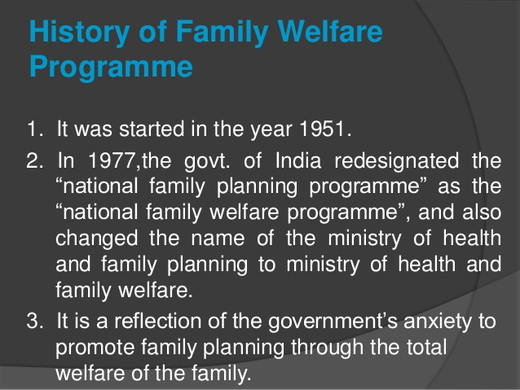
India has been recognised as the First country in the world to officially adopt Family planning programme in 1952
Family planning services enable individuals to determine freely the number and spacing of their children and to select the means by which this may be achieved
India was the first country in the world to have launched a National Programme for Family Planning in 1952
For improved access to contraceptives and family planning services in high fertility districts, the Ministry of Health and Family Welfare launched “Mission Pariwar Vikas”in 2016

