Slide 1

CH2-1.MongoDB – CUD

Slide 2
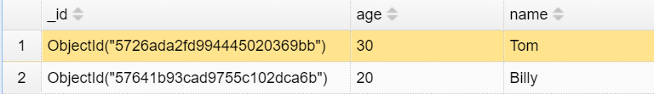
MongoDB Data Types
String
Double // 64bit Float number
Int32/Int64 // Integer
Boolean
Embed Document // Another BSON document
Array // Array of any data types
ObjectId // A 96-bit length random string. Common used for the unique Key of each document in MongoDB, the “_id” field, like :

Slide 3
MongoDB Data Types
The full definition of data type:
https://docs.mongodb.com/manual/reference/bson-types/

Slide 4
MongoDB -- CUD
Create -- insert

Slide 5
Create – insert(Single insert)
 | Syntax Rules
MongoDB | document = {name: “Frye”, ……} db.collection.insert (document) 或者 db.collection.insert({name: “Frye”, ……})
SQL | insert into table (column1, column2, …) values (value1, value2, …)

Slide 6


Create – insert(Single insert)
If inserted successfully:

Slide 7

Create – insert(Single insert)
Think about it:
Did we define the data schema?
MongoDB accepts schemaless !

Slide 8
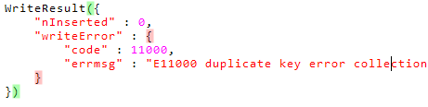
Create – insert(Single insert)
Think about it:
What happens if we insert:

Slide 9
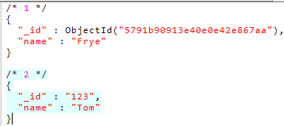
Create – insert(Single insert)
Result:

Slide 10
Create – insert(Single insert)
Principle：
“_id” must be unique in one collection. If user does not assign its value, MongoDB will generate a random ObjectId.
2. Driver transform the data into BSON format and pass to MongoDB.
3. MongoDB validate BSON（check“_id”, max document size limitation 16MB）。
Advantage：
MongoDB provides functions(API) to user. User doesn’t need to write statement in a specified syntax like SQL.

Slide 11
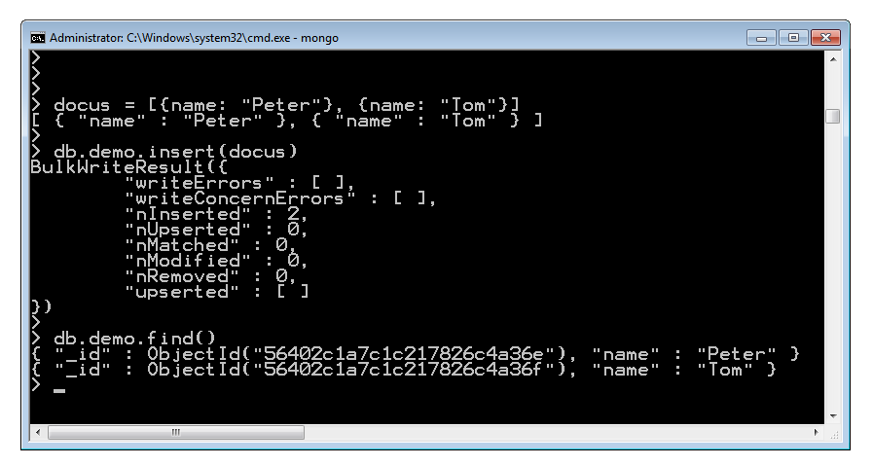
Create -- insert (batch insert)
(1)insert by array:
documents = [document1, document2, ……];
db.collection.insert(documents);

Slide 12
MongoDB -- CUD
Update -- update

Slide 13
Update
 | Syntax
MongoDB | db.collection.update( { age: { $gt: 25 } }, // Query Criteria { $set:{salary: 5000}}, // Update Operator { multi: true } // Optional )
SQL | UPDATE table SET salary = 5000 WHERE age > 25

Slide 14
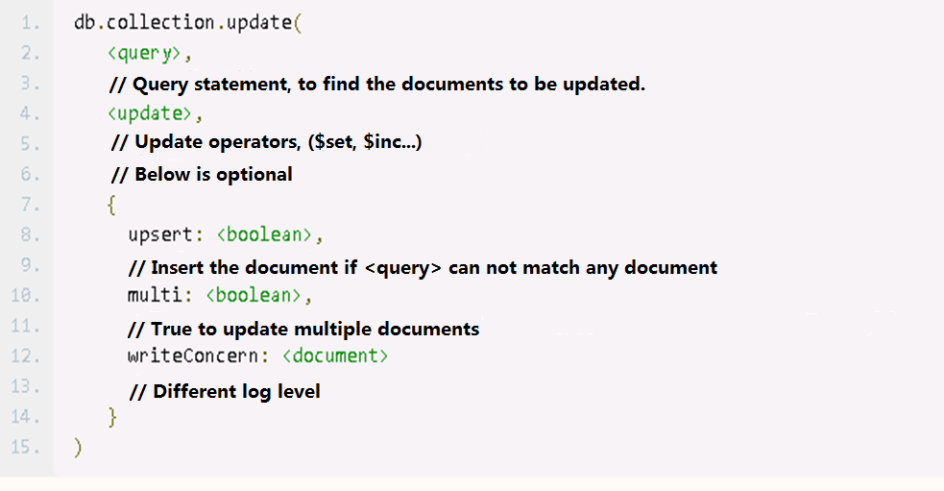
Update-- update
Syntax：
db.collection.update({<query>},{<update>},{upsert: value,multi: value})
// We will talk about query in next chapter.

Slide 15
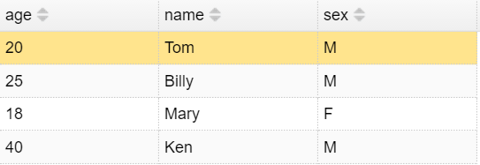

Update-- update
What Happen if execute：

Slide 16
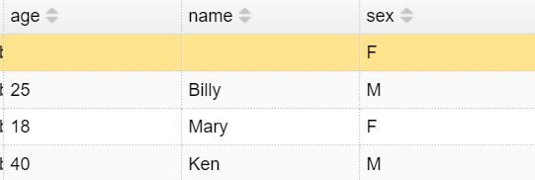
Update-- update
WTF ？！
We lost Tom’s name & age !

Slide 17
Update-- update
Without update operator, the entire Document will be overridden
Let’s start to talk about update operators!

Slide 18
Update-- update
Common update operators：
operators | description
$set | Update a specified field. If the field does not exist, then add this field to document.
$unset | Remove the specified field from document.
$inc | Focus on numerical field, increments a field by a specified value
$rename | Rename a field

Slide 19

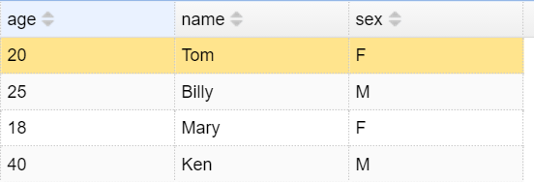
Update-- update
If we want to update a/some fields of a document, we should use $set

Slide 20

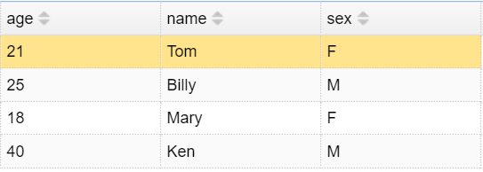
Update-- update
Example: Increase the age

Slide 21
Update-- update
Update operators to Array ：
operators | description
$push | appends a specified value to an array.
$pull | removes from an existing array all instances of a value or values that match a specified condition.
$pop | removes the first or last element of an array.
$addToSet | adds a value to an array unless the value is already present.
{<array>.$ : value} | The positional $ operator identifies an element in an array to update without explicitly specifying the position of the element in the array.

Slide 22
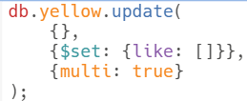
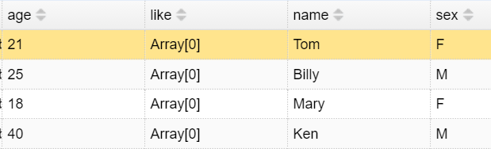
Update-- update
We add a “like” array to everyone.

Slide 23

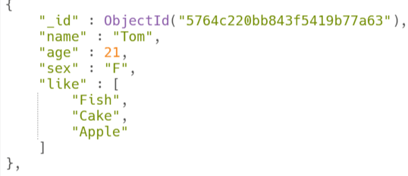
Update-- update
We add “Fish”to Tom’s likes

Slide 24

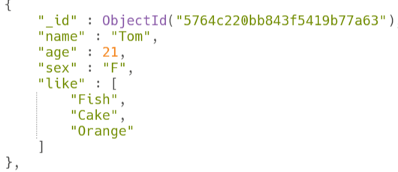
Update-- update
Change Apple to Orange in Tom’s like

Slide 25
MongoDB -- CUD
Delete -- remove

Slide 26
Delete-- remove
 | MongoDB | SQL
drop collection | db.collection.drop(); // Indexes will be also removed. | drop table table_name
Remove all documents | db.collection.remove({}); // Keep indexes | truncate table table_name
Remove specified documents | db.collection.remove(<query>) | delete from table_name where <condition>

Slide 27
Q & A

Slide 28
Think about this after class:
Can I update the ‘_id’ field of a document?

