Slide 1

CH2-2.MongoDB - Query

Slide 2
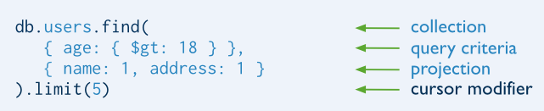
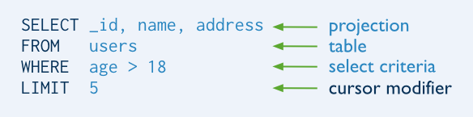
MongoDB find() VS SQL SELECT

Slide 3
Basic Query
db.users.find() | SELECT * FROM users
db.users.findOne() | SELECT * FROM users LIMIT 1
db.users.find( { }, { name: 1, age: 1} ) | SELECT id, name, age FROM users
db.users.count() | SELECT COUNT(*) FROM users
db.users.find().pretty()

Slide 4
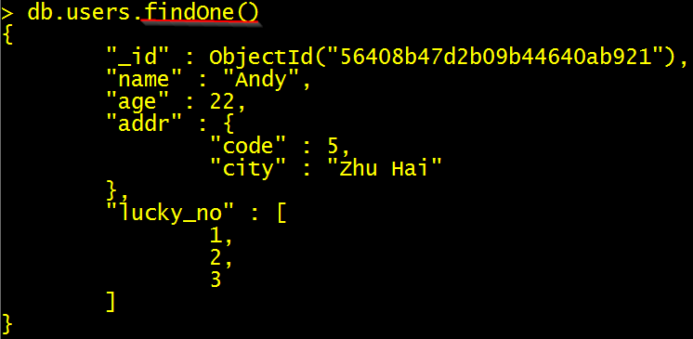
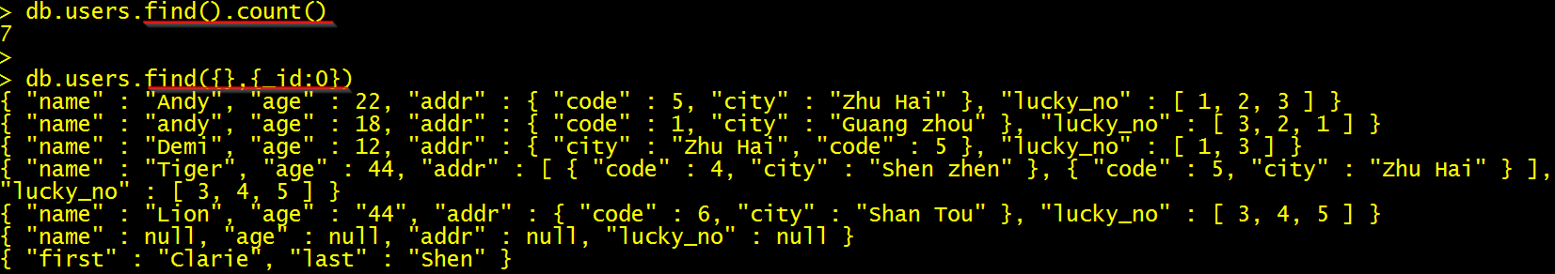
Prepared Data

Slide 5
Query Operators
Comparison
Logical
Embedded Document
Array

Slide 6
1.Comparison Query
$eq | WHERE age=18 | {age:{$eq:18}} {age:18}
$gt | > | {age:{$gt:18}}
$gte | >= | {age:{$gte:18}}
$lt | < | {age:{$lt:18}}
$lte | <= | {age:{$lte:18}}
$ne | <> | {age:{$ne:18}}
$in | in | {lucky_no:{$in:[1,3]}}
$nin | not in | {lucky_no:{$nin:[1,3]}}

Slide 7
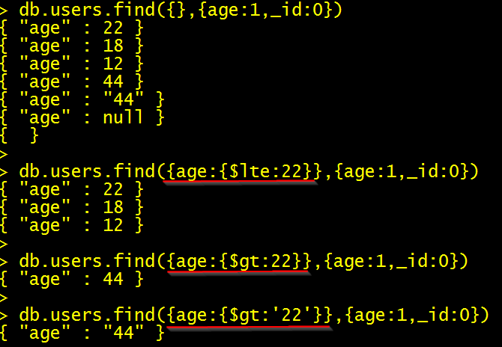

Slide 8
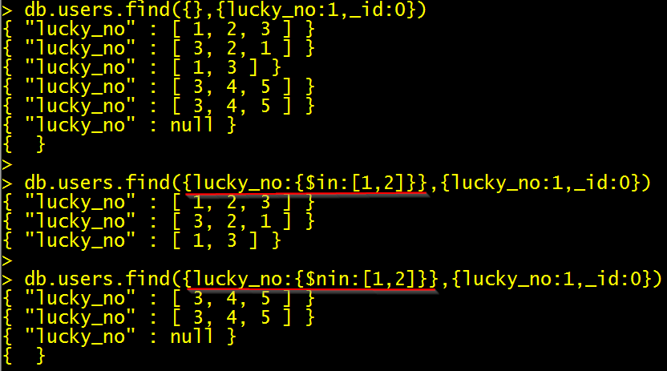

Slide 9
2.Logical Query
$or | WHERE name='Andy' OR age=18 | { $or:[ {name:'Andy'}, {age:22} ] }
$and | WHERE name='Andy' AND age=18 | { $and:[ {name:'Andy'}, {age:22} ] } {age:22,name:'Andy'}
$not | WHERE lucky_no not in (1,3) | { lucky_no: { $not: { $in: [1, 3] } }}
$nor | WHERE name<>'Andy' AND age<>18 | { $nor:[ {name:'Andy'}, {age:22} ]}

Slide 10
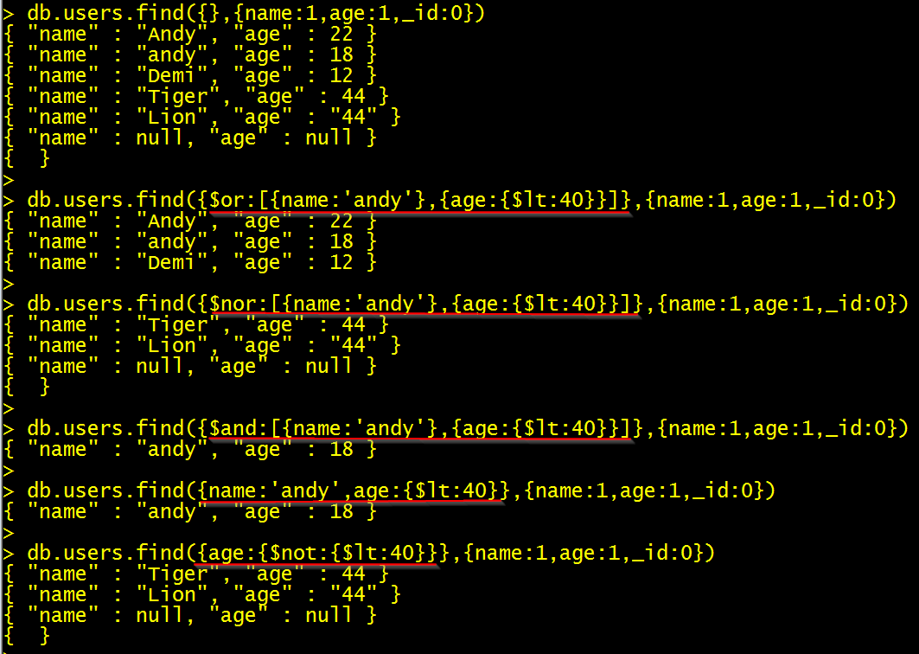

Slide 11
3. Embedded Document Query
1. Exact Match on the Embedded Document
{addr : { code: 5 , city: 'Zhu Hai'} }
2. Equality Match on Fields within an Embedded Document
{'addr.code' : 5 ,'addr.city' : 'Zhu Hai' }

Slide 12
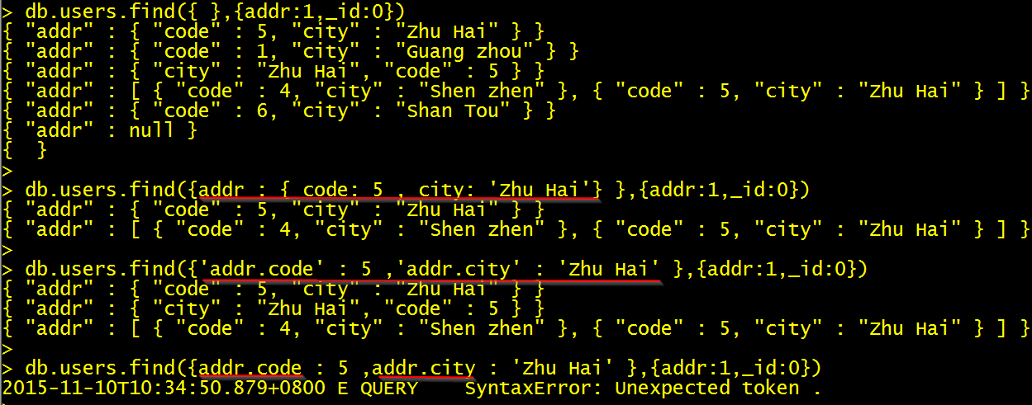

Slide 13
4.Array Query
$all | { lucky_no: { $all: [ 1,2,3] } }
$size | { lucky_no: { $size: 3} }
$elemMatch | { lucky_no: { $elemMatch: { $gt: 1, $lt: 3 } } }
Projection Operators
$elemMatch | {},{ lucky_no: { $elemMatch: { $gt: 1, $lt: 3 } }}
$slice | {},{lucky_no:{$slice :1}}

Slide 14
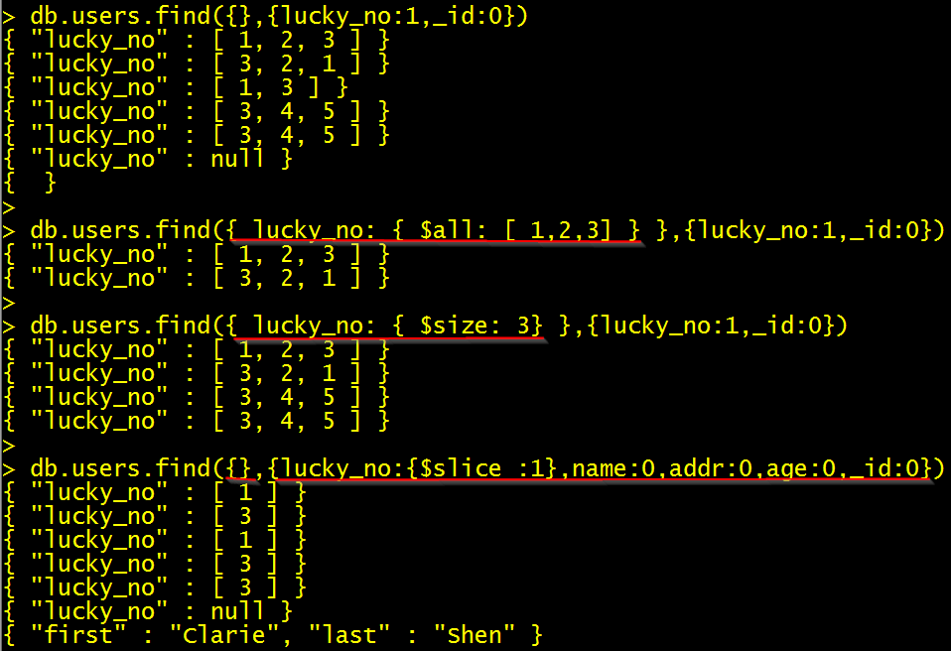

Slide 15
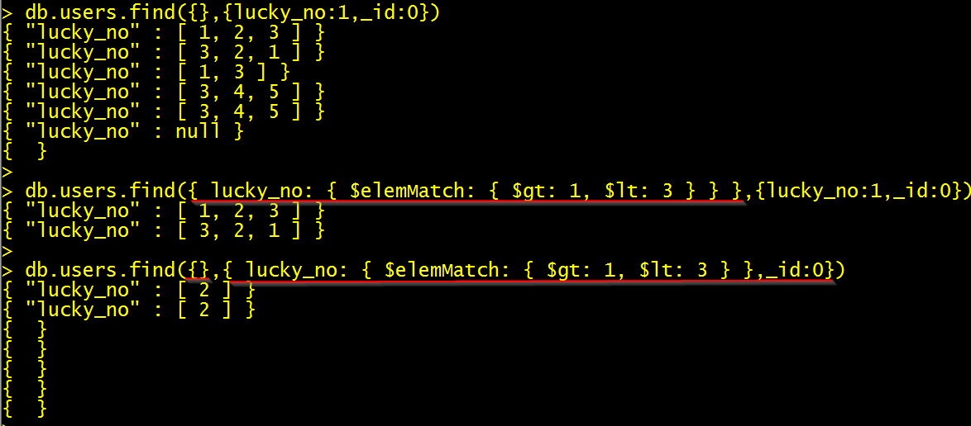

Slide 16
Cursor
sort() | find(…) .sort({age:-1,name:1})
skip() | find(…). skip(2)
limit() | find(…). limit(2)

Slide 17
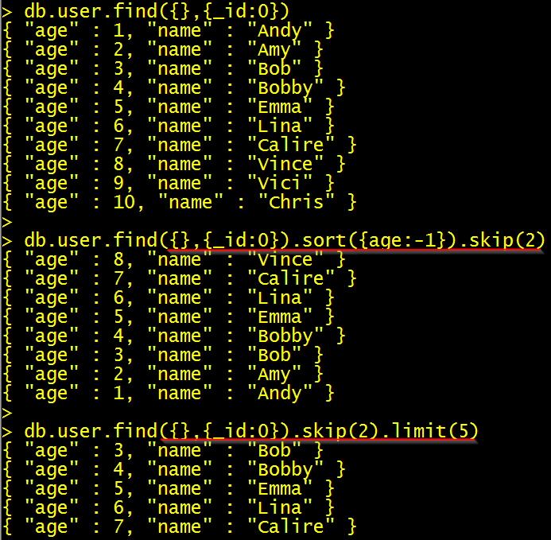

Slide 18
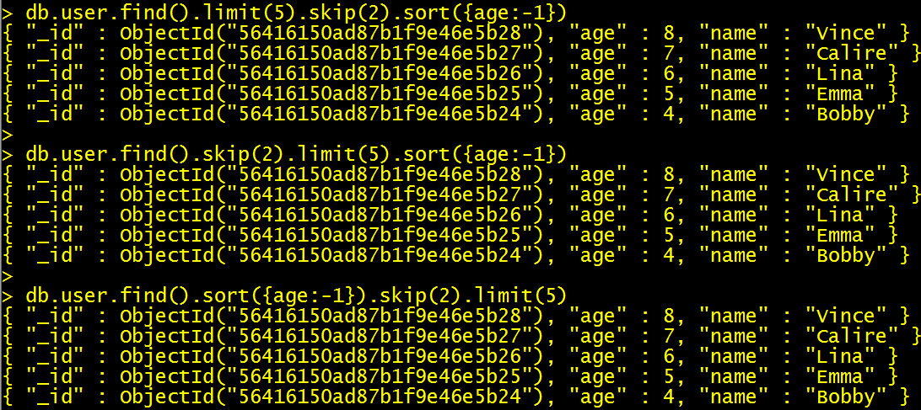

Slide 19
Links
https://docs.mongodb.org/manual/reference/operator/query

Slide 20
Exercise
\\HUANGYE-3-W7\mg_ex
CH2_exercise folder

