Slide 1

3.MongoDB Index

Slide 2
0.Review
1.Concept of Index
2.Structure of MongoDB Index
3.Usage of MongoDB Index
4.Analyze Query Plan

Slide 3
Review
Collection
-> Table
Document
-> Row
Field
-> Column

Slide 4
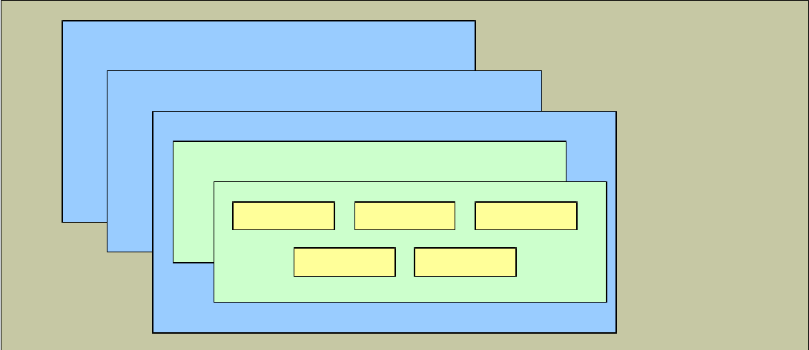
Review
Collection
Document
Field
Model

Slide 5
0.Review
1.Concept of Index
2.Structure of MongoDB Index
3.Usage of MongoDB Index
4.Analyze Query Plan

Slide 6
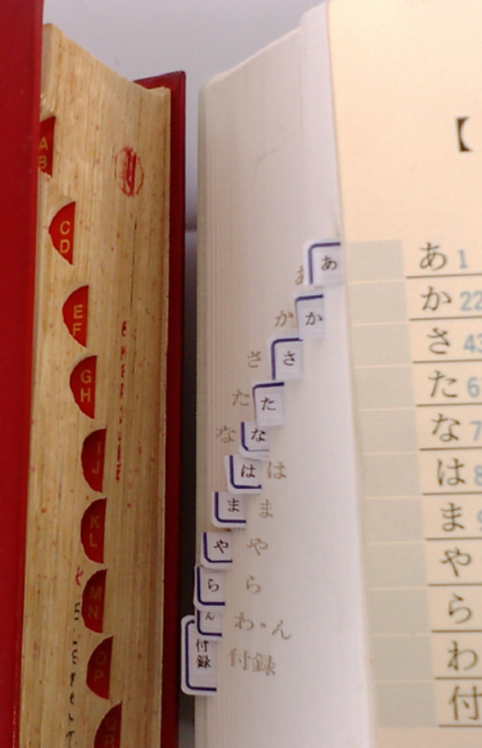
What is Index?
“Indexes are designed to help the reader find information quickly and easily.”

Slide 7
What is DB Index?
A database index is a data structure that improves the speed of data retrieval operations on a database table. Quickly locate data without having to search every row.

Slide 8
Index in RDBMS
1.Which column should be indexed？
2.More indexes, more performance?

Slide 9
0.Review
1.Concept of Index
2.Structure of MongoDB Index
3.Usage of MongoDB Index
4.Analyze Query Plan

Slide 10
B-Tree
1. MongoDB use B-Tree as the Index data structure. The minimum unit is Index Item.
2. Index Items are sorted and support Equivalence query & Range query。

Slide 11
Logical view(Data & Index)
1. Document are stored in Disk unorderly.
Collection
a | b | c
3 | 2 | 1
1 | 1 | 3
1 | 2 | 3
2 | 2 | 1
3 | 1 | 3
1 | 3 | 1
2 | 3 | 3
3 | 1 | 1
1 | 2 | 1
2 | 1 | 3
2 | 2 | 2
3 | 2 | 3

Slide 12
Logical view(Data & Index)
2.An Index is an ordered List of Index Items(unique)
Collection
a | b | c
3 | 2 | 1
1 | 1 | 3
1 | 2 | 3
2 | 2 | 1
3 | 1 | 3
1 | 3 | 1
2 | 3 | 3
3 | 1 | 1
1 | 2 | 1
2 | 1 | 3
2 | 2 | 2
3 | 2 | 3
Index(a:1)
a
1
2
3

Slide 13
Logical view(Data & Index)
3. Each Index Item contains the value of indexed field from corresponding document. (unique)
Collection
a | b | c
3 | 2 | 1
1 | 1 | 3
1 | 2 | 3
2 | 2 | 1
3 | 1 | 3
1 | 3 | 1
2 | 3 | 3
3 | 1 | 1
1 | 2 | 1
2 | 1 | 3
2 | 2 | 2
3 | 2 | 3
Index(a:1)
a
1
2
3

Slide 14
Logical view(Data & Index)
4.Each Index Item points to the address of corresponding documents in Disk.
Collection
a | b | c
3 | 2 | 1
1 | 1 | 3
1 | 2 | 3
2 | 2 | 1
3 | 1 | 3
1 | 3 | 1
2 | 3 | 3
3 | 1 | 1
1 | 2 | 1
2 | 1 | 3
2 | 2 | 2
3 | 2 | 3
Index(a:1)
a
1
2
3

Slide 15
Logical view(Data & Index)
5.We can have multiple Indexes in a collection.
Collection
a | b | c
3 | 2 | 1
1 | 1 | 3
1 | 2 | 3
2 | 2 | 1
3 | 1 | 3
1 | 3 | 1
2 | 3 | 3
3 | 1 | 1
1 | 2 | 1
2 | 1 | 3
2 | 2 | 2
3 | 2 | 3
Index(a:1)
a
1
2
3
Index(c:-1)
c
3
2
1

Slide 16
Summary
Index is an ordered List！！！
Index is an individual structure from the business data.
Index Item points to the address of corresponding documents.

Slide 17
0.Review
1.Concept of Index
2.Structure of MongoDB Index
3.Usage of MongoDB Index
4.Analyze Query Plan

Slide 18
Single Field Index
Create index on a single field:
Collection
a | b | c
3 | 2 | 1
1 | 1 | 3
1 | 2 | 3
2 | 2 | 1
3 | 1 | 3
1 | 3 | 1
2 | 3 | 3
3 | 1 | 1
1 | 2 | 1
2 | 1 | 3
2 | 2 | 2
3 | 2 | 3
Index(a:1)
a
1
2
3
Index(c:-1)
c
3
2
1

Slide 19
Single Field Index
In large data volume, we will have huge performance boost when doing Equivalence & Range query on indexed field.
PS: $ne/$nin : low efficiency

Slide 20
Single Field Index
Sample data:
{ "_id" : ObjectId(...),
"name" : "Alice",
"age" : 27
}
Create single field index on ‘name’:
db.friends.createIndex( { "name" : 1 } )

Slide 21
Single Field Index
Sample data:
{"name": "John Doe",
"address": {
"zipcode": "53511“
}
}
Create index on embedded field:
db.people.createIndex( { "address.zipcode":1 } )

Slide 22
Single Field Index
The argument 1 or -1 in create index:
//createIndex( { "name" : 1 } )
1 = Index items sorted in ASC order
-1 = Index items sorted in DESC order
(Actually this argument will not affect query performance in Single Field Index. But it will affect Compound Indexes)

Slide 23
Compound Indexes
1.Index on multiple fields.
2.The order can be different for fields.(e.g. ASC order for name, DESC order for age)

Slide 24
Compound Indexes
Sample: Index( { "a": 1, "b": 1, "c": 1 } )
Collection
a | b | c
3 | 2 | 1
1 | 1 | 3
1 | 2 | 3
2 | 2 | 1
3 | 1 | 3
1 | 3 | 1
2 | 3 | 3
3 | 1 | 1
1 | 2 | 1
2 | 1 | 3
2 | 2 | 2
3 | 2 | 3
Index(a:1 ,b:1, c:1)
a | b | c
1 | 1 | 3
1 | 2 | 2
1 | 2 | 3
1 | 3 | 1
2 | 1 | 3
2 | 2 | 1
2 | 2 | 2
2 | 3 | 3
3 | 1 | 1
3 | 1 | 3
3 | 2 | 1
3 | 2 | 3

Slide 25
Compound Indexes (Prefixes Query)
If you want to get benefit from compound indexes, ensure query criteria is beginning subset of the Compound Indexes.
db.products.find( { "a": 1, "b": 2, "c": 3 } )
db.products.find( { "a": 2} )
db.products.find( { "a": 2, "b": 2} )

Slide 26
Compound Indexes (Prefixes Query)
Sample: find( { "a": 2, "b": 2} )
Collection
a | b | c
3 | 2 | 1
1 | 1 | 3
1 | 2 | 3
2 | 2 | 1
3 | 1 | 3
1 | 3 | 1
2 | 3 | 3
3 | 1 | 1
1 | 2 | 1
2 | 1 | 3
2 | 2 | 2
3 | 2 | 3
Index(a:1 ,b:1, c:1)
a | b | c
1 | 1 | 3
1 | 2 | 2
1 | 2 | 3
1 | 3 | 1
2 | 1 | 3
2 | 2 | 1
2 | 2 | 2
2 | 3 | 3
3 | 1 | 1
3 | 1 | 3
3 | 2 | 1
3 | 2 | 3

Slide 27
Compound Indexes (Prefixes Query)
These queries can not get benefit from compound indexes. Why？
db.products.find( { "b": 2, "c": 3 } )
db.products.find( { "c": 3} )
db.products.find( { "a": 1, "c": 3} )

Slide 28
Compound Indexes (Sort)
If you want to get benefit from compound indexes in sorting, below conditions need to be satisfied on the sort keys:
1.Satisfied Prefixes.
2.The orders of sort keys are completely the same or opposite to indexes.

Slide 29
Compound Indexes (Sort)
We have Index( { "a": 1, "b": 1, "c": 1 } )
Good Sorting which use Index:
db.products.find().sort({ "a": 1, "b": 1, "c": 1 } )
db.products.find().sort({ "a": -1,"b": -1,"c": -1} )
db.products.find().sort({ "a": 1 } )
Bad sorting can not use Index:
db.products.find().sort({ "a": -1,"b": 1,"c": -1} )

Slide 30
Compound Indexes (Sort)
Index(a:1 ,b:1, c:1)
a | b | c
1 | 1 | 3
1 | 2 | 2
1 | 2 | 3
1 | 3 | 1
2 | 1 | 3
2 | 2 | 1
2 | 2 | 2
2 | 3 | 3
3 | 1 | 1
3 | 1 | 3
3 | 2 | 1
3 | 2 | 3

Slide 31
Compound Indexes (Prefixes + Sort)
e.g.: find( { "a": 1} ).sort( { "a": 1, "b": 1 } )
Query Keys
Sort Keys
Key Points:
Can Query Keys get benefit from index?
If (1) is satisfied, Can Sort Keys get benefit from index?

Slide 32
Compound Indexes (Prefixes + Sort)
We have Index( { "a": 1, "b": 1, "c": 1 } )
Good queries get benefit from Index:
find( { "a": 1} ).sort( { "a": 1, "b": 1 } )
find( { "a": { $gt: 1 }} ).sort({"a":1,"b": 1, "c": 1 } )
find( { "a": 1} ).sort( { "b": 1, "c": 1 } )
find( { "a": 1, "b": 2} ).sort( { "c": 1 } )
Examples↓

Slide 33
Compound Indexes (Prefixes + Sort)
find( { "a": 1} ).sort( { "a": 1, "b": 1 } )
Index(a:1 ,b:1, c:1)
a | b | c
1 | 1 | 3
1 | 2 | 2
1 | 2 | 3
1 | 3 | 1
2 | 1 | 3
2 | 2 | 1
2 | 2 | 2
2 | 3 | 3
3 | 1 | 1
3 | 1 | 3
3 | 2 | 1
3 | 2 | 3

Slide 34
Compound Indexes (Prefixes + Sort)
find( { "a": 1, "b": 2} ).sort( { "c": 1 } )
Index(a:1 ,b:1, c:1)
a | b | c
1 | 1 | 3
1 | 2 | 2
1 | 2 | 3
1 | 3 | 1
2 | 1 | 3
2 | 2 | 1
2 | 2 | 2
2 | 3 | 3
3 | 1 | 1
3 | 1 | 3
3 | 2 | 1
3 | 2 | 3

Slide 35
Compound Indexes (Prefixes + Sort)
We have Index( { "a": 1, "b": 1, "c": 1 } )
Bad Query can not get full benefit from Index:
find( { "a": { $gt: 1 }} ).sort( { "b": 1, "c": 1 } )
Examples↓

Slide 36
Compound Indexes (Prefixes + Sort)
find( { "a": { $gt: 1 }} ).sort( { "b": 1, "c": 1 } )
Index(a:1 ,b:1, c:1)
a | b | c
1 | 1 | 3
1 | 2 | 2
1 | 2 | 3
1 | 3 | 1
2 | 1 | 3
2 | 2 | 1
2 | 2 | 2
2 | 3 | 3
3 | 1 | 1
3 | 1 | 3
3 | 2 | 1
3 | 2 | 3

Slide 37
Compound Indexes (Prefixes + Sort)
For query + sorting, below conditions be satisfied to get benefit from index:
1.Query Keys satisfied Prefixes.
2.The filtered indexes are already sorted to sort keys.
[1] https://docs.mongodb.org/manual/tutorial/sort-results-with-indexes/

Slide 38
Multikey Indexes
If create index on array, MongoDB will create index items on each array element. This Type of index is Multikey Indexes.
{
_id: 1,
item: "iPhone6",
tags: ["Apple", "Phone", "iOS" ]
}
db.goods.createIndex( {tags : 1 } )

Slide 39
Multikey Indexes
Key Point:
(1) Since MongoDB will create index items on each element in array, be careful that the size of indexes maybe huge. (If you have a lot of document & every document has a large array)

Slide 40
Index Cardinality
Cardinality refers to the uniqueness of data values
Max cardinality: All values are unique(ID card / Passport#)
Min cardinality: All values are the same(Male & Female)
Create index on high cardinality fields to get high performance!

Slide 41
Summary
Single Filed Index
Compound Indexes (Prefixes + Sort)
Multikey Indexes (huge size)
Index on high cardinality fields

Slide 42
0.Review
1.Concept of Index
2.Structure of MongoDB Index
3.Usage of MongoDB Index
4.Analyze Query Plan

Slide 43
Common Commands
（1） db.coll.getIndexes() : List all existing Indexes in collection.
（2） db.coll.createIndex({"a": 1, "b": -1}) : Create Index on specified fields.
（3） db.coll.dropIndex("a_1_b_-1"): Remove index by specified index name.

Slide 44
Use explain()
PS:
The usage of explain() has huge change after MongoDB v3.0. Must read official document!
[3] https://docs.mongodb.org/manual/reference/explain-results/

Slide 45
Use explain()
Usage：
db.products.find({...}).sort({…}).explain();
Accept 3 different arguments：
1. “queryPlanner”: Default value. Return all query plans，but not run any plan. 2. “executionStats”: Based on (1)，run winningPlan & return its Statistical data. 3. “allPlansExecution”: Based on (2) ， run all rejectedPlan & return their stat data.

Slide 46
Use explain()
Try？
We have Index( { "a": 1, "b": 1, "c": 1 } )
find({a:1, b:2}).explain("executionStats");

Slide 47
How to read？
"executionStats" : {
"nReturned" : 1, //documents returned.
"executionTimeMillis" : 0, // time consumption
"totalKeysExamined" : 1, // Index items scanned
"totalDocsExamined" : 1, // Documents scanned
"executionStages" : { // Last step
"stage" : "FETCH",
……
"inputStage" : { // Second last step
"stage" : "IXSCAN",
…… // More steps
}
}}

Slide 48
Query plan we expected
No Full Collection Scan
totalKeysExamined =
nReturned = totalDocsExamined (Index worked!)
3. No Sort Stage (Already sorted by Index)

Slide 49
Demo
（1） find({ a : 1, b : 2}, {a : 1 , _id : 0} );
(2) find({a: {$ne : 3}}).sort({b : 1});
Index(a:1 ,b:1, c:1)
a | b | c
1 | 1 | 3
1 | 2 | 2
1 | 2 | 3
1 | 3 | 1
2 | 1 | 3
2 | 2 | 1
2 | 2 | 2
2 | 3 | 3
3 | 1 | 1
3 | 1 | 3
3 | 2 | 1
3 | 2 | 3

Slide 50
Summary
（1）Common Commands
（2）explain() Usage
（3）How to read query plan

Slide 51
Q & A

Slide 52
Exercise
\\HUANGYE-3-W7\mg_ex
CH3_exercise folder

