Slide 1

4.Data Modeling

Slide 2
Data Modeling Concept
Date Modeling in MongoDB
Samples

Slide 3
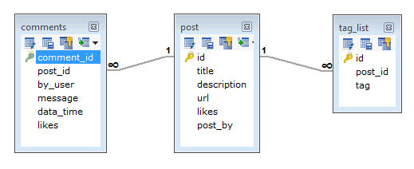
Data Model（RDBMS）
tag
Comment
post

Slide 4
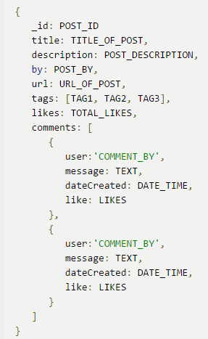
Data Model（MongoDB）
Post
Tag
Comment

Slide 5
RDBMS VS MongoDB
1.Flat Table Structure
2.Cross-record transaction
3.Table Joint
1.Document Structure
2.Single Document transaction
3.No Joint

Slide 6
Advantages of Doc. Model
Data Locality, High Read/Write performance
No Joint, High Scalability
Schemaless, Flexibility, easy to maintain
Easy for human to understand

Slide 7
Consideration
Match Business Requirement?
Data consistency
Performance

Slide 8
Data Modeling Concept
Date Modeling in MongoDB
Samples

Slide 9
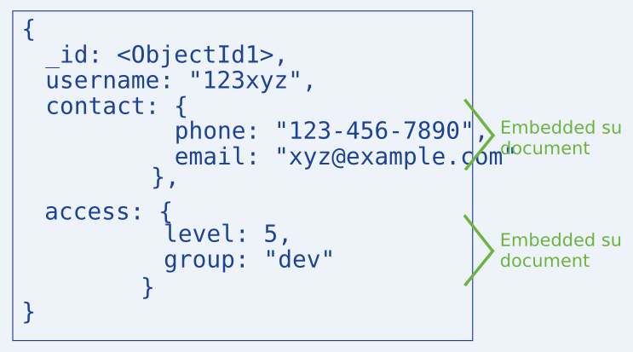
1.Embedded Data
Put related data into one Document

Slide 10
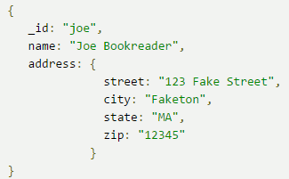
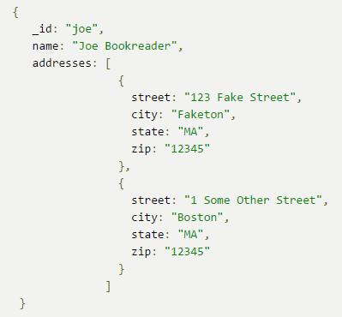
1. Embedded Data Sample
one-one
one-many

Slide 11
1. Embedded Data
Less requests sent to MongoDB
High read performance, but be careful the document grows
MongoDB handles data consistency
Scenario ：one-one，one-many, needs high read performance.

Slide 12
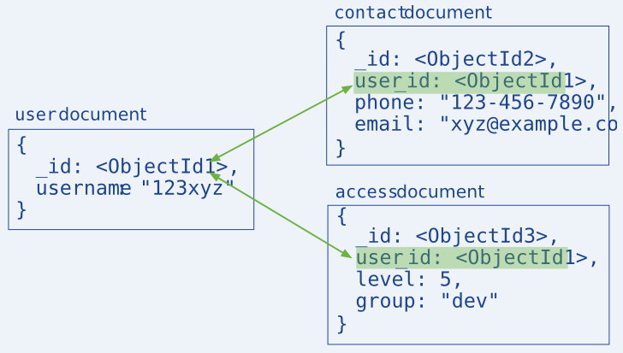
2.References
one document keeps a reference points to another

Slide 13
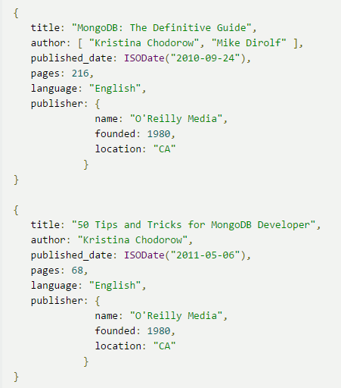
2. References Sample:one-many
This is Embedded data:
Book1
publisher
Book2

Slide 14
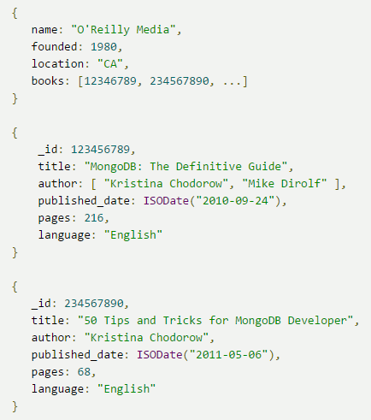
2. References Sample: one-many
This is References: (publisher point to books)
publisher
Book1
Book2

Slide 15
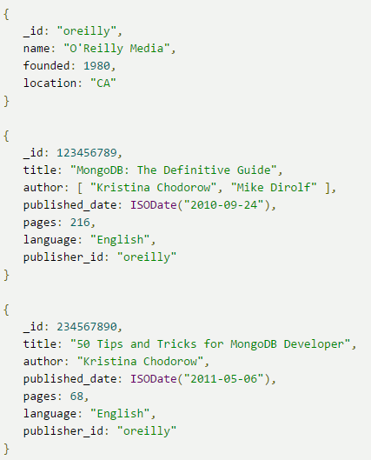
2. References Sample: one-many
This is References: (book point to publisher)
publisher
book1
book2
Think about it: which model is better?

Slide 16
2.References
More flexible than embedded data
Less storage space, but more requests sent to MongoDB
App handles data consistency
Scenario: complex many-many relation, not allow large Duplicated data(space limited)

Slide 17
So，Embedded or Reference？
Common sense：
Consider Embedded first
If Embedded not match your Requirement，consider Reference

Slide 18
Data Modeling Concept
Date Modeling in MongoDB
Samples

Slide 19
Modeling Samples
Data consistency focused modeling
Monetary Data Modeling

Slide 20
Data consistency focused
For those fields should be updated at the same time, better to put them into one Document to ensure all of them are updated / unupdated.
Example:
Library(Borrow books) ,we need to maintain:
Available amount of a book
The List of Borrowers of a book

Slide 21
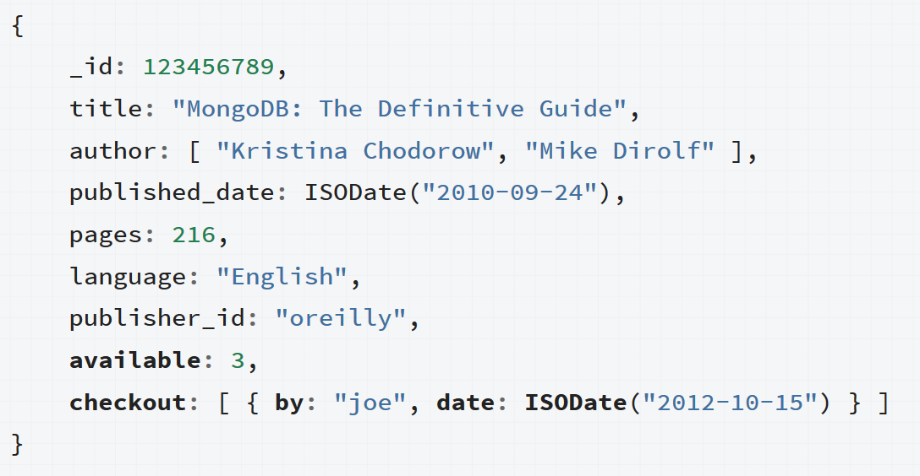
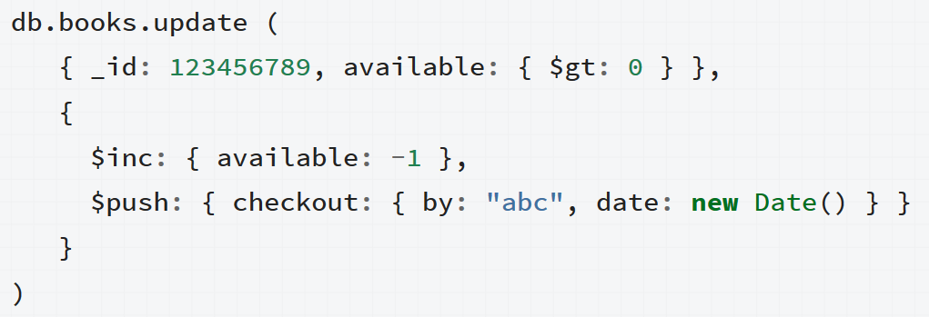
Data consistency focused

Slide 22

Monetary Data
Exact Precision
Pay attention to money：
Don’t use Float/Double to store money, because they are not precise!
Use Integer(Int64) to store it:
Based on the smallest unit of currency.
Sample: the smallest unit of USD is Cent, 1 Dollar = 100 Cent
Store 50.23 dollar as 5023 Cent (50.23 * 100)

Slide 23
Summary
Modeling concept
Modeling Embedded, References
Modeling Samples

Slide 24
Exercise
Think about this:
How to model many-many relationship? Suppose :
(1)There are some students & teachers
(2)One student can applied courses from multiple teachers.
(3)One teacher can teach multiple students.
What is your design?

Slide 25
Q & A

