Slide 1

5.MongoDB Aggregation

Slide 2
0.What is Aggregation
1.MongoDB Aggregation

Slide 3
What is Aggregation?
Aggregation is a function where the values of multiple rows are grouped together as input on certain criteria to form a single value of more significant meaning: Average/Max/Min/Summary…

Slide 4
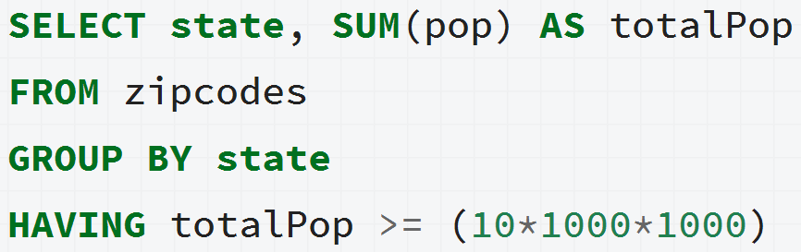
Aggregation in RDMS

Slide 5
0.What is Aggregation
1.MongoDB Aggregation

Slide 6
What is Aggregation Pipeline？
MongoDB’s Aggregation Pipeline is a data Processing flow. Documents enter a multi-stage pipeline that transforms the documents into an aggregated result.

Slide 7
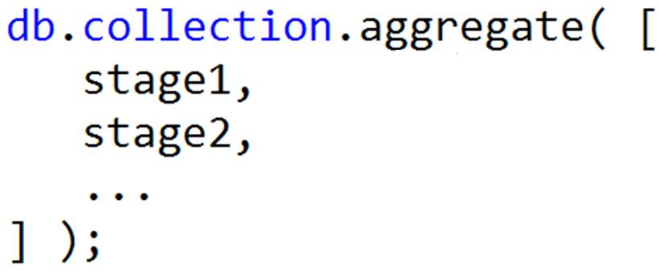
Aggregation Pipeline Syntax

Slide 8
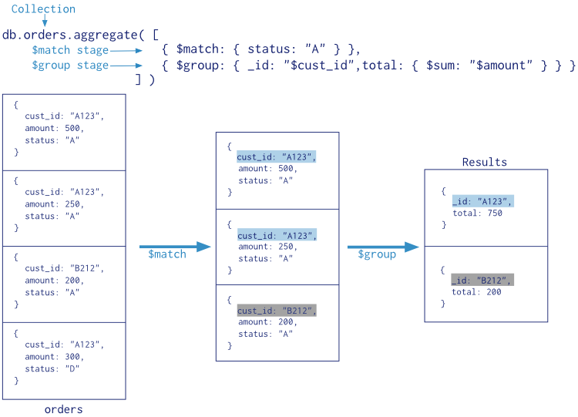
Aggregation Pipeline flow

Slide 9
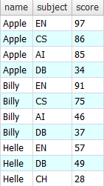
Common Stage

Slide 10
Common Stage
（1） $match （= WHERE）
Filters the documents and pass those matched documents to the next stage
db.exam.aggregate([ {$match:{score:{$gte:60}}}
]);

Slide 11
Common Stage
（2） $group （= GROUP BY）
Groups documents by some specified expression.
db.exam.aggregate([ {$group:{_id:”$subject”,
score:{$avg:”$score”}}}
]);
group key
output field
accumulator

Slide 12
Common Stage
（3） $limit（= LIMIT）
Limits the number of documents passed to the next stage
（4） $sort （= ORDER BY）
Sorts all input documents and returns them to the pipeline in sorted order
（5） $skip （= LIMIT）
Skips over the specified number of documents and pass the remaining documents to next stage
https://docs.mongodb.com/manual/reference/operator/aggregation-pipeline/

Slide 13
Example, data:

Slide 14
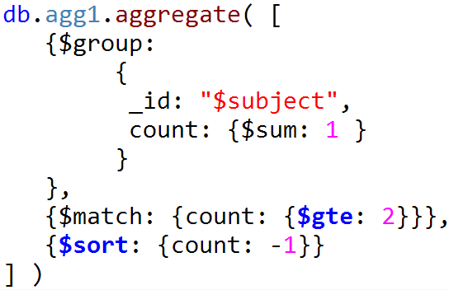
Example - School wants to know:
(1)Which subjects are applied by > 1 student
(2)The number of applied students of these subjects
(3)Sort the subjects by the number in DESC order
Group by subject, summary the count of each subject
Filter, remain those count > 1
Sort by count DESC

Slide 15
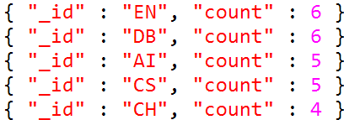
Example
School wants to know:
(1)Which subjects are applied by > 1 student
(2)The number of applied students of these subjects
(3)Sort the subjects by the number in DESC order

Slide 16
Pay attention
（1）Place the $match as early in the aggregation pipeline as possible. Because $match limits the total number of documents in the aggregation pipeline and save memory.
（2）Max memory can be used in each aggregation pipeline is limited to 100MB，do not run aggregation pipeline on a huge dataset.

Slide 17
Summary
（1）Aggregation Pipeline concept
（2）Common Stages
WHERE | $match
GROUP BY | $group
HAVING | $match
SELECT | $project
ORDER BY | $sort
LIMIT | $limit
SUM() | $sum
COUNT() | $sum

Slide 18
Exercise
School wants to know:
(1)Who are the TOP 3 students(higher average score) ?
(2)Please show me these TOP3 student names & his/her average score. Sort by avg. score.
Can you help?

Slide 19
Q & A

Slide 20
Exercise
\\HUANGYE-3-W7\mg_ex
CH5_exercise folder

Slide 21
Best way to learn MongoDB：
https://docs.mongodb.com/manual/

