Slide 1
MongoDB Course
Overall Introduction
Yellow Huang
Ver 2017_06_07

Slide 2
Agenda
1
What is NoSQL?
2
What is MongoDB?
3
MongoDB vs RDBMS
4
Benefit from MongoDB

Slide 3
1
What is NoSQL?

Slide 4
1
What is NoSQL?
Not Only SQL
database provides a mechanism for storage and retrieval of data which is modeled in means other than the tabular relations used in relational databases.
<1>Not use SQL
<2>Not full ACID & JOIN support
<3>Data model is diff from traditional RDBMS
<4>More focus on Scalability, Performance rather than Consistency

Slide 5



1
What is NoSQL?
Not Only SQL
NoSQL database existed since the late 1960s, but rapid development triggered by the needs of Web 2.0 companies such as Facebook, Google and Amazon.

Slide 6
1
What is NoSQL?
Not Only SQL
Vast ecosystem:
Key-Value Database (e.g. Redis)
Document Database (e.g. MongoDB)
Tabular table Database (e.g. BigTable)
Graph database (e.g. Neo4J)
……

Slide 7
2
What is MongoDB?

Slide 8

2
What is MongoDB?
Not “mango”
HUMONGOUS

Slide 9
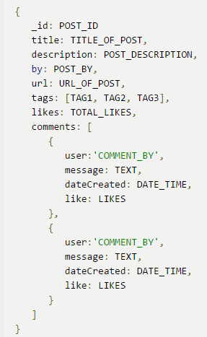
2
What is MongoDB?
Document based Model
Post
tag
comment

Slide 10
2
What is MongoDB?
No Pre-defined schema
Index support
Supports high Scalability & Performance

Slide 11
3
MongoDB vs RDBMS

Slide 12
3
MongoDB vs RDBMS
Logic structure
RDBMS | MongoDB
Schema | Database
Table | Collection
Row | Document
Column | Field

Slide 13
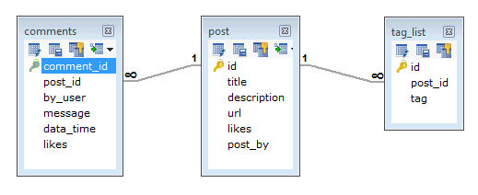
3
MongoDB vs RDBMS
Data structure（RDBMS）
tag
Comment
post

Slide 14
3
MongoDB vs RDBMS
Data structure（MongoDB）
Post
tag
comment

Slide 15
3
MongoDB vs RDBMS
Consistency
(1)ACID vs BASE(sometimes other thread will see inconsistent data) (example)
(2)Multiple rows transaction vs. Single document transaction

Slide 16
3
MongoDB vs RDBMS
Scalability
(1)FK vs. no FK no Join - easy to Horizontal split.
(2)Built-in Horizontal Scalability - low cost.

Slide 17
4
Benefit from MongoDB

Slide 18
4
Benefit from MongoDB
Document Data Model
App and DB data structures in harmony
Dynamic Schema, fast to develop – quicker to market
Rich Query Language
No syntax like SQL - safety
rich query language to support read and write – quicker to iterate
Built-in Horizontal Scalability
Low infrastructure costs – commodity hosts & no need for SAN
Elasticity - start small and invest incrementally

