Slide 1
MongoDB Course
Insert, Update, Delete
Yellow Huang
Ver 2017_06_07

Slide 2
Agenda
1
MongoDB Data Types
2
Insert
3
Update
4
Delete

Slide 3
1
MongoDB Data Types

Slide 4
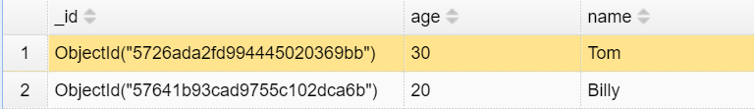
1
MongoDB Data Types
String
Double // 64bit Float number
Int32/Int64 // Integer
Boolean
Embed Document // Another BSON document
Array // Array of any data types
ObjectId // A 96-bit length random string. Common used for the unique Key of each document in MongoDB, the “_id” field, like :

Slide 5
1
MongoDB Data Types
The full definition of data type:
https://docs.mongodb.com/manual/reference/bson-types/

Slide 6
2
Insert

Slide 7
2
Insert
Compare MongoDB to SQL:
 | Syntax Rules
MongoDB | document = {name:“Frye”, age: 20} db.collection.insertOne (document) //or db.collection.insertOne({name:“Frye”,age: 20})
SQL | insert into table (name, age) values (‘Frye’, 20)

Slide 8
2
Insert
3 commands for Insert document:
1
db.collection.insertOne()
2
db.collection.insertMany()
3
db.collection.insert() //Deprecation!

Slide 9


2
Insert
Insert Single document:
MongoDB returns:
Data inserted:

Slide 10

2
Insert
Think about it:
Did we define the data schema?
MongoDB accepts schemaless !

Slide 11

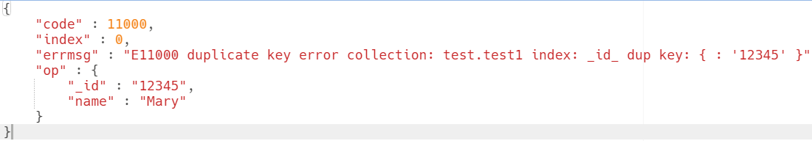
2
Insert
Think about it:
What happens if we execute?

Slide 12

2
Insert
Result:

Slide 13
2
Insert
Principle：
“_id” must be unique in one collection. If user does not assign its value, MongoDB will generate a ObjectId.
2. Driver transform the data into BSON format and pass to MongoDB.
3. MongoDB validate BSON（check“_id”, max document size limitation 16MB）。

Slide 14

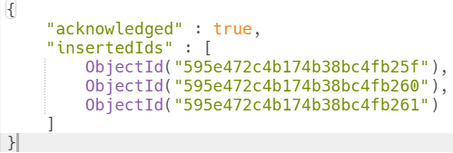
2
Insert
Insert Multiple documents:
MongoDB returns: (default ordered=true)

Slide 15
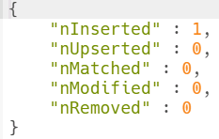
2
Insert
Old Insert API
MongoDB returns:

Slide 16
2
Insert
API compare:
API | Input | Returns
insertOne | 1 document(obj) | New _id
insertMany | 1~n documents(array) | New _ids
insert | 1~n documents(obj or array) | Insert count

Slide 17
3
Update

Slide 18
3
Update
Compare MongoDB to SQL:
 | Syntax Rules
MongoDB | db.collection.updateMany ( {name: “Frye”}, // Filter {$set: {age: 21}}, // Update statement { /* Options */ } )
SQL | update table SET age = 21 WHERE name=“Frye”

Slide 19
3
Update
4 commands for Update document:
1
db.collection.updateOne()
2
db.collection.updateMany()
3
db.collection.replaceOne()
4
db.collection.update() //Deprecation!

Slide 20
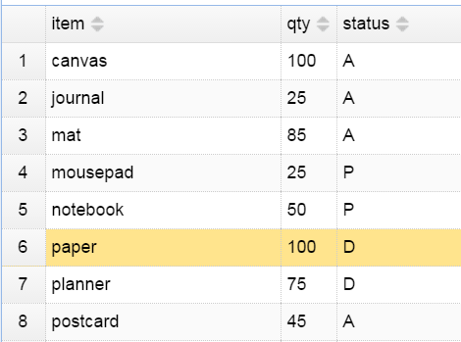
3
Update
Test data:

Slide 21
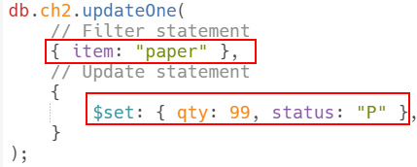
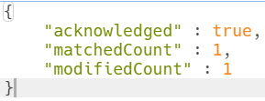
3
Update
Update Single document:
MongoDB returns:

Slide 22
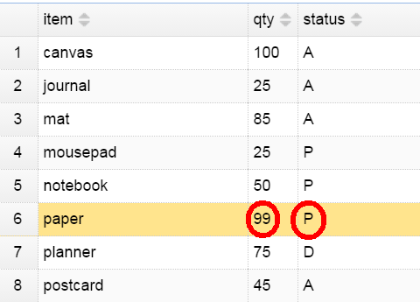
3
Update
Test data after update:

Slide 23
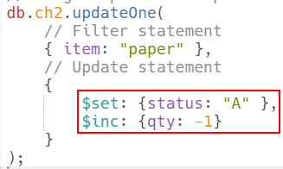

3
Update
Update Single document – more complex:

Slide 24
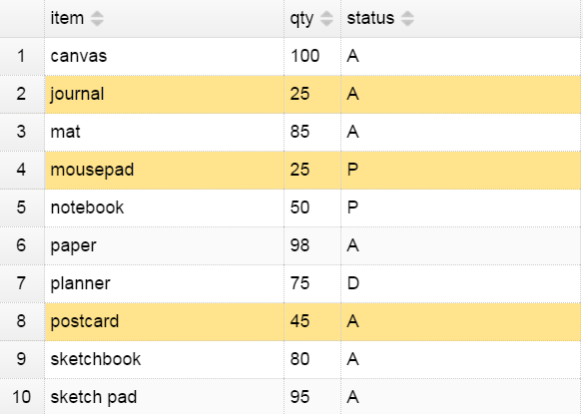
3
Update
Test data before multiple update:

Slide 25
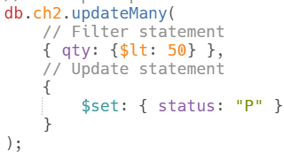
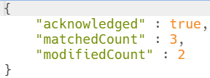
3
Update
Update multiple documents:
MongoDB returns:

Slide 26
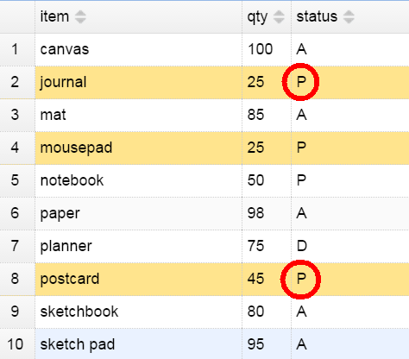
3
Update
Test data after multiple update:

Slide 27
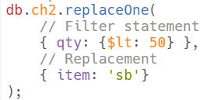
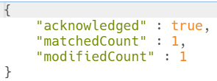
3
Update
Replace a document:
MongoDB returns:

Slide 28
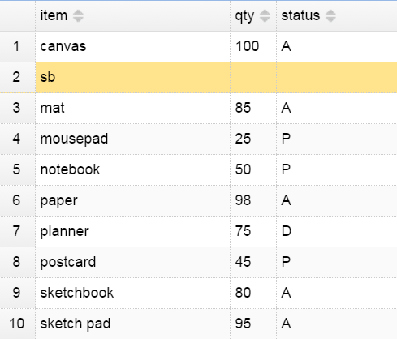
3
Update
Test data after replace:

Slide 29
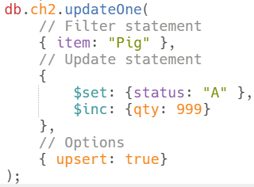
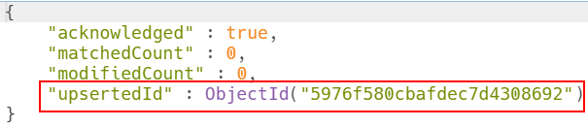
3
Update
Option - upsert:
MongoDB returns:

Slide 30
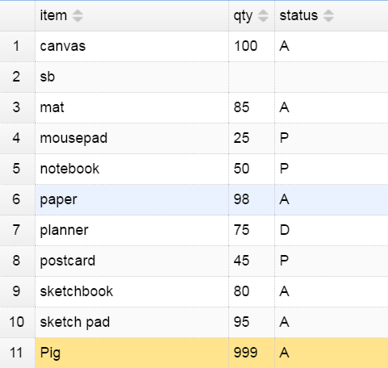
3
Update
Test data after upsert:

Slide 31
3
Update
Update operators: https://docs.mongodb.com/manual/reference/operator/update/
operators | description
$set | Update a specified field. If the field does not exist, then add this field to document.
$unset | Remove the specified field from document.
$inc | Focus on numerical field, increments a field by a specified value
$push | appends a specified value to an array.
$pop | removes the first or last element of an array.

Slide 32
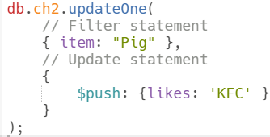
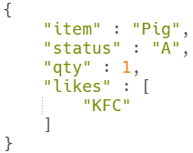
3
Update
Update operator sample - $push:
Result:

Slide 33
3
Update
API compare:
API | Input | Returns
updateOne | Filter + Update + Options | matchedCount + modifiedCount
updateMany | Filter + Update + Options | matchedCount + modifiedCount
replaceOne | Filter + Replacement + Options | matchedCount + modifiedCount + new doc _id(if)

Slide 34
4
Delete

Slide 35
4
Delete
Compare MongoDB to SQL:
 | Syntax Rules
MongoDB | db.collection.deleteMany ( {name: “Frye”}, // Filter )
SQL | delete from table WHERE name=“Frye”

Slide 36
4
Delete
2 commands for Delete document:
1
db.collection.deleteOne()
2
db.collection.deleteMany()
3
db.collection.remove() //Deprecation!

Slide 37

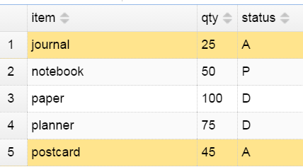
4
Delete
Delete with single criteria：
Result:

Slide 38
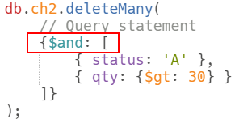
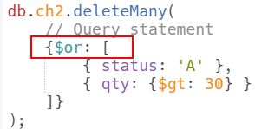
4
Delete
Delete with multiple criteria：
Status = ‘A’ AND
Qty > 30
Status = ‘A’
OR
Qty > 30

Slide 39
4
Delete
Delete all docs：
(Indexes will be reserved)
Drop a collection:
(All docs and all indexes will be deleted)

