Slide 1
MongoDB Course
Query
Yellow Huang
Ver 2017_06_07

Slide 2
Agenda
1
Basic Query
2
Query Operators: Comparison
3
Query Operators: Logical
4
Query Operators: Embedded Document
5
Query Operators: Array
6
Cursor

Slide 3
1
Basic Query

Slide 4
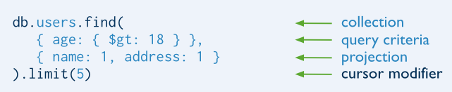
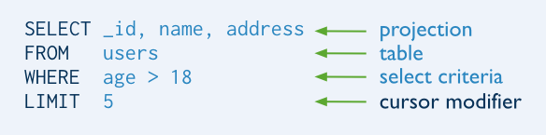
1
Basic Query
MongoDB find() VS SQL SELECT

Slide 5
1
Basic Query
db.users.find() | SELECT * FROM users
db.users.findOne() | SELECT * FROM users LIMIT 1
db.users.find( { }, { name: 1, age: 1} ) | SELECT id, name, age FROM users
db.users.find().count() | SELECT COUNT(*) FROM users

Slide 6
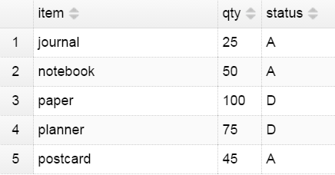
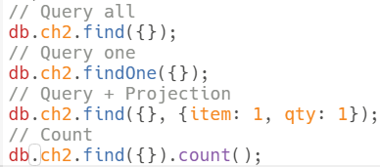
1
Basic Query

Slide 7
2
Query Operators: Comparison

Slide 8
2
Query Operators: Comparison
$eq | WHERE age=18 | {age:{$eq:18}} {age:18}
$gt | > | {age:{$gt:18}}
$gte | >= | {age:{$gte:18}}
$lt | < | {age:{$lt:18}}
$lte | <= | {age:{$lte:18}}
$ne | <> | {age:{$ne:18}}
$in | in (or) | {lucky_no:{$in:[1,3]}}
$nin | not in (and) | {lucky_no:{$nin:[1,3]}}

Slide 9
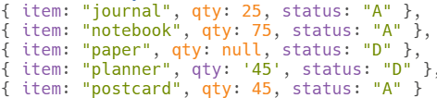
2
Query Operators: Comparison
Query:
MongoDB returns:

Slide 10

2
Query Operators: Comparison
Query:
MongoDB returns:

Slide 11
2
Query Operators: Comparison
Query:
MongoDB returns:

Slide 12
3
Query Operators: Logical

Slide 13
3
Query Operators: Logical
$or | WHERE name='Andy' OR age=18 | { $or:[ {name:'Andy'}, {age:22} ] }
$and | WHERE name='Andy' AND age=18 | { $and:[ {name:'Andy'}, {age:22} ] } {age:22, name:'Andy'}
$not | WHERE name<>'Andy' | {name: {$not: {$eq: "Andy"} }
$nor | WHERE name<>'Andy' AND age<>18 | { $nor:[ {name:'Andy'}, {age:22} ]}

Slide 14
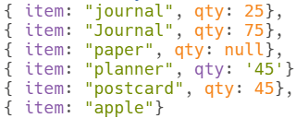


3
Query Operators: Logical
Query:
MongoDB returns:

Slide 15


3
Query Operators: Logical
Query:
MongoDB returns:

Slide 16


3
Query Operators: Logical
Query:
MongoDB returns:

Slide 17
4
Query Operators: Embedded Document

Slide 18
4
Query Operators: Embedded Document
1. Exact Match on the Embedded Document
{addr : { code: 5 , city: ‘GZ'} }
2. Equality Match on Fields within an Embedded Document
{'addr.code' : 5 , 'addr.city' : ‘GZ' }

Slide 19
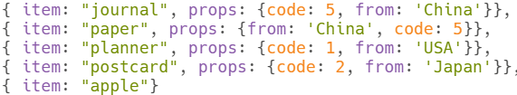
4
Query Operators: Embedded Document
Query:
MongoDB returns:

Slide 20
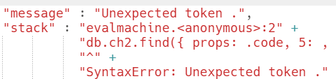
4
Query Operators: Embedded Document
Query:
MongoDB returns:

Slide 21
4
Query Operators: Embedded Document
Query:
MongoDB returns:

Slide 22
5
Query Operators: Array

Slide 23
5
Query Operators: Array
$in | { lucky_no: { $in: [ 1,2,3] } }
$all | { lucky_no: { $all: [ 1,2,3] } }
$size | { lucky_no: { $size: 3} }
$elemMatch | { lucky_no: { $elemMatch: { $gt: 1, $lt: 3 } } }

Slide 24
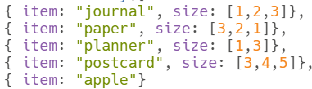

5
Query Operators: Array
Query:
MongoDB returns:

Slide 25

5
Query Operators: Array
Query:
MongoDB returns:

Slide 26
5
Query Operators: Array
Query:
MongoDB returns:

Slide 27

5
Query Operators: Array
Query:
MongoDB returns:

Slide 28
6
Cursor

Slide 29
6
Cursor
sort() | find(…) .sort({age:-1,name:1})
skip() | find(…). skip(2)
limit() | find(…). limit(2)

Slide 30
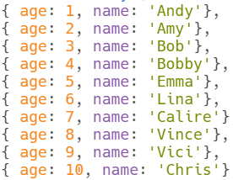
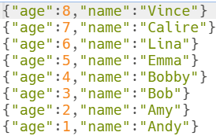
6
Cursor

Slide 31

6
Cursor

Slide 32

6
Cursor

Slide 33
@
https://docs.mongodb.com/manual/crud/
Exercise:
\full-stack-web-course\db\mongodb\2017\materials\exercise\CH2_exercise
Sample Code:
\db\mongodb\2017\materials\sample_code

