Slide 1
MongoDB Course
Index
Yellow Huang
Ver 2017_06_07

Slide 2
Agenda
1
Review
2
Concept of Index
3
Structure of MongoDB Index
4
Usage of MongoDB Index
5
Measure Index Use

Slide 3
1
Review

Slide 4
1
Review
Collection
-> Table
Document
-> Row
Field
-> Column

Slide 5
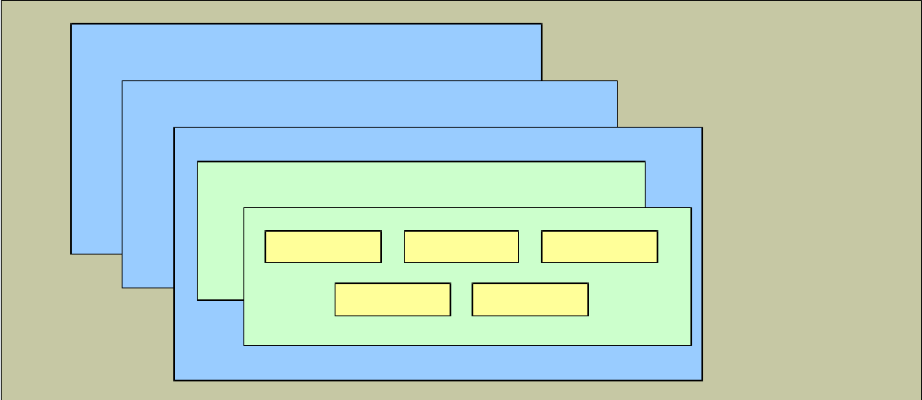
1
Review
Collection
Document
Field
DB

Slide 6
2
Concept of Index

Slide 7
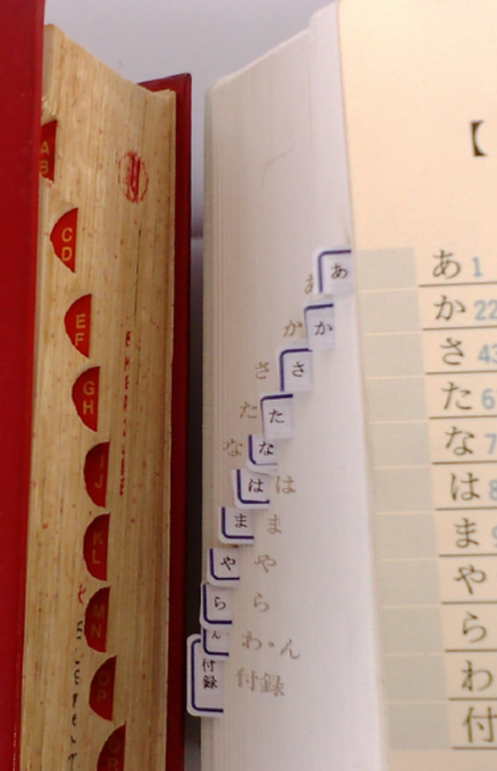
2
Concept of Index
What is Index?
“Indexes are designed to help the reader find information quickly and easily.”

Slide 8
2
Concept of Index
What is DB Index?
A database index is a data structure that improves the speed of data retrieval / sorting operations on a database table. Quickly locate data without having to search every row.

Slide 9
2
Concept of Index
Index in RDBMS
1.Which column should be indexed？
2.More indexes, more performance?

Slide 10
3
Structure of MongoDB Index

Slide 11
3
Structure of MongoDB Index
Logical view(Data & Index)
1. Document are stored in Disk unorderly.
Collection
a | b | c
3 | 2 | 1
1 | 1 | 3
1 | 2 | 3
2 | 2 | 1
3 | 1 | 3
1 | 3 | 1
2 | 3 | 3
3 | 1 | 1
1 | 2 | 1
2 | 1 | 3
2 | 2 | 2
3 | 2 | 3

Slide 12
3
Structure of MongoDB Index
2. An Index is an ordered List of Index Items(unique)
Collection
a | b | c
3 | 2 | 1
1 | 1 | 3
1 | 2 | 3
2 | 2 | 1
3 | 1 | 3
1 | 3 | 1
2 | 3 | 3
3 | 1 | 1
1 | 2 | 1
2 | 1 | 3
2 | 2 | 2
3 | 2 | 3
Index(a:1)
a
1
2
3

Slide 13
3
Structure of MongoDB Index
3. Each Index Item contains the value of indexed field from corresponding document. (unique)
Collection
a | b | c
3 | 2 | 1
1 | 1 | 3
1 | 2 | 3
2 | 2 | 1
3 | 1 | 3
1 | 3 | 1
2 | 3 | 3
3 | 1 | 1
1 | 2 | 1
2 | 1 | 3
2 | 2 | 2
3 | 2 | 3
Index(a:1)
a
1
2
3

Slide 14
3
Structure of MongoDB Index
4.Each Index Item points to the address of corresponding documents in Disk.
Collection
a | b | c
3 | 2 | 1
1 | 1 | 3
1 | 2 | 3
2 | 2 | 1
3 | 1 | 3
1 | 3 | 1
2 | 3 | 3
3 | 1 | 1
1 | 2 | 1
2 | 1 | 3
2 | 2 | 2
3 | 2 | 3
Index(a:1)
a
1
2
3

Slide 15
3
Structure of MongoDB Index
5.We can have multiple Indexes in a collection.
Collection
a | b | c
3 | 2 | 1
1 | 1 | 3
1 | 2 | 3
2 | 2 | 1
3 | 1 | 3
1 | 3 | 1
2 | 3 | 3
3 | 1 | 1
1 | 2 | 1
2 | 1 | 3
2 | 2 | 2
3 | 2 | 3
Index(a:1)
a
1
2
3
Index(c:-1)
c
3
2
1

Slide 16
3
Structure of MongoDB Index
Summary
Index is an ordered List.
Index is an individual structure from the business data.
Index Item points to the address of corresponding documents.

Slide 17
4
Usage of MongoDB Index
1
Single Field Index
2
Compound Indexes
3
Multikey Indexes
4
Index Cardinality

Slide 18
4.1
Single Field Index
Sample data:
{
"name" : "Alice",
"age" : 27
}
Create single field index on ‘name’:
db.friends.createIndex( { "name" : 1 } )

Slide 19
4.1
Single Field Index
Sample data:
{"name": "John Doe",
"address": {
"zipcode": "53511“
}
}
Create index on embedded field:
db.people.createIndex({ "address.zipcode":1 })

Slide 20
4.1
Single Field Index
The argument 1 or -1 in create index:
//createIndex( { "name" : 1 } )
1 = Index items sorted in ASC order
-1 = Index items sorted in DESC order
(Actually this argument will not affect query performance in Single Field Index. But it will affect Compound Indexes)

Slide 21
4.2
Compound Indexes
1. Index on multiple fields.
2. The order can be different for fields.(e.g. ASC order for name, DESC order for age)

Slide 22
4.2
Compound Indexes
Sample: Index( { "a": 1, "b": 1, "c": 1 } )
Collection
a | b | c
3 | 2 | 1
1 | 1 | 3
1 | 2 | 3
2 | 2 | 1
3 | 1 | 3
1 | 3 | 1
2 | 3 | 3
3 | 1 | 1
1 | 2 | 1
2 | 1 | 3
2 | 2 | 2
3 | 2 | 3
Index(a:1 ,b:1, c:1)
a | b | c
1 | 1 | 3
1 | 2 | 2
1 | 2 | 3
1 | 3 | 1
2 | 1 | 3
2 | 2 | 1
2 | 2 | 2
2 | 3 | 3
3 | 1 | 1
3 | 1 | 3
3 | 2 | 1
3 | 2 | 3

Slide 23
4.2
Compound Indexes (Prefixes Query)
If you want to get benefit from compound indexes, ensure query criteria is beginning subset of the Compound Indexes.
db.products.find( { "a": 1, "b": 2, "c": 3 } )
db.products.find( { "a": 2} )
db.products.find( { "a": 2, "b": 2} )

Slide 24
4.2
Compound Indexes (Prefixes Query)
Sample: find( { "a": 2, "b": 2} )
Collection
a | b | c
3 | 2 | 1
1 | 1 | 3
1 | 2 | 3
2 | 2 | 1
3 | 1 | 3
1 | 3 | 1
2 | 3 | 3
3 | 1 | 1
1 | 2 | 1
2 | 1 | 3
2 | 2 | 2
3 | 2 | 3
Index(a:1 ,b:1, c:1)
a | b | c
1 | 1 | 3
1 | 2 | 2
1 | 2 | 3
1 | 3 | 1
2 | 1 | 3
2 | 2 | 1
2 | 2 | 2
2 | 3 | 3
3 | 1 | 1
3 | 1 | 3
3 | 2 | 1
3 | 2 | 3

Slide 25
4.2
Compound Indexes (Prefixes Query)
These queries can not get benefit from compound indexes. Why？
db.products.find( { "b": 2, "c": 3 } )
db.products.find( { "c": 3} )
db.products.find( { "a": 1, "c": 3} )

Slide 26
4.2
Compound Indexes (Sort)
If you want to get benefit from compound indexes in sorting, below conditions need to be satisfied on the sort keys:
1.Satisfied Prefixes.
2.The orders of sort keys are completely the same or opposite to indexes.

Slide 27
4.2
Compound Indexes (Sort)
We have Index( { "a": 1, "b": 1, "c": 1 } )
Good Sorting which use Index:
db.products.find().sort({ "a": 1, "b": 1, "c": 1 } )
db.products.find().sort({ "a": -1,"b": -1,"c": -1} )
db.products.find().sort({ "a": 1 } )
Bad sorting can not use Index:
db.products.find().sort({ "a": -1,"b": 1,"c": -1} )

Slide 28
4.2
Compound Indexes (Sort)
Index(a:1 ,b:1, c:1)
a | b | c
1 | 1 | 3
1 | 2 | 2
1 | 2 | 3
1 | 3 | 1
2 | 1 | 3
2 | 2 | 1
2 | 2 | 2
2 | 3 | 3
3 | 1 | 1
3 | 1 | 3
3 | 2 | 1
3 | 2 | 3

Slide 29
4.2
Compound Indexes (Prefixes + Sort)
e.g.: find( { "a": 1} ).sort( { "a": 1, "b": 1 } )
Query Keys
Sort Keys
Key Points:
Can Query Keys get benefit from index?
If (1) is satisfied, Can Sort Keys get benefit from index?

Slide 30
4.2
Compound Indexes (Prefixes + Sort)
We have Index( { "a": 1, "b": 1, "c": 1 } )
Good queries get benefit from Index:
(1) find( { "a": 1} ).sort( { "a": 1, "b": 1 } )
(2) find( { "a": { $gt: 1 }} )
.sort({"a":1,"b": 1, "c": 1 } )
(3) find( { "a": 1} ).sort( { "b": 1, "c": 1 } )
(4) find( { "a": 1, "b": 2} ).sort( { "c": 1 } )
Examples↓

Slide 31
4.2
Compound Indexes (Prefixes + Sort)
find( { "a": 1} ).sort( { "a": 1, "b": 1 } )
Index(a:1 ,b:1, c:1)
a | b | c
1 | 1 | 3
1 | 2 | 2
1 | 2 | 3
1 | 3 | 1
2 | 1 | 3
2 | 2 | 1
2 | 2 | 2
2 | 3 | 3
3 | 1 | 1
3 | 1 | 3
3 | 2 | 1
3 | 2 | 3

Slide 32
4.2
Compound Indexes (Prefixes + Sort)
find( { "a": 1, "b": 2} ).sort( { "c": 1 } )
Index(a:1 ,b:1, c:1)
a | b | c
1 | 1 | 3
1 | 2 | 2
1 | 2 | 3
1 | 3 | 1
2 | 1 | 3
2 | 2 | 1
2 | 2 | 2
2 | 3 | 3
3 | 1 | 1
3 | 1 | 3
3 | 2 | 1
3 | 2 | 3

Slide 33
4.2
Compound Indexes (Prefixes + Sort)
We have Index( { "a": 1, "b": 1, "c": 1 } )
Bad Query can not get full benefit from Index:
find( { "a": { $gt: 1 }} ).sort( { "b": 1, "c": 1 } )
Examples↓

Slide 34
4.2
Compound Indexes (Prefixes + Sort)
find( { "a": { $gt: 1 }} ).sort( { "b": 1, "c": 1 } )
Index(a:1 ,b:1, c:1)
a | b | c
1 | 1 | 3
1 | 2 | 2
1 | 2 | 3
1 | 3 | 1
2 | 1 | 3
2 | 2 | 1
2 | 2 | 2
2 | 3 | 3
3 | 1 | 1
3 | 1 | 3
3 | 2 | 1
3 | 2 | 3

Slide 35
4.2
Compound Indexes (Prefixes + Sort)
For query + sorting, below conditions be satisfied to get benefit from index:
1.Query Keys satisfied Prefixes.
2.The filtered indexes are already sorted to sort keys.
[1] https://docs.mongodb.org/manual/tutorial/sort-results-with-indexes/

Slide 36
4.3
Multikey Indexes
If create index on array, MongoDB will create index items on each array element. This Type of index is Multikey Indexes.
{
_id: 1,
item: "iPhone6",
tags: ["Apple", "Phone", "iOS" ]
}
db.goods.createIndex( {tags : 1 } )

Slide 37
4.3
Multikey Indexes
Key Point:
(1) Since MongoDB will create index items on each element in array, be careful that the size of indexes maybe huge. (If you have a lot of document & every document has a large array)

Slide 38
4.4
Index Cardinality
Cardinality refers to the uniqueness of data values
Max cardinality: Most values are unique(ID card / Passport#)
Min cardinality: Most values are the same(Male & Female)
Create index on high cardinality fields to get high performance!

Slide 39
4
Usage of MongoDB Index
Summary
Single Filed Index
Compound Indexes (Prefixes + Sort)
Multikey Indexes (huge size)
Index on high cardinality fields

Slide 40
5
Measure Index Use

Slide 41
5
Measure Index Use
Common Commands
（1） db.coll.getIndexes() : List all existing Indexes in collection.
（2） db.coll.createIndex({"a": 1, "b": -1}) : Create Index on specified fields.
（3） db.coll.dropIndex("a_1_b_-1"): Remove index by specified index name.

Slide 42
5
Measure Index Use
Use explain()
PS:
The usage of explain() has huge change after MongoDB v3.0. Must read official document!
[3] https://docs.mongodb.org/manual/reference/explain-results/

Slide 43
5
Measure Index Use
Usage：
db.products.find({...}).sort({…}).explain(<arg>);
Accept 3 different arguments：
1. “queryPlanner”: Default value. Return all query plans，but not run any plan. 2. “executionStats”: Based on (1)，run winningPlan & return its Statistical data. 3. “allPlansExecution”: Based on (2) ， run all rejectedPlan & return their stat data.

Slide 44
5
Measure Index Use
Try？
We have Index( { "a": 1, "b": 1, "c": 1 } )
find({a:1, b:2}).explain("executionStats");

Slide 45
5
How to read？
Measure Index Use
"executionStats" : {
"nReturned" : 1, //documents returned.
"executionTimeMillis" : 0, // time consumption
"totalKeysExamined" : 1, // Index items scanned
"totalDocsExamined" : 1, // Documents scanned
"executionStages" : { // Last step
"stage" : "FETCH",
……
"inputStage" : { // Second last step
"stage" : "IXSCAN",
…… // More steps
}
}}

Slide 46
5
Measure Index Use
Query plan we expected
No Full Collection Scan
totalKeysExamined
= nReturned
= totalDocsExamined (Index 100% worked!)
3. No Sort Stage (Already sorted by Index)

Slide 47
5
Measure Index Use
Summary
（1）Common Commands
（2）explain() Usage
（3）How to read query plan

Slide 48
@
https://docs.mongodb.com/manual/indexes/
Sample Code:
\db\mongodb\2017\materials\sample_code

Slide 49
Exercise
(1) find({ a : 1, b : 2}, {a : 1 , _id : 0} );
(2) find({a: {$ne : 3}}).sort({b : 1});
Index(a:1 ,b:1, c:1)
a | b | c
1 | 1 | 3
1 | 2 | 2
1 | 2 | 3
1 | 3 | 1
2 | 1 | 3
2 | 2 | 1
2 | 2 | 2
2 | 3 | 3
3 | 1 | 1
3 | 1 | 3
3 | 2 | 1
3 | 2 | 3

