Slide 1
MongoDB Course
Modeling
Yellow Huang
Ver 2017_06_07

Slide 2
Agenda
1
Data Modeling Concept
2
Date Modeling in MongoDB
3
Samples

Slide 3
1
Data Modeling Concept

Slide 4
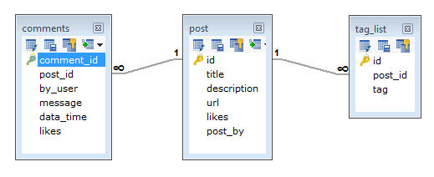
1
Data Modeling Concept
Data Model（RDBMS）
tag
Comment
post

Slide 5
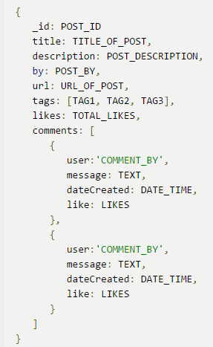
1
Data Modeling Concept
Data Model（MongoDB）
Post
Tag
Comment

Slide 6
1
Data Modeling Concept
RDBMS VS MongoDB
1.Flat Table Structure
2.Cross-record transaction
3.Table Joint
1.Document Structure
2.Single Document transaction
3.No Joint

Slide 7
1
Data Modeling Concept
Advantages of Doc. Model
Data Locality, High Read/Write performance
No Joint, High Scalability
Schemaless, Flexibility, easy to maintain
Easy for human to understand

Slide 8
1
Data Modeling Concept
Consideration
Match Business Requirement?
Data consistency
Performance

Slide 9
2
Date Modeling in MongoDB

Slide 10
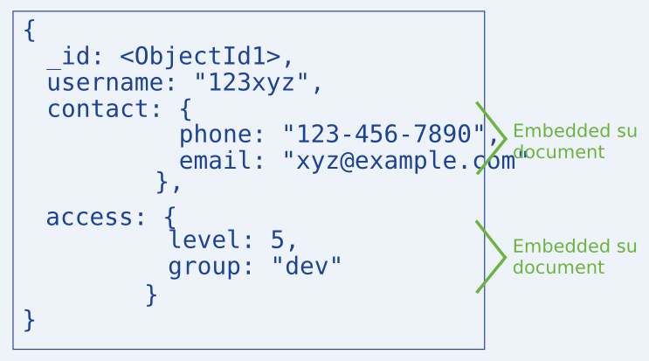
2
Date Modeling in MongoDB
1.Embedded Data
Put related data into one Document

Slide 11
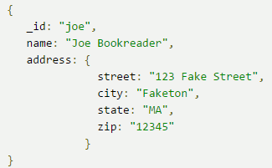
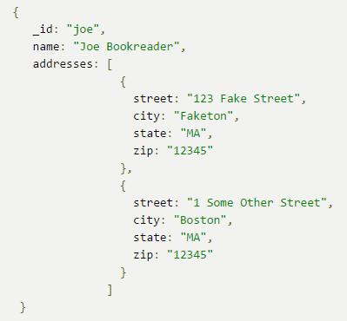
2
Date Modeling in MongoDB
1.Embedded Data Sample
one-one
one-many

Slide 12
2
Date Modeling in MongoDB
1.Embedded Data
Less requests sent to MongoDB
High read performance, but be careful the document grows.
MongoDB handles data consistency.
Scenario ：one-one，one-many, needs high read performance.

Slide 13
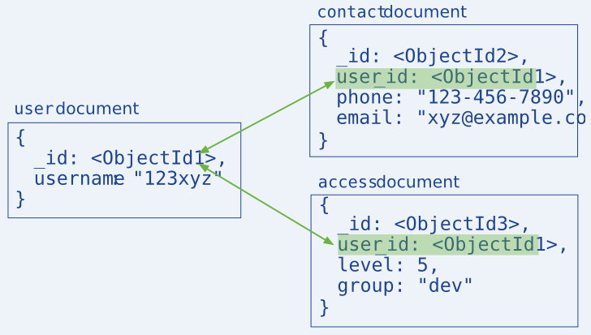
2
Date Modeling in MongoDB
2.References
one document keeps a reference points to another

Slide 14
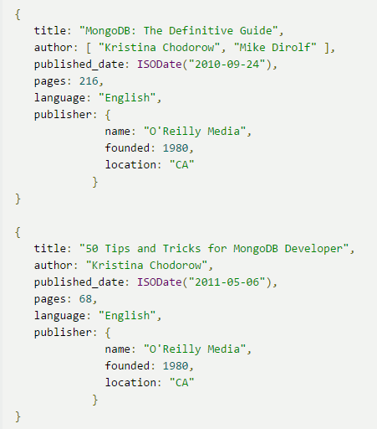
2
Date Modeling in MongoDB
This is Embedded data:
Book1
publisher
Book2

Slide 15
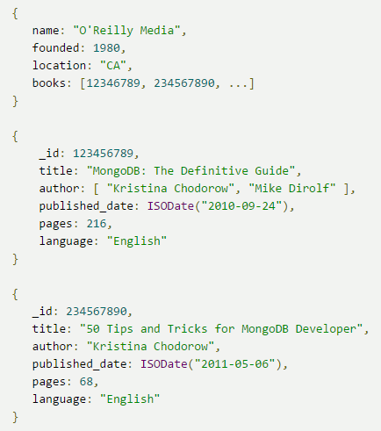
2
Date Modeling in MongoDB
This is References: (publisher -> books)
publisher
Book1
Book2

Slide 16
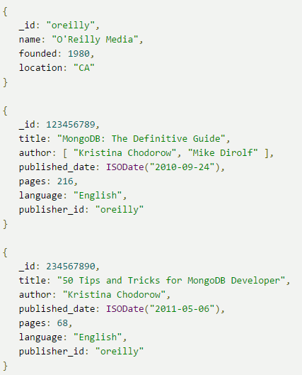
2
Date Modeling in MongoDB
This is References: (book -> publisher)
publisher
book1
book2

Slide 17
2
Date Modeling in MongoDB
Think about it: which model is better?

Slide 18
2
Date Modeling in MongoDB
2.References
More flexible than embedded data
Less storage space, but more requests sent to MongoDB
App handles data consistency
Scenario: complex many-many relation, not allow large Duplicated data(space limited)

Slide 19
2
Date Modeling in MongoDB
Common sense：
Consider Embedded first
If Embedded not match your Requirement，consider Reference

Slide 20
3
Samples
1
Data consistency focused modeling
2
Monetary Data Modeling

Slide 21
3
Data consistency focused
For those fields should be updated at the same time, better to put them into one Document to ensure all of them are updated / unupdated.
Example:
Library(Borrow books) ,we need to maintain:
Available amount of a book
The List of Borrowers of a book

Slide 22
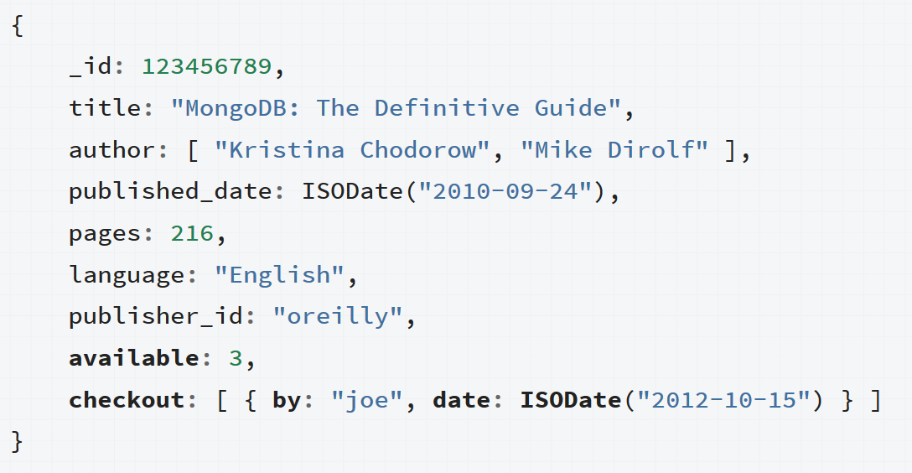
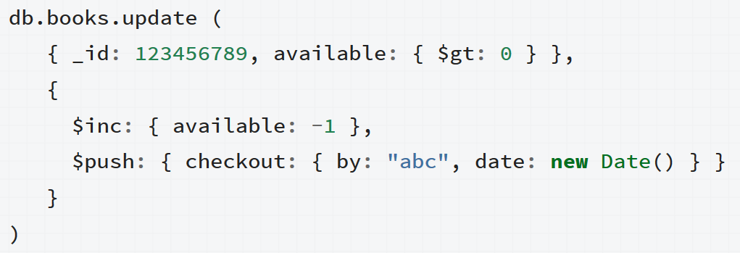
Data consistency focused

Slide 23

3
Monetary Data
Exact Precision
Pay attention to money：
Don’t use Float/Double to store money, because they are not precise!
Use Integer(Int64) to store it:
Based on the smallest unit of currency.
Sample: the smallest unit of USD is Cent, 1 Dollar = 100 Cent
Store 50.23 dollar as 5023 Cent (50.23 * 100)

Slide 24
Summary
Modeling concept
Modeling Embedded, References
Modeling Samples

Slide 25
@
https://docs.mongodb.com/manual/core/data-modeling-introduction/

