Slide 1
MongoDB Course
Using MongoDB with Node.JS
Yellow Huang
Ver 2017_06_07

Slide 2
Agenda
1
Installation of mongoose
2
Concepts of mongoose
3
Quick-start
4
Schema
5
Model
6
Middleware

Slide 3
1
Installation of mongoose

Slide 4
1
Installation of mongoose
Mongoose provides a straight-forward, schema-based solution to model your application data. It includes built-in type casting, validation, query building, business logic hooks and more, out of the box.
$ npm install mongoose --save

Slide 5
2
Concepts of mongoose

Slide 6
2
Concepts of mongoose
Compile
new
Schema
Model
Document
Structure
Definition- fields
constructor
instances
.insertMany()
.find()
.remove()
…
.save()
…
validators
hooks
…

Slide 7
3
Quick-start

Slide 8
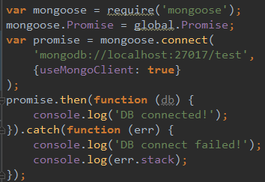
3
Quick-start
Step 1: Establish DB connection

Slide 9

3
Quick-start
Step 2: Define schema
Step 3: Compile Schema into Model

Slide 10


3
Quick-start
Step 4: Create document from Model
Step 5: Save document to DB

Slide 11
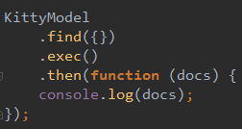

3
Quick-start
Step 6: Find inserted document

Slide 12
4
Schema

Slide 13
4
Schema
The permitted Schema Types are
String
Number
Date
Buffer
Boolean
Mixed // Any type
ObjectId
Array

Slide 14
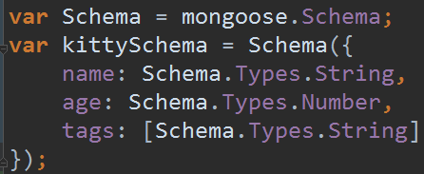
4
Schema
(1)How to define a schema?
Most formal:

Slide 15
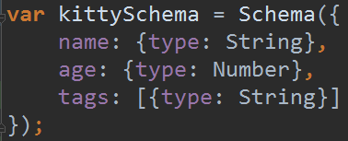
4
Schema
(1)How to define a schema?
Another form:

Slide 16
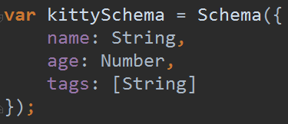
4
Schema
(1)How to define a schema?
More simpler form:

Slide 17
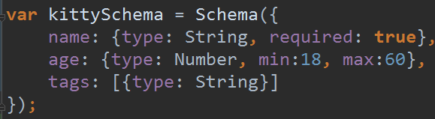
4
Schema
(2)Built-in validators in schema:
More built-in validators:
http://mongoosejs.com/docs/schematypes.html

Slide 18
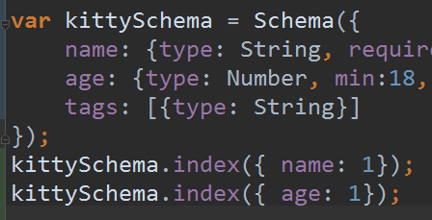
4
Schema
(3)Define indexes in schema:
Will invoke .ensureIndex() when app starts.

Slide 19
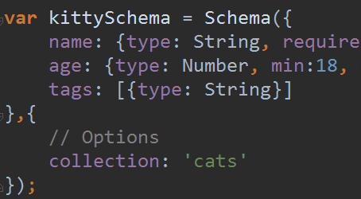
4
Schema
(4)Schema options:
http://mongoosejs.com/docs/guide.html#autoIndex

Slide 20
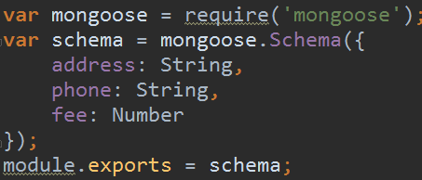
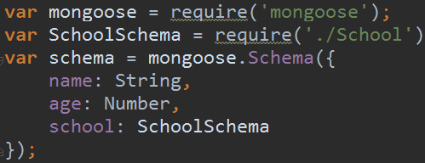
4
Schema
(5)Sub schema:

Slide 21
4
Schema
Reference:
http://mongoosejs.com/docs/guide.html
http://mongoosejs.com/docs/schematypes.html
http://mongoosejs.com/docs/subdocs.html

Slide 22
5
Model

Slide 23
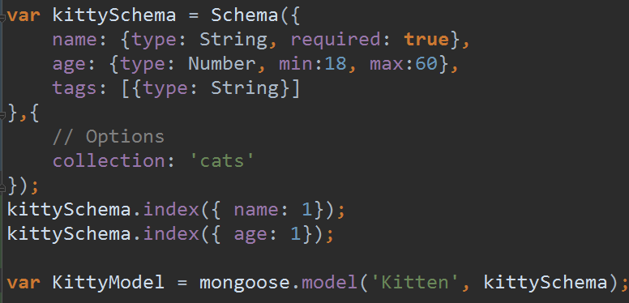
5
Model
Create Model from Schema before use:
Model of same name will be cached.

Slide 24
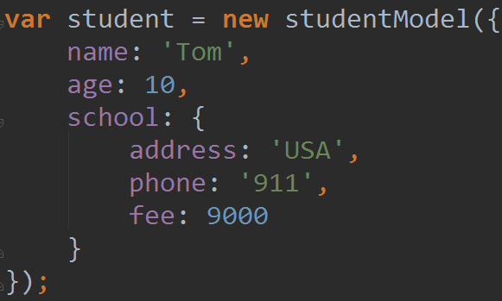
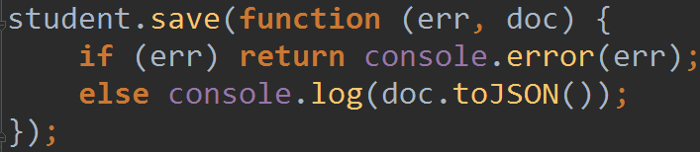
5
Model
Insert document: (1) document.save()

Slide 25
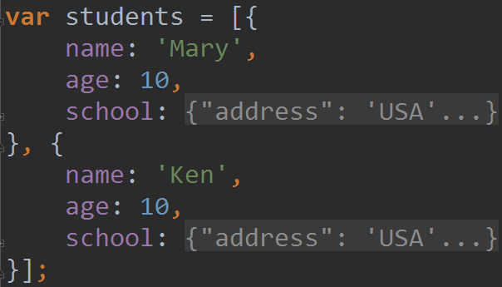
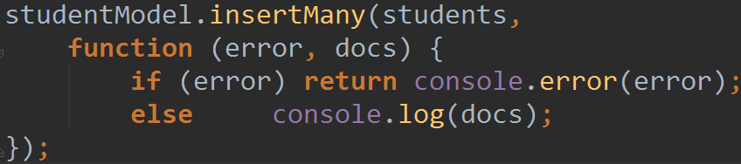
5
Model
Insert document: (2) Model.insertMany()

Slide 26
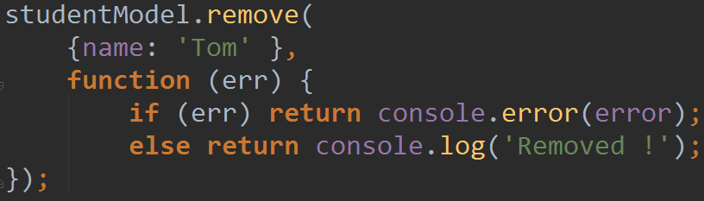
5
Model
Remove document: Model.remove()

Slide 27
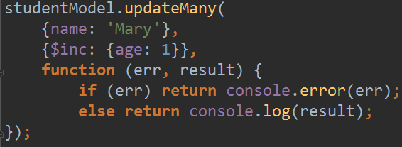
5
Model
Update document: Model.updateMany()
Query
Update

Slide 28
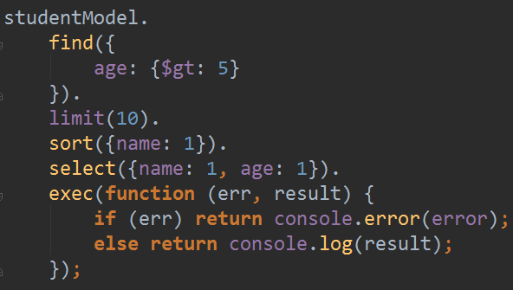
5
Model
Find document: Model.find()
Query
Limit
Sort
projection

Slide 29
5
Model
Reference:
http://mongoosejs.com/docs/models.html
http://mongoosejs.com/docs/queries.html

Slide 30
6
Middleware

Slide 31
6
Middleware
Built-in validators:

Slide 32
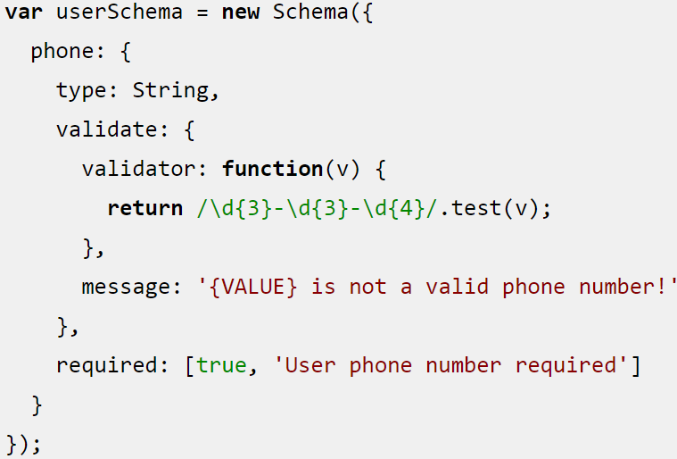
6
Middleware
Custom validators:

Slide 33
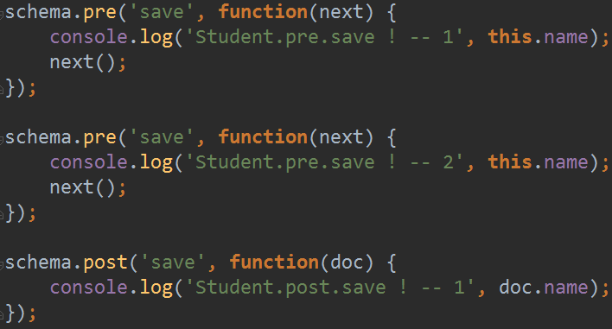
6
Middleware
hooks: .pre & .post

Slide 34
6
Middleware
hooks:
Be careful:
Model.insertMany() will NOT trigger ‘pre’ & ‘post’ hooks on ‘save’

Slide 35
6
Middleware
Reference:
http://mongoosejs.com/docs/middleware.html
http://mongoosejs.com/docs/validation.html

Slide 36
@
http://mongoosejs.com/docs/index.html
Sample code:
\db\mongodb\2017\materials\sample_code\CH5_mongoose

Slide 37
@
http://www.cnblogs.com/irocker/tag/mongoose/
Chinese ver.

