Slide 1
Development Skills
Powerful development Utils Sharing
Jason Cui
2017-08-31

Slide 2
Table of content
Environment Setup
Common Useful Configuration
Cmder : (Personal Recommend)
IDEA: (Personal Recommend)

Slide 3
1
Environment Setup

Slide 4
1
Environment Setup
Basic requirement
**Mandatory Installation & Settings**
- Node.js
**Optional Installation & Settings** (For better network settings in mainland china / better development experience)
- VSCode
- Yarn
**Personal Suggestion**
- Node.js with NPM 5.X
- IntelliJ IDEA
- Yarn with mainland china registry
- Cmder for better windows terminal ui

Slide 5
2
Common Useful Configuration

Slide 6
2.1
Common Useful Configuration
npm & yarn
Do not use “npm install cnpm -g” (combo x3)
Keep npm config clean
Install Yarn
Upgrade yarn register to taobao npm registry

Slide 7
3
Cmder

Slide 8
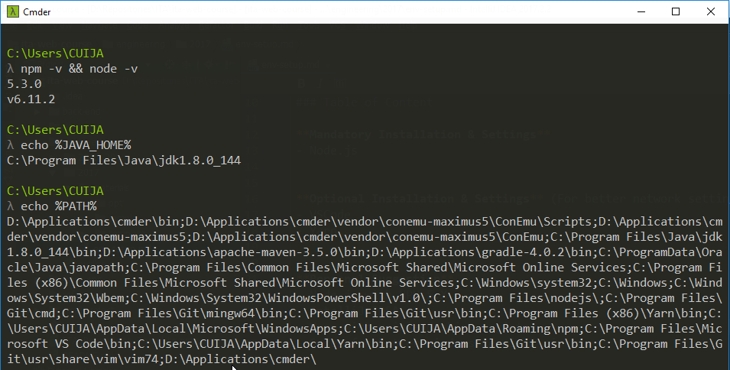
3.1
Cmder
Installation
Unzip and install it

Slide 9
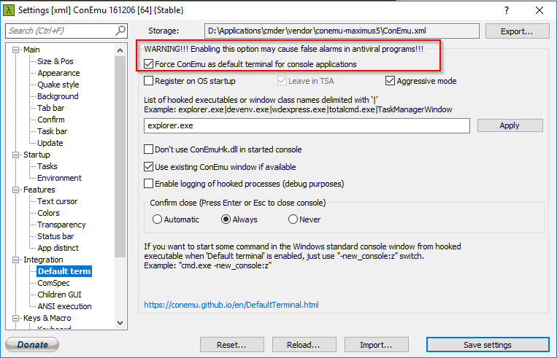
3.2
Cmder
Optional configuration
Set as your default terminal app

Slide 10
4
IntelliJ IDEA

Slide 11
4.1
IntelliJ IDEA
Benefits
FullStack Support all in one (Java, JavaScript, Web, Python …)
Powerful Integration features(npm,node.js, webpack, npm, gulp)
Increase Productivity 10 times

Slide 12
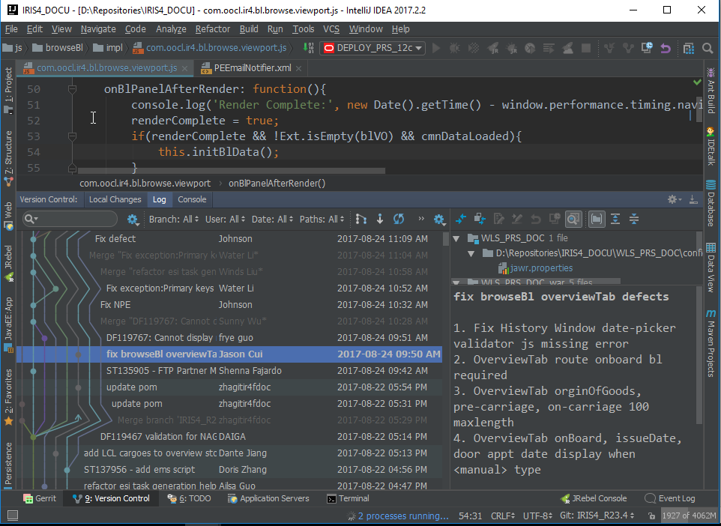
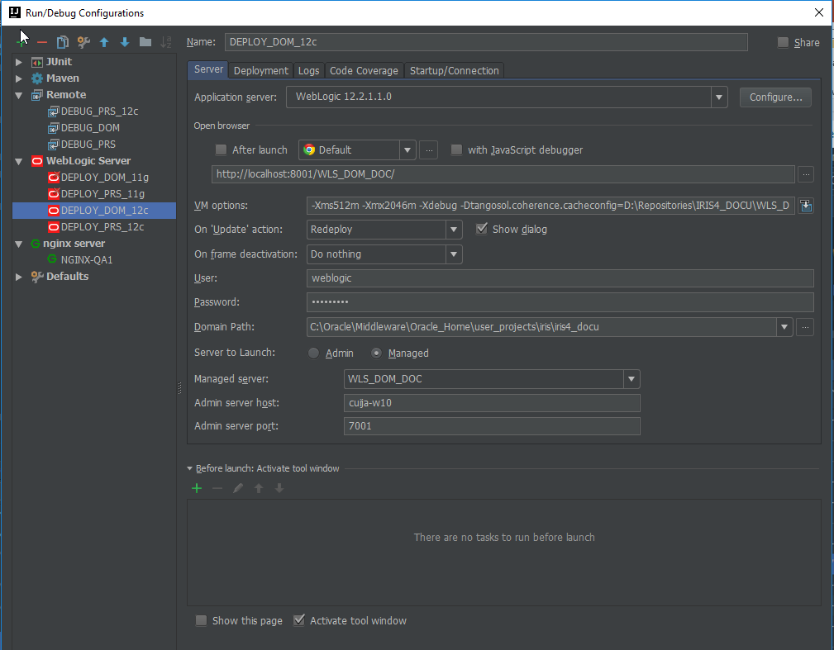
4.2
IntelliJ IDEA
Bundled Integration
Java Side: Spring, Tomcat, Weblogic, Maven, Gradle
VSC: Git, Github
JavaScript: Node, NPM, Gulp, Webpack, Angular(AngularJS), React, Vue
Others File Types: markdown, gitattributes, template engine files..

Slide 13
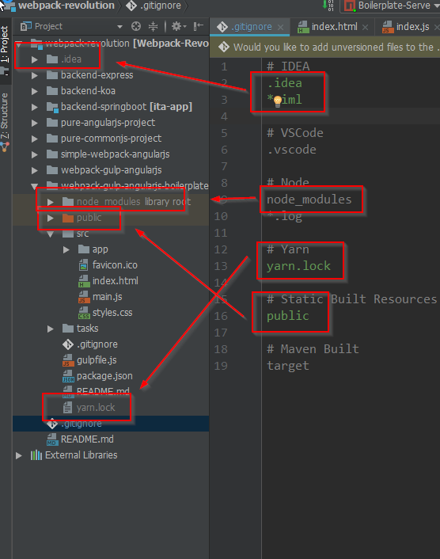
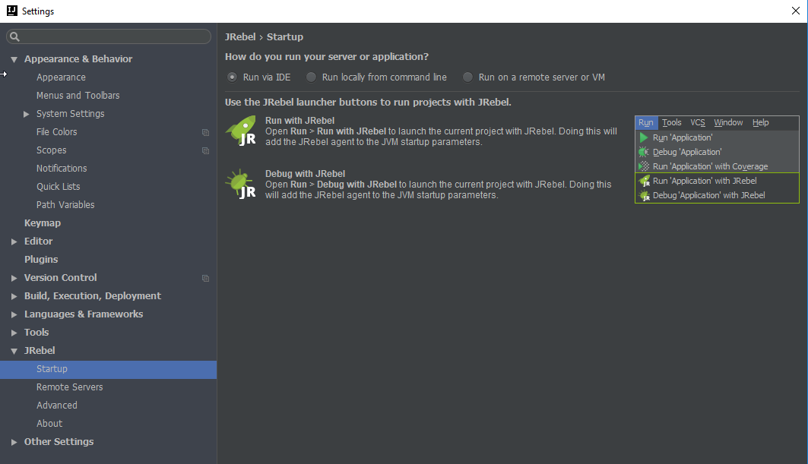
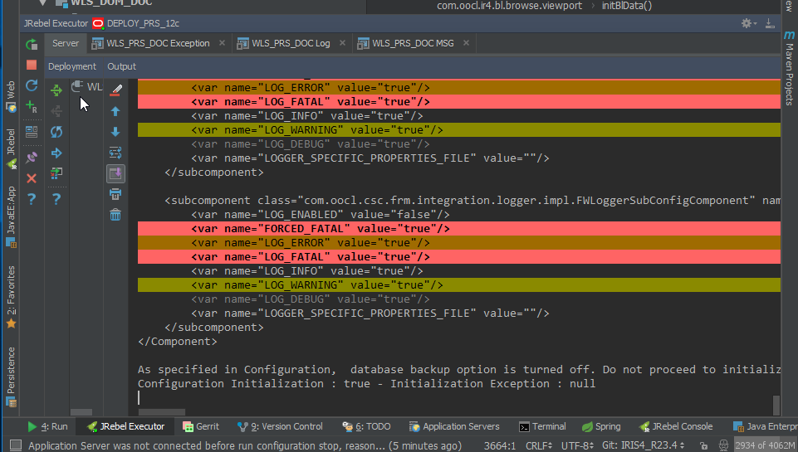
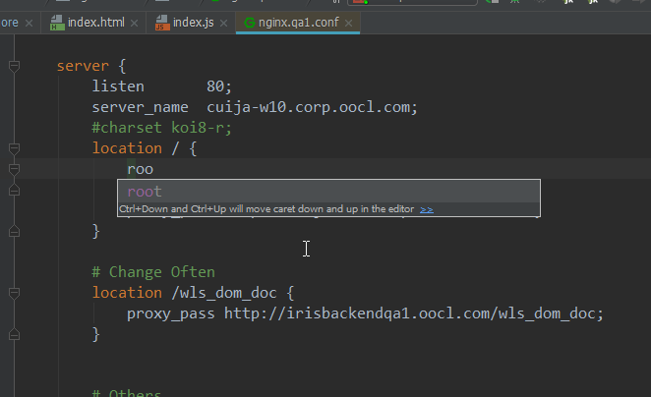
4.3
IntelliJ IDEA
Useful Plugins
.ignore
Grepconsole
JRebel (For Java)
Nginx
Bash & CMD Support

