Slide 1
aegis_40566
IRR
LTD
cosmos_32842
LTD
ETD
goodsn_12606
ETD
LTD

Slide 2
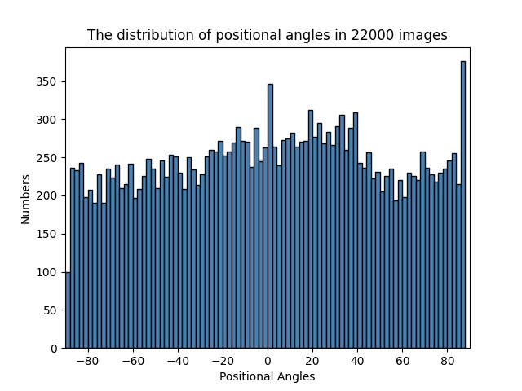
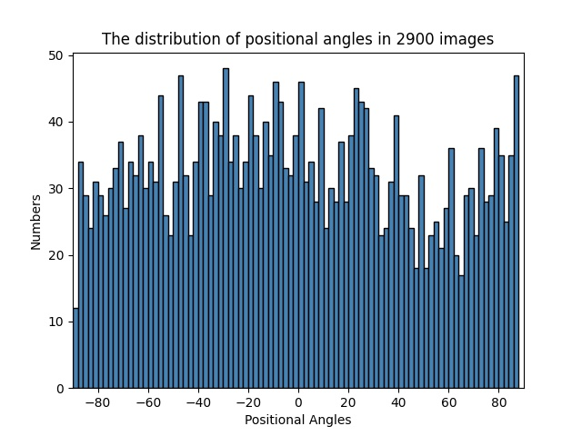
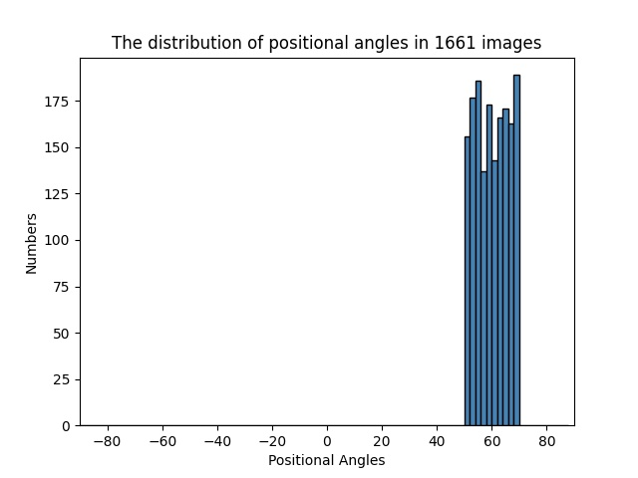
a)
similar
angle
distributions
b)
different
angle
distributions
c)
Training set 1
Test set
Training set 2
similar angle
distribution
d)
e)
different angle distribution
after rotation
The overall accuracies of the test set.
The training set 2
The overall accuracies of the test set.
The training set 1

Slide 3
a)
similar
angle
distributions
b)
different
angle
distributions
c)
Training set 1
Test set
Training set 2
The overall accuracies of the test set.
The training set 1
The overall accuracies of the test set.
The training set 2
d)
similar angle
distribution
e)
APCT is
angle distribution free
different angle
distribution
after rotation
angle distribution
dependent

Slide 4

a)
similar
angle
distributions
b)
different
angle
distributions
c)
Training set 1
Test set
Training set 2
The overall accuracies of the test set.
Model trained on the training set 1
The overall accuracies of the test set.
Model trained on the training set 2
d)
e)
APCT is
angle distribution free
The accuracies are smaller
due to the smaller size of training set
The accuracy drops
due to different
angle distributions
The high accuracy
is due to the ‘similar angle distribution’

Slide 5
d)
e)
different angle distribution
after rotation
The overall accuracies of the test set.
The training set 2
The overall accuracies of the test set.
The training set 1

Slide 6
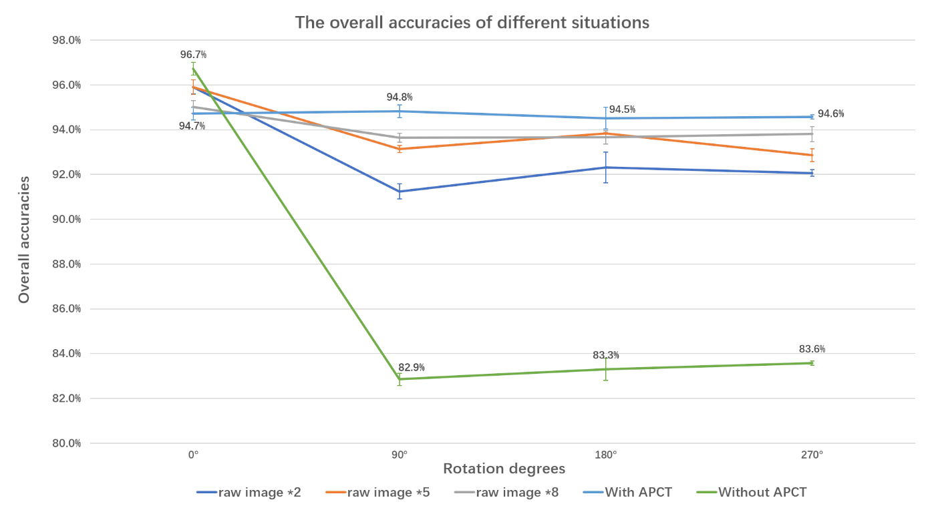
The accuracies on rotated test set rise due to the differences between angle distribution is reducing after data augmentation
The accuracies on raw test set drop due to the emergence of
angle distribution difference
after data augmentation

Slide 7
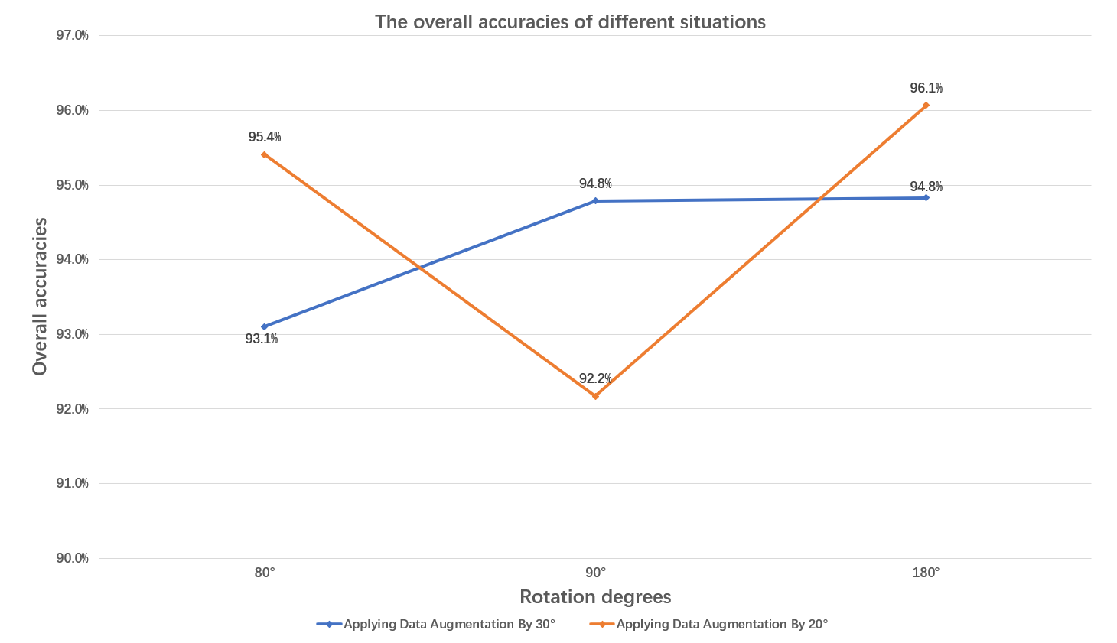
For the training set A, the model gives lower accuracy on test set rotated at missing angles, 90 degress here.
For the training set B, the model gives lower accuracy on test set rotated at missing angles, 80 degrees here.

Slide 8
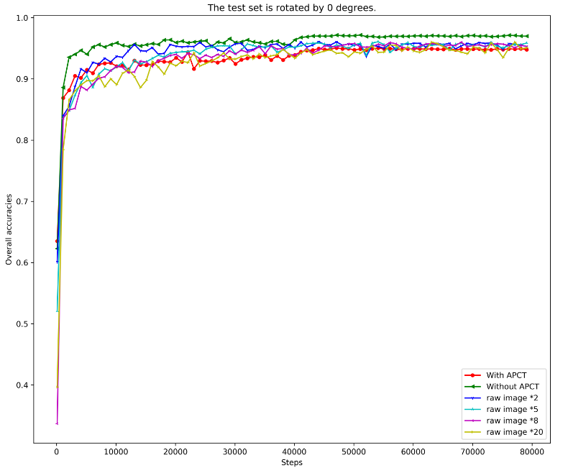
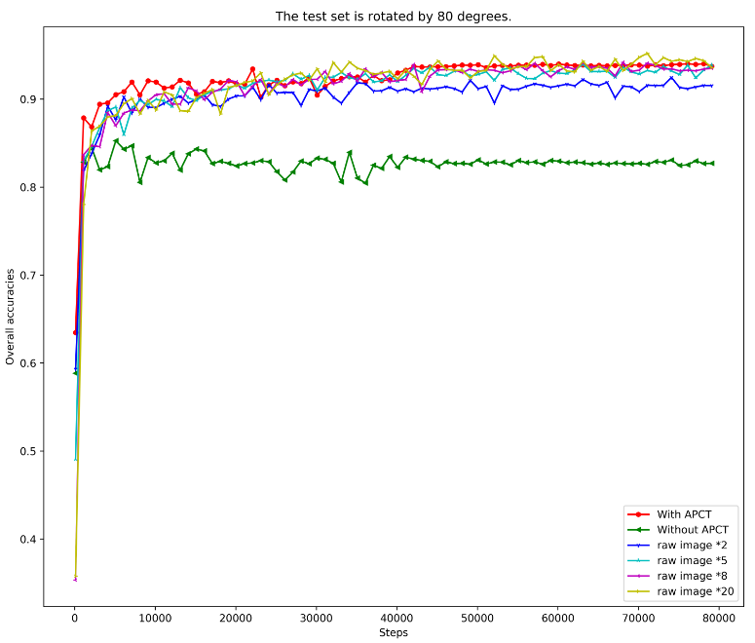
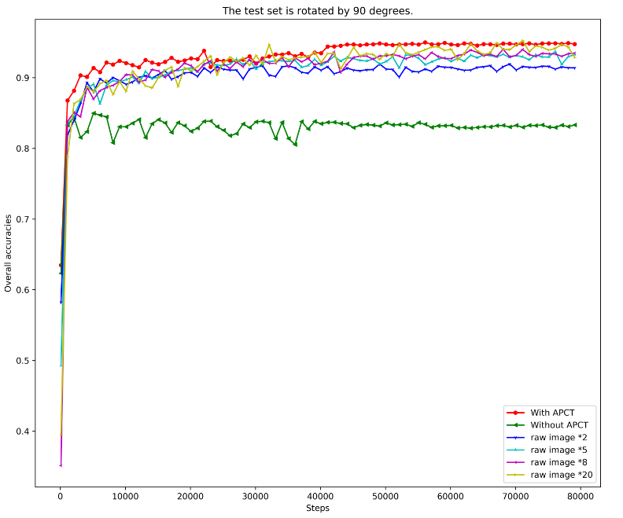
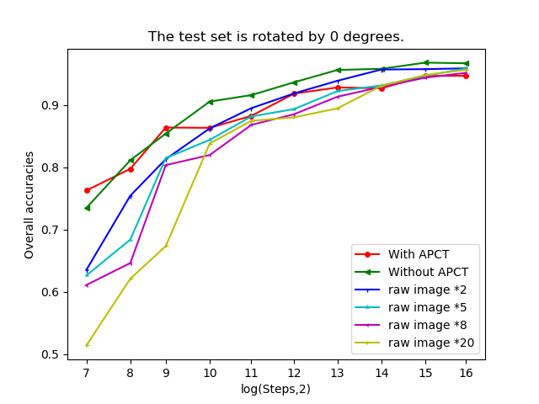
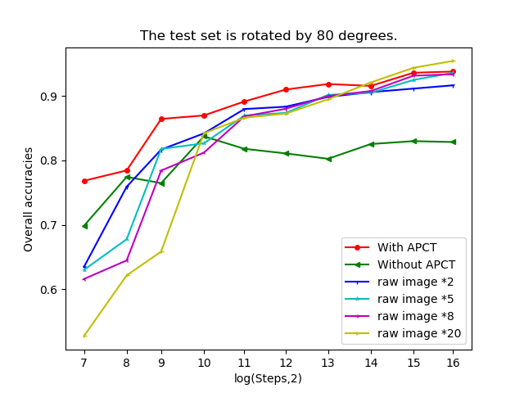
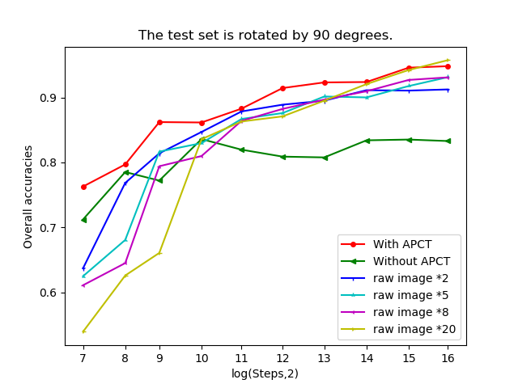
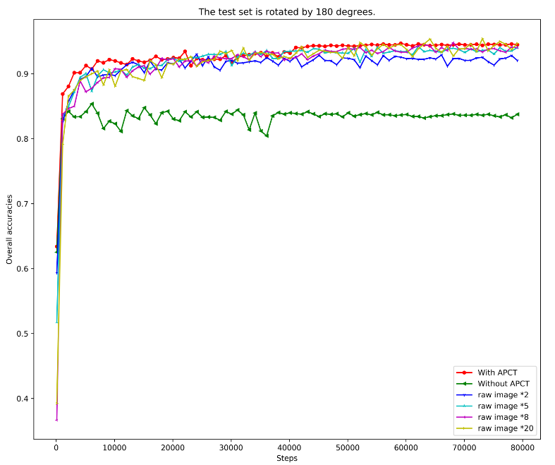
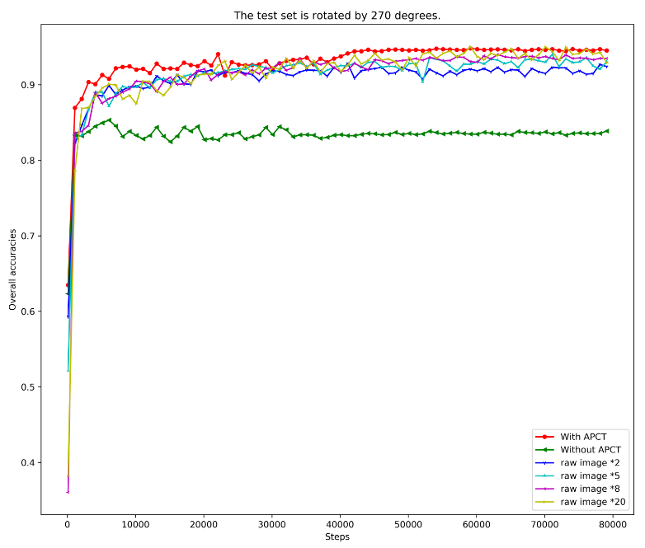
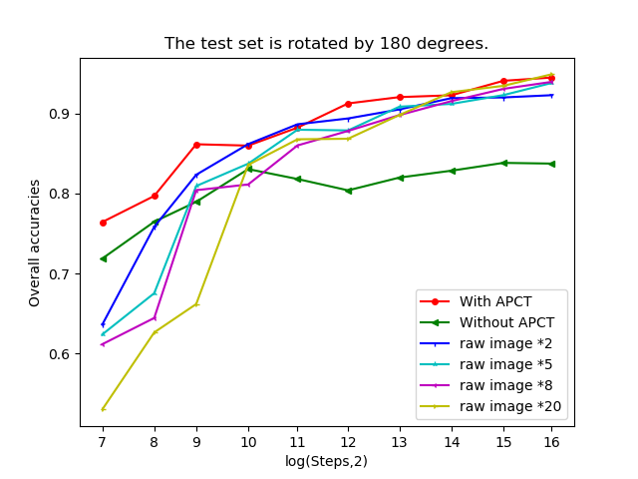
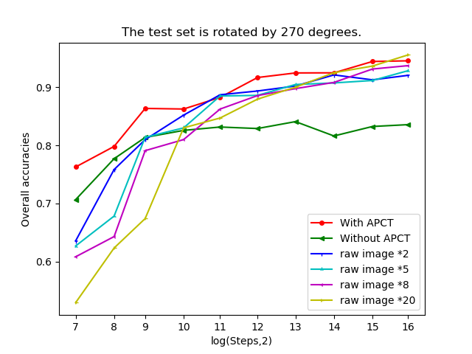
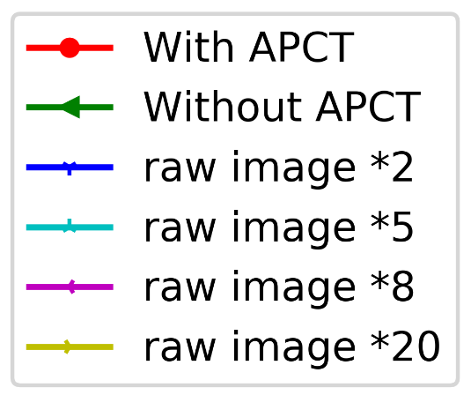
a) Test set rotated at 0 degree
b) 80 degrees
c) 90 degrees
Log scale
of steps
APCT converges faster during
training, except for 0 degree
d) 180 degrees
e) 270 degrees
The more rotated images are
added, the closer accuracies with
that of APCT

Slide 9
a) Test set rotated at 0 degree
b) 80 degrees
Log scale
of steps
c) 90 degrees
d) 180 degrees
APCT converges faster during training, except for 0 degree
e) 270 degrees
The more rotated images are
added, the closer accuracies with that of APCT

Slide 10
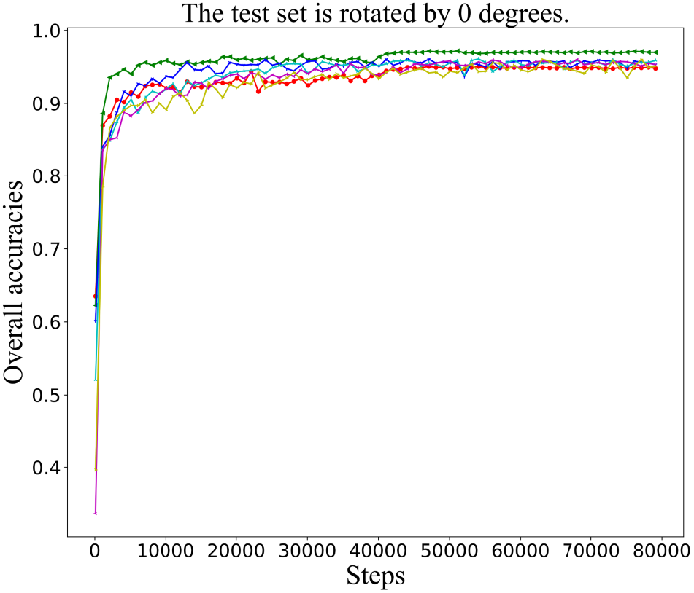
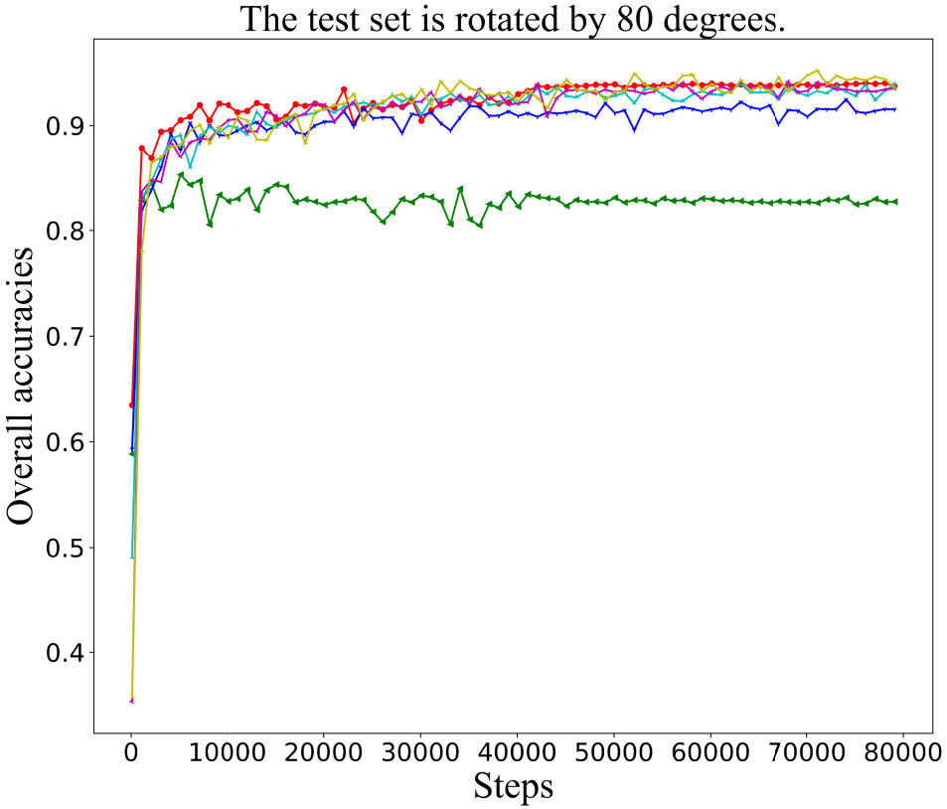
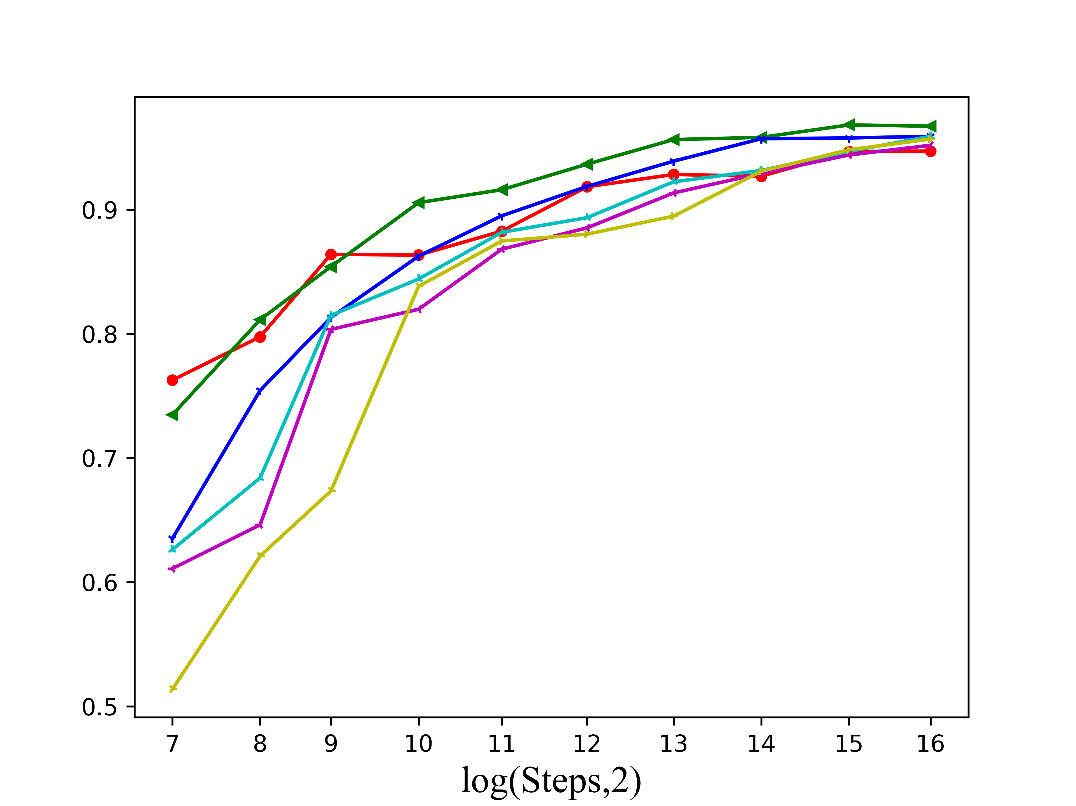
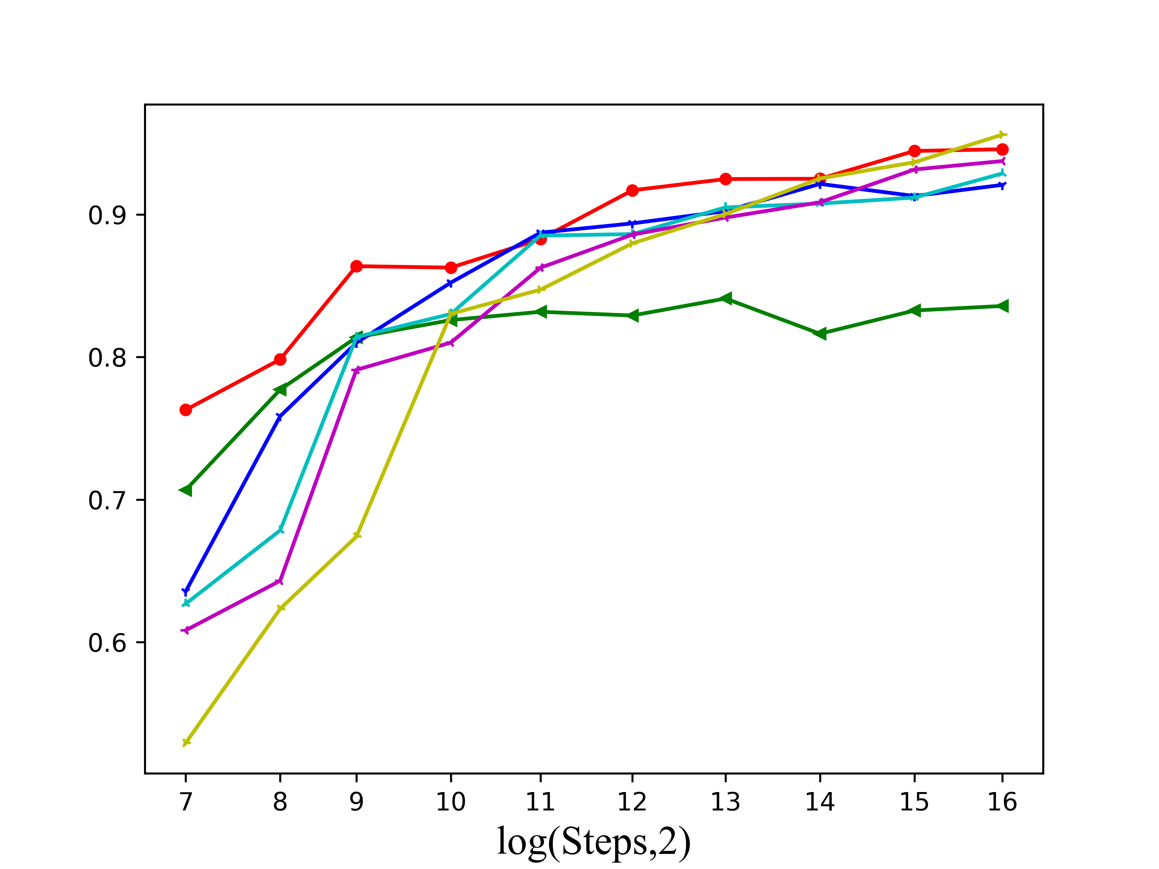
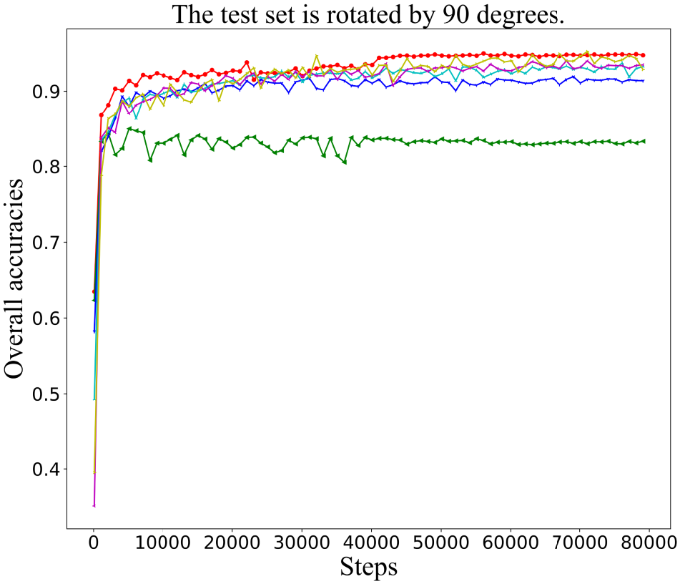
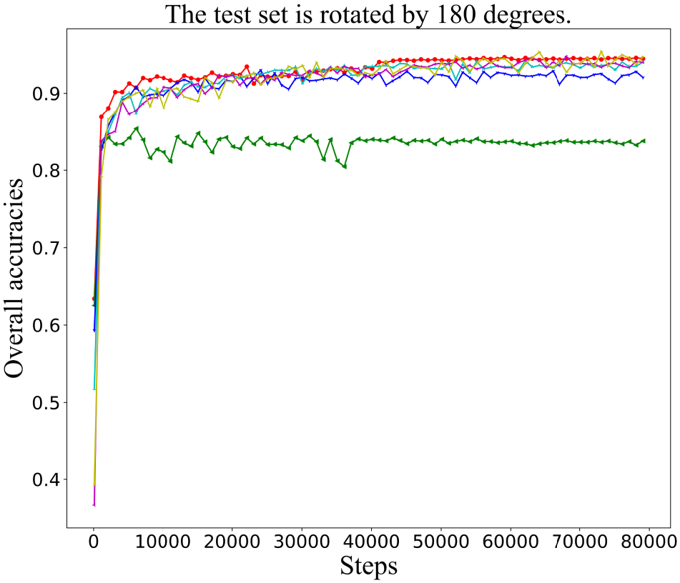
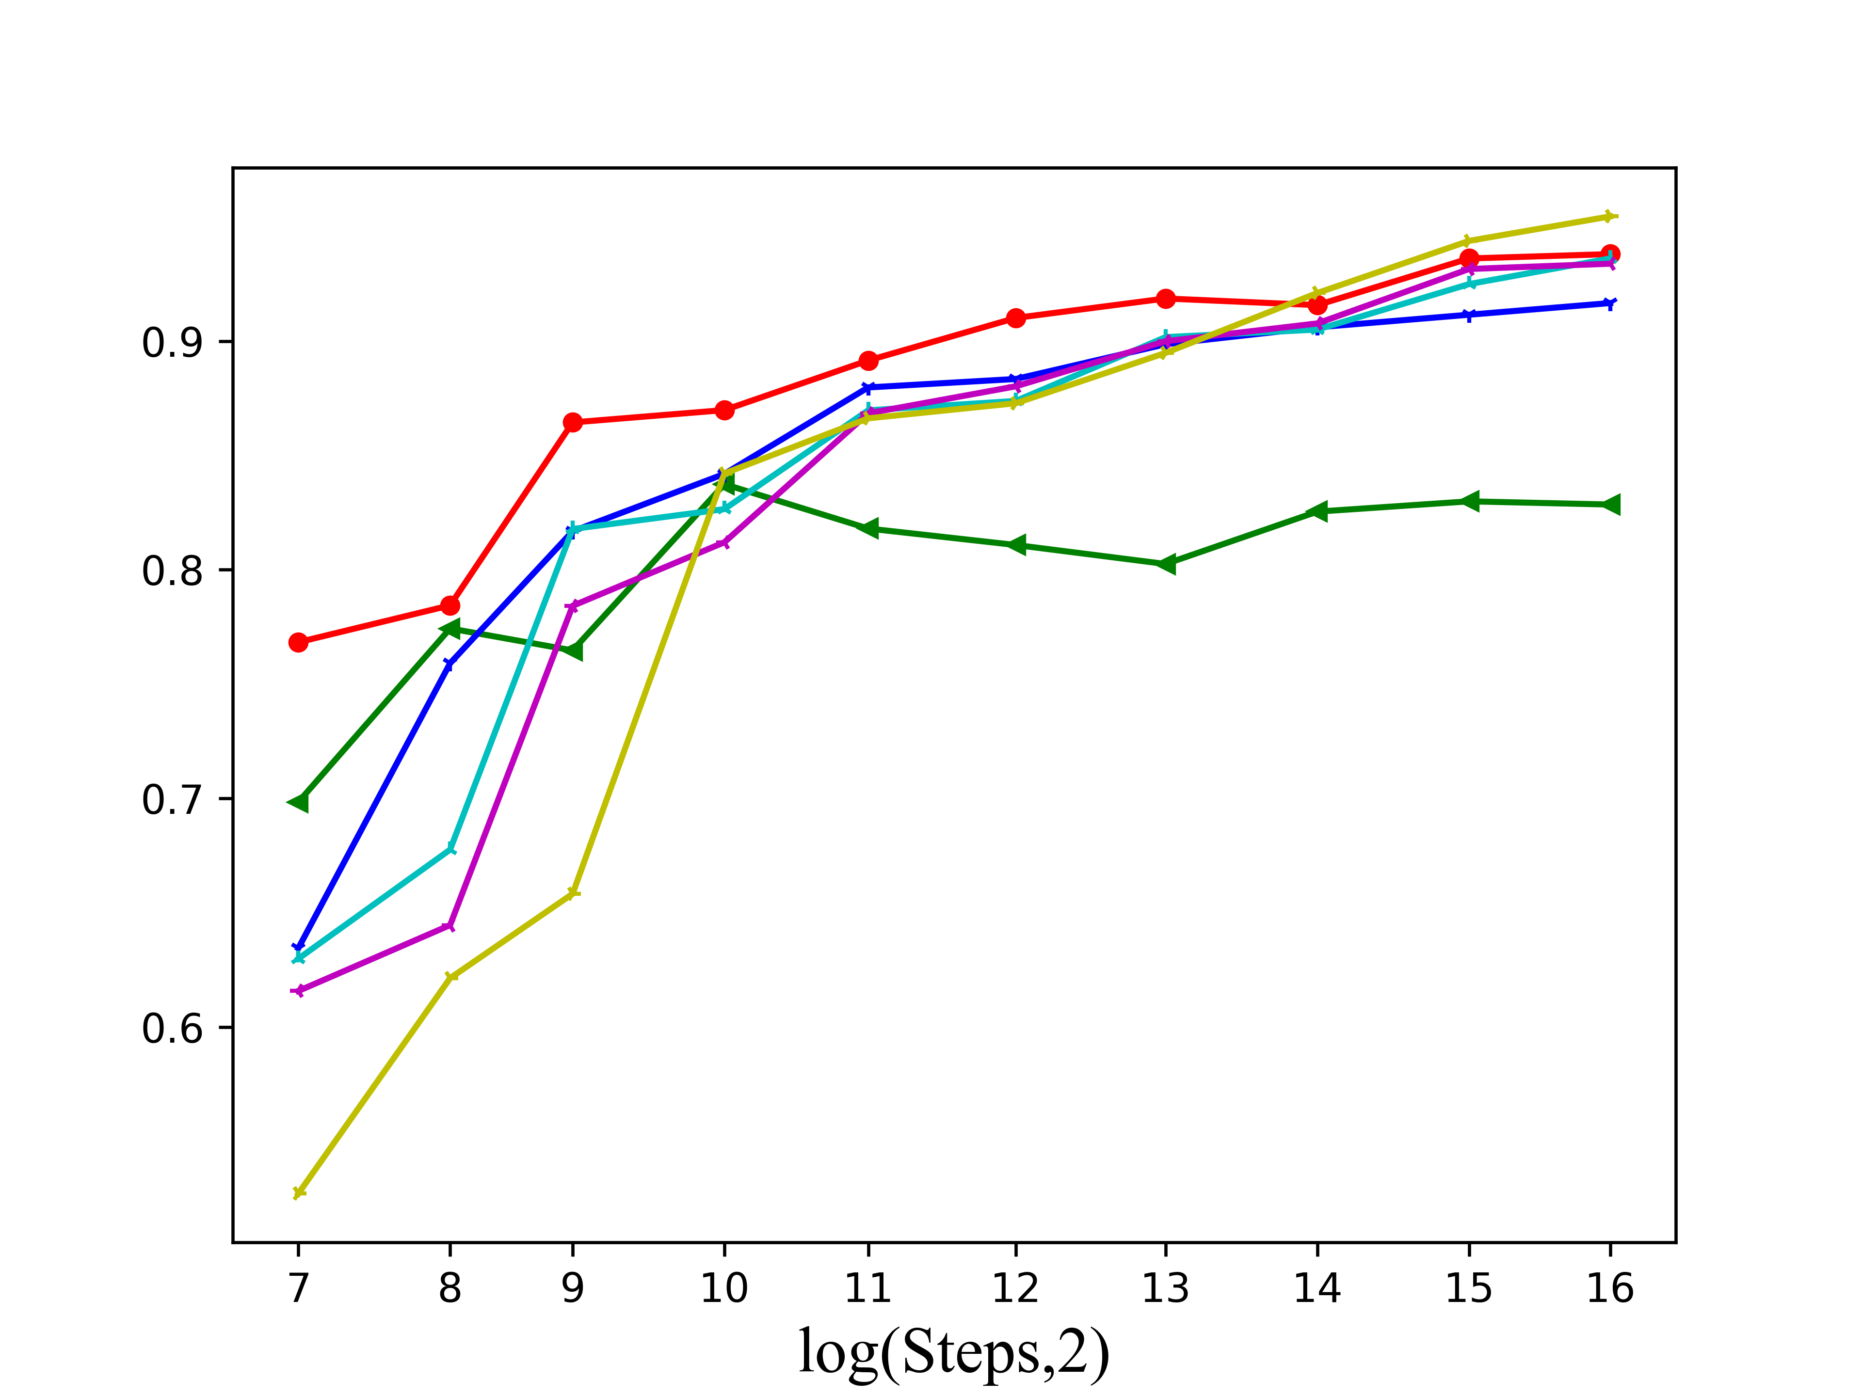
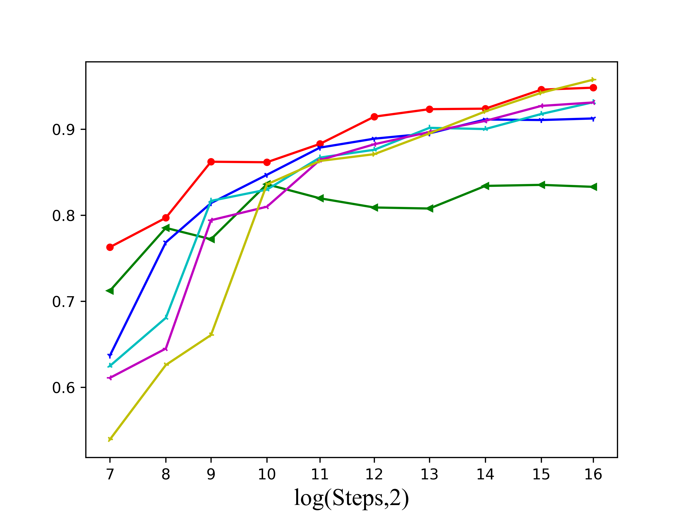
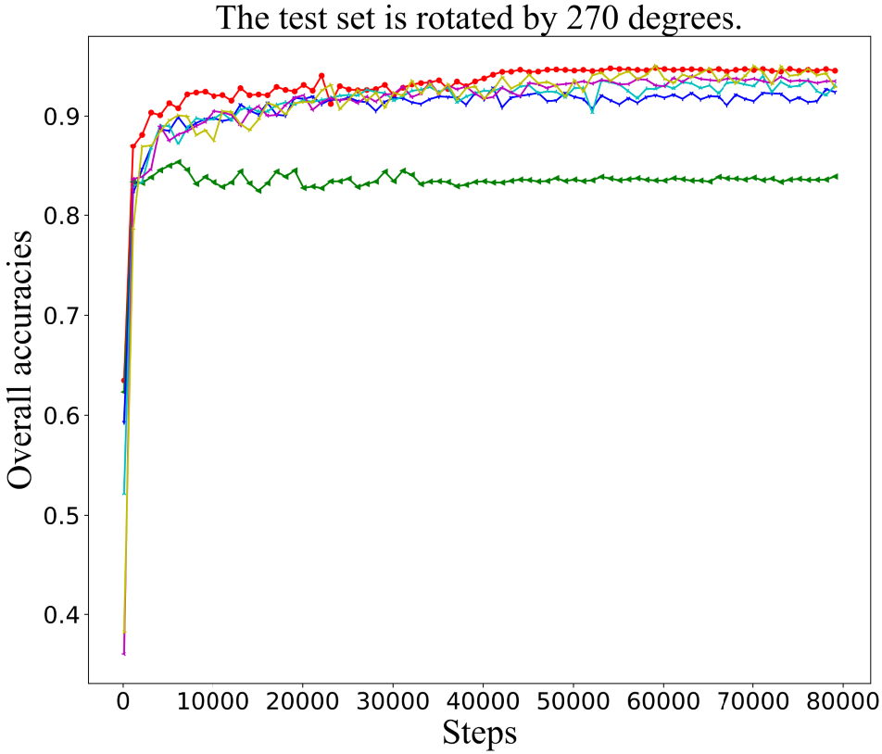
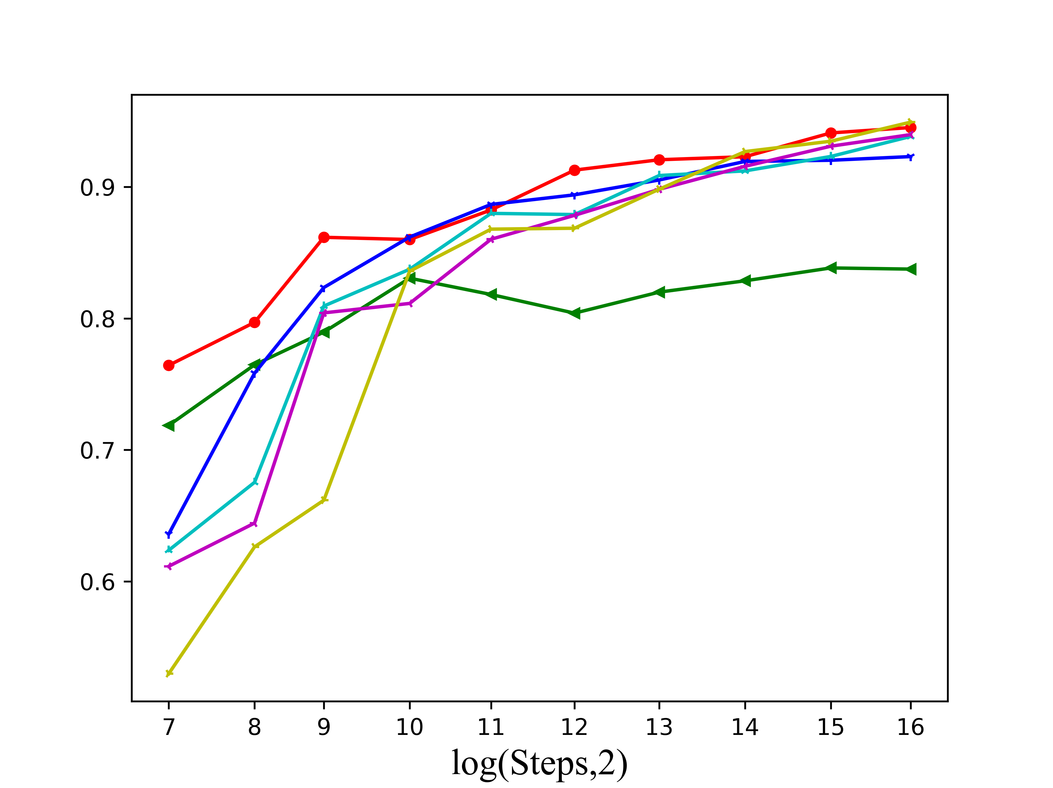
APCT converges faster during training, except for 0 degree
The more rotated images are added, the closer accuracies with that of APCT

