Slide 1
No time. No designer. Still beautiful!
Using component libraries to help design beautiful web apps when time isn’t on your side and you don’t have a designer

Slide 2
Who am I?
Sarah Williams
CTO @ Nightingale HQ
Consultant @ Yellow Brick Code
Cloud native architect
75% stack developer
Notes:
75% stack developer
So my LinkedIn says full stack developer, but I’ve started using 75% stack
How many of you would class yourselves as full stack developer?

Slide 3

What’s a 75% stack developer?
15%
75%
10%
Notes:
Full stack means different things to different people, definition is getting broader all the time
The glass is my stack
Top 15% is the real creative stuff and heavy, amazing CSS
Middle 75% is a bit of CSS & markup, front end engineering, back end engineering through to some light DB knowledge (e.g. SQL I know the basics, querying, joins, indexes etc)
Bottom 10% is the deeper knowledge of DB and networking etc that a back-end developer would probably know
Prefer backend but got into front end in 2012, fell in love with Knockout then was lead front end developer on a greenfield project

Slide 4
How did I get to this point?
Short on time
Don’t have a designer
Not very creative
Not great at CSS
Notes:
Nightingale HQ building an online platform for AI, needs a web app and an API
Short on time
Building for a startup
Need to get something out there ASAP for validation
Doesn’t need to be perfect or amazing, but also don’t want it to look rubbish and kill our first impression
Don’t have a designer
Again, startup, pre-revenue & pre-funding
Not very creative
I’m a typical non-creative. Happy to give feedback on designs, but can’t create them myself
My branding and images are courtesy of my wife who’s an illustrator and very creative person
Not great at CSS
My knowledge is a bit out of date
Not great at it because I don’t enjoy doing it

Slide 5

How do I get what’s in my head out and on the screen?
Notes:
I could see what I wanted in my head
Worked with amazing UX & UI designer and been doing web for 12 years so I understand it
It would take ages to get it onto the screen
When on screen, it wouldn’t look as good as in my head
Used things like Bootstrap in the past,
We’re using Vue (felt most natural to me) so looked to see what was around for Vue
Found Vuetify and it ticked a lot of boxes

Slide 6
Let’s build a Lego catalogue!
I want to keep track of what Lego kits I have, which ones I’ve built and how many pieces they have
Notes:
No live coding, I’m not crazy!

Slide 7

The challenge
15 minutes
Notes:
If I hadn’t given myself a limit I could have spent forever tweaking and perfecting

Slide 8
Component 1: The base layout
Needs to be responsive
Needs a way to navigate the web app
Notes:
Layout is complicated
Making something responsive etc isn’t easy. So many ways to do it now!
Decided to go with CSS grid and I’d never used that before so I did a little research on the basics before the 15 minutes

Slide 9
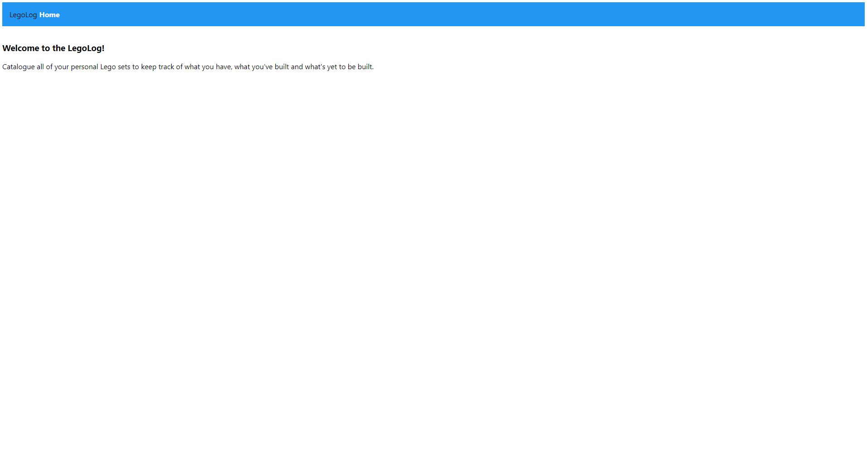
Component 1 – The results…
Notes:
The basics are there
Couldn’t get the grid to work, didn’t want the content here to be full width
Never implemented CSS grid before, knew very little about it in practical terms. Had a read through some basics before starting the 15 minute timer

Slide 10
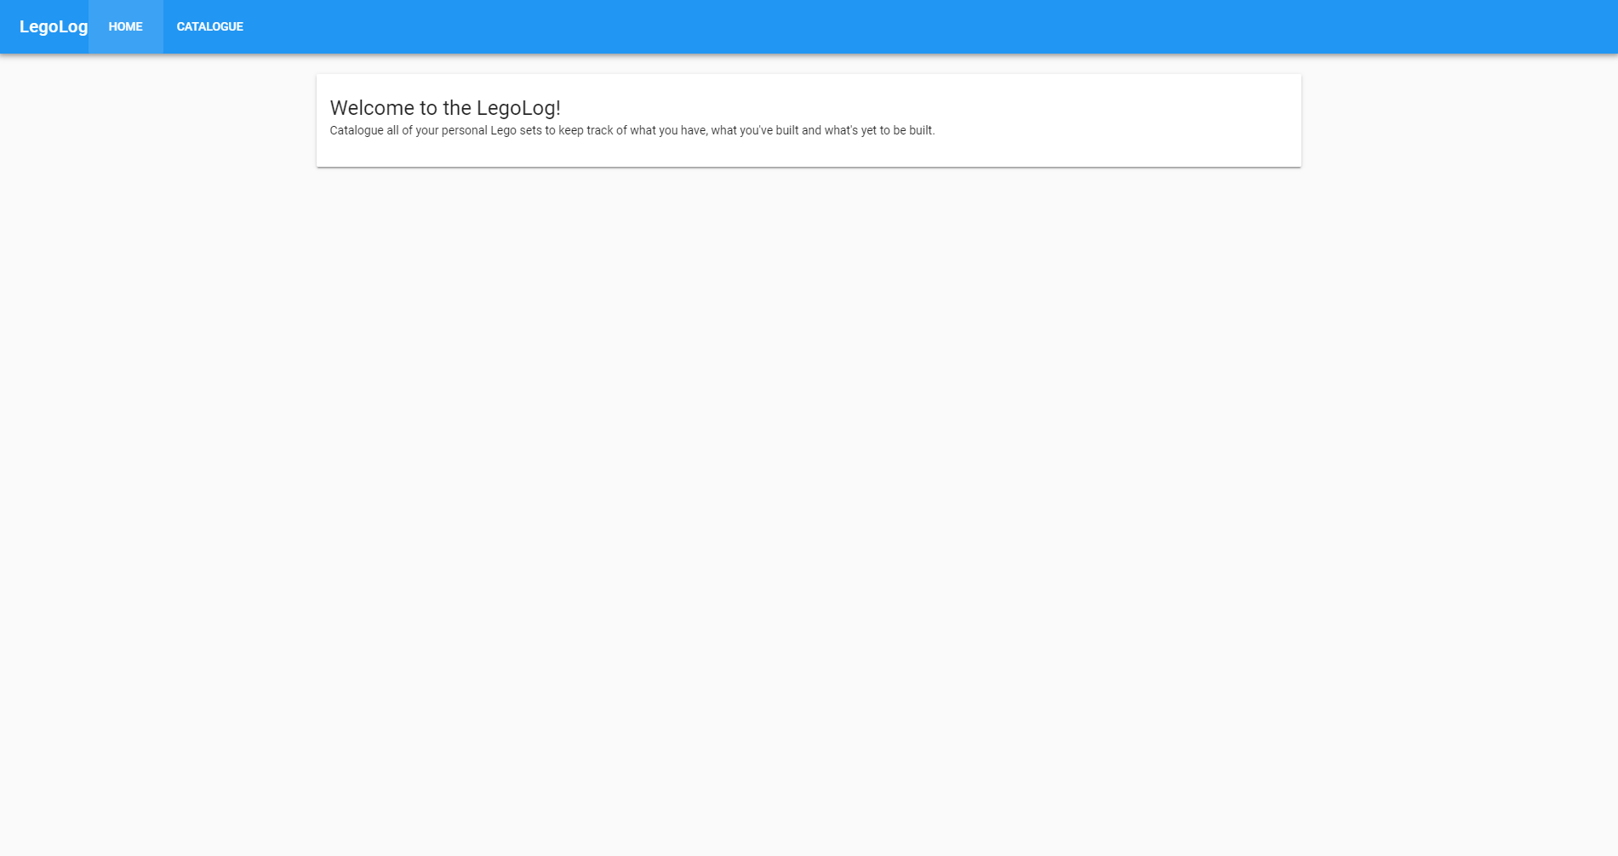
Component 1 – The results…
Notes:
Was much easier and quicker
Layout was as I wanted it
Even had time for some refactoring

Slide 11
Component 1 – The stats
Solo
Supported
Markup = 12 lines
CSS = 27 lines
JS = 0 lines
Markup = 29 lines
CSS = 0 lines
JS = 6 lines
Notes:
Supported has more markup partly because I managed to finish the basics in time to refactor and start moving things out into different pages
Supported has zero CSS required!
Show the code

Slide 12
Component 2: Search
Needs to be easy to use
Should offer suggestions as you search

Slide 13
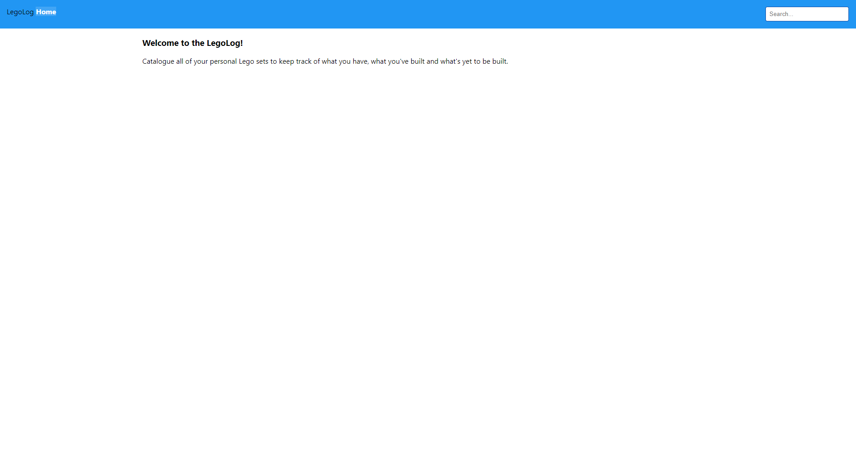
Component 2 – The results…
Notes:
There’s some improvements!
Figured out the CSS grid problem I was having
Added the search and did some basic styling
Had time to refactor a little and get the home content moved into its own view and wire up the router
Didn’t have time to implement the auto suggest drop down

Slide 14
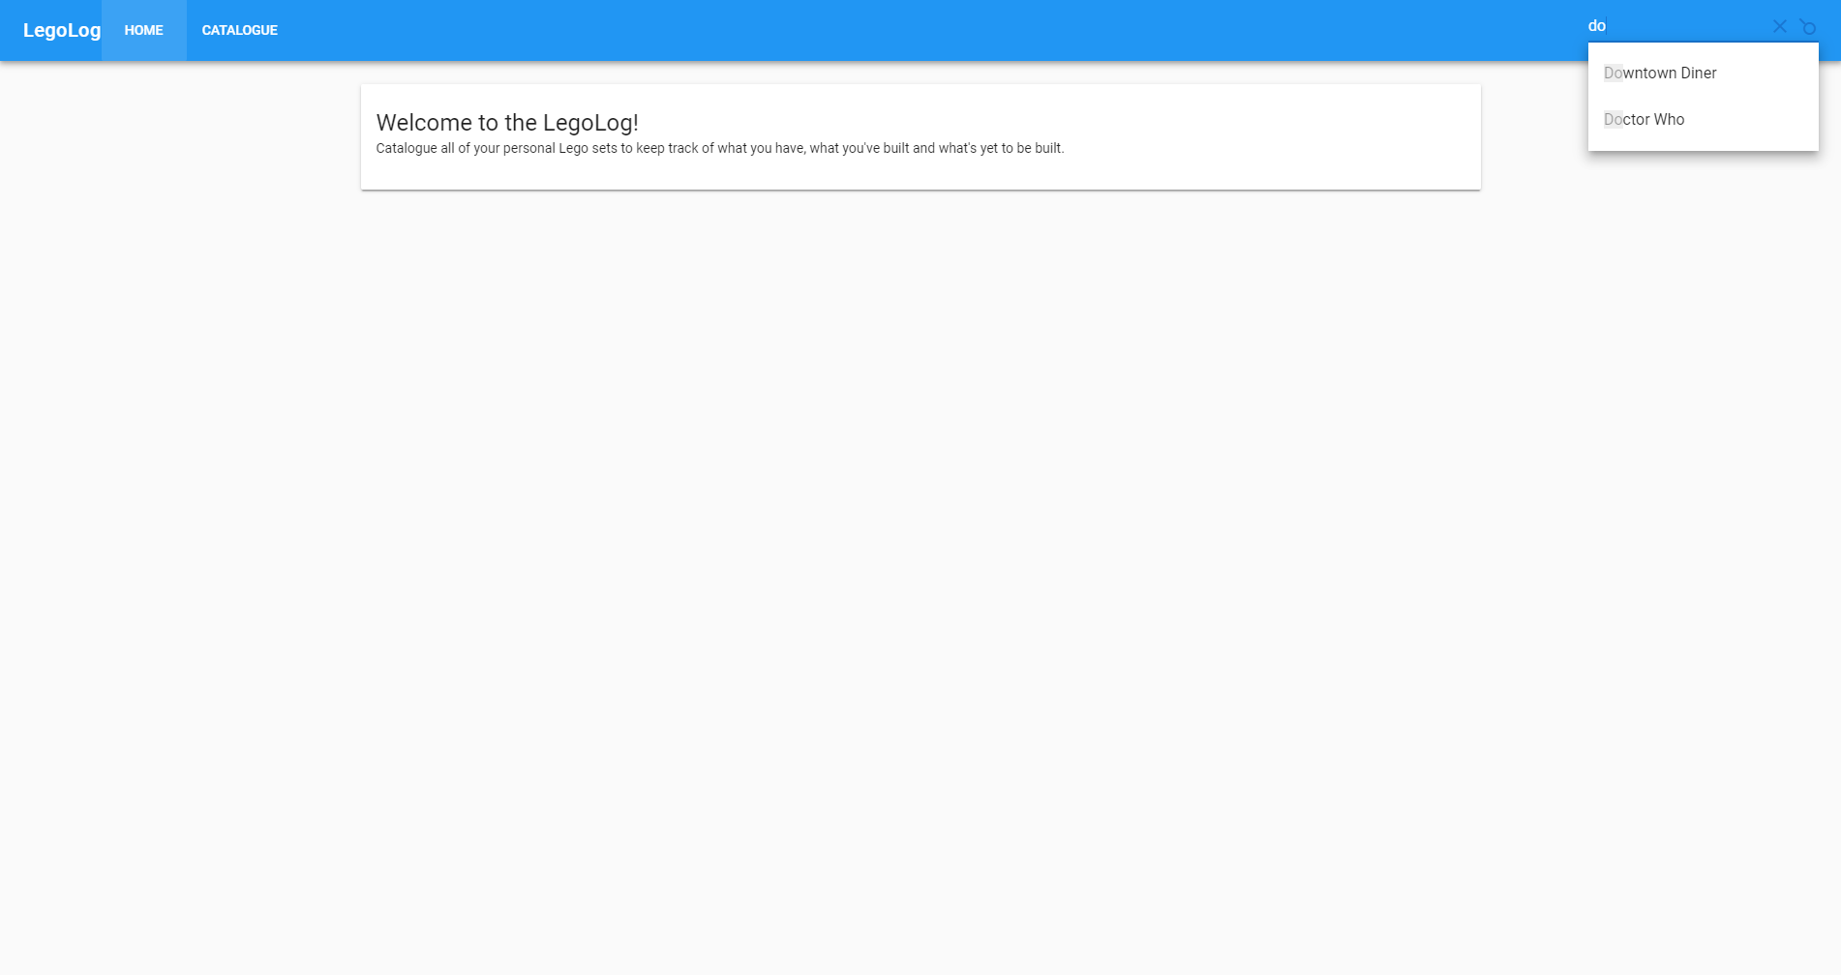
Component 2 – The results…
Notes:
Used the Vuetify autocomplete component
Was pretty quick, longest part was the JS to get the search part working

Slide 15
Component 2 – The stats
Solo
Supported
Markup = 9 lines
CSS = 16 lines
JS = 3 lines
Markup = 14 lines
CSS = 0 lines
JS = 30 lines (20 of those were data)
Notes:
Zero CSS again!
Lot of JS in Supported but 20 of those were data for the catalogue
Show the code

Slide 16
Component 3: The catalogue
Needs to display information about all the kits in the catalogue
Should have pagination

Slide 17
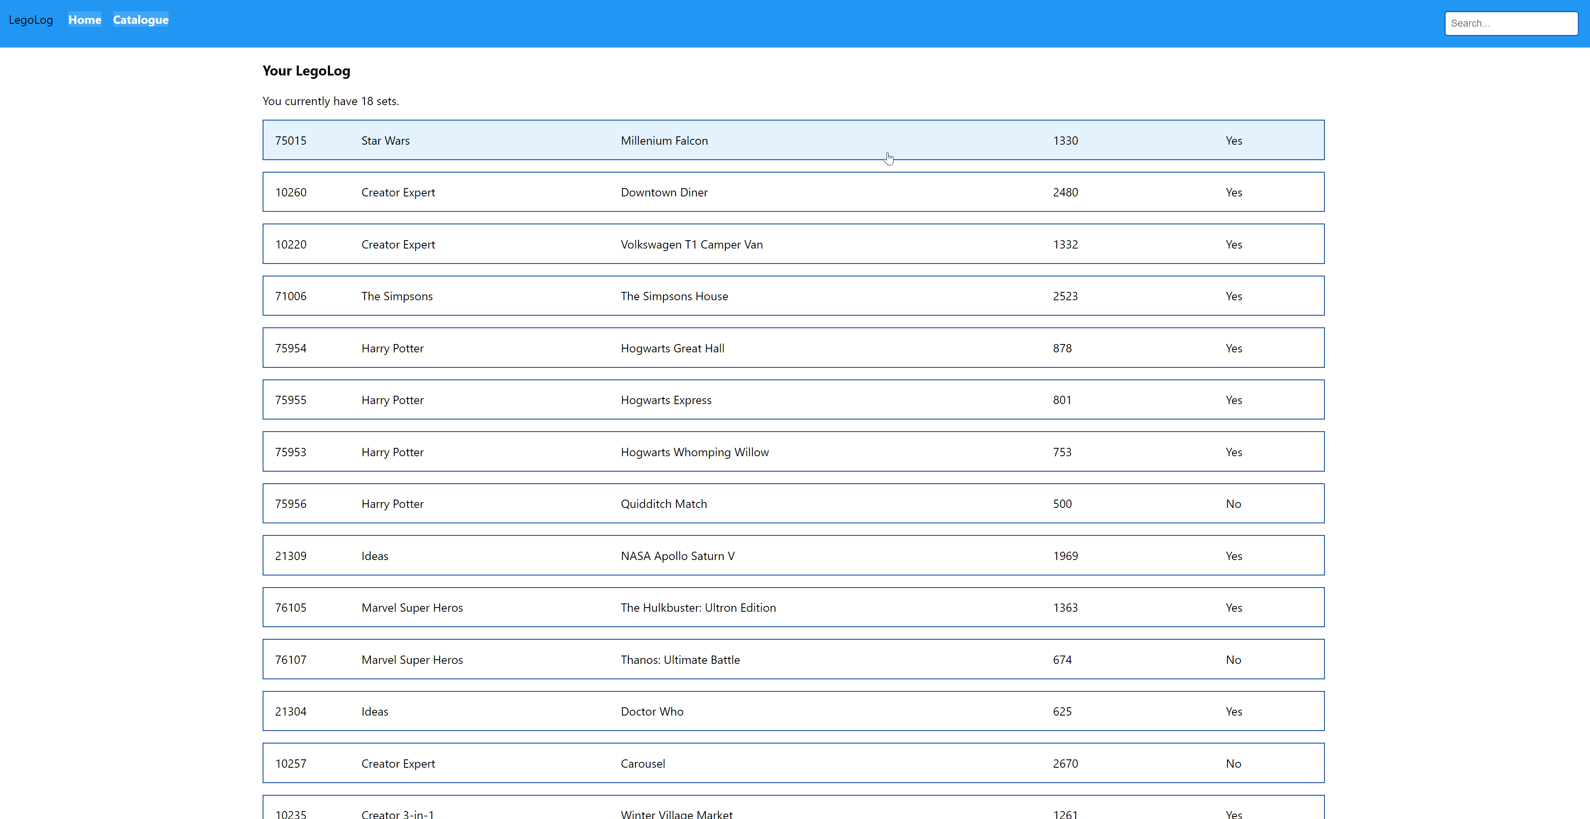
Component 3 – The results…
Notes:
Not too bad to get the basics in place
Now have some familiarity with CSS Grid. No idea if I’m using it right, but it’s doing what I want at least
Added the catalogue page and wired it all up to the router
Run out of time before I got to figuring out anything for pagination

Slide 18
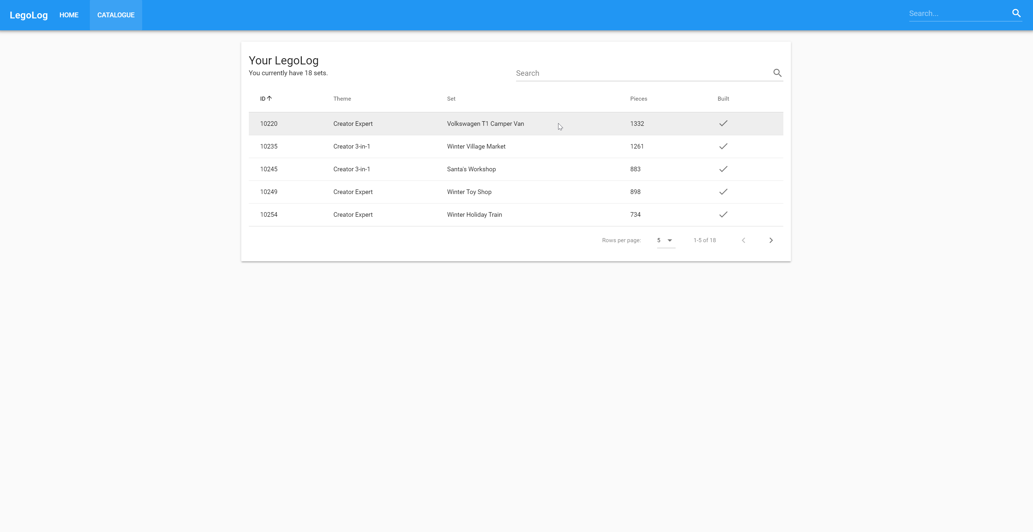
Component 3 – The results…
Notes:
Went with a data table as it was the most similar to what I’d done in the solo version
Got sortable columns, pagination and a search with very little extra effort required
I only added the search because I had a few minutes left and didn’t know what else to do with the time!

Slide 19
Component 3 – The stats
Solo
Supported
Markup = 19 lines
CSS = 45 lines
JS = 40 lines (22 of those were data)
Markup = 38 lines
CSS = 0 lines
JS = 16 lines
Notes:
Solo
Most CSS so far!
Lots of JS but again just over half of that for data
Supported
No CSS again!
Show the live examples

Slide 20
The good parts
Saves a lot of time
You don’t need to be a good designer
You don’t need to be good at CSS
They’re well tested
They use familiar UX patterns
Notes:
Saves a lot of time
You can see the difference in 15 mins v 15 mins
You don’t need to be a good designer
Libraries are built by people who are creative and good at design
You don’t need to be good at CSS
Vuetify version needed zero CSS! Solo version was 88
For Nightingale I’ve had to write barely any CSS because I’ve also added Tailwind which gives me utility classes that help with small tweaks
Built by people who are very good at CSS and keep up with modern practices
They’re well tested
For cross browser compatibility
For different device sizes
Coverage of people testing these is huge because so many people are using them
They use familiar UX patterns
How likely is it someone using our web app hasn’t used YouTube or GMail?
You’re more likely to hit on functionality that people feel familiar with straight away

Slide 21
The bad parts
Tightly couples you to the chosen library
Your UI isn’t unique
It won’t cover everything
It’s not as good as having a dedicated designer & front-end developer
Notes:
Tightly couples you to the chosen library
Vuetify as an example, all the markup become Vuetify specific
To move away means re-writing all the templates
Your UI isn’t unique
The familiarity is a con as well as a pro
You might use the components in your own way, but it will be difficult to set your UI apart from others using the same library
It won’t cover everything
You’ll inevitably reach a point where you need to start tweaking things
Ideally a library will evolve with the web app
It’s not as good as having a dedicated designer & talented front-end developer
UI and UX isn’t easy!
You have to make your app fit the library, a designer will make a library that fits your requirements
It’ll do, but it’s not the best option long term

Slide 22
Best fit
Rapid prototyping
Minimum Viable Product (MVP) development
Small to medium projects
Open source projects
Teams without a dedicated designer
Notes:
Rapid prototyping & MVP development
Sort of what we’re doing at Nightingale HQ. Is it really worth us investing in a totally custom design before we’ve even validated our idea is something people actually want?
Small to medium projects
Especially good for internal projects
Anything large you’ll start to hit on more of the pains that come from the bad bits
Open source projects
If the project isn’t specifically about the design, they’re great
Teams without a dedicated designer
Not unique to startups

Slide 23
Other libraries
React
Material-UI
React Toolbox
Grommet
Vue
Vuetify
Keen UI
Buefy
Aurelia
Materialize Bridge
Angular
Material
PrimeNG
Notes:
React toolbox is also based on Material
Keen UI is inspired by Material
Buefy is components built with Bulma
Not many around for Aurelia yet!
Angular PrimeNG over 70 components with different themes. Used by eBay among others

Slide 24
Thank you!
I appreciate your time today and hope you found some of the information useful

