Slide 1
1 Introduction

Slide 2
Computer Networks & Distributed system
Computer Networks
A collection of autonomous computers interconnected by a single technology
Users are exposed to the actual machines
If the machines have different hardware and different operating systems, that is fully visible to the users
Distributed system
A collection of independent computers appears to its users as a single coherent system
A single model or paradigm 范式 that it presents to the users (web, …)
A layer of software on top of the operating system, called middleware, is responsible for implementing this model

Slide 3
1.2 Network Hardware

Slide 4
Transmission Technology and Scale

Slide 5
Transmission technology
Broadcast networks
Sending a packet to all destinations, each machine checks the address field
If the packet is intended for the receiving machine, that machine processes the packet
If the packet is intended for some other machine, it is just ignored.
Unicasting
Broadcasting
Multicasting (subscribe) / Anycasting 区分单播广播组播任播的必要性
Point-to-point networks
To go from the source to the destination, a packet may visit one or more intermediate machines (Often multiple routes are possible, finding good ones is important)

Slide 6
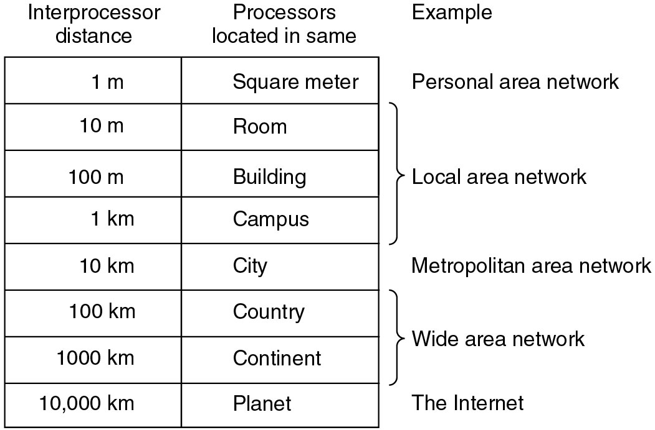
Classification by Scale

Slide 7
Personal Area Networks
(PAN)

Slide 8
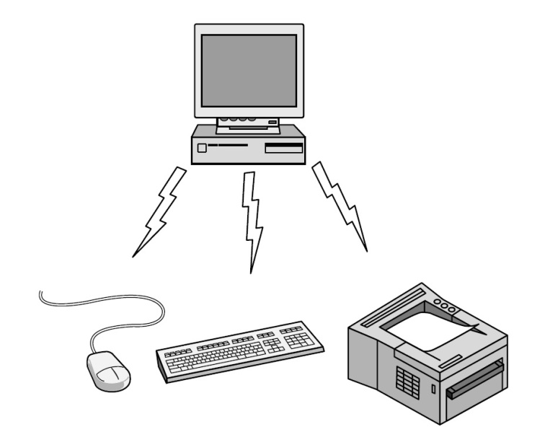
PAN
Bluetooth
Connects a computer with its peripherals
Master-slave paradigm
The PC is normally the master, talking to the mouse, keyboard, etc., as slaves
The master tells the slaves what addresses to use, when they can broadcast, how long they can transmit, what frequencies they can use

Slide 9
Local Area Networks
(LAN)

Slide 10
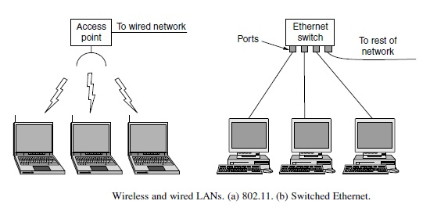
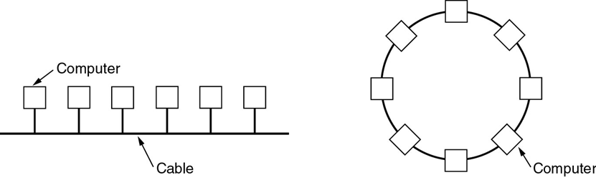
Topology
Bus & Ring

Slide 11
Channel allocation
(Static & Dynamic)
A typical static allocation
Divide time into discrete intervals and use a round-robin algorithm, allowing each machine to broadcast only when its time slot comes up
TDM/FDM 时分复用/频分复用
Dynamic allocation methods
Centralized
Decentralized

Slide 12
MAN and WAN

Slide 13
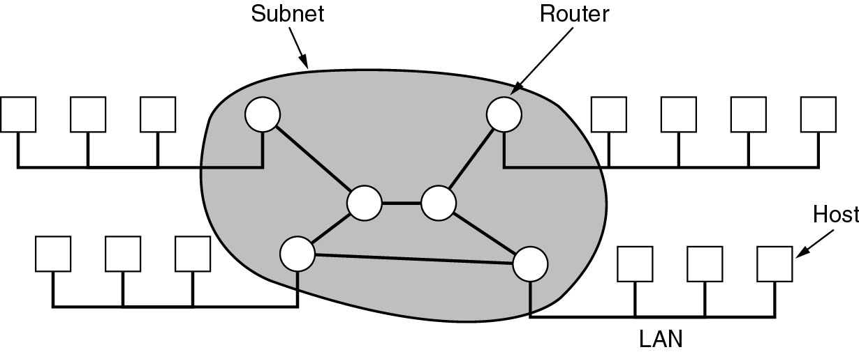
WAN Topology: Subnet, LAN, Host
Relation between hosts on LANs and the subnet

Slide 14
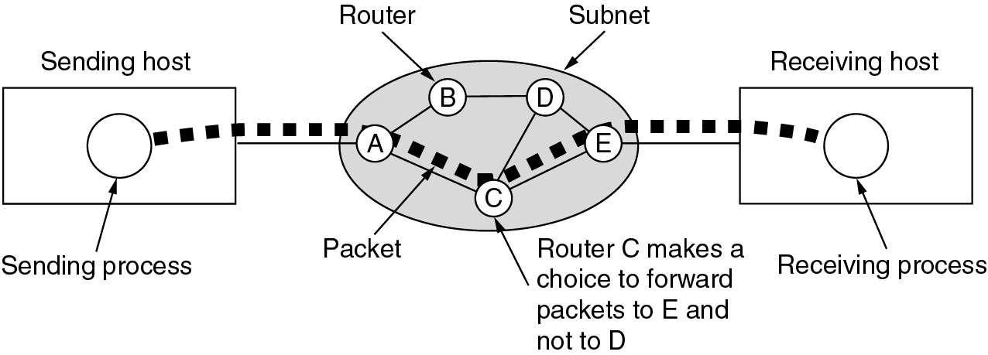
Communication Subnet
Transmission lines
Switching elements (Router)
Store-and-forward (packet-switched)
Routing decisions: Routing algorithm
Message Path
Single-path vs. Multi-path
Best route must be used
Routing decisions are made locally

Slide 15
1.3 Network Software

Slide 16
Protocol Hierarchies

Slide 17
Network architecture
Networks are organized as a stack of layers
Reduce design complexity
The purpose of each layer is to offer certain services to the higher layers, shielding those layers from the details of how the offered services are actually implemented 降低上下层之间的耦合度
Each layer is a kind of virtual machine, offering certain services to the layer above it
Object-oriented programming
A particular piece of software (or hardware) provides a service to its users but keeps the details of its internal state and algorithms hidden from them

Slide 18
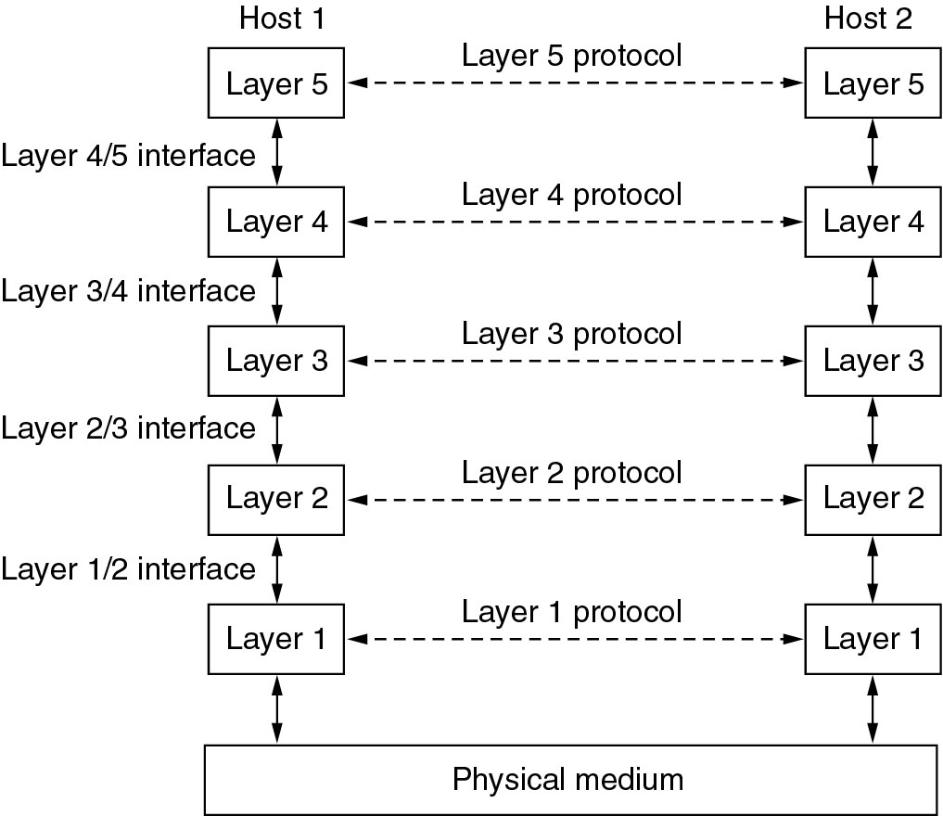
Layers, Peers, Protocols, and Interfaces

Slide 19
Layers, Peers, Protocols, and Interfaces
Protocol
An agreement between the communicating parties on how communication is to proceed
Peers 同侪、对等体
The entities comprising the corresponding layers on different machines are called peers, the peers may be processes, hardware devices
Physical medium
Interface
Defines which primitive operations （语法）and services （语义）the lower layer makes available to the upper one
Network architecture （确保异构计算机系统的“互联互通”）
A set of layers and protocols
Neither the details of the implementation nor the specification of the interfaces is part of the architecture

Slide 20
Philosopher-Translator-Secretary
Interfaces
Protocols
Translator: A neutral language known to both of them
Secretary: communication method

Slide 21
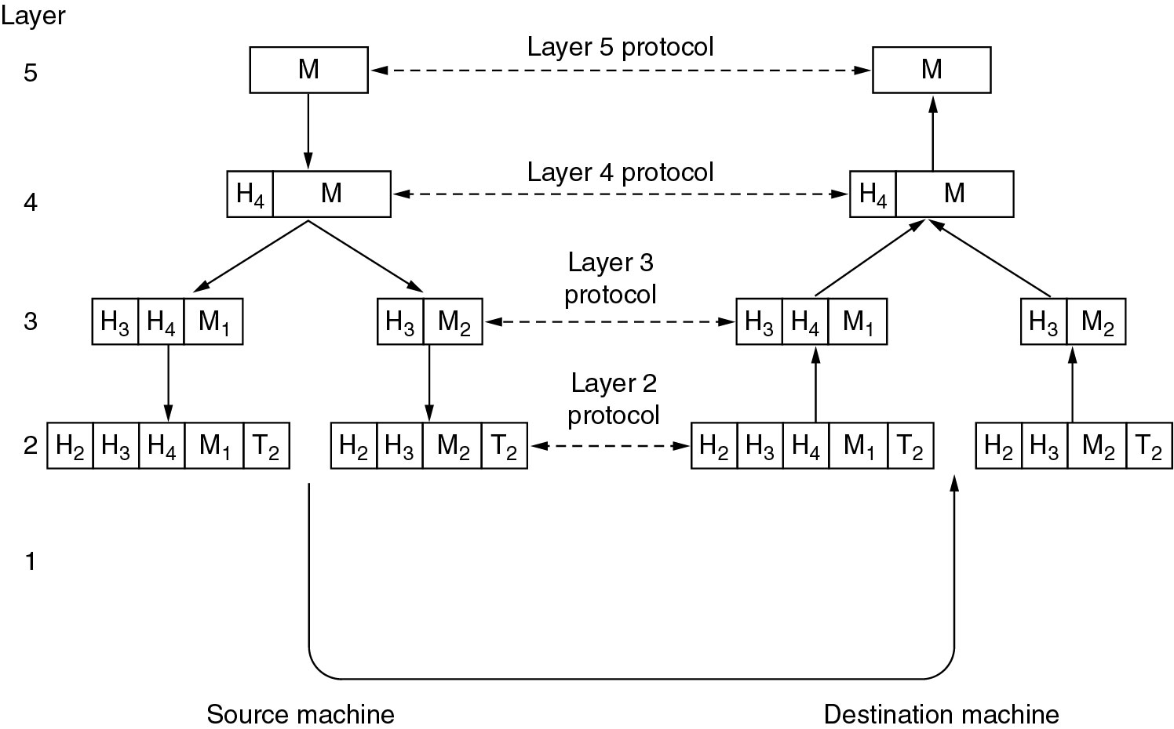
Information flow
Example information flow supporting virtual communication in layer 5.

Slide 22
Virtual Communication of Layer 5 Peers(1)
Layer 5
A message, M, is produced by an application process and given to layer 4 for transmission
Layer 4
Puts a header in front of the message to identify the message and passes the result to layer 3
Header: control information, such as sequence numbers (In some layers, headers can also contain sizes, times, and other control fields)

Slide 23
Virtual Communication of Layer 5 Peers(2)
Layer 3
There is limit to the size of messages transmitted in the layer 3 protocol
Break up the incoming messages into smaller units (packets)
Prepend a layer 3 header to each packet
Decides which of the outgoing lines to use and passes the packets to layer 2
Layer 2
Adds a header & trailer to each piece
Gives the resulting unit to layer 1
Layer 1
Physical transmission

Slide 24
Design Issues for the Layers

Slide 25
Design Issues for the Layers (1)
Reliability
Error Control：Physical lines are not perfect (bit error)
Error-detecting & Error-correcting codes
How the receiver tells the sender which messages have been correctly received and which have not
Routing
There may be some links or routers that are broken，finding a working path through a network
Messages may be out of sequence 乱序
How the sender numbers the messages
How the receiver deals with the messages arriving out of order

Slide 26
Design Issues for the Layers (2)
Network evolution
Addressing or naming
Each layer needs a mechanism for identifying senders and receivers
(processes on machine)
Internetworking 网络互通性
Scalability 可扩展性
Resource allocation
Statistical multiplexing 统计时分复用：按需分配
Flow Control 流量控制
Flow Control: A fast sender may swamp a slow receiver with data, …
Congestion 拥塞控制

Slide 27
Design Issues for the Layers (3)
QoS: Quality of service
安全问题
Confidentiality 防窃听
Authentication 身份鉴别
Integrity 防篡改、伪造（包括重放）

Slide 28
Connection-Oriented and Connectionless Services

Slide 29
Connection-oriented Service
Establishes a connection
Sender, receiver, and subnet conduct a negotiation about parameters to be used, such as maximum message size, quality of service required, and other issues
Uses the connection
Sender pushes objects (bits) in at one end, receiver takes them out at the other end
In most cases the order is preserved so that the bits arrive in the order they were sent.
Releases the connection

Slide 30
Connectionless Service
Each message (letter) carries the full destination address
Each one is routed through the system independent of all the others

Slide 31
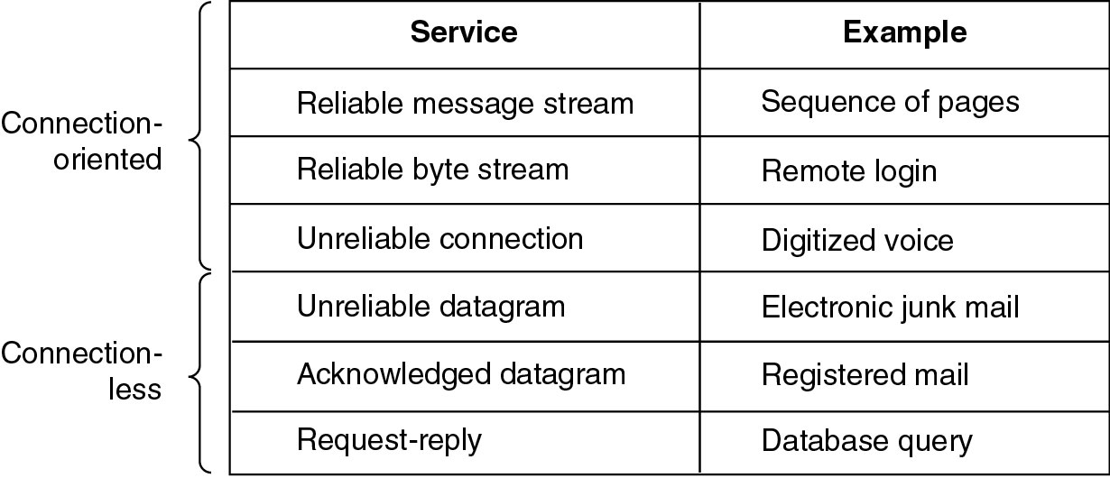
Quality of Service (QoS)
Reliable Connection-oriented Service
Message sequences
Message boundaries are preserved
Byte streams
Connection is simply a stream of bytes, with no message boundaries

Slide 32
Service Primitives

Slide 33
Service Primitives
A set of primitives原语 (operations) available to a user process to access the service
These primitives tell the service to perform some action or report on an action taken by a peer entity
If the protocol stack is located in the operating system, the primitives are normally system calls系统调用
操作系统内核内部：驱动程序

Slide 34
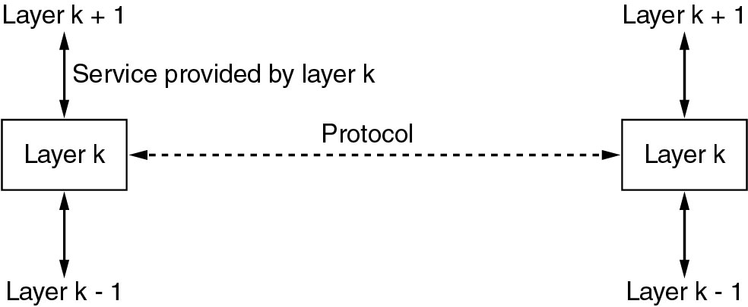
The Relationship of Services to Protocols
Service
Defines what operations the layer is prepared to perform 语义
Relates to an interface between the service provider and the service user
Protocol
A set of rules governing the format and meaning of the messages exchanged by the peer entities
Entities use protocols to implement service definitions
Service and protocol are completely decoupled
They are free to change their protocols at will, provided they do not change the service visible to their users.

Slide 35
1.4 Reference Models

Slide 36
The OSI Reference Model

Slide 37
Layer Principles
Each layer should perform a well-defined function
The layer boundaries should be chosen to minimize the information flow across the interfaces
ISO/OSI Model
ISO国际标准化组织 OSI开放系统互连

Slide 38
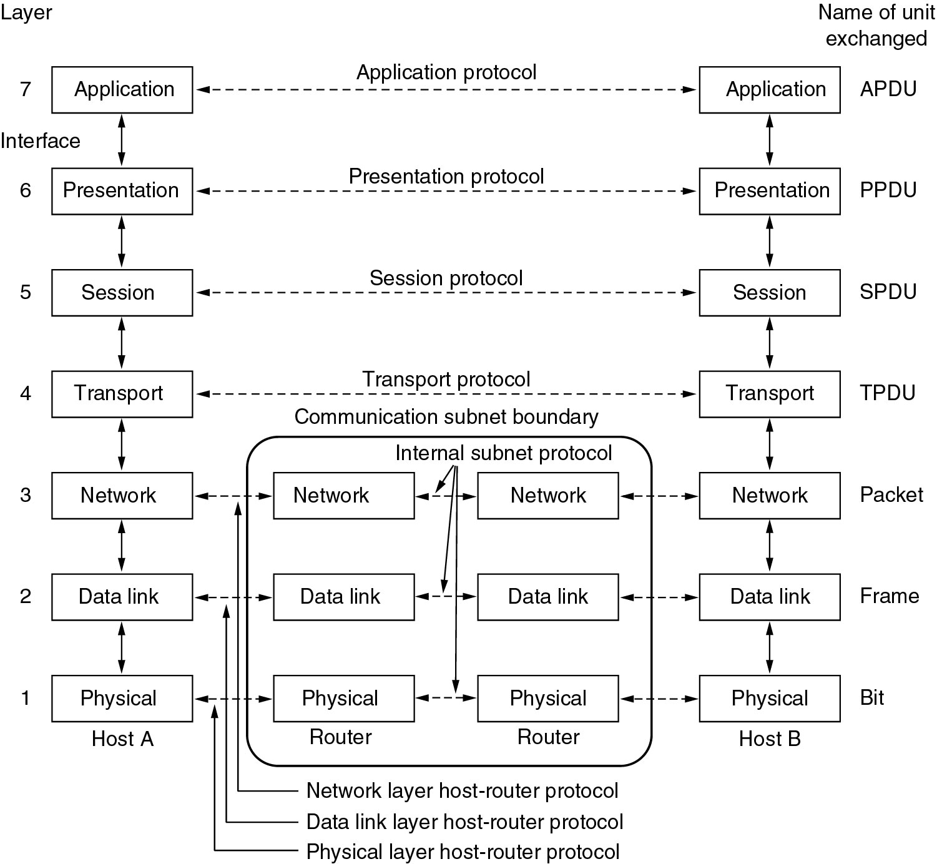
The ISO/OSI reference model

Slide 39
L1: Physical layer
Transmitting raw bits over a communication channel
how many volts should be used to represent 1/0 (electrical)
how many nanoseconds a bit lasts (timimg)
Physical transmission medium

Slide 40
L2: Data link layer
Transform a raw transmission facility into a logic channel
(protocols between each machine and its immediate neighbors,
Point-to-Point 注意“点到点” 与“端到端”End-to-End的区别)
Sender break up the input data into data frames and transmit the frames
If the service is reliable, the receiver sends back an acknowledgement frame
Flow control
Keep a fast transmitter from drowning a slow receiver in data
Broadcast networks: how to control access to the shared channel

Slide 41
L3: Network layer
Controls operation of subnet
Forwarding
Routing: How packets are routed from source to destination (route table)
Static
Be determined at start of each conversation
Highly dynamic
Congestion
Handling congestion is the responsibility of network layer, in conjunction with higher layers that adapt the load they place on the net
QoS (Quality of service)
delay, jitter, etc.
Heterogeneous networks interconnection

Slide 42
L4: Transport Layer
Transport Layer: end-to-end layer
Determines what type of service to provide to the upper layer
an error-free end-to-end channel
transporting of isolated messages, with no guarantee about the order of delivery
broadcasting of messages to multiple destinations
(Layer 1-2: p-to-p, protocol is
between a machine and its immediate neighbors)
(Layer 4-7: e-to-e, protocol is between the ultimate source and destination machines, which may be separated by many routers)

Slide 43
Session Layer
Allows users on different machines to establish sessions
Token management
preventing two parties from attempting the same critical operation互斥的临界区操作 at the same time
Synchronization
checkpointing long transmissions to allow them to continue from where they were after a crash

Slide 44
Presentation Layer
Syntax and semantics of the information transmitted
abstract data structures (semantics)
a standard encoding (syntax)
Unicode 0-0x10FFFF(最多21比特）中文编码GBK和UTF8
对象状态或者配置信息：XML/JSON
网页HTML
ans.1(抽象标记表示Abstract Syntax Notation)，MIB库（管理信息库）

Slide 45
Application Layer
A variety of protocols that are commonly needed by users
File transfer
Electronic mail
Network news
Telnet
HTTP (HyperText Transfer Protocol)
…….

Slide 46
The TCP/IP Reference Model

Slide 47
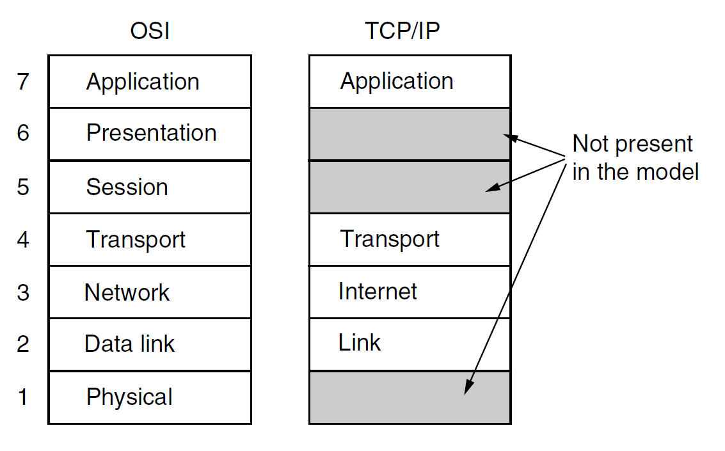
The TCP/IP Reference Model

Slide 48
The Link Layer
An interface between hosts and transmission links
(IP over everything)

Slide 49
The Internet Layer
A packet-switching network based on a connectionless internetwork layer
Defines an official packet format and protocol called IP (Internet Protocol), plus a companion protocol called ICMP (Internet Control Message Protocol)
Deliver IP packets
Best-effort delivering
Packet routing
Avoiding congestion

Slide 50
The Transport Layer: TCP
TCP (Transmission Control Protocol)
Reliable connection-oriented byte stream
Fragments incoming byte stream into discrete messages
Reassembles the received messages into the output stream
Flow control
响应网络层的拥塞控制信号

Slide 51
The Transport Layer: UDP
UDP (User Datagram Protocol)
Unreliable, connectionless protocol, 大数据量通信也必须响应网络层的拥塞控制信号
For applications that wish to imply their own reliability
NFS （网络文件系统，流行于Unix世界，与Windows的SMB不同）
request/reply queries
DNS，NTP （域名解析，网络时间协议：幂等模式的通信）
For applications in which prompt delivery is more important than accurate delivery
Transmitting speech or video (RTP: Real-time Transport Protocol）

Slide 52
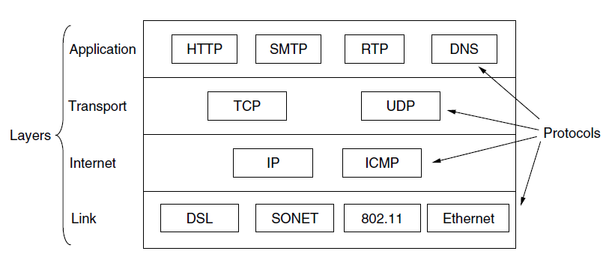
Protocols & networks in the TCP/IP

Slide 53
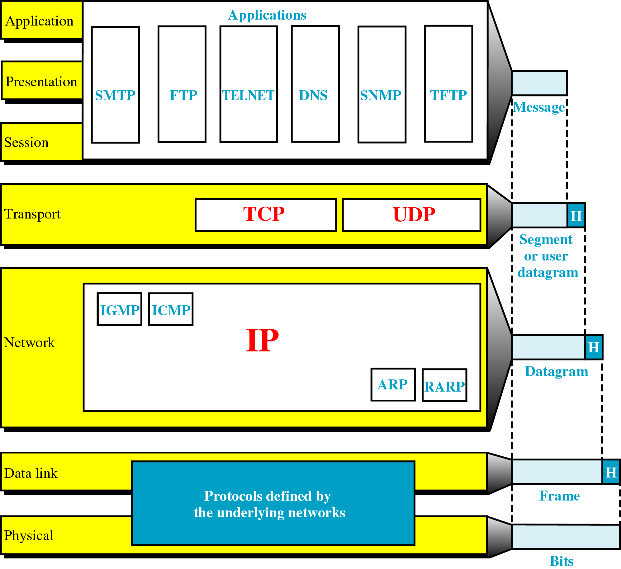
TCP/IP Model: in Details

Slide 54
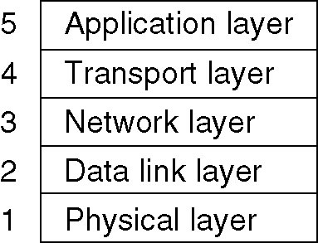
Hybrid Model
The hybrid reference model to be used in this book

Slide 55
Comparing OSI and TCP/IP Models

Slide 56
3 Concepts are Central to OSI Model
Services (semantics)
What the layer does, not how entities above it access it or how the layer works
Interfaces (syntax)
Tells the processes above it how to access it
Protocols (implementation)

Slide 57
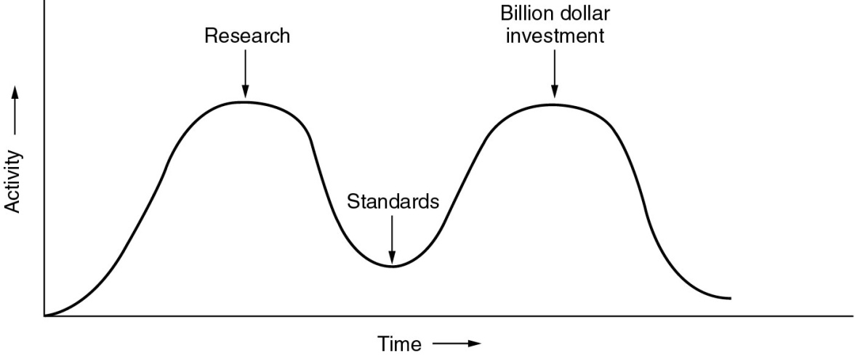
A Critique of OSI Model & Protocols
Why OSI did not take over the world?
Bad timing: too late
Bad technology
The choice was more political than technical
Layer 5&6 are nearly empty, layer 2&3 are overfull
Service definitions and protocols are extraordinarily complex and difficult to implement and inefficient in operation
Flow control and error control, reappear again and again in each layer
Bad implementations: poor quality
Bad politics: bureaucrats of European & U.S. Government

Slide 58
A Critique of the TCP/IP Reference Model
Service, interface, and protocol not distinguished
Host-to-network “layer” not really a layer
No mention of physical and data link layers
Minor protocols deeply entrenched, hard to replace

Slide 59
1.5 Example Networks

Slide 60
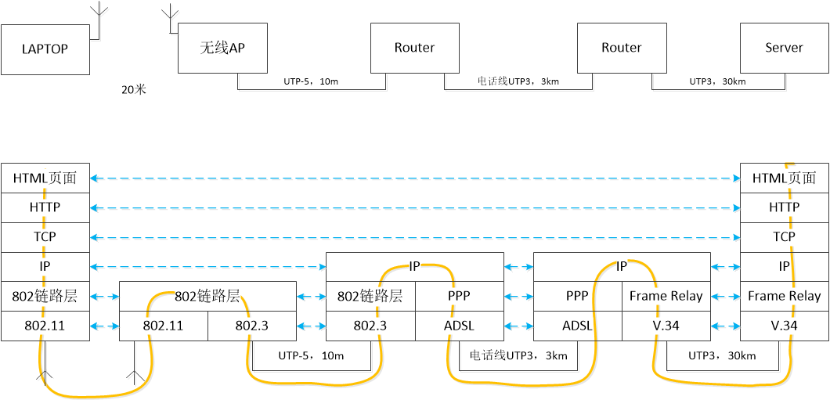

Slide 61
1.6 Network Standardization

Slide 62
Network Standardization (1)
De facto, De jure
Telecommunications World: ITU (International Telecommunication Union)
Since 1865, telegraphy -->telephone-->data communication 1947年ITU成为联合国的一个机构
Members
200 national governments (almost all members of UN, PTT)
700 members (telephone companies, telecom equipment manufacturer, computer vendors, chip manufacturers)
3 Main sectors
Radio communications (ITU-R)
coordinating the use by competing interest groups of radio frequencies worldwide
Development (ITU-D)
Telecommunications Standardization (ITU-T)
CCITT, Comité Consultatif International Télégraphique et Téléphonique (1956-1993)
10 Study Groups, Make technical recommendations about telephone, telegraph, and data communication interfaces： H.264(AVC) H.265(HEVC) X.509 …

Slide 63
Network Standardization (2)
International Standards World:
ISO (International Standards Organization)
Its members are the national standards organizations of the 157 member countries
ANSI (American National Standards Institute)
NIST (National Institute of Standards and Technology)
Part of the U.S. Department of Commerce, issues standards that are mandatory for purchases made by the U.S. Government
ECMA (European Computer Manufacturers Association)
欧洲计算机制造商协会,信息和电信标准化组织。
IEEE (Institute of Electrical and Electronics Engineers)
IEEE’s 802 committee has standardized many kinds of LANs

Slide 64
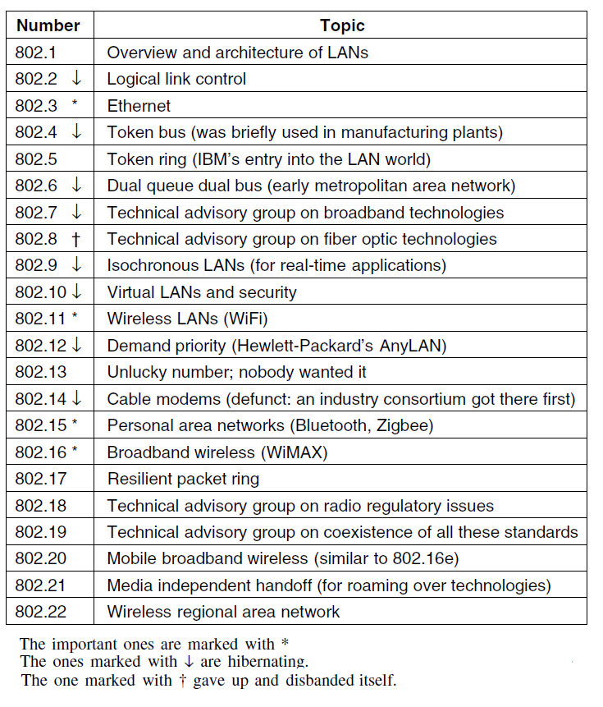
IEEE 802 Standards

Slide 65
Internet Standards World
Internet协会（ISOC，Internet Society）
推动、支持和促进Internet不断增长和发展的专业组织
它把Internet作为全球研究通信的基础设施
体系结构委员会（IAB，Internet Architecture Board）
技术监督和协调的机构。它由国际上来自不同专业的15个志愿者组成，其职能是负责Internet标准的最后编辑和技术审核
工程任务组（IETF，Internet Engineering Task Force）
面向近期标准的组织，它分为9个领域（应用、寻径和寻址、安全等等）。IETF开发成为Internet标准的规范
研究任务组（IRTF，Internet Research Task Force）
主要对长远的项目进行研究
IRTF和IETF隶属于IAB， IAB隶属于ISOC
所有关于Internet的标准都以RFC (Request for Comment)文档出版
Proposed Standard-->Draft Standard-->Internet Standard

Slide 66
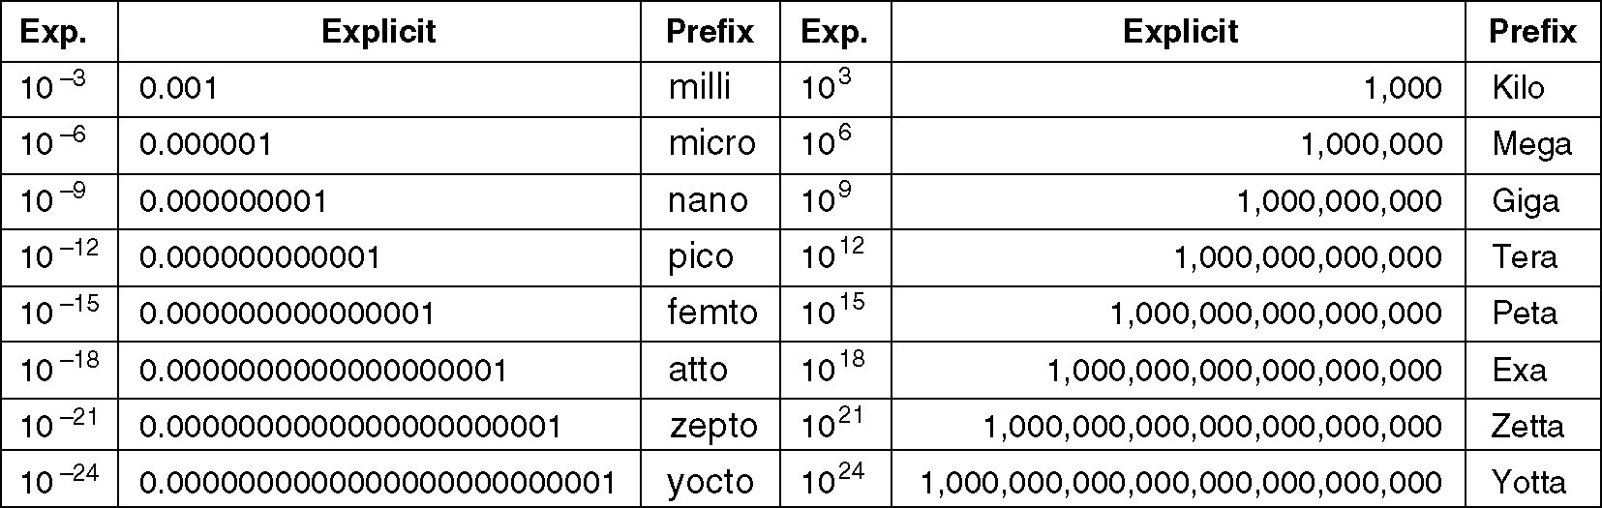
Metric Units
m is for milli and µ is for micro
KB MB GB (2¹⁰, 2²⁰, 2³⁰)
kbps, Mbps, Gbps (10³, 10⁶, 10⁹)

Slide 67
Homework

Slide 68
Homework
网络服务参数 2, 3, 9
服务类型：10,11,
重传次数：15
参考模型：16,17,18,30

Slide 69
思考题
在数据报文的目的地址字段，地址类型分unicast，multicast，broadcast，anycast。四种类型有什么区别？无线局域网本来就是“广播式”通信，为什么目的地址要区分multicast和broadcast？
通信子网由哪些硬件部分构成？分别完成什么功能？通信子网中的路由器在提供通信服务的过程中运行七层协议的哪几层？哪些设备不属于通信子网？
理解路由器在选路时的独立性，多台路由器分布式协作（没有统一的协调指挥中心）将数据包逐跳传送到目的地。
计算机网络采用分层体系结构。为什么要分层？深刻理解上下层“解耦”的重要性。
解释网络分层体系结构中的概念：interface，service，protocol，implementation，peer（entity）。这些概念中哪些部分是“互联互通”不同计算机系统时必须达成一致的，哪些是本地系统自行定义不必与其他系统协商的？
面向连接的服务与无连接的服务有什么区别？某协议实体对上提供面向连接的服务，那么，它要求为他提供服务的下层实体也必须提供面向连接的服务吗？面向连接的服务一定是可靠的通信服务吗？
设计分层体系结构的某一层协议时，一般需要考虑哪些方面的问题？
什么是流量控制？

Slide 70
思考题
相距甚远的两个高性能服务器通过因特网连接在一起交换大量数据，两个服务器网口均为1Gbps，两个服务器之间的实际通信速率在10~50Mbps之间浮动，网络系统中的哪个机制决定了服务器间的实际通信速率？
OSI七层模型中每层的名称和作用。
因特网协议模型，因特网协议簇的沙漏型形态，IP over Everything和Everything over IP，对构建庞大的因特网生态圈所起的作用（对比：Windows、Linux、Andriod等操作系统生态圈）
通过一次web页面访问的实例，分析层间信息的流动及设备间数据交换过程，理解各层的功能。
理解会话层，理解表示层semantics和syntax，理解会话层与表示层之间的解耦。
TCP和UDP分别提供了什么服务？准确理解TCP的“可靠性”和“无报文边界的字节流”服务。什么情况下应用程序选择UDP而不选择TCP？为什么？
了解国际组织ITU，ISO，IEEE，IETF。

