Slide 1
Chapter 2 The Physical Layer

Slide 2
Physical Layer
Fundamental Concepts 
Theoretical Basis for Data Communication
3 kinds transmission media
Guided Transmission Media
Twisted pair
Coax
fiber optics
wireless (terrestrial radio)
satellite
Examples of communication systems
telephone system
The Local Loop, Modems, ADSL 
Trunks and Multiplexing 
Switching
cable television system
Physical Interface

Slide 3
Fundamental Concepts (1)
信道(Channel)：传送信息的媒体
带宽(Bandwidth)：信号或信道的频率范围 (Hz)
数据率(Bit Rate)：数据传输速率 (bps)
波特率(Baud)：符号速率，码元传输速率
1 Baud = (log₂V) bps，其中V是码元的电平级数
信道容量(Channel Capacity)：信道的最大数据率
传播速度(Propagation Speed)：信号单位时间内传送的距离（米/秒）
媒体不同，速度不同，小于光速
同种媒体，频率不同的电磁波速度也有差异
误码率BER (Bit Error Rate)：信道传输可靠性指标
BER=传送错的位数 / 传送总位数

Slide 4
Fundamental Concepts (2)
时延(Delay)：
从向网络中发送数据块的第一比特开始，到最后一比特被接收所经历的时间
时延的组成：传播时延、发送时延、处理时延、排队时延
传播时延：信号通过传输介质的时间。
发送时延：设备发送一个数据块所需要的时间（数据块长度/传输速率）
处理时延：交换机/路由器检查数据、选路的时间
排队时延：在交换机/路由器中排队等待的时间

Slide 5
Simplex, Half-duplex, Full-duplex
Simplex 单工
Transmission occurs in only one direction
eg. FM Radio broadcasting
Half-duplex 半双工
Transmission can be made in both direction, but at one time only one direction is available
eg. talkie and walkie 语音对讲机
Full-duple 全双工
Transmission can be made in both directions simultaneously
eg. Phone conversation
Notes:
传输模式

Slide 6
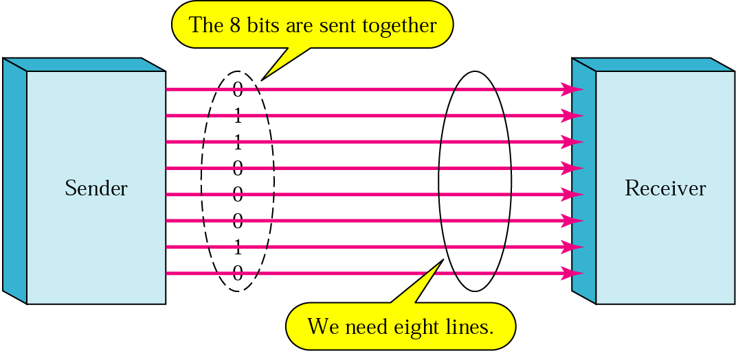
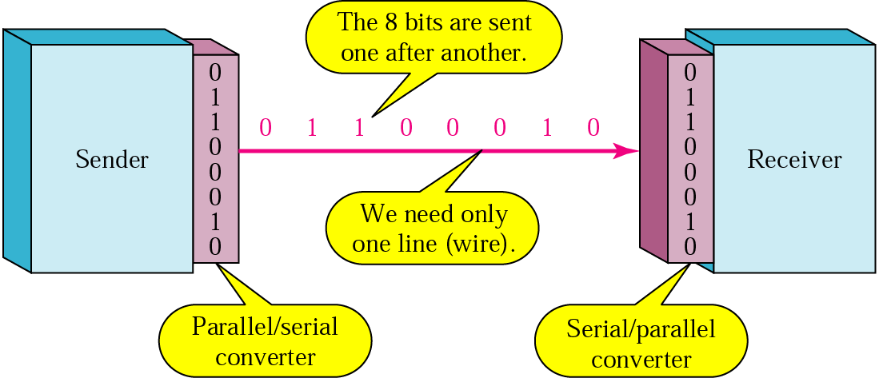
Parallel vs. Serial transmission

Slide 7
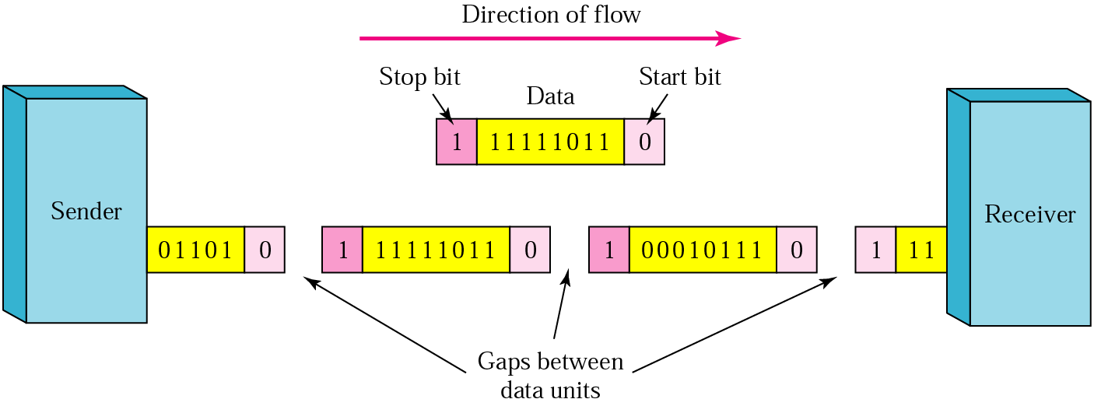
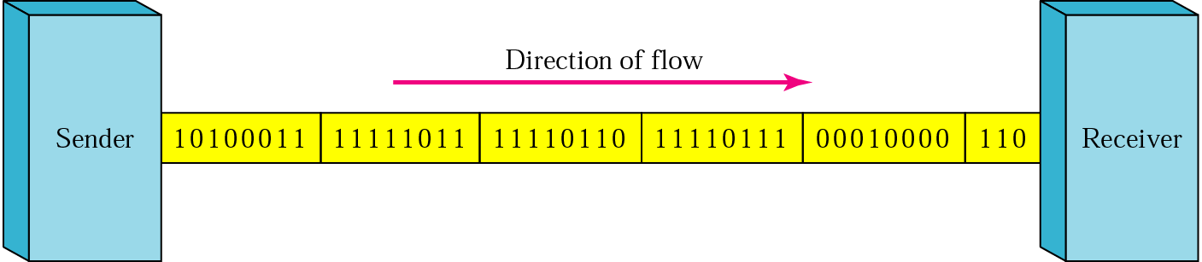
Async. & Synchronous Transmission
Notes:
异步传输：
独立时钟，无须同步
以字符为单位进行传输
发送两个字符之间的间隔是任意的
接收方依靠字符中的起始位来同步
同步传输：以时钟来对传输进行同步
以数据块（帧或分组）为单位传输

Slide 8
同步串行传输和异步串行传输
同步串行传输
独立于数据线的时钟线
以时钟信号线对数据线上传输的信号进行比特同步
恒定速率的比特流服务
异步串行传输
独立时钟，无须同步
（字符流）以字符为单位进行传输
发送两个字符之间的间隔是任意的
接收方依靠字符中的起始位和停止位来同步
思考题：异步串行通信的基本单位为“字符”，每字符都需要开始位与停止位，为什么开始位与停止位不能同时为0或同时为1？如果发送方一直在不断地发送一个字节流，后开机的接收方如何从线路上的比特流中识别出字节边界？

Slide 9
2.1 The Theoretical Basis for Data Communication

Slide 10
Fourier Analysis
Any periodic function g(t) with period T can be constructed as the sum of a (possibly infinite) number of sines and cosines:
A data signal that has a finite duration can be handled by just imagining that it repeats the entire pattern over and over forever (i.e., the interval from T to 2T is the same as from 0 to T, etc.)

Slide 11
Bandwidth
No transmission facility can transmit signal without losing some power
All transmission facilities diminish different Fourier components by different amounts
Range of frequencies transmitted without being strongly (0.5) attenuated is called bandwidth
Telephone wire’s bandwidth （UTP-3）: 1 MHz
UTP 5: 100MHz (UTP: Unshielded Twist Pair)
Bandwidth is a physical property of the transmission medium, depends on
Construction
Thickness
Length bandwidth (Hz, bps)

Slide 12
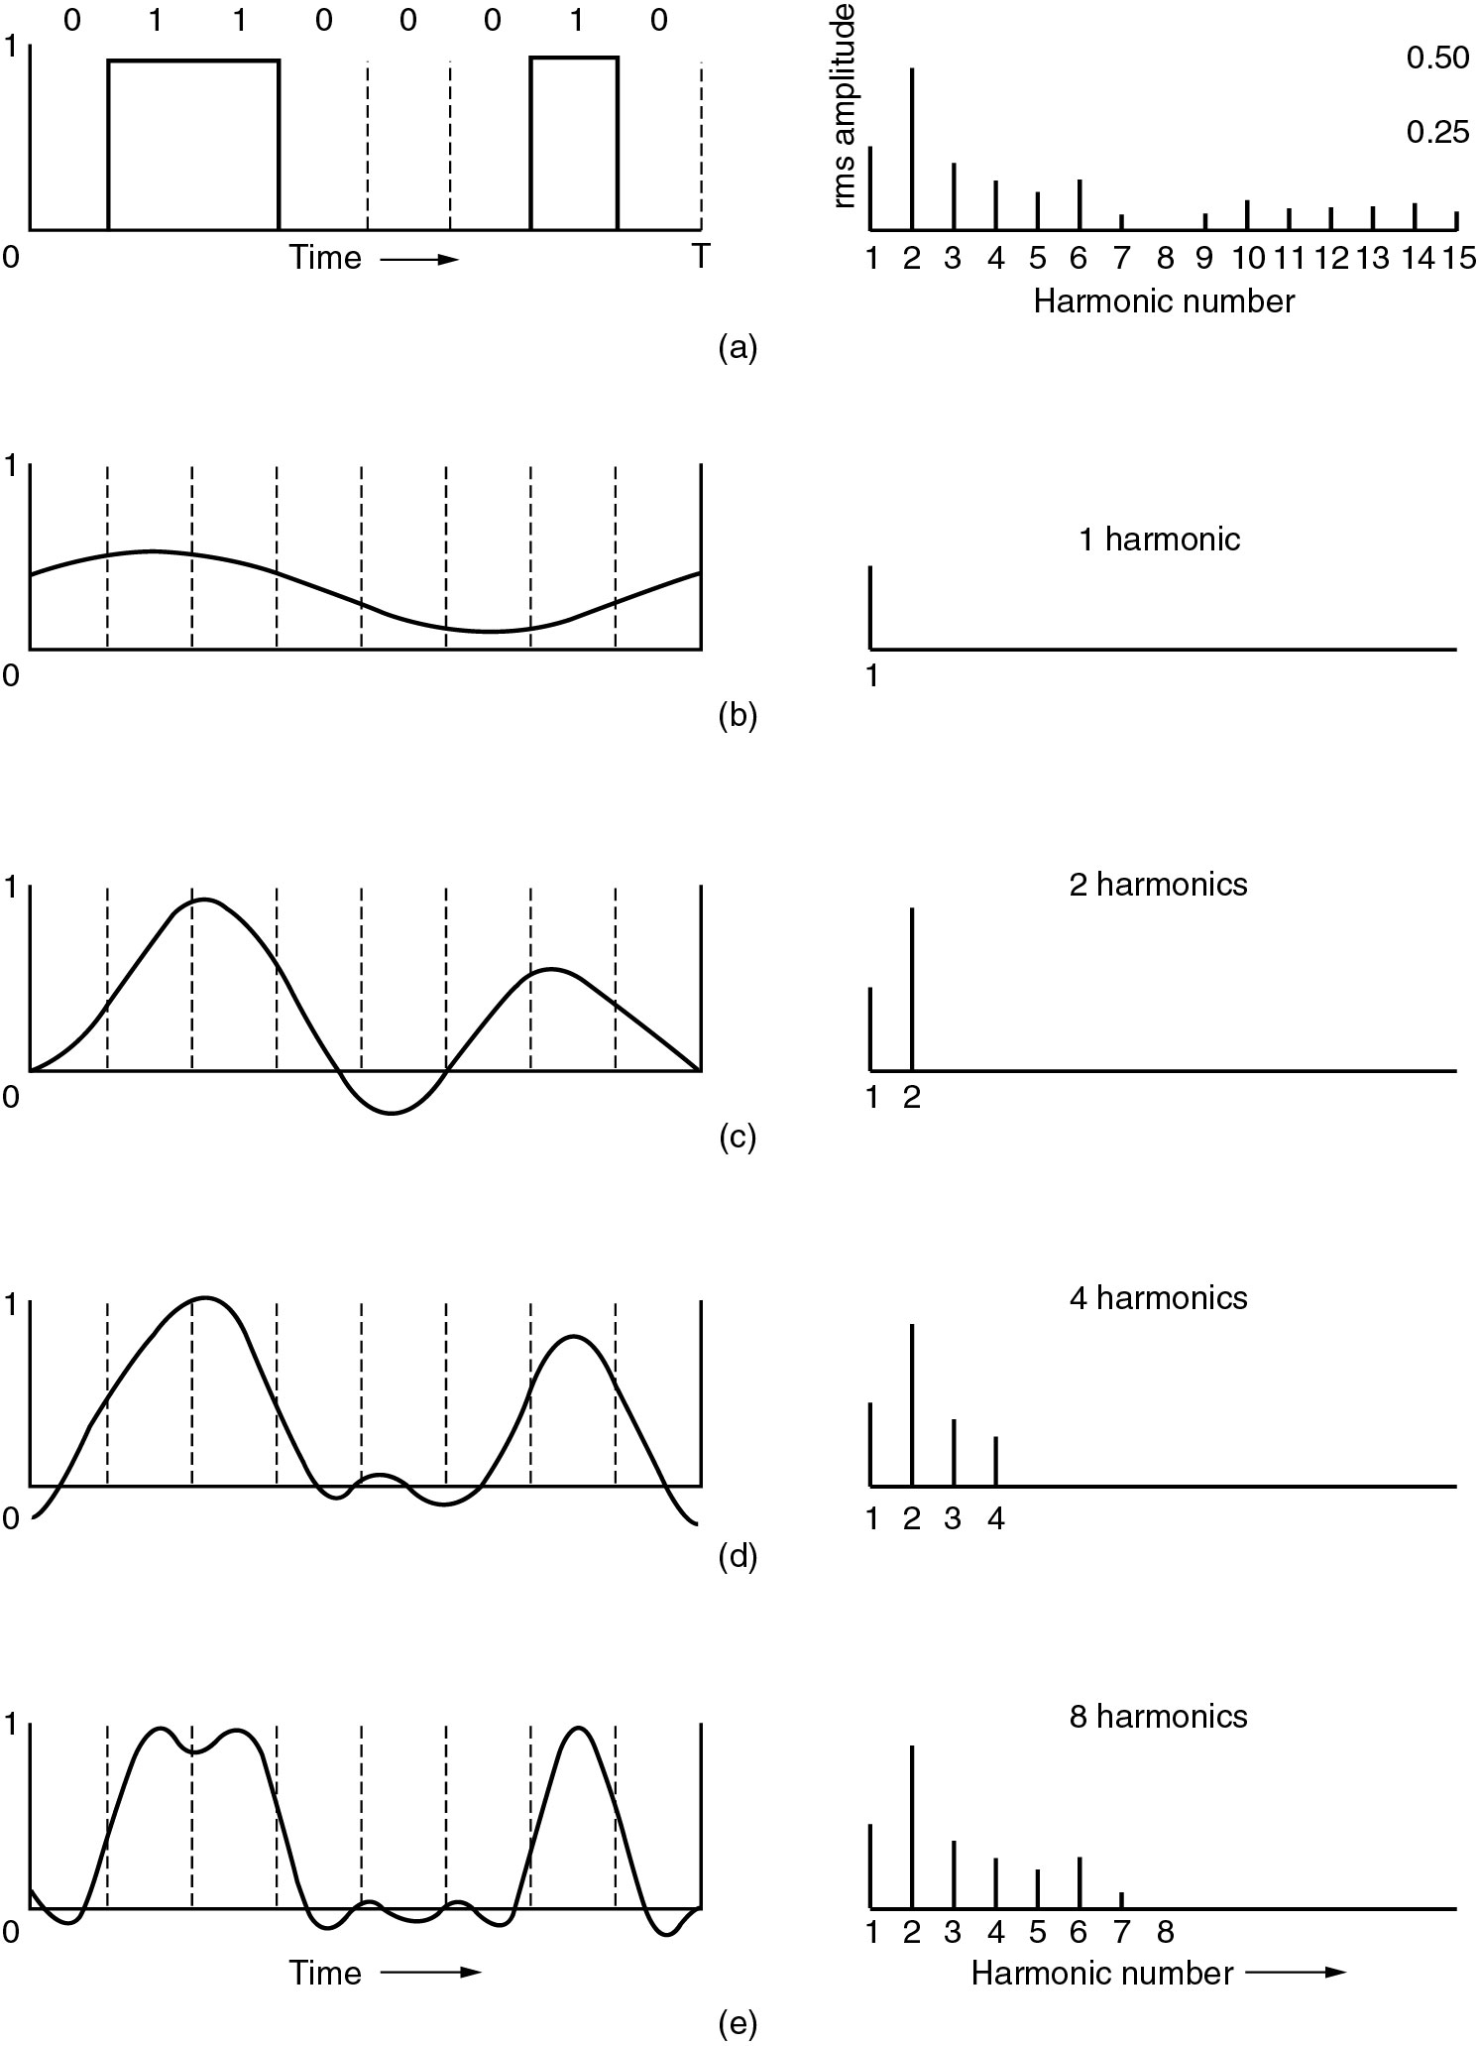
Bandwidth-Limited Signals (1)
(a) A binary signal (‘b’) and its Fourier amplitudes.
(b)-(e) Successive approximations to the original signal. n次谐波

Slide 13
Bandwidth-Limited Signals (2)

Slide 14
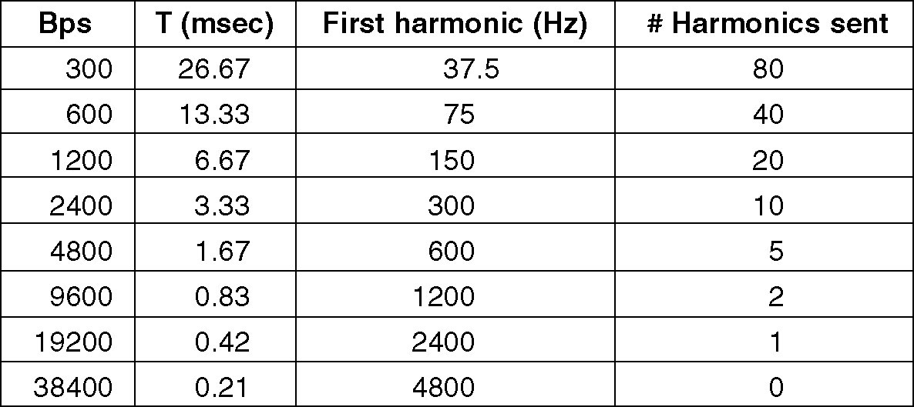
Bandwidth-Limited Signals (3)
For voice-grade line bandwidth 3000 Hz
T=8/bps, First harmonic f=bps/8
Number of harmonics sent=3000/f=24000/bps
At data rates ≥38.4 kbps, there is no hope at all for binary signals, even if the transmission facility is completely noiseless
Notes:
T=1000/b*8
Hz=b/8
3000hz

Slide 15
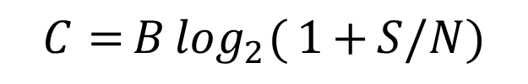
Maximum Data Rate of a Channel
Nyquist's theorem (1924)
If an arbitrary signal has been run through a low-pass filter（低通滤波器） of bandwidth B Hz, the filtered signal can be completely reconstructed by making only 2B (exact) samples per second (symbol rate, baud) C=2Blog₂V （bps）
Shannon’s Theorem (1948)
$$C{=}B\log_{2}{(}1{+}S/N)$$
Example: Voice phone line 300Hz-3300Hz, S/N 30dB（信噪比30分贝）

Slide 16
2.2 Guided Transmission Media

Slide 17
Twisted Pair (1)
Category 3 UTP
Category 5 UTP
Since 1865: Single wire -->Twisted pair
Twisted Pair: Most common transmission media
For analog/digital signals transmitting
差分传输
减弱环境噪音对自身信号的影响
When the wires are twisted, the waves from 2 wires cancel out, so the wire radiates less effectively(串扰：自身信号对环境影响)
A B C

Slide 18
Twisted Pair (2)
UTP & STP (Unshielded / shielded twist pair)
Bandwidth
Category 3 UTP: 16MHz
Category 5 UTP: 100MHz
Category 6 UTP: 250MHz
Category 7 UTP: 600MHz

Slide 19
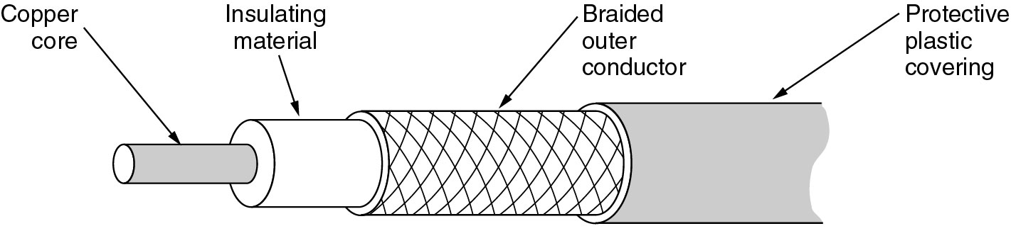
Coaxial Cable
It can span longer distances at higher speeds
High bandwidth
Modern cables have a bandwidth of up to a few GHz
Excellent noise immunity

Slide 20
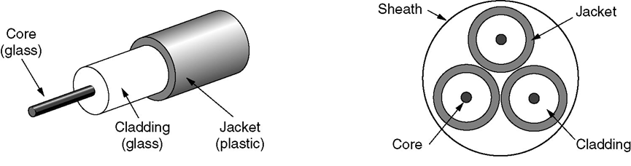
Fiber Cables
From 1981 to 2000
CPU (4.77M to 2G Hz)
A gain of a factor of 20 per decade
Physical limits: speed of light, heat dissipation
Data communication (56k to 2G bps)
A gain of a factor of 125 per decade
Error rate: 10⁻⁵ to almost 0
Electrical and optical signals by photodiode: 40Gbps

Slide 21
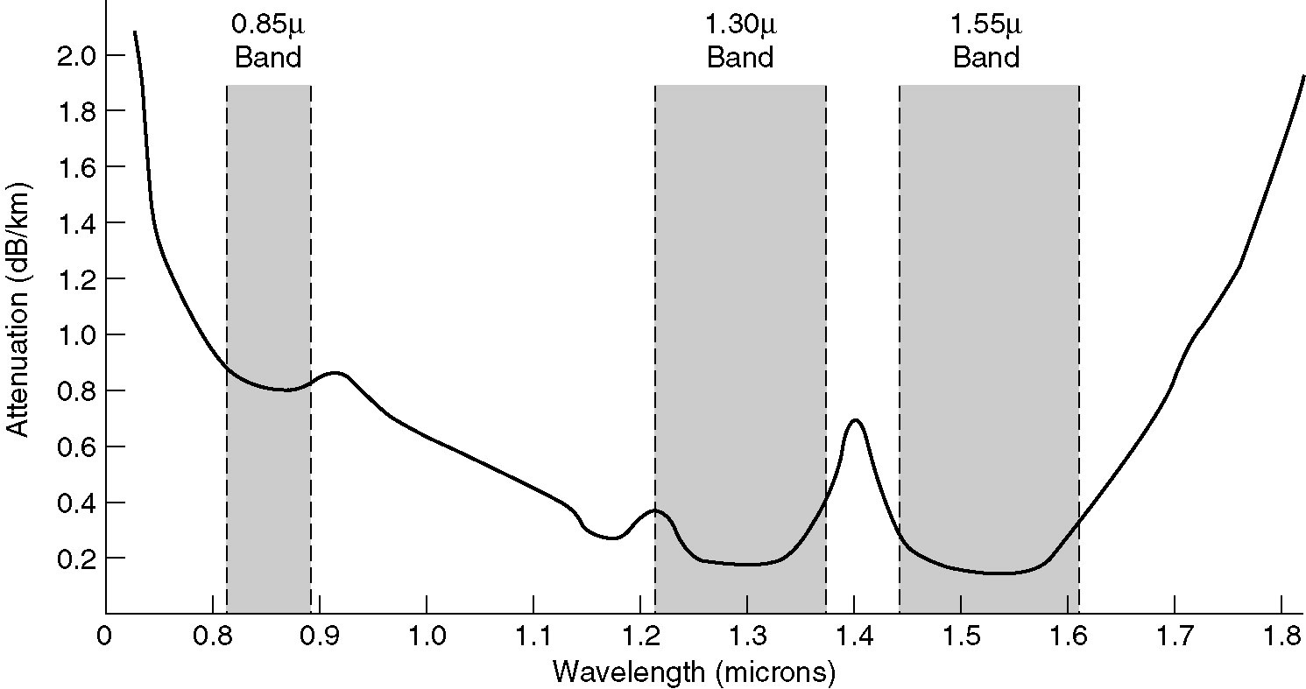
Transmission of Light through Fiber
Attenuation of light through fiber depends on the wavelength of the light
3 bands are used for optical communication
Bandwidth: All 3 bands are 25~30THz wide

Slide 22
2.3 Wireless Transmission

Slide 23
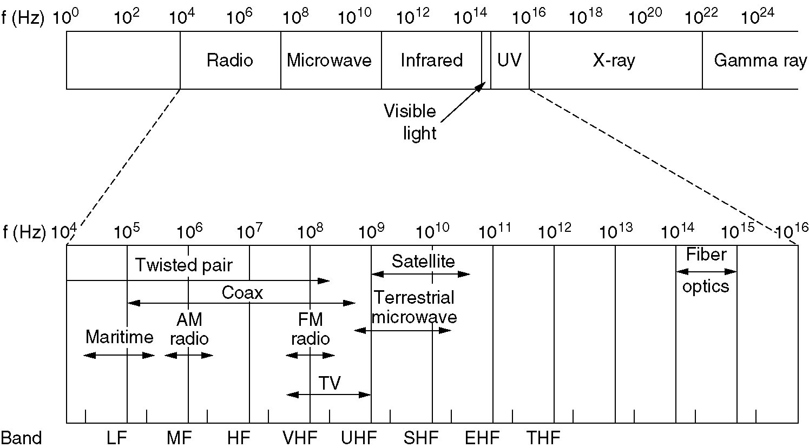

The Electromagnetic Spectrum
Electromagnetic spectrum and its uses for communication
In general, as we go from long-wave radio toward visible light, the waves behave more and more like light and less like radio

Slide 24
Transmission Frequency Band
Using narrow frequency band (radio, TV, ...)
Most transmission use narrow frequency band (∆f/f<<1) to get the best reception
Spread Spectrum (bluetooth, wlan, cdma, ...) 扩频
FHSS: Frequency hopping spread spectrum
DSSS: Direct sequence spread spectrum
Hedy Lamarr (1913-2000) A B C D 

Slide 25
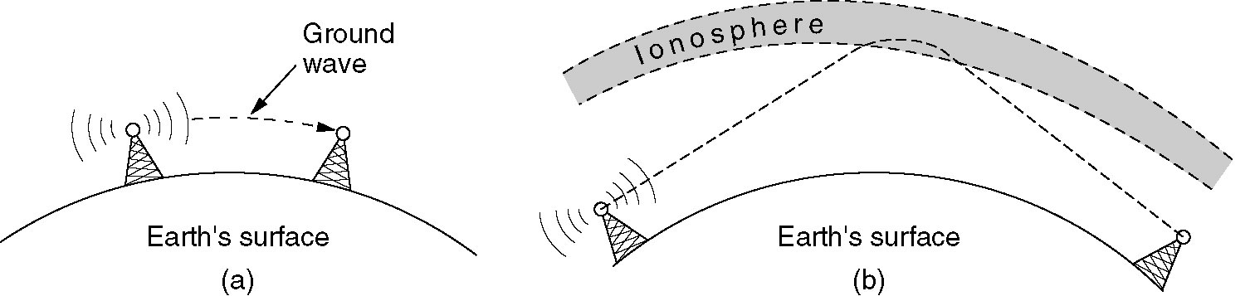
Radio Transmission (VLF,LF,MF,HF)
(a) In the VLF, LF, and MF bands, radio waves follow the curvature of the earth (1000km， Beijing<->Wuhan)
(b) In the HF band, they bounce off the ionosphere at a height of 100~500 km

Slide 26
Microwave Transmission
(100M~10GHz)
Before fiber optic, microwaves formed the heart of the long-distance telephone transmission system
Waves travel in nearly straight lines, the transmitting & receiving antennas must be accurately aligned
Distance between repeaters: 80km
Multipath fading is often a serious problem (weather and frequency dependent)
(At about 2.4GHz, absorbed by rain and tree leaves)

Slide 27
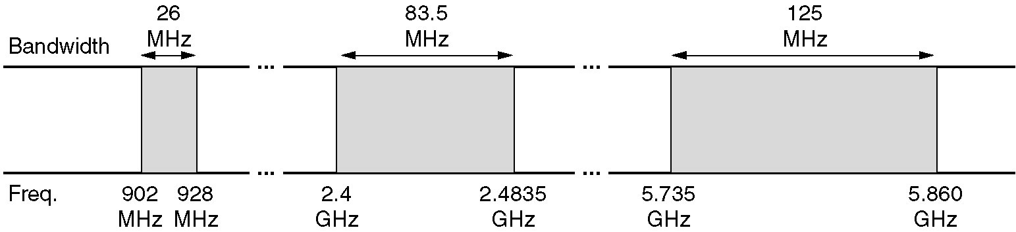
Politics of Electromagnetic Spectrum
National governments allocate spectrum
ISM (Industrial, Scientific, Medical) bands
some frequency bands for unlicensed usage
FCC mandates that all devices in ISM bands use spread spectrum techniques to minimize interference between uncoordinated devices
Power is under 1 watt （限制频率范围，调制技术，信号强度）
ISM bands in USA

Slide 28
2.4 Communication Satellites

Slide 29
Communication Satellites
Act as a big microwave repeater in the sky
Contains multiple antennas and multiple transponders
Transponder
listen to some portion of the spectrum
amplifies the incoming signals
rebroadcasts it at another frequency (downward beams)
Downward beams
Broad: a substantial fraction of the earth’s surface
Narrow: spot beams cover an area hundreds of kms in diameter (bent pipe)
Station keeping
Lifetime: about 10 years

Slide 30
2.5 Digital modulation and multiplexing

Slide 31
Baseband & Passband
Baseband transmission 基带
The signal occupies frequencies from zero up to a maximum that depends on the signaling rate
Common for wires
Passband transmission 通带
Regulate the amplitude, phase, or frequency of a carrier signal to convey bits
The signal occupies a band of frequencies around the frequency of the carrier signal
Wireless and optical channels

Slide 32
Baseband transmission

Slide 33
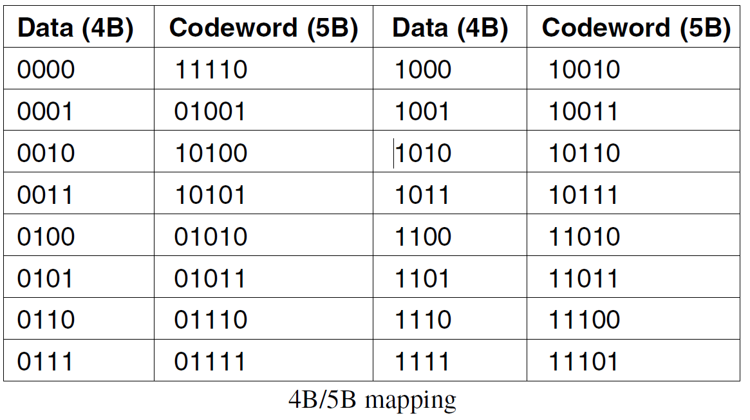
Baseband transmission
Bandwidth efficiency
bit rate=baud rate * the number of bits per symbol
Number of signal levels doesn’t need to be a power of 2
Clock recovery
NRZI coding (USB)
Manchester (100% overhead)
4B/5B (25% overhead)
Never be a run of more 3 consecutive 0s
Non-data codes to represent physical layer
control signals:
11111 - an idle line
11000 - represents the start of a frame
Scrambler (0% overhead)
XORing the data with a pseudorandom sequence before it is transmitted
Notes:
波束

Slide 34
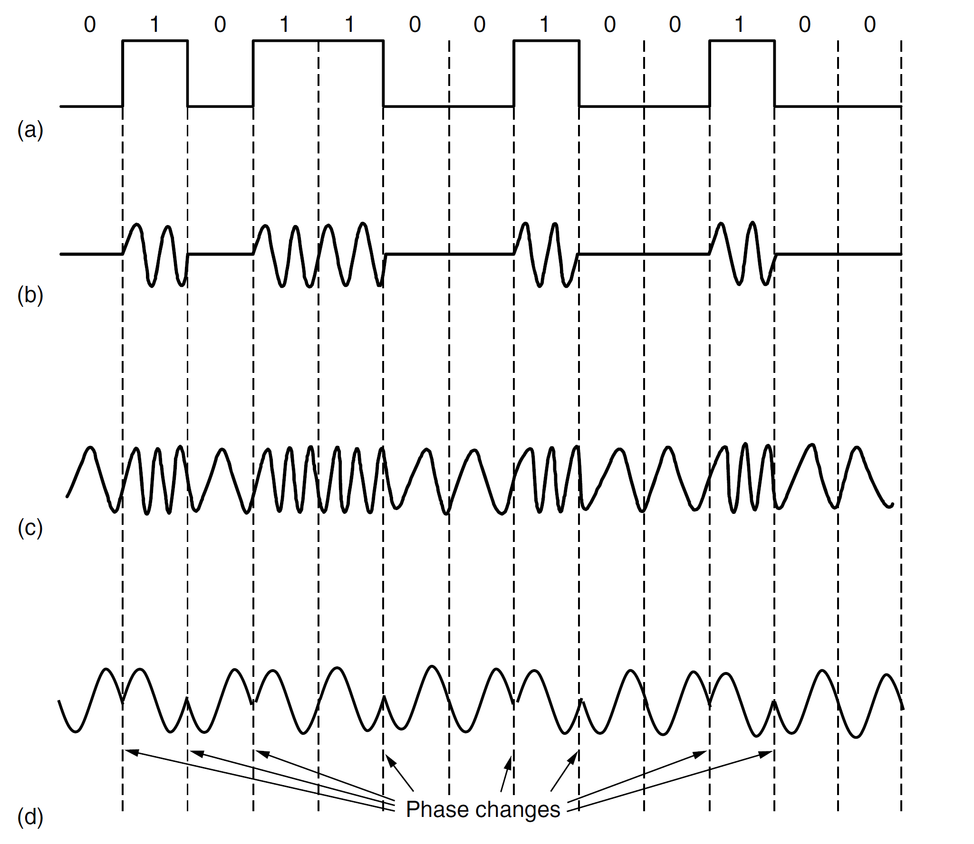
Passband Transmission
(a) A binary signal
(b) Amplitude modulation
(c) Frequency modulation
(d) Phase modulation

Slide 35
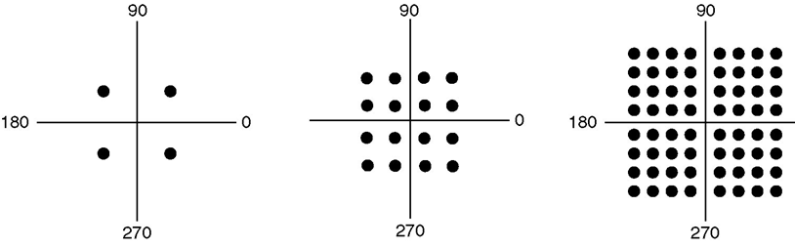
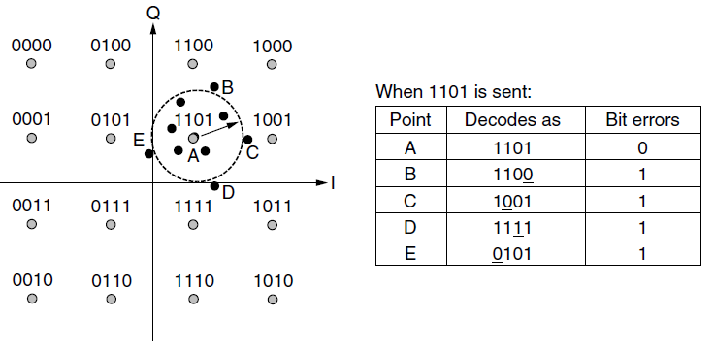
QPSK & QAM
QPSK QAM-16 QAM-64

Slide 36
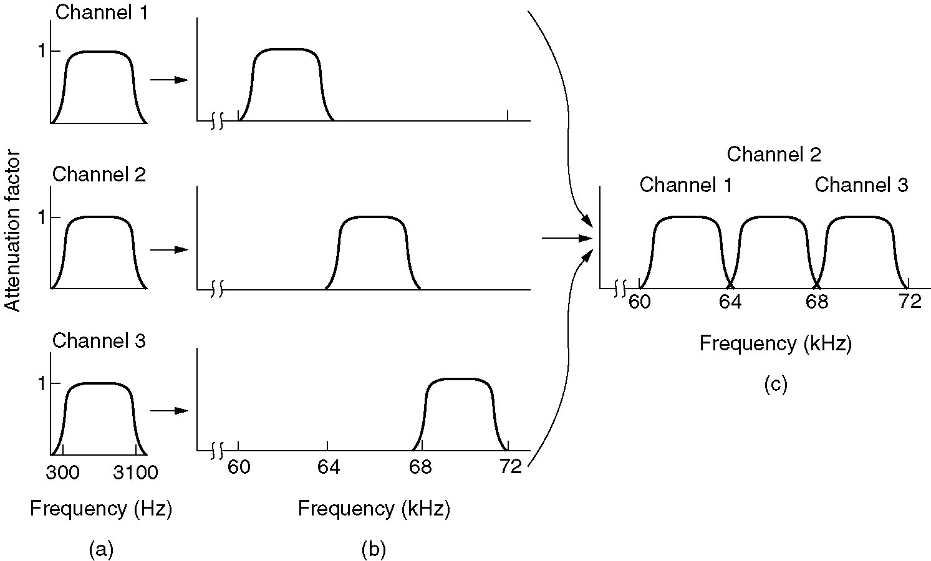
FDM: Frequency Division Multiplexing
(a) The original bandwidths.
(b) The bandwidths raised in frequency.
(b) The multiplexed channel.

Slide 37
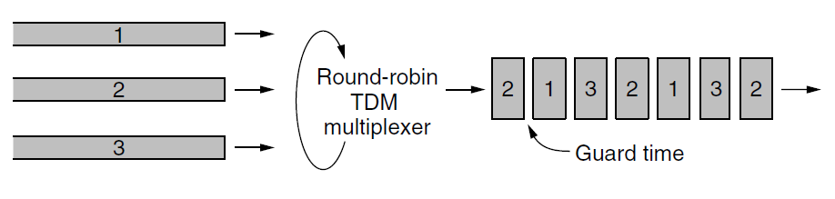
TDM: Time Division Multiplexing

Slide 38
CDMA: Code Division Multiple Access
A form of spread spectrum communication 扩频通信
Bit time
Each bit time is subdivided into m short intervals called chips (m=64,128)
Chip sequence
Each station is assigned a unique m-bit code called a chip sequence
Orthogonality
比较站A和站B的片序列分量：一半相同，一半相反
Send data
Transmit bit 1: sends its chip sequence
Transmit bit 0: sends the complement of its chip sequence
No other patterns are permitted

Slide 39
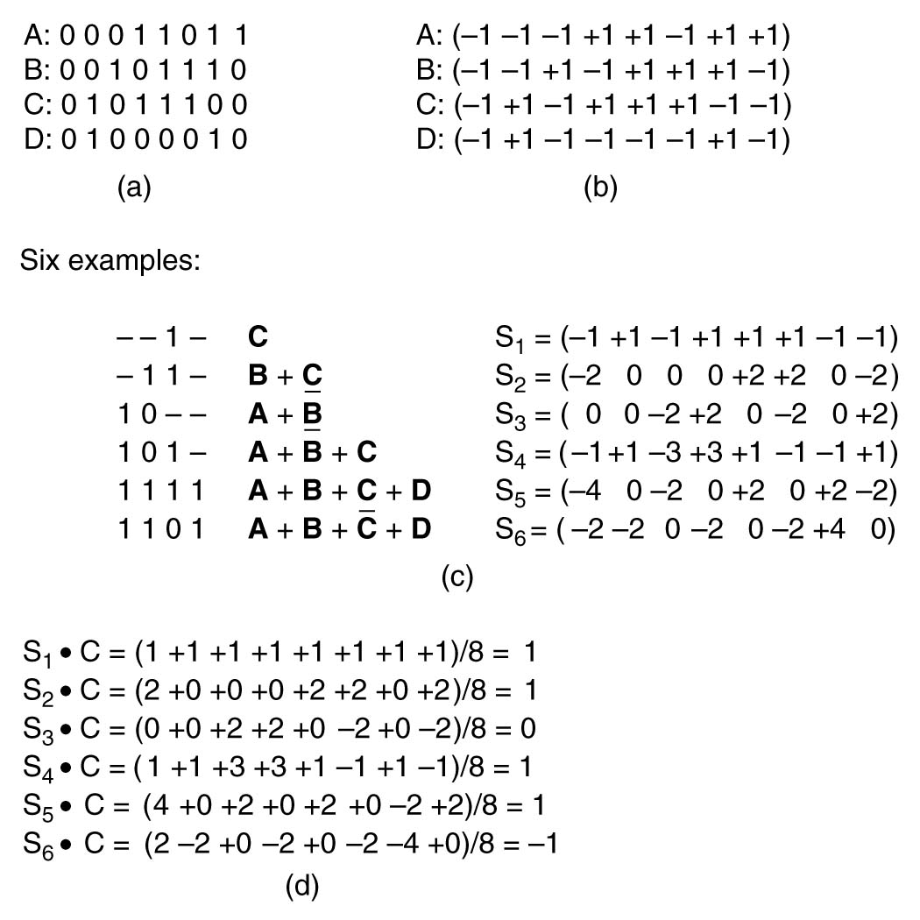
CDMA – Code Division Multiple Access
Orthogonality
A*A=1
A*(~A)=-1
A*B=0
A*(~B)=0
(a) Binary chip sequences for four stations
(b) Bipolar chip sequences
(c) Six examples of transmissions
(d) Recovery of station C’s signal

Slide 40
2.6 Public Switched Telephone Network (PSTN)

Slide 41
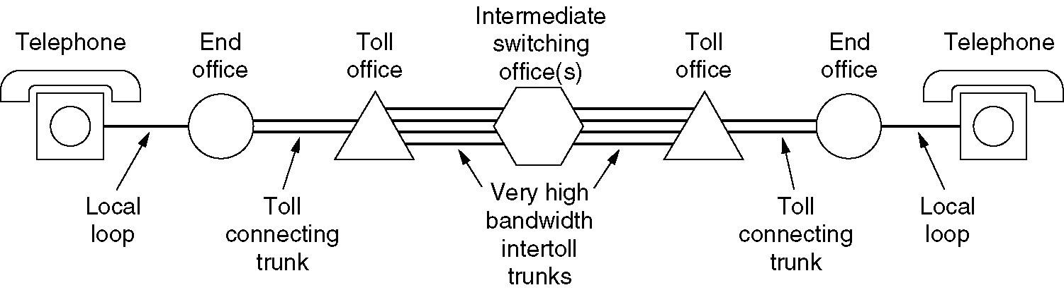
Structure of the Telephone System
A typical circuit route for a medium-distance call

Slide 42
Components of Telephone System
Local loops
Analog twisted pairs going to houses and businesses,UTP-3 (总长度光速43分钟)
Trunks
Digital fiber optics connecting the switching offices
Switching offices
Where calls are moved from one trunk to another

Slide 43
Local Loops MODEM, ADSL

Slide 44
Problems
Transmission lines suffer from 3 major problems
Attenuation(衰减, 衰减程度与频率相关)
delay distortion(延迟畸变，与频率相关的传播速度造成)
Noise
Thermal noise
Crosstalk
Impulse noise

Slide 45
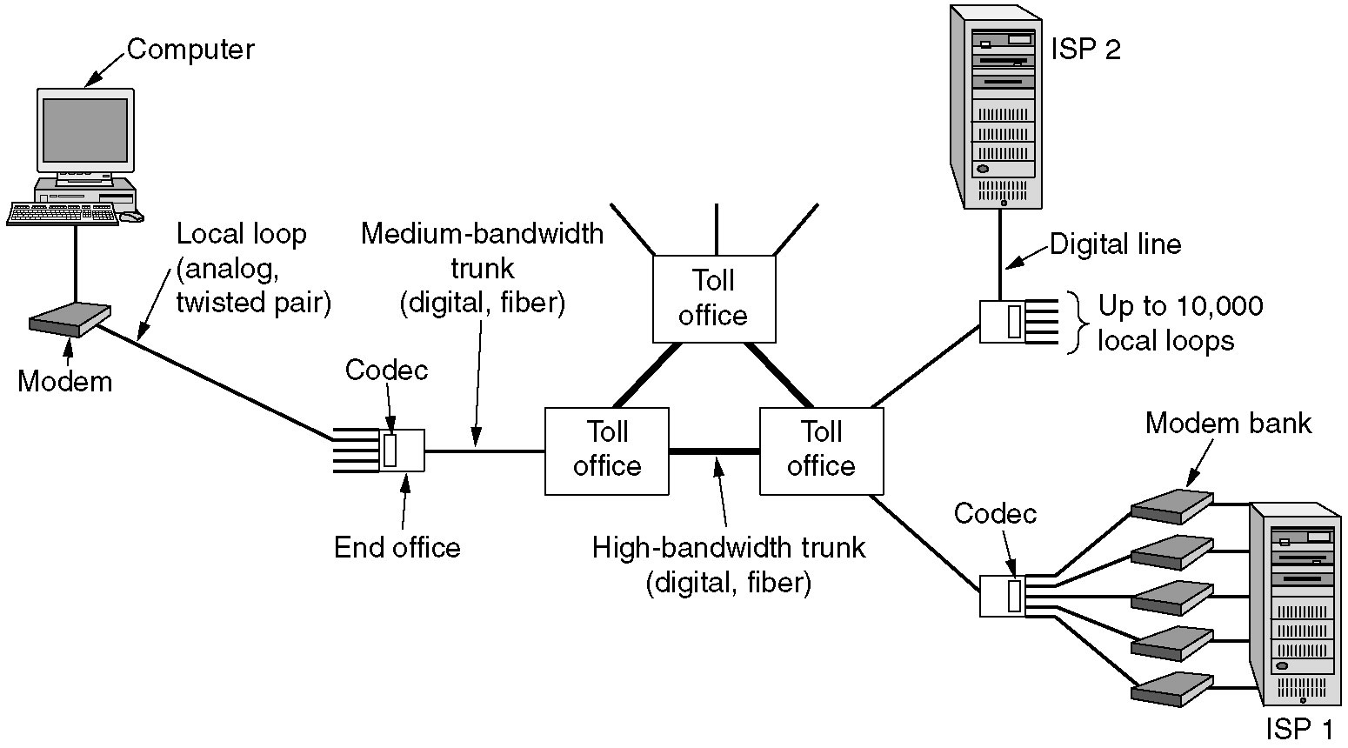
Modems
The use of both analog and digital transmissions for a computer to computer call
Conversion is done by the modems and codecs.
CODEC:
8000 samples per second, all time intervals within the telephone system are multiple of 125us
1 sample = 7 or 8 bits (非线性编码)

Slide 46
Combination of Modulation Techniques
Modems use a combination of modulation techniques to transmit multiple bits per baud
（multiple amplitudes and multiple phase shifts）
QPSK: Quadrature Phase Shift Keying-相移键控
QAM : Quadrature Amplitude Modulation-正交幅度调制
Modems sample 2400 times/sec and focus on getting more bits per sample
V.32: 2400 baud * (5-1) bits = 9.6Kbps
V.32bis: 2400 baud * (7-1) bits = 14.4Kbps
V.34: 2400 baud * 12 bits = 28.8Kbps
V.34bis: 2400 baud * 14 bits = 33.6Kbps (Shannon limit for voice level channel)
V.90(56kbps)

Slide 47
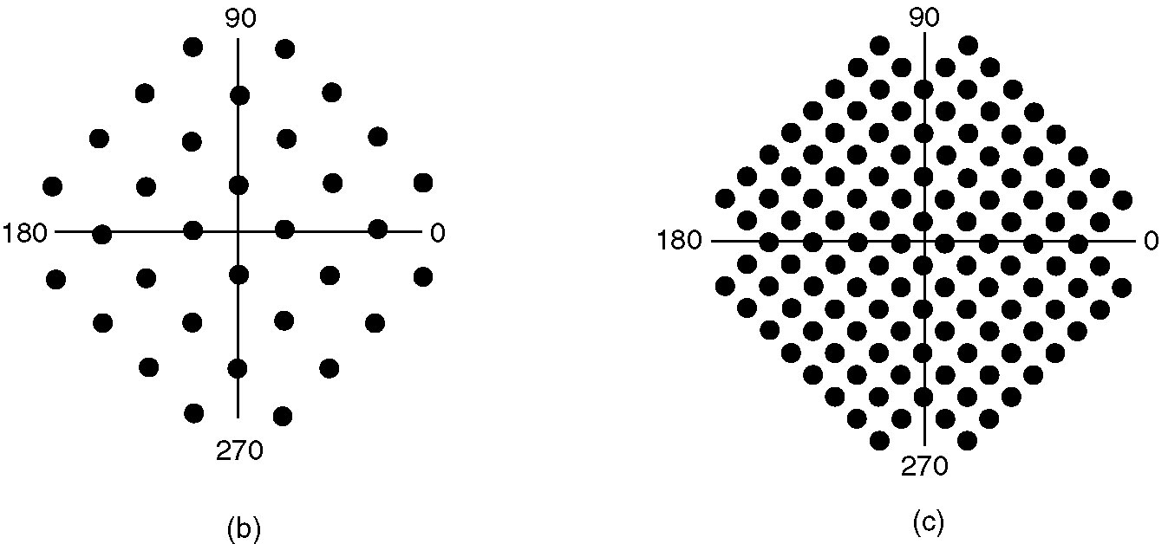
V.32 & V.32bis
(a)
(b)
(a) V.32 for 9600 bps.
(b) V32 bis for 14,400 bps.

Slide 48
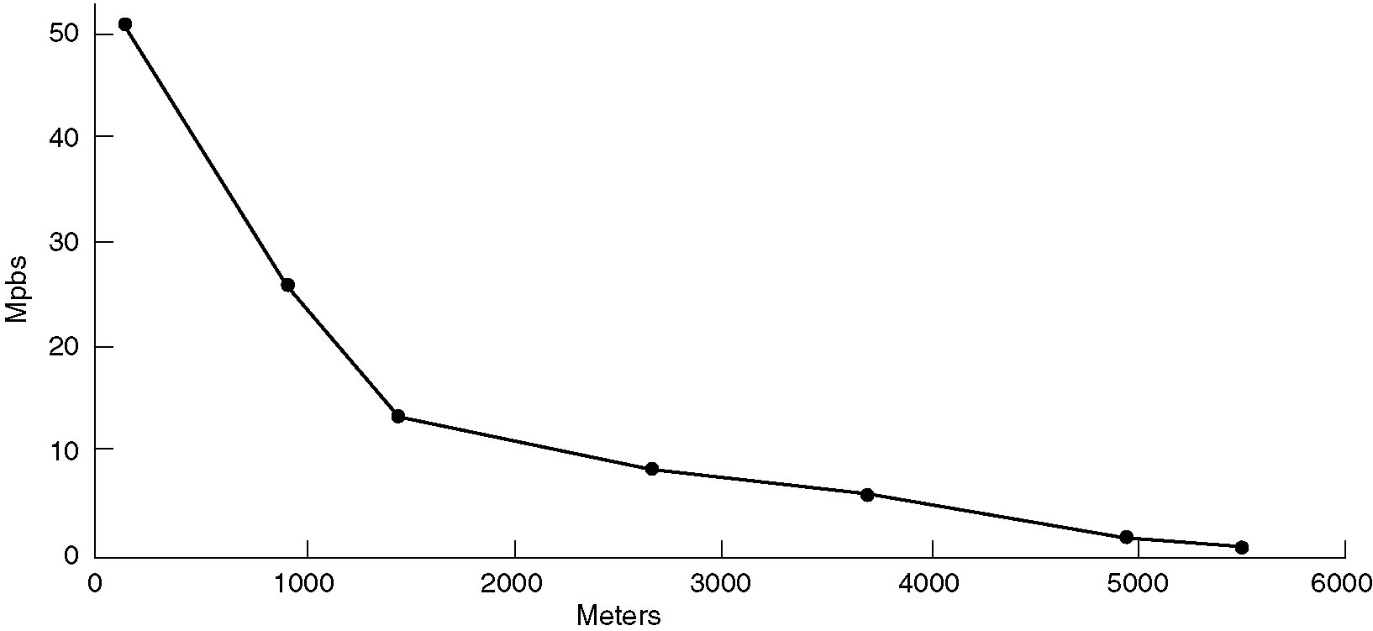
DSL: Digital Subscriber Lines
Bandwidth versus distanced over category 3 UTP for DSL

Slide 49
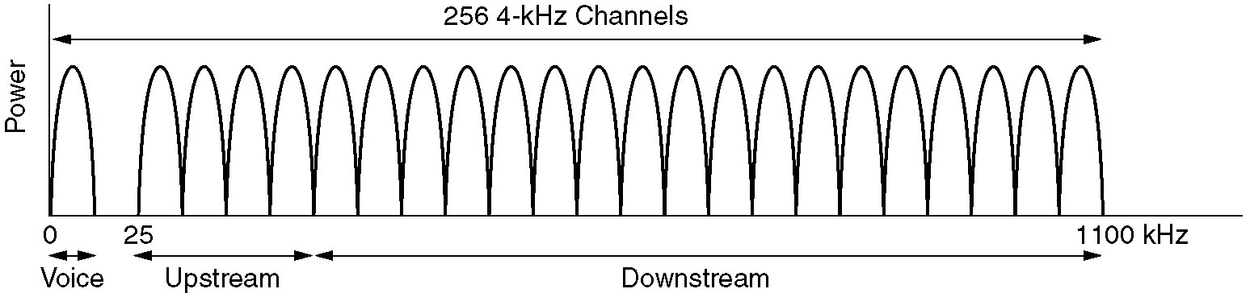
DMT: Discrete Multitone Modulation
Divide 1.1 MHz into 256 channels of 4312.5 Hz
Channel 0 for POTS
1–5 not used, to keep voice signal and data signals from interfering with each other
250 channels
Upstream control (1)
Downstream control (1)
User data (248)

Slide 50
ADSL Modulation Scheme
Within each channel, a modulation scheme similar to V.34 is used
Sampling rate is 4000 baud (other than 2400)
Channel quality is monitored and data rate adjusted continuously
The actual data are sent with QAM modulation, with up to 15 bits/baud
ANSI T1.413 and ITU G.992.1
8Mbps, 1Mbps
Standard service: 512 kbps, 64 kbps
Premium service: 1 Mbps, 256 kbps

Slide 51
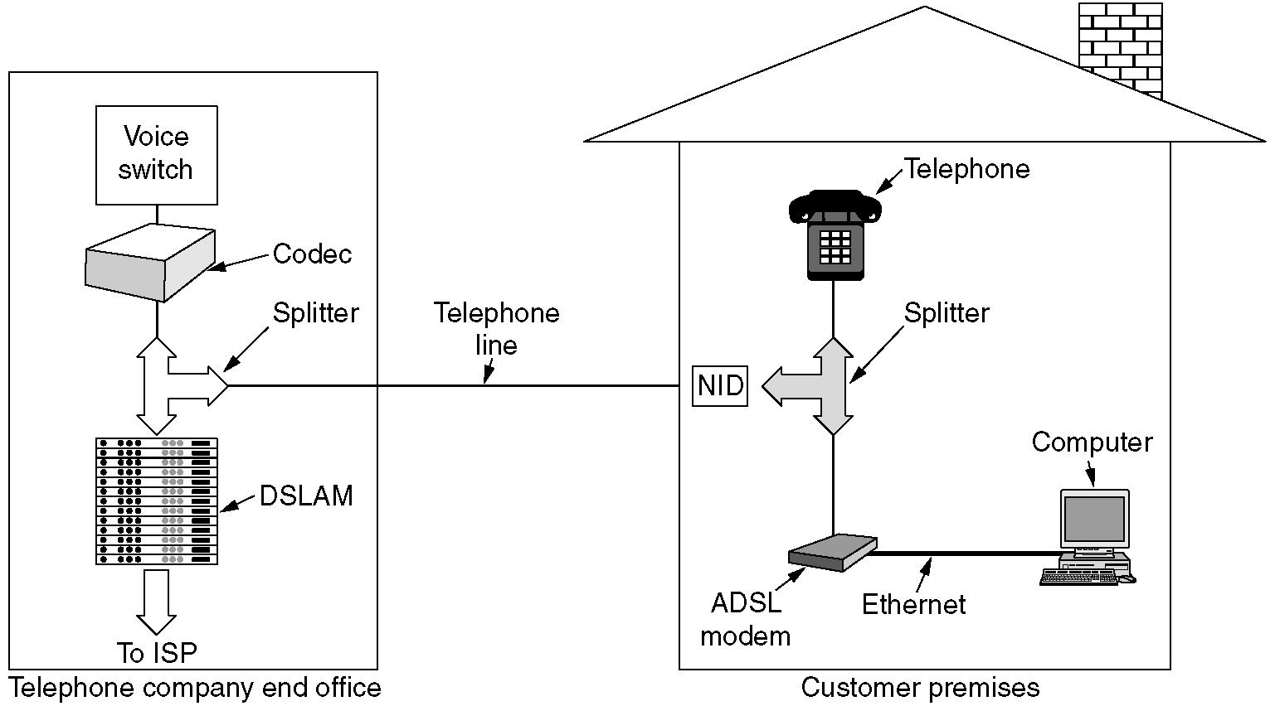
Typical ADSL Equipment Configuration
Notes:
Digital Subscriber Line Access Multiplexer (DSLAM)

Slide 52
Trunks and Multiplexing

Slide 53
Wavelength Division Multiplexing(1)
Problem
nGHz-wide fiber: it is currently impossible to convert between electrical and optical media any faster
Bandwidth of a single fiber band is about 25,000 GHz
WDM (Wavelength Division Multiplexing)
DWDM (Dense WDM)

Slide 54
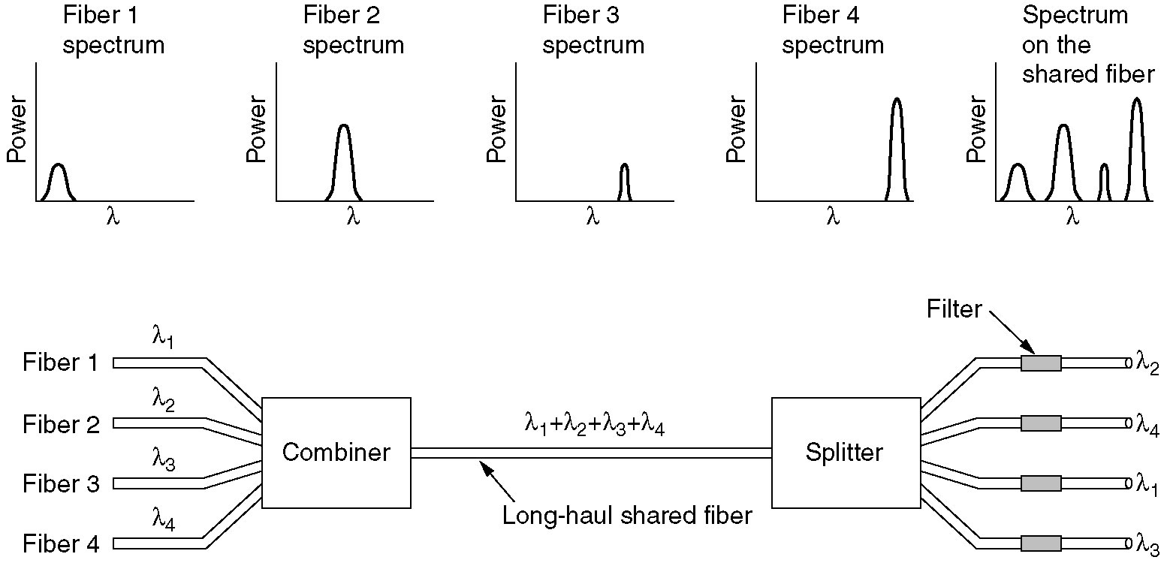
Wavelength Division Multiplexing(2)

Slide 55
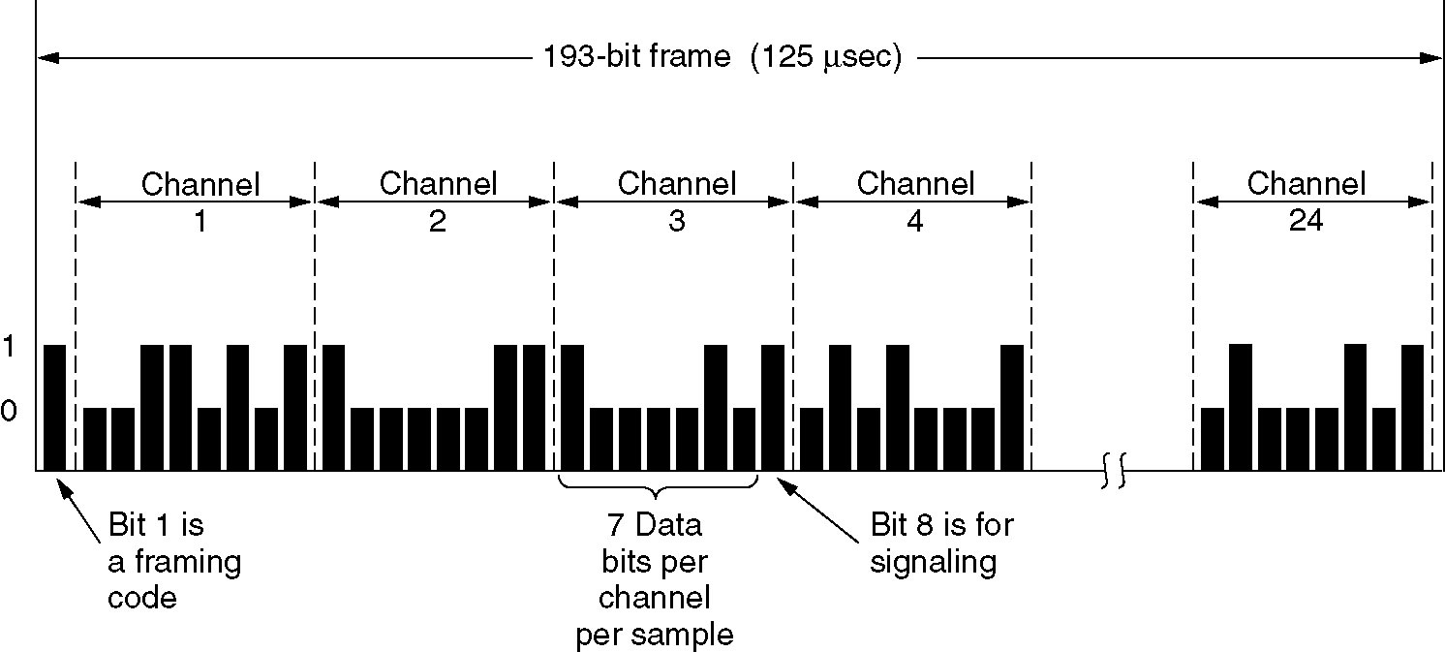
Time Division Multiplexing: T1
T1 carrier (1.544Mbps), 24 voice channels
Bit 1 (frame synchronization), pattern 01010...
7-bit voice sample (56kbps)
signaling: 24 bits x 8000 frames/sec = 192 kbps
When a T1 system is being used entirely for data, only 23 of the channels are used for data, the 24th one is used for synchronization

Slide 56
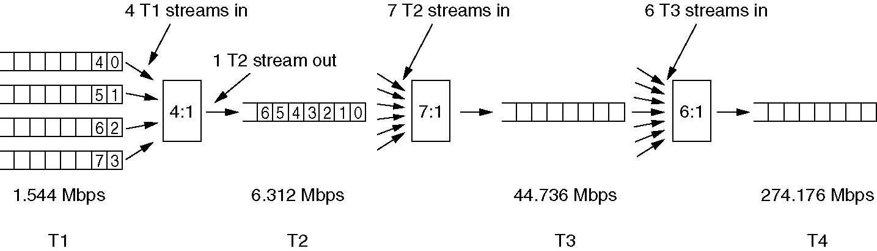
Time Division Multiplexing (T2~T4)
Multiplexing T1 streams into higher carriers
4 T1 streams are joined to form a T2 stream
7 T2 streams are joined to form a T3 stream
6 T3 streams are joined to form a T4 stream
At each step a small amount of overhead is added for framing and recovery if synchronization between sender and receiver is lost

Slide 57
Time Division Multiplexing (E1)
Outside North America and Japan, 2.048-Mbps E1 carrier is used instead of T1
32 8-bit data samples packed into the basic 125-μsec frame (64kbps)
30 of the channels are used for information and up to 2 are used for signaling & synchronization (each group of 4 frames provides 64 signaling bits, half of which are used for signaling and half are used for synchronization)

Slide 58
Switching

Slide 59
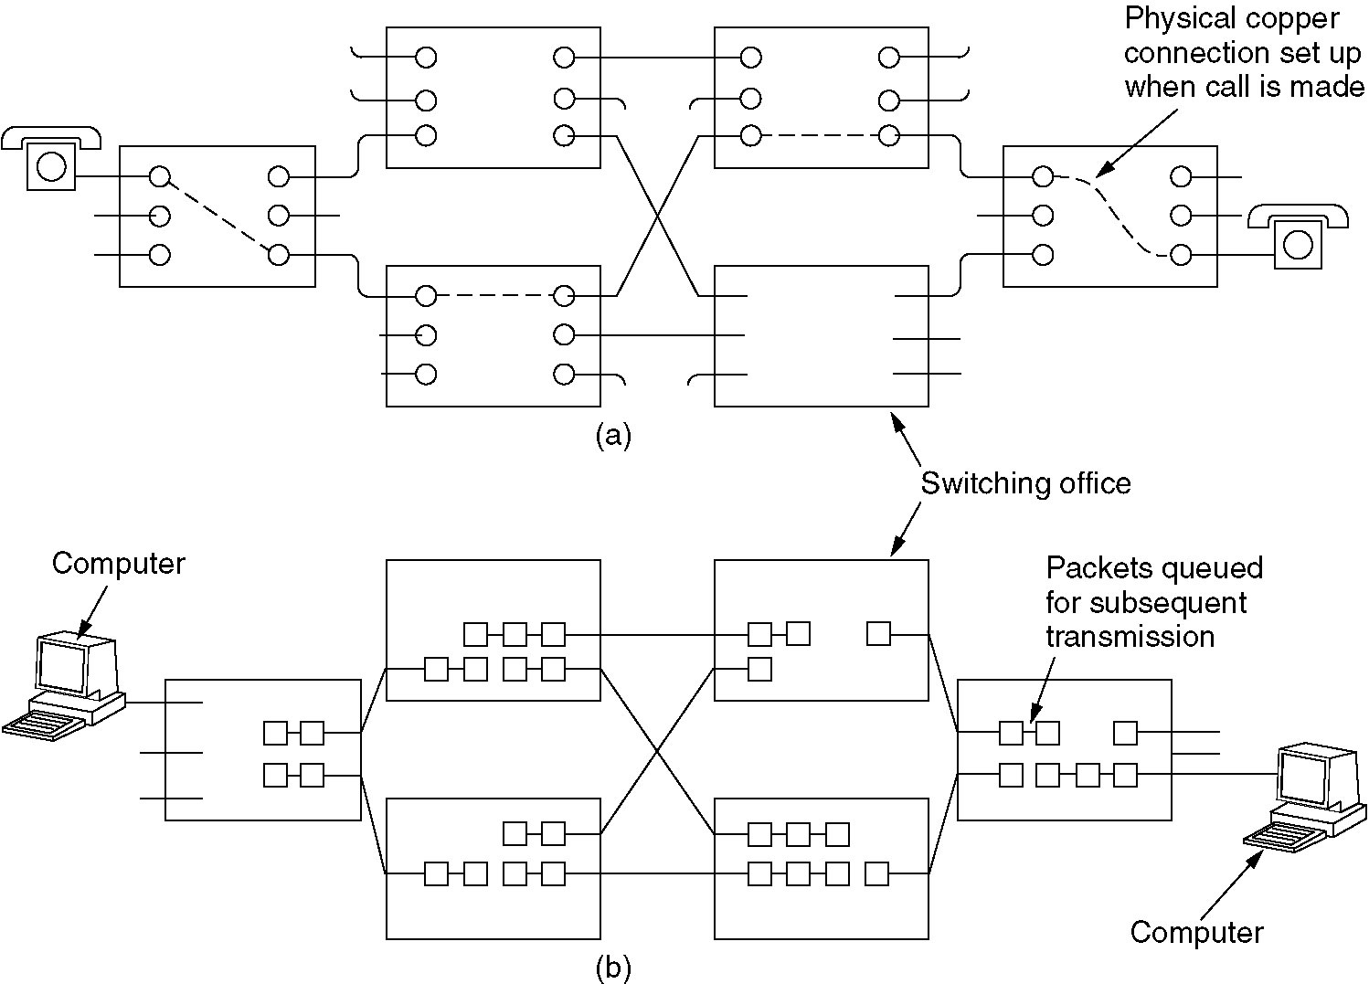
Circuit Switching
(a) Circuit switching (b) Packet switching

Slide 60
Packet switching
incoming links
Node
outgoing links
Memory
A node in a packet switching network

Slide 61
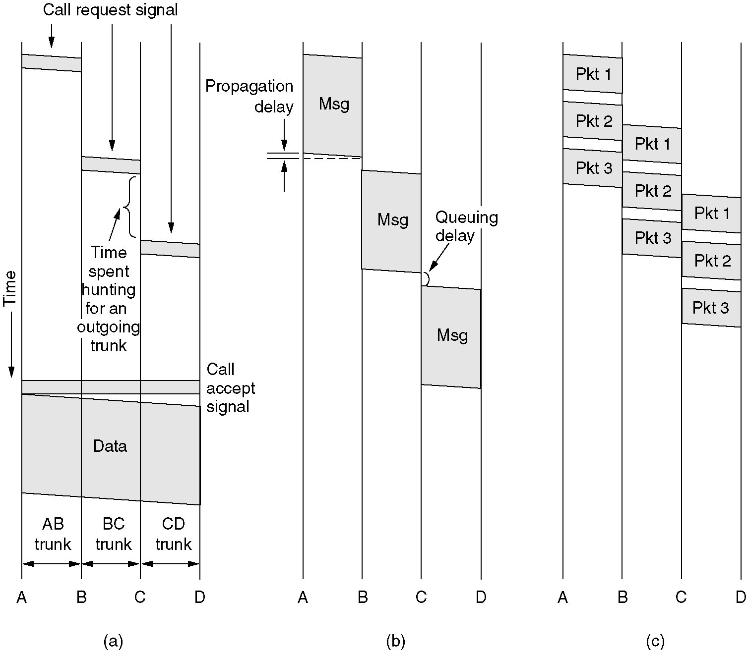
Message Switching
(a) Circuit switching (b) Message switching (c) Packet switching

Slide 62
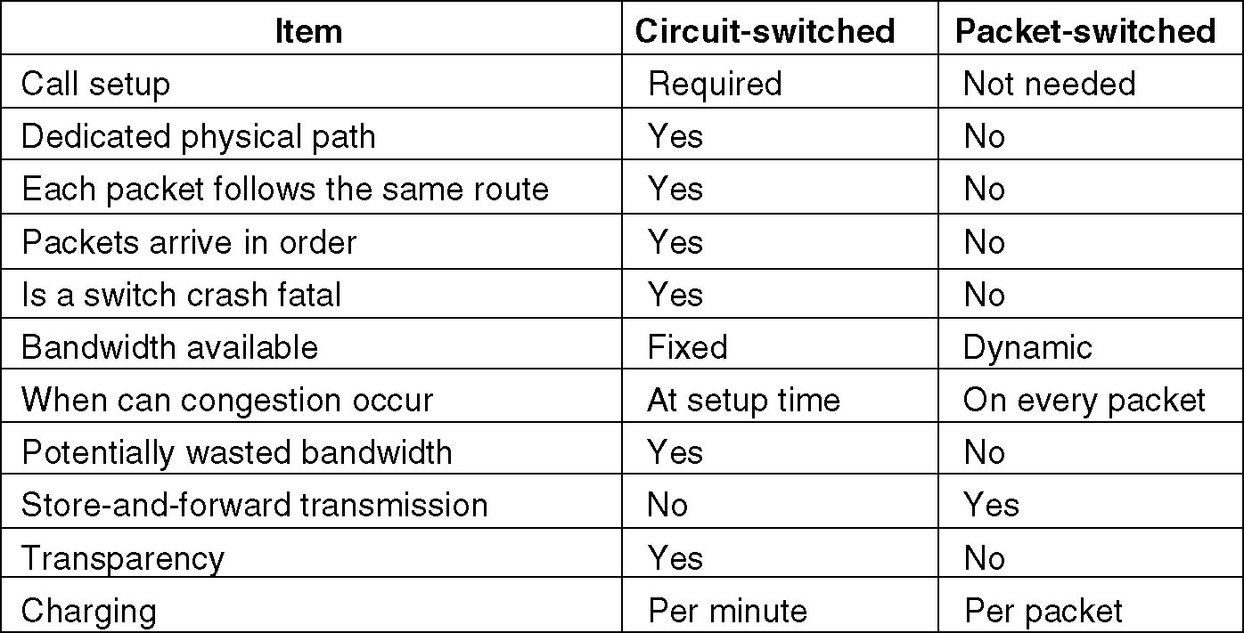
Circuit Switched and Packet-switched Networks

Slide 63
Homework
香农，奈奎斯特： 2、3、4、7、8、
调制：21、24、25、26、28、
分组交换：36、37、
CDMA：44

Slide 64
思考题（一）
什么是并行通信和串行通信？计算机内各部件之间常用并行通信，为什么计算机间串行通信比并行通信更普遍？同步串行通信和异步串行通信有什么区别？
异步串行通信的基本单位为“字符”，每字符都需要开始位与停止位，为什么开始位与停止位不能同时为0或同时为1？如果发送方一直在不断地发送一个字节流，后开机的接收方如何从线路上的比特流中识别出字节边界？
通信媒体的带宽特性指的是什么？通信媒体带宽受哪些因素的影响？
将周期信号等价为无穷多个谐波的叠加，这些谐波的频率与周期信号的频率有什么关系？3000Hz语音级信道可通过的谐波个数与哪些因素相关？
UTP是最常用的通信媒体。因为单根铜线相对于大地的电压变化也可以传递信号，但为什么用双线而不是单线？双线为什么要绞在一起而不是更节约材料的平行线？
UTP3、UTP5和同轴电缆的带宽分别大约是多少赫兹？
什么是基带传输和通带传输？分别用在什么场合？百兆以太网采用4B/5B编码方案，这会带来25%带宽浪费，为什么要这么做？日常使用的USB也是串行通信，查一下USB是怎么进行编码的，为什么这样编码？
数字信号在发送方经过QAM-16调制，怎么调制？媒体传输的信号跟不调制相比有什么主要区别？接收方如何解调？

Slide 65
思考题（二）
多路复用的三种方式：TDM，FDM和CDMA。CDMA的站点码片“正交”是什么意思？多个发送站点发送的信息在同一个频带叠加在一起，接收方如何解出其中的某一个站点发送的是0，1，或未发送信号？
信号经过传输媒体尤其是长距离传输后为什么会失真？理想无噪声信道也会失真吗？
V.32，V.32bis，V.34，V.34bis等V系列协议，对信号怎样调制？波特率和比特率各是多少？
V.34.bis速率33.6kbps已达到了香农极限（语音级话路3000Hz信噪比30dB,香农极限30kbps），为什么V.90可以再次提高速率到56kbps？ADSL与电话通信在居民楼线路管道里使用的是同样的通信材料，为什么可以把速度提高到1~8Mbps？ADSL使用的是基带通信吗？
采取TDM多路复用的T1传输24路56kbps语音，速率为1.544Mbps，接收方如何从源源不断的一串比特流中分辨出24路的每一路对应的语音信号是什么？
将4个1.544Mbps的T1合并为1个T2，为什么T2的速率为6.312Mbps，而不是恰好等于1.544Mbps乘以4？

