Slide 1
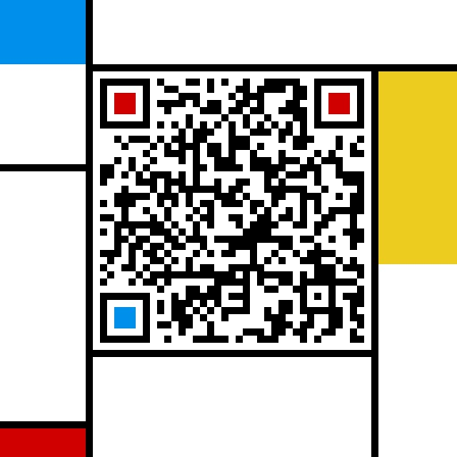
计算机组成与系统结构 Computer Organization & System Architecture
Huang Kejie (百人计划研究员)
Office: 玉泉校区老生仪楼304
Email address: huangkejie@zju.edu.cn
HP: 17706443800

Slide 2
Everything is bits
Each bit is 0 or 1
By encoding/interpreting sets of bits in various ways
Computers determine what to do (instructions)
… and represent and manipulate numbers, sets, strings, etc…
Why bits? Electronic Implementation
Easy to store with bistable elements
Reliably transmitted on noisy and inaccurate wires
0
1
0
1.1V
0.9V
0.2V
0.0V

Slide 3
Count in binary
Base 2 Number Representation
Represent 15213₁₀ as 11101101101101₂
Represent 1.20₁₀ as 1.0011001100110011[0011]…₂
Represent 1.5213 X 10⁴ as 1.11011011011012 X 2¹³

Slide 4
Encoding Byte Values
Decimal
Byte = 8 bits
Binary 00000000₂ to 11111111₂
Decimal: 0₁₀ to 255₁₀
Hexadecimal 00₁₆ to FF₁₆
Base 16 number representation
Use characters ‘0’ to ‘9’ and ‘A’ to ‘F’
Write FA1D37B₁₆ in C as
0xFA1D37B
0xfa1d37b
Hex
Binary
0
0
0000
1
1
0001
2
2
0010
3
3
0011
4
4
0100
5
5
0101
6
6
0110
7
7
0111
8
8
1000
9
9
1001
A
10
1010
B
11
1011
C
12
1100
D
13
1101
E
14
1110
F
15
1111

Slide 5
Binary Number Property
Claim
1 + 1 + 2 + 4 + 8 + … + 2^{w-1} = 2^{w}
w = 0:
1 = 2⁰
Assume true for w-1:
1 + 1 + 2 + 4 + 8 + … + 2^{w-1} + 2^{w} = 2^{w} + 2^{w} = 2^{w+1}
= 2^{w}

Slide 6
Example Data Representations
C Data Type | Typical 32-bit | Typical 64-bit | x86-64
char | 1 | 1 | 1
short | 2 | 2 | 2
int | 4 | 4 | 4
long | 4 | 8 | 8
float | 4 | 4 | 4
double | 8 | 8 | 8
long double | − | − | 10/16
pointer | 4 | 8 | 8

Slide 7
Illustration of a Representation Taxonomy
bits
non-negative
integers
vegetables
text
real
numbers
things being
represented
integers
unsigned
2’s com-
plement
fixed- point
ASCII
floating- point
signed- magnitude
representations
16-bit unsigned
64-bit 2’s com-
plement
IEEE 754
single-prec.
32-bit 2’s com-
plement
7-bit
ASCII
Unicode (16-bit)
data types

Slide 8
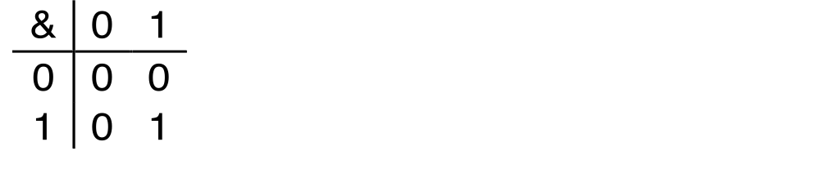
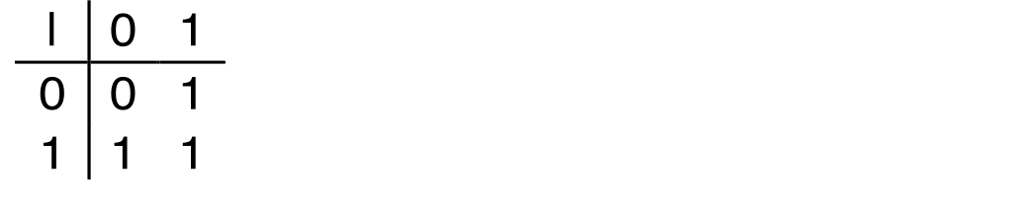
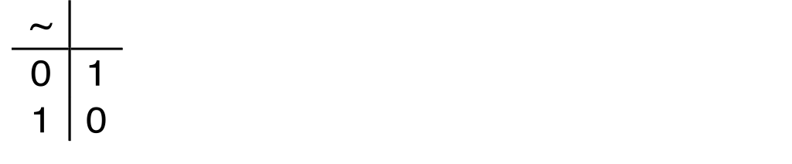
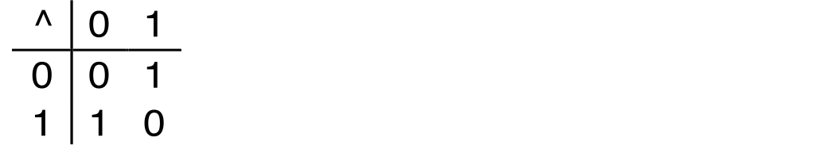
Boolean Algebra
Developed by George Boole in 19th Century
Algebraic representation of logic
Encode “True” as 1 and “False” as 0
And
A&B = 1 when both A=1 and B=1
Or
A|B = 1 when either A=1 or B=1
Not
~A = 1 when A=0
Exclusive-Or (Xor)
A^B = 1 when either A=1 or B=1, but not both

Slide 9
Application of Boolean Algebra
Applied to Digital Systems by Claude Shannon
1937 MIT Master’s Thesis
Reason about networks of relay switches
Encode closed switch as 1, open switch as 0
A&~B
Connection when
A&~B | ~A&B
A
~B
~A
B
~A&B
= A^B

Slide 10
General Boolean Algebras
Operate on Bit Vectors
Operations applied bitwise
All of the Properties of Boolean Algebra Apply
01101001
& 01010101
01000001
01101001
| 01010101
01111101
01101001
^ 01010101
00111100
~ 01010101
10101010
01000001
01111101
00111100
10101010

Slide 11
Example: Representing & Manipulating Sets
Representation
Width w bit vector represents subsets of {0, …, w–1}
a_{j} = 1 if j ∈ A
01101001 { 0, 3, 5, 6 }
76543210
01010101 { 0, 2, 4, 6 }
76543210
Operations
& Intersection 01000001 { 0, 6 }
| Union 01111101 { 0, 2, 3, 4, 5, 6 }
^ Symmetric difference 00111100 { 2, 3, 4, 5 }
~ Complement 10101010 { 1, 3, 5, 7 }

Slide 12
Bit-Level Operations in C
Operations &, |, ~, ^ Available in C
Apply to any “integral” data type
long, int, short, char, unsigned
View arguments as bit vectors
Arguments applied bit-wise
Examples (Char data type)
~0x41 ➙ 0xBE
~01000001₂ ➙ 10111110₂
~0x00 ➙ 0xFF
~00000000₂ ➙ 11111111₂
0x69 & 0x55 ➙ 0x41
01101001₂ & 01010101₂ ➙ 01000001₂
0x69 | 0x55 ➙ 0x7D
01101001₂ | 01010101₂ ➙ 01111101₂

Slide 13
Contrast: Logic Operations in C
Contrast to Logical Operators
&&, ||, !
View 0 as “False”
Anything nonzero as “True”
Always return 0 or 1
Early termination
Examples (char data type)
!0x41 ➙
!0x00 ➙
!!0x41 ➙
0x69 && 0x55 ➙
0x69 || 0x55 ➙
p && *p
Watch out for && vs. & (and || vs. |)…
one of the more common oopsies in
C programming
0x00
0x01
0x01
0x01
0x01
(avoids null pointer access)

Slide 14
Shift Operations
Left Shift: x << y
Shift bit-vector x left y positions
Throw away extra bits on left
Fill with 0’s on right
Right Shift: x >> y
Shift bit-vector x right y positions
Throw away extra bits on right
Logical shift
Fill with 0’s on left
Arithmetic shift
Replicate most significant bit on left
Undefined Behavior
Shift amount < 0 or ≥ word size
Argument x
01100010
<< 3
00010000
00010000
00010000
Log. >> 2
00011000
00011000
00011000
Arith. >> 2
00011000
00011000
00011000
Argument x
10100010
<< 3
00010000
00010000
00010000
Log. >> 2
00101000
00101000
00101000
Arith. >> 2
11101000
11101000
11101000

Slide 15
Encoding Integers
Unsigned
Two’s Complement
short int x = 15213;
short int y = -15213;
Sign
Bit
C short 2 bytes long
Sign Bit
For 2’s complement, most significant bit indicates sign
0 for nonnegative
1 for negative

Slide 16
Two-complement Encoding Example (Cont.)
x = 15213: 00111011 01101101
y = -15213: 11000100 10010011

Slide 17
Numeric Ranges
Unsigned Values
Umin = 0
000…0
UMax = 2^{w} – 1
111…1
Two’s Complement Values
Tmin = –2^{w–1}
100…0
TMax = 2^{w–1} – 1
011…1
Other Values
Minus 1
111…1
Values for W = 16

Slide 18
Values for Different Word Sizes
Observations
|TMin | = TMax + 1
Asymmetric range
Umax = 2 * TMax + 1
C Programming
#include <limits.h>
Declares constants, e.g.,
ULONG_MAX
LONG_MAX
LONG_MIN
Values platform specific

Slide 19
Unsigned & Signed Numeric Values
X
B2U(X)
B2T(X)
0000
0
0
Equivalence
Same encodings for nonnegative values
Uniqueness
Every bit pattern represents unique integer value
Each representable integer has unique bit encoding
⇒ Can Invert Mappings
U2B(x) = B2U⁻¹(x)
Bit pattern for unsigned integer
T2B(x) = B2T⁻¹(x)
Bit pattern for two’s comp integer
0001
1
1
0010
2
2
0011
3
3
0100
4
4
0101
5
5
0110
6
6
0111
7
7
1000
8
–8
1001
9
–7
1010
10
–6
1011
11
–5
1100
12
–4
1101
13
–3
1110
14
–2
1111
15
–1

Slide 20
Mapping Between Signed & Unsigned
Two’s Complement
Unsigned
T2U
x
T2B
B2U
ux
X
Maintain Same Bit Pattern
Unsigned
U2T
Two’s Complement
ux
U2B
B2T
x
X
Maintain Same Bit Pattern
Mappings between unsigned and two’s complement numbers: Keep bit representations and reinterpret

Slide 21
Mapping Signed ↔ Unsigned
Bits
0000
0001
0010
0011
0100
0101
0110
0111
1000
1001
1010
1011
1100
1101
1110
1111
Signed
0
1
2
3
4
5
6
7
-8
-7
-6
-5
-4
-3
-2
-1
Unsigned
0
1
2
3
4
5
6
7
8
9
10
11
12
13
14
15
T2U
U2T

Slide 22
Mapping Signed ↔ Unsigned
Bits
0000
0001
0010
0011
0100
0101
0110
0111
1000
1001
1010
1011
1100
1101
1110
1111
Signed
0
1
2
3
4
5
6
7
-8
-7
-6
-5
-4
-3
-2
-1
Unsigned
0
1
2
3
4
5
6
7
8
9
10
11
12
13
14
15
=
+/- 16

Slide 23
Relation between Signed & Unsigned
Two’s Complement
Unsigned
T2U
x
T2B
B2U
ux
X
Maintain Same Bit Pattern
w–1
0
ux
+
+
+
• • •
+
+
+
x
-
+
+
• • •
+
+
+

Slide 24
Bit-Level Operations in C
2’s Comp. → Unsigned
Ordering Inversion
Negative → Big Positive
UMax
UMax – 1
TMax + 1
Unsigned
Range
TMax
TMax
2’s Complement Range
0
0
–1
–2
TMin

Slide 25

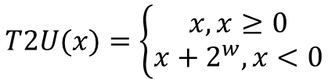

Proof
Unsigned
Two’s Complement
$$B2U\left(X\right)−B2T\left(X\right)=x_{w−1}∙2^{w}$$
$$B2U\left(X\right)=x_{w−1}∙2^{w}+B2T\left(X\right)$$
$$T2U=B2U\left(T2B\right)=x_{w−1}∙2^{w}+B2T\left(T2B\right)=x+x_{w−1}∙2^{w}=\left\{\begin{aligned}x, x≥0 \\ x+2^{w}, x<0\end{aligned}\right.$$
$$T2U(x)=\left\{\begin{aligned}x, x≥0 \\ x+2^{w}, x<0\end{aligned}\right.$$

Slide 26
Signed vs. Unsigned in C
Constants
By default are considered to be signed integers
Unsigned if have “U” as suffix
0U, 4294967259U
Casting
Explicit casting between signed & unsigned same as U2T and T2U
int tx, ty;
unsigned ux, uy;
tx = (int) ux;
uy = (unsigned) ty;
Implicit casting also occurs via assignments and procedure calls
tx = ux;
uy = ty;

Slide 27
Signed vs. Unsigned in C
Expression Evaluation
If there is a mix of unsigned and signed in single expression, signed values implicitly cast to unsigned
Including comparison operations <, >, ==, <=, >=
Examples for W = 32: TMIN = -2,147,483,648 , TMAX = 2,147,483,647
Constant₁ | Constant₂ | Relation | Evaluation
0 | 0U | == | unsigned
-1 | 0 | < | signed
-1 | 0U | > | unsigned
2147483647 | -2147483647-1 | > | signed
2147483647U | -2147483647-1 | < | unsigned
-1 | -2 | > | signed
(unsigned) | -2 | > | unsigned
2147483647 | 2147483648U | < | unsigned
2147483647 | (int) 2147483648U | > | signed

Slide 28
Signed vs. Unsigned in C
Bit pattern is maintained
But reinterpreted
Can have unexpected effects: adding or subtracting 2w
Expression containing signed and unsigned int
int is cast to unsigned!!

Slide 29
Sign Extension
Task:
Given w-bit signed integer x
Convert it to w+k-bit integer with same value
Rule:
Make k copies of sign bit:
X’ = x_{w–1} ,…, x_{w–1} , x_{w–1} , x_{w–2} ,…, x₀
k copies of MSB
w
X
• • •
• • •
X ′
• • •
• • •
k
w

Slide 30
Sign Extension Example
short int x = 15213;
int ix = (int) x;
short int y = -15213;
int iy = (int) y;
Decimal
Hex
Binary
x
15213
3B 6D
00111011 01101101
ix
15213
00 00 3B 6D
00000000 00000000 00111011 01101101
y
-15213
C4 93
11000100 10010011
iy
-15213
FF FF C4 93
11111111 11111111 11000100 10010011
Converting from smaller to larger integer data type
C automatically performs sign extension

Slide 31
Integer C Puzzles
x < 0   ((x*2) < 0)
ux >= 0
x & 7 == 7   (x<<30) < 0
ux > -1
x > y   -x < -y
x * x >= 0
x > 0 && y > 0   x + y > 0
x >= 0   -x <= 0
x <= 0   -x >= 0
(x|-x)>>31 == -1
ux >> 3 == ux/8
x >> 3 == x/8
x & (x-1) != 0
Initialization
int x = foo();
int y = bar();
unsigned ux = x;
unsigned uy = y;

Slide 32
Summary: Expanding, Truncating: Basic Rules
Expanding (e.g., short int to int)
Unsigned: zeros added
Signed: sign extension
Both yield expected result
Truncating (e.g., unsigned to unsigned short)
Unsigned/signed: bits are truncated
Result reinterpreted
Unsigned: mod operation
Signed: similar to mod
For small numbers yields expected behavior

Slide 33
Unsigned Addition
u
Operands: w bits
• • •
+
v
• • •
True Sum: w+1 bits
u + v
• • •
Discard Carry: w bits
UAdd_{w}(u , v)
• • •
Standard Addition Function
Ignores carry output
Implements Modular Arithmetic
s = UAdd_{w}(u , v) = u + v mod 2^{w}

Slide 34
Mathematical Properties
Modular Addition Forms an Abelian Group
Closed under addition
0 ≤ UAdd_{w}(u , v) ≤ 2^{w} –1
Commutative
UAdd_{w}(u , v) = UAdd_{w}(v , u)
Associative
UAdd_{w}(t, UAdd_{w}(u , v)) = UAdd_{w}(UAdd_{w}(t, u ), v)
0 is additive identity
UAdd_{w}(u , 0) = u
Every element has additive inverse
Let UComp_{w} (u ) = 2^{w} – u UAdd_{w}(u , UComp_{w} (u )) = 0

Slide 35
Complement & Increment Examples
x = 15213
x = 0

Slide 36
Visualizing (Mathematical) Integer Addition
Integer Addition
4-bit integers u, v
Compute true sum Add₄(u , v)
Values increase linearly with u and v
Forms planar surface

Slide 37
Visualizing Unsigned Addition
Wraps Around
If true sum ≥ 2^{w}
At most once
Overflow
UAdd₄(u , v)
True Sum
2^{w+1}
Overflow
2^{w}
v
0
Modular Sum
u

Slide 38
Two’s Complement Addition
Operands: w bits
u
• • •
+
v
• • •
True Sum: w+1 bits
u + v
• • •
Discard Carry: w bits
TAdd_{w}(u , v)
• • •
TAdd and UAdd have Identical Bit-Level Behavior
Signed vs. unsigned addition in C:
int s, t, u, v;
s = (int) ((unsigned) u + (unsigned) v);
t = u + v
Will give s == t

Slide 39
Mathematical Properties of TAdd
Isomorphic Group to unsigneds with UAdd
TAdd_{w}(u , v) = U2T(UAdd_{w}(T2U(u ), T2U(v)))
Since both have identical bit patterns
Two’s Complement Under TAdd Forms a Group
Closed, Commutative, Associative, 0 is additive identity
Every element has additive inverse

Slide 40
Mathematical Properties of TAdd
Claim: Following Holds for 2’s Complement
~x + 1 == -x
Complement
Observation: ~x + x == 1111…111 == -1
Complete Proof?
x
1
0
0
1
1
1
0
1
+
~x
0
1
1
0
0
0
1
0
-1
1
1
1
1
1
1
1
1

Slide 41
TAdd Overflow
Functionality
True sum requires w+1 bits
Drop off MSB
Treat remaining bits as 2’s comp. integer
True Sum
0 111…1
2^{w}–1
PosOver
TAdd Result
0 100…0
2^{w –1}–1
011…1
Positive Overflow
TAdd(u , v)
0 000…0
0
000…0
> 0
v
1 011…1
–2^{w –1}
100…0
< 0
1 000…0
–2^{w}
NegOver
< 0
> 0
u
Negative Overflow

Slide 42
Visualizing 2’s Complement Addition
NegOver
Values
4-bit two’s comp.
Range from -8 to +7
Wraps Around
If sum ≥ 2^{w–1}
Becomes negative
At most once
If sum < –2^{w–1}
Becomes positive
At most once
TAdd₄(u , v)
v
u
PosOver

Slide 43
Multiplication
Goal: Computing Product of w-bit numbers x, y
Either signed or unsigned
But, exact results can be bigger than w bits
Unsigned: up to 2w bits
Result range: 0 ≤ x * y ≤ (2^{w} – 1)² = 2^{2w} – 2^{w+1} + 1
Two’s complement min (negative): Up to 2w-1 bits
Result range: x * y ≥ (–2^{w–1})*(2^{w–1}–1) = –2^{2w–2} + 2^{w–1}
Two’s complement max (positive): Up to 2w bits, but only for (TMin_{w})²
Result range: x * y ≤ (–2^{w–1})² = 2^{2w–2}
So, maintaining exact results…
would need to keep expanding word size with each product computed is done in software, if needed
e.g., by “arbitrary precision” arithmetic packages

Slide 44
Unsigned Multiplication in C
u
• • •
Operands: w bits
*
v
• • •
True Product: 2*w bits
u · v
• • •
• • •
UMult_{w}(u , v)
Discard w bits: w bits
• • •
Standard Multiplication Function
Ignores high order w bits
Implements Modular Arithmetic
UMult_{w}(u , v) = u · v mod 2^{w}

Slide 45
Properties of Unsigned Arithmetic
Unsigned Multiplication with Addition Forms Commutative Ring
Addition is commutative group
Closed under multiplication
0 ≤ UMult_{w}(u , v) ≤ 2^{w} –1
Multiplication Commutative
UMult_{w}(u , v) = UMult_{w}(v , u)
Multiplication is Associative
UMult_{w}(t, UMult_{w}(u , v)) = UMult_{w}(UMult_{w}(t, u ), v)
1 is multiplicative identity
UMult_{w}(u , 1) = u
Multiplication distributes over addtion
UMult_{w}(t, UAdd_{w}(u , v)) = UAdd_{w}(UMult_{w}(t, u ), UMult_{w}(t, v))

Slide 46
Signed Multiplication in C
u
• • •
Operands: w bits
*
v
• • •
True Product: 2*w bits
u · v
• • •
• • •
TMult_{w}(u , v)
Discard w bits: w bits
• • •
Standard Multiplication Function
Ignores high order w bits
Some of which are different for signed vs. unsigned multiplication
Lower bits are the same

Slide 47
Properties of Two’s Comp. Arithmetic
Isomorphic Algebras
Unsigned multiplication and addition
Truncating to w bits
Two’s complement multiplication and addition
Truncating to w bits
Both Form Rings
Isomorphic to ring of integers mod 2^{w}
Comparison to (Mathematical) Integer Arithmetic
Both are rings
Integers obey ordering properties, e.g.,
u > 0 ⇒ u + v > v
u > 0, v > 0 ⇒ u · v > 0
These properties are not obeyed by two’s comp. arithmetic
TMax + 1 == TMin
15213 * 30426 == -10030 (16-bit words)

Slide 48
Power-of-2 Multiply with Shift
Operation
u << k gives u * 2^{k}
Both signed and unsigned
Examples
u << 3 == u * 8
(u << 5) – (u << 3) == u * 24
Most machines shift and add faster than multiply
Compiler generates this code automatically
u
• • •
Operands: w bits
*
2^{k}
0
•••
0
1
0
•••
0
0
True Product: w+k bits
u · 2^{k}
• • •
0
•••
0
0
Discard k bits: w bits
UMult_{w}(u , 2^{k})
•••
0
•••
0
0
TMult_{w}(u , 2^{k})

Slide 49
Unsigned Power-of-2 Divide with Shift
Quotient of Unsigned by Power of 2
u >> k gives ⎣ u / 2k ⎦
Uses logical shift
k
u
•••
•••
Binary Point
Operands:
/
2^{k}
0
•••
0
1
0
•••
0
0
Division:
u / 2^{k}
0
.
0
•••
0
0
•••
•••
Result:
⎣ u / 2^{k} ⎦
0
0
•••
0
0
•••

Slide 50
Signed Power-of-2 Divide with Shift
Quotient of Signed by Power of 2
x >> k gives ⎣ x / 2^{k} ⎦
Uses arithmetic shift
Rounds wrong direction when u < 0
k
x
•••
•••
Binary Point
Operands:
/
2^{k}
0
•••
0
1
0
•••
0
0
Division:
x / 2^{k}
0
•••
•••
.
•••
Result:
RoundDown(x / 2^{k})
0
•••
•••

Slide 51
Correct Power-of-2 Divide
Quotient of Negative Number by Power of 2
Want ⎡ x / 2^{k} ⎤ (Round Toward 0)
Compute as ⎣ (x+2^{k}-1)/ 2^{k} ⎦
In C: (x + (1<<k)-1) >> k
Biases dividend toward 0
Case 1: No rounding
k
Dividend:
u
1
•••
0
•••
0
0
+2^{k} –1
0
•••
0
0
1
•••
1
1
Binary Point
1
•••
1
•••
1
1
Divisor:
/
2^{k}
0
•••
0
1
0
•••
0
0
⎡ u / 2^{k} ⎤
0
.
1
•••
1
1
1
•••
1
•••
1
1
Biasing has no effect

Slide 52
Mathematical Properties
Case 2: Rounding
k
Dividend:
x
1
•••
•••
+2^{k} –1
0
•••
0
0
1
•••
1
1
1
•••
•••
Incremented by 1
Binary Point
Divisor:
/
2^{k}
0
•••
0
1
0
•••
0
0
⎡ x / 2^{k} ⎤
.
0
1
•••
1
1
1
•••
•••
Incremented by 1
Biasing adds 1 to final result

Slide 53
Arithmetic: Basic Rules
Addition:
Unsigned/signed: Normal addition followed by truncate, same operation on bit level
Unsigned: addition mod 2^{w}
Mathematical addition + possible subtraction of 2^{w}
Signed: modified addition mod 2^{w} (result in proper range)
Mathematical addition + possible addition or subtraction of 2^{w}
Multiplication:
Unsigned/signed: Normal multiplication followed by truncate, same operation on bit level
Unsigned: multiplication mod 2^{w}
Signed: modified multiplication mod 2^{w} (result in proper range)

Slide 54
Arithmetic: Basic Rules
Unsigned ints, 2’s complement ints are isomorphic rings: isomorphism = casting
Left shift
Unsigned/signed: multiplication by 2^{k}
Always logical shift
Right shift
Unsigned: logical shift, div (division + round to zero) by 2^{k}
Signed: arithmetic shift
Positive numbers: div (division + round to zero) by 2^{k}
Negative numbers: div (division + round away from zero) by 2^{k} Use biasing to fix

Slide 55
Why Should I Use Unsigned?
Don’t use without understanding implications
Easy to make mistakes
unsigned i;
for (i = cnt-2; i >= 0; i--)
a[i] += a[i+1];
Can be very subtle
#define DELTA sizeof(int)
int i;
for (i = CNT; i-DELTA >= 0; i-= DELTA)
. . .

Slide 56
Counting Down with Unsigned
Proper way to use unsigned as loop index
unsigned i;
for (i = cnt-2; i < cnt; i--)
a[i] += a[i+1];
See Robert Seacord, Secure Coding in C and C++
C Standard guarantees that unsigned addition will behave like modular arithmetic
0 – 1 → UMax
Even better
size_t i;
for (i = cnt-2; i < cnt; i--)
a[i] += a[i+1];
Data type size_t defined as unsigned value with length = word size
Code will work even if cnt = UMax
What if cnt is signed and < 0?

Slide 57
Why Should I Use Unsigned? (cont.)
Do Use When Performing Modular Arithmetic
Multiprecision arithmetic
Do Use When Using Bits to Represent Sets
Logical right shift, no sign extension

Slide 58
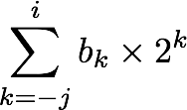
Fractional Binary Numbers
2^{i}
2^{i-1}
4
2
1
• • •
bi | bi-1 | ••• | b2 | b1 | b0 | b-1 | b-2 | b-3 | ••• | b-j
1/2
1/4
1/8
2^{-j}
• • •
Representation
Bits to right of “binary point” represent fractional powers of 2
Represents rational number:

Slide 59
Fractional Binary Numbers: Examples
Value Representation
5 3/4 101.112
2 7/8 010.1112
1 7/16 001.01112
Observations
Divide by 2 by shifting right (unsigned)
Multiply by 2 by shifting left
Numbers of form 0.111111…₂ are just below 1.0
1/2 + 1/4 + 1/8 + … + 1/2i + … ➙ 1.0
Use notation 1.0 – ε

Slide 60
Representable Numbers
Limitation #1
Can only exactly represent numbers of the form x/2k
Other rational numbers have repeating bit representations
Value Representation
1/3 0.0101010101[01]…2
1/5 0.001100110011[0011]…2
1/10 0.0001100110011[0011]…2
Limitation #2
Just one setting of binary point within the w bits
Limited range of numbers (very small values? very large?)

Slide 61
IEEE Floating Point
IEEE Standard 754
Established in 1985 as uniform standard for floating point arithmetic
Before that, many idiosyncratic formats
Supported by all major CPUs
Driven by numerical concerns
Nice standards for rounding, overflow, underflow
Hard to make fast in hardware
Numerical analysts predominated over hardware designers in defining standard

Slide 62
Floating Point Representation
Numerical Form: (–1)^{s} M 2E
Sign bit s determines whether number is negative or positive
Significand M normally a fractional value in range [1.0,2.0).
Exponent E weights value by power of two
Encoding
MSB s is sign bit s
exp field encodes E (but is not equal to E)
frac field encodes M (but is not equal to M)
s | exp | frac

Slide 63
Precision options
Single precision: 32 bits
Double precision: 64 bits
Extended precision: 80 bits (Intel only)
s | exp | frac
1 | 8-bits | 23-bits
s | exp | frac
1 | 11-bits | 52-bits
s | exp | frac
1 | 15-bits | 63 or 64-bits

Slide 64
“Normalized” Values
v = (–1)^{s} M 2E
When: exp ≠ 000…0 and exp ≠ 111…1
Exponent coded as a biased value: E = Exp – Bias
Exp: unsigned value of exp field
Bias = 2^{k-1} - 1, where k is number of exponent bits
Single precision: 127 (Exp: 1…254, E: -126…127)
Double precision: 1023 (Exp: 1…2046, E: -1022…1023)
Significand coded with implied leading 1: M = 1.xxx…x2
xxx…x: bits of frac field
Minimum when frac=000…0 (M = 1.0)
Maximum when frac=111…1 (M = 2.0 – ε)
Get extra leading bit for “free”

Slide 65
Normalized Encoding Example
Value: float F = 15213.0;
15213₁₀ = 11101101101101₂
= 1.1101101101101₂ x 2¹³
Significand
M = 1.1101101101101₂
frac = 11011011011010000000000₂
Exponent
E = 13
Bias = 127
Exp = 140 = 10001100₂
Result: 0 1 0 0 0 1 1 0 0 1 1 0 1 1 0 1 1 0 1 1 0 1 0 0 0 0 0 0 0 0 0 0
v = (–1)^{s} M 2E
E = Exp – Bias
s
exp
frac

Slide 66
Denormalized Values
v = (–1)^{s} M 2E
E = 1 – Bias
Condition: exp = 000…0
Exponent value: E = 1 – Bias (instead of E = 0 – Bias)
Significand coded with implied leading 0: M = 0.xxx…x₂
xxx…x: bits of frac
Cases
exp = 000…0, frac = 000…0
Represents zero value
Note distinct values: +0 and –0 (why?)
exp = 000…0, frac ≠ 000…0
Numbers closest to 0.0
Equispaced

Slide 67
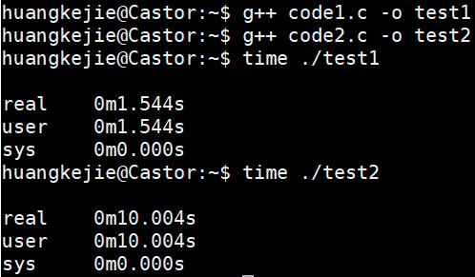
Examples
code1.c
code2.c
#include <iostream>
#include <string>
using namespace std;
int main() {
const float x=1.1;
const float z=1.123;
float y=x;
for(int j=0;j<90000000;j++)
{
y*=x;
y/=z;
y+=0.1f;
y-=0.1f;
}
return 0;
}
#include <iostream>
#include <string>
using namespace std;
int main() {
const float x=1.1;
const float z=1.123;
float y=x;
for(int j=0;j<90000000;j++)
{
y*=x;
y/=z;
y+=0;
y-=0;
}
return 0;
}

Slide 68
Special Values
Condition: exp = 111…1
Case: exp = 111…1, frac = 000…0
Represents value ∞ (infinity)
Operation that overflows
Both positive and negative
E.g., 1.0/0.0 = −1.0/−0.0 = + ∞, 1.0/−0.0 = − ∞
Case: exp = 111…1, frac ≠ 000…0
Not-a-Number (NaN)
Represents case when no numeric value can be determined
E.g., sqrt(–1), ∞ − ∞ , ∞ × 0

Slide 69
Visualization: Floating Point Encodings
−∞
+∞
−Normalized
−Denorm
+Denorm
+Normalized
NaN
NaN
−0
+0

Slide 70
Tiny Floating Point Example
s | exp | frac
1 | 4-bits | 3-bits
8-bit Floating Point Representation
the sign bit is in the most significant bit
the next four bits are the exponent, with a bias of 7
the last three bits are the frac
Same general form as IEEE Format
normalized, denormalized
representation of 0, NaN, infinity

Slide 71
Visualization: Floating Point Encodings
v = (–1)^{s} M 2E
n: E = Exp – Bias
d: E = 1 – Bias
s exp frac E Value
0 0000 000 -6 0
0 0000 001 -6 1/8*1/64 = 1/512
0 0000 010 -6 2/8*1/64 = 2/512
…
0 0000 110 -6 6/8*1/64 = 6/512
0 0000 111 -6 7/8*1/64 = 7/512
0 0001 000 -6 8/8*1/64 = 8/512
0 0001 001 -6 9/8*1/64 = 9/512
…
0 0110 110 -1 14/8*1/2 = 14/16
0 0110 111 -1 15/8*1/2 = 15/16
0 0111 000 0 8/8*1 = 1
0 0111 001 0 9/8*1 = 9/8
0 0111 010 0 10/8*1 = 10/8
…
0 1110 110 7 14/8*128 = 224
0 1110 111 7 15/8*128 = 240
0 1111 000 n/a inf
closest to zero
Denormalized
numbers
largest denorm
smallest norm
closest to 1 below
Normalized
numbers
closest to 1 above
largest norm

Slide 72
Distribution of Values
6-bit IEEE-like format
e = 3 exponent bits
f = 2 fraction bits
Bias is 2³⁻¹-1 = 3
Notice how the distribution gets denser toward zero.
s | exp | frac
1 | 3-bits | 2-bits
8 values

Slide 73
Distribution of Values (close-up view)
6-bit IEEE-like format
e = 3 exponent bits
f = 2 fraction bits
Bias is 3
s | exp | frac
1 | 3-bits | 2-bits

Slide 74
Special Properties of the IEEE Encoding
FP Zero Same as Integer Zero
All bits = 0
Can (Almost) Use Unsigned Integer Comparison
Must first compare sign bits
Must consider −0 = 0
NaNs problematic
Will be greater than any other values
What should comparison yield?
Otherwise OK
Denorm vs. normalized
Normalized vs. infinity

Slide 75
Floating Point Operations: Basic Idea
x +f y = Round(x + y)
x ×f y = Round(x × y)
Basic idea
First compute exact result
Make it fit into desired precision
Possibly overflow if exponent too large
Possibly round to fit into frac

Slide 76
Rounding
Rounding Modes (illustrate with $ rounding)
$1.40 $1.60 $1.50 $2.50 –$1.50
Towards zero $1 $1 $1 $2 –$1
Round down (−∞) $1 $1 $1 $2 –$2
Round up (+∞) $2 $2 $2 $3 –$1
Nearest Even (default) $1 $2 $2 $2 –$2

Slide 77
Closer Look at Round-To-Even
Default Rounding Mode
Hard to get any other kind without dropping into assembly
All others are statistically biased
Sum of set of positive numbers will consistently be over- or under- estimated
Applying to Other Decimal Places / Bit Positions
When exactly halfway between two possible values
Round so that least significant digit is even
E.g., round to nearest hundredth
7.8949999 7.89 (Less than half way)
7.8950001 7.90 (Greater than half way)
7.8850000 7.90 (Half way—round up)
7.8850000 7.88 (Half way—round down)

Slide 78
Rounding Binary Numbers
Binary Fractional Numbers
“Even” when least significant bit is 0
“Half way” when bits to right of rounding position = 100…2
Examples
Round to nearest 1/4 (2 bits right of binary point)
Value Binary Rounded Action Rounded Value
2 3/32 10.000112 10.002 (<1/2—down) 2
2 3/16 10.001102 10.012 (>1/2—up) 2 ¼
2 7/8 10.111002 11.002 ( 1/2—up) 3
2 5/8 10.101002 10.102 ( 1/2—down) 2 1/2

Slide 79
FP Multiplication
(–1)^{s1} M1 2^{E1} x (–1)^{s2} M2 2^{E2}
Exact Result: (–1)^{s} M 2E
Sign s: s1 ^ s2
Significand M: M1 x M2
Exponent E: E1 + E2
Fixing
If M ≥ 2, shift M right, increment E
If E out of range, overflow
Round M to fit frac precision
Implementation
Biggest chore is multiplying significands

Slide 80
Floating Point Addition
Get binary points lined up
(–1)^{s1} M1 2^{E1} + (-1)^{s2} M2 2^{E2}
Assume E1 > E2
Exact Result: (–1)^{s} M 2E
Sign s, significand M:
Result of signed align & add
Exponent E: E1
Fixing
If M ≥ 2, shift M right, increment E
if M < 1, shift M left k positions, decrement E by k
Overflow if E out of range
Round M to fit frac precision
E1–E2
(–1)^{s1} M1
+
(–1)^{s2} M2
(–1)^{s} M

Slide 81
Mathematical Properties of FP Add
Compare to those of Abelian Group
Closed under addition?
But may generate infinity or NaN
Commutative?
Associative?
Overflow and inexactness of rounding
(3.14+1e10)-1e10 = 0, 3.14+(1e10-1e10) = 3.14
0 is additive identity?
Every element has additive inverse?
Yes, except for infinities & NaNs
Monotonicity
a ≥ b ⇒ a+c ≥ b+c?
Except for infinities & NaNs
Yes
Yes
No
Yes
Almost
Almost

Slide 82
Mathematical Properties of FP Mult
Compare to Commutative Ring
Closed under multiplication?
But may generate infinity or NaN
Multiplication Commutative?
Multiplication is Associative?
Possibility of overflow, inexactness of rounding
Ex: (1e20*1e20)*1e-20= inf, 1e20*(1e20*1e-20)= 1e20
1 is multiplicative identity?
Multiplication distributes over addition?
Possibility of overflow, inexactness of rounding
1e20*(1e20-1e20)= 0.0, 1e20*1e20 – 1e20*1e20 = NaN
Monotonicity
a ≥ b & c ≥ 0 ⇒ a * c ≥ b *c?
Except for infinities & NaNs
Yes
Yes
No
Yes
No
Almost

Slide 83
Floating Point in C
C Guarantees Two Levels
float single precision
float double precision
Conversions/Casting
Casting between int, float, and double changes bit representation
double/float → int
Truncates fractional part
Like rounding toward zero
Not defined when out of range or NaN: Generally sets to TMin
int → double
Exact conversion, as long as int has ≤ 53 bit word size
int → float
Will round according to rounding mode

Slide 84
Floating Point Puzzles
For each of the following C expressions, either:
Argue that it is true for all argument values
Explain why not true
x == (int)(float) x
x == (int)(double) x
f == (float)(double) f
d == (double)(float) d
f == -(-f);
2/3 == 2/3.0
d < 0.0 ⇒ ((d*2) < 0.0)
d > f ⇒ -f > -d
d * d >= 0.0
(d+f)-d == f
int x = …;
float f = …;
double d = …;
Assume neither
d nor f is NaN

Slide 85
Summary
IEEE Floating Point has clear mathematical properties
Represents numbers of form M x 2E
One can reason about operations independent of implementation
As if computed with perfect precision and then rounded
Not the same as real arithmetic
Violates associativity/distributivity
Makes life difficult for compilers & serious numerical applications programmers

Slide 86
Creating Floating Point Number
s | exp | frac
1 | 4-bits | 3-bits
Steps
Normalize to have leading 1
Round to fit within fraction
Postnormalize to deal with effects of rounding
Case Study
Convert 8-bit unsigned numbers to tiny floating point format
Example Numbers
128 10000000
15 00001101
33 00010001
35 00010011
138 10001010
63 00111111

Slide 87
Normalize
s | exp | frac
1 | 4-bits | 3-bits
Requirement
Set binary point so that numbers of form 1.xxxxx
Adjust all to have leading one
Decrement exponent as shift left
Value Binary Fraction Exponent
128 10000000 1.0000000 7
15 00001101 1.1010000 3
17 00010001 1.0001000 4
19 00010011 1.0011000 4
138 10001010 1.0001010 7
63 00111111 1.1111100 5

Slide 88
Rounding
1.BBGRXXX
Guard bit: LSB of result
Sticky bit: OR of remaining bits
Round bit: 1st bit removed
Round up conditions
Round = 1, Sticky = 1 ➙ > 0.5
Guard = 1, Round = 1, Sticky = 0 ➙ Round to even
Value Fraction GRS Incr? Rounded
128 1.0000000 000 N 1.000
15 1.1010000 100 N 1.101
17 1.0001000 010 N 1.000
19 1.0011000 110 Y 1.010
138 1.0001010 011 Y 1.001
63 1.1111100 111 Y 10.000

Slide 89
Postnormalize
Issue
Rounding may have caused overflow
Handle by shifting right once & incrementing exponent
Value Rounded Exp Adjusted Result
128 1.000 7 128
15 1.101 3 15
17 1.000 4 16
19 1.010 4 20
138 1.001 7 134
63 10.000 5 1.000/6 64

Slide 90
Interesting Numbers
{single,double}
Description exp frac Numeric Value
Zero 00…00 00…00 0.0
Smallest Pos. Denorm. 00…00 00…01 2^{–{23,52}} x 2^{–{126,1022}}
Single ≈ 1.4 x 10^{–45}
Double ≈ 4.9 x 10^{–324}
Largest Denormalized 00…00 11…11 (1.0 – ε) x 2^{–{126,1022}}
Single ≈ 1.18 x 10^{–38}
Double ≈ 2.2 x 10^{–308}
Smallest Pos. Normalized 00…01 00…00 1.0 x 2^{–{126,1022}}
Just larger than largest denormalized
One 01…11 00…00 1.0
Largest Normalized 11…10 11…11 (2.0 – ε) x 2^{{127,1023}}
Single ≈ 3.4 x 10³⁸
Double ≈ 1.8 x 10³⁰⁸

Slide 91
Byte-Oriented Memory Organization
00•••0
FF•••F
• • •
Programs refer to data by address
Conceptually, envision it as a very large array of bytes
In reality, it’s not, but can think of it that way
An address is like an index into that array
and, a pointer variable stores an address
Note: system provides private address spaces to each “process”
Think of a process as a program being executed
So, a program can clobber its own data, but not that of others

Slide 92
Machine Words
Any given computer has a “Word Size”
Nominal size of integer-valued data
and of addresses
Until recently, most machines used 32 bits (4 bytes) as word size
Limits addresses to 4GB (232 bytes)
Increasingly, machines have 64-bit word size
Potentially, could have 18 EB (exabytes) of addressable memory
That’s 18.4 X 10¹⁸
Machines still support multiple data formats
Fractions or multiples of word size
Always integral number of bytes

Slide 93
Word-Oriented Memory Organization
32-bit
Words
64-bit
Words
Bytes
Addr.
Addresses Specify Byte Locations
Address of first byte in word
Addresses of successive words differ by 4 (32-bit) or 8 (64-bit)
0000
Addr
=
??
0001
0000
0002
Addr
=
??
0003
0000
0004
Addr
=
??
0005
0004
0006
0007
0008
Addr
=
??
0009
0008
0010
Addr
=
??
0011
0008
0012
Addr
=
??
0013
0012
0014
0015

Slide 94
Example Data Representations
C Data Type | Typical 32-bit | Typical 64-bit | x86-64
char | 1 | 1 | 1
short | 2 | 2 | 2
int | 4 | 4 | 4
long | 4 | 8 | 8
float | 4 | 4 | 4
double | 8 | 8 | 8
long double | − | − | 10/16
pointer | 4 | 8 | 8

Slide 95
Byte Ordering
So, how are the bytes within a multi-byte word ordered in memory?
Conventions
Big Endian: Sun, PPC Mac, Internet
Least significant byte has highest address
Little Endian: x86, ARM processors running Android, iOS, and Windows
Least significant byte has lowest address

Slide 96
Byte Ordering Example
Example
Variable x has 4-byte value of 0x01234567
Address given by &x is 0x100
Big Endian
0x100
0x101
0x102
0x103
01
01
23
23
45
45
67
67
Little Endian
0x100
0x101
0x102
0x103
67
67
45
45
23
23
01
01

Slide 97
Representing Integers
Decimal: 15213
Binary: 0011 1011 0110 1101
Hex: 3 B 6 D
int A = 15213;
long int C = 15213;
IA32, x86-64
Sun
IA32
x86-64
Sun
6D
00
3B
00
6D
6D
00
00
3B
3B
3B
00
00
6D
00
00
3B
00
00
6D
00
int B = -15213;
00
IA32, x86-64
Sun
00
00
93
FF
C4
FF
FF
C4
FF
93
Two’s complement representation

Slide 98
Examining Data Representations
Code to Print Byte Representation of Data
Casting pointer to unsigned char * allows treatment as a byte array
typedef unsigned char *pointer;
void show_bytes(pointer start, size_t len){
size_t i;
for (i = 0; i < len; i++)
printf("%p\t0x%.2x\n",start+i, start[i]);
printf("\n");
}
Printf directives:
%p: Print pointer
%x: Print Hexadecimal

Slide 99
show_bytes Execution Example
int a = 15213;
printf("int a = 15213;\n");
show_bytes((pointer) &a, sizeof(int));
Result (Linux x86-64):
int a = 15213;
0x7fffb7f71dbc 6d
0x7fffb7f71dbd 3b
0x7fffb7f71dbe 00
0x7fffb7f71dbf 00

Slide 100
Representing Pointers
int B = -15213;
int *P = &B;
Sun
IA32
x86-64
EF
FF
FB
2C
AC
28
F5
FF
3C
1B
FE
82
FD
7F
00
00
Different compilers & machines assign different locations to objects
Even get different results each time run program

Slide 101
Representing Strings
Strings in C
Represented by array of characters
Each character encoded in ASCII format
Standard 7-bit encoding of character set
Character “0” has code 0x30
Digit i has code 0x30+i
String should be null-terminated
Final character = 0
Compatibility
Byte ordering not an issue
char S[6] = "18213";
IA32
Sun
31
38
32
31
33
00
31
38
32
31
33
00

Slide 102
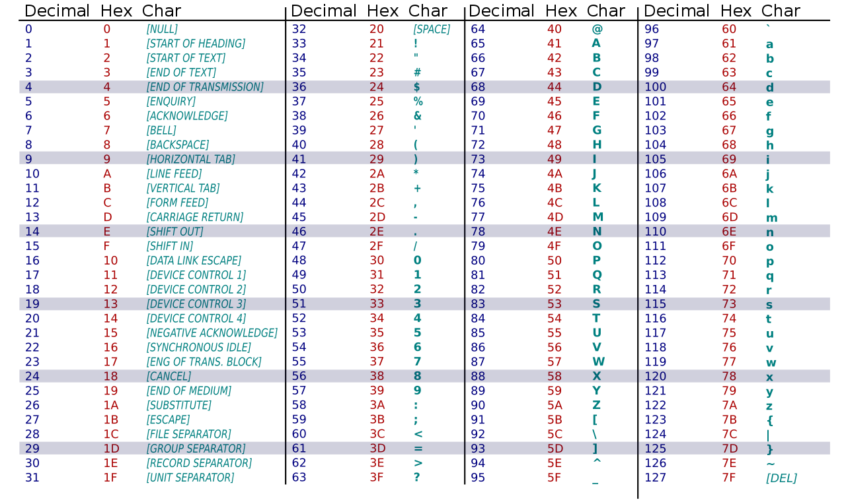
ASCII Table

Slide 103
Compiled Multiplication Code
C Function
long mul12(long x)
{
return x*12;
}
Compiled Arithmetic Operations
Explanation
leaq (%rax,%rax,2), %rax
salq $2, %rax
t <- x+x*2
return t << 2;
C compiler automatically generates shift/add code when multiplying by constant

Slide 104
Compiled Unsigned Division Code
C Function
unsigned long udiv8
(unsigned long x)
{
return x/8;
}
Compiled Arithmetic Operations
Explanation
shrq $3, %rax
# Logical shift
return x >> 3;
Uses logical shift for unsigned
For Java Users
Logical shift written as >>>

Slide 105
Compiled Signed Division Code
long idiv8(long x)
{
return x/8;
}
Compiled Arithmetic Operations
Explanation
testq %rax, %rax
js L4
L3:
sarq $3, %rax
ret
L4:
addq $7, %rax
jmp L3
if x < 0
x += 7;
# Arithmetic shift
return x >> 3;
Uses arithmetic shift for int
For Java Users
Arith. shift written as >>

