Slide 1

计算机组成与系统结构 Computer Organization & System Architecture
Huang Kejie (黄科杰) 百人计划研究员
Office: 玉泉校区老生仪楼304
Email address: huangkejie@zju.edu.cn
HP: 17706443800

Slide 2
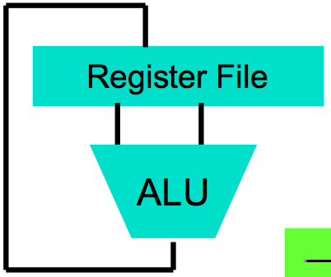
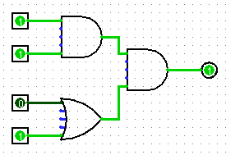
Levels of Representation/Interpretation
High Level Language Program (e.g., C)
temp = v[k];
v[k] = v[k+1];
v[k+1] = temp;
Compiler
Anything can be represented as a number, i.e., data or instructions
Assembly Language Program (e.g., RISC-V)
lw $t0, 0($2)
lw $t1, 4($2)
sw $t1, 0($2)
sw $t0, 4($2)
Assembler
Machine Language Program (RISC-V)
Machine Interpretation
Hardware Architecture Description (e.g., block diagrams)
Architecture Implementation
Logic Circuit Description (Circuit Schematic Diagrams)

Slide 3
Instruction Set Architecture (ISA)
Job of a CPU (Central Processing Unit, aka Core): execute instructions
Instructions: CPU’s primitives operations
Like a sentence: operations (verbs) applied to operands (objects) processed in sequence …
With additional operations to change the sequence
CPUs belong to “families,” each implementing its own set of instructions
CPU’s particular set of instructions implements an Instruction Set Architecture (ISA)
Examples: ARM, Intel x86, MIPS, RISC-V, IBM/Motorola PowerPC (old Mac), Intel IA64, ...

Slide 4
Instruction Set Architectures
Early trend: add more instructions to new CPUs for elaborate operations
VAX architecture had an instruction to multiply polynomials!
RISC philosophy (Cocke IBM, Patterson UCB, Hennessy Stanford, 1980s) – Reduced Instruction Set Computing
Keep the instruction set small and simple, in order to build fast hardware
Let software do complicated operations by composing simpler ones

Slide 5
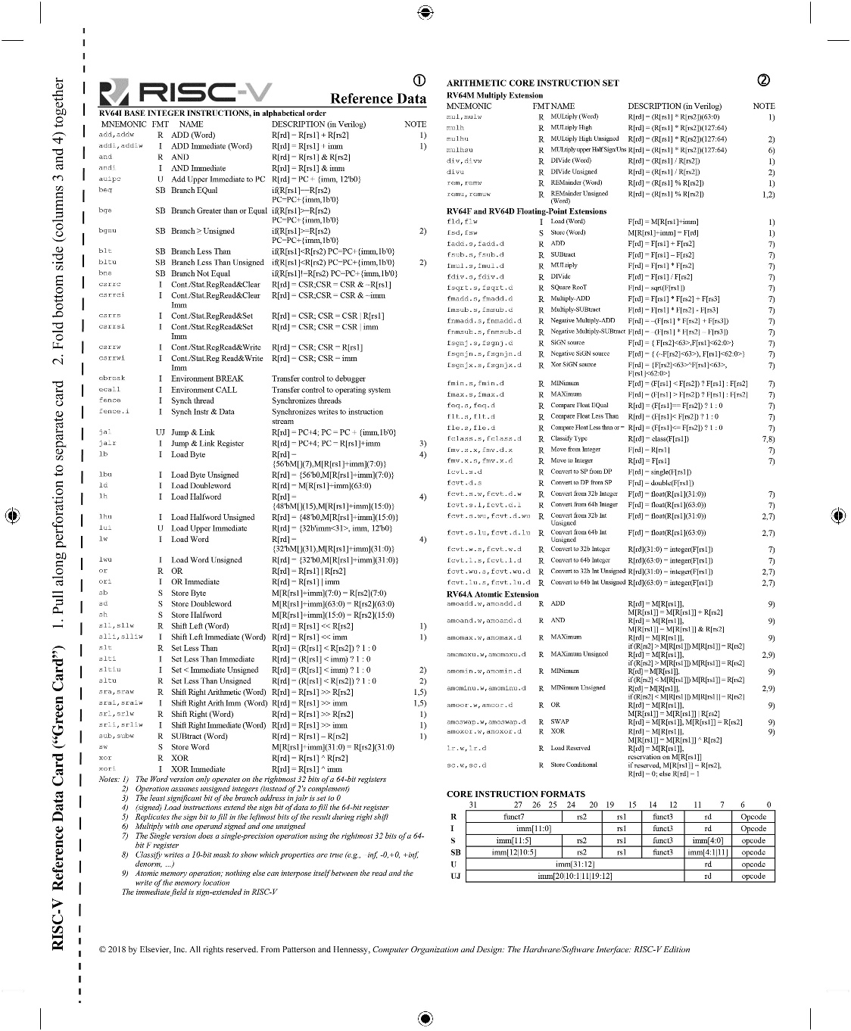
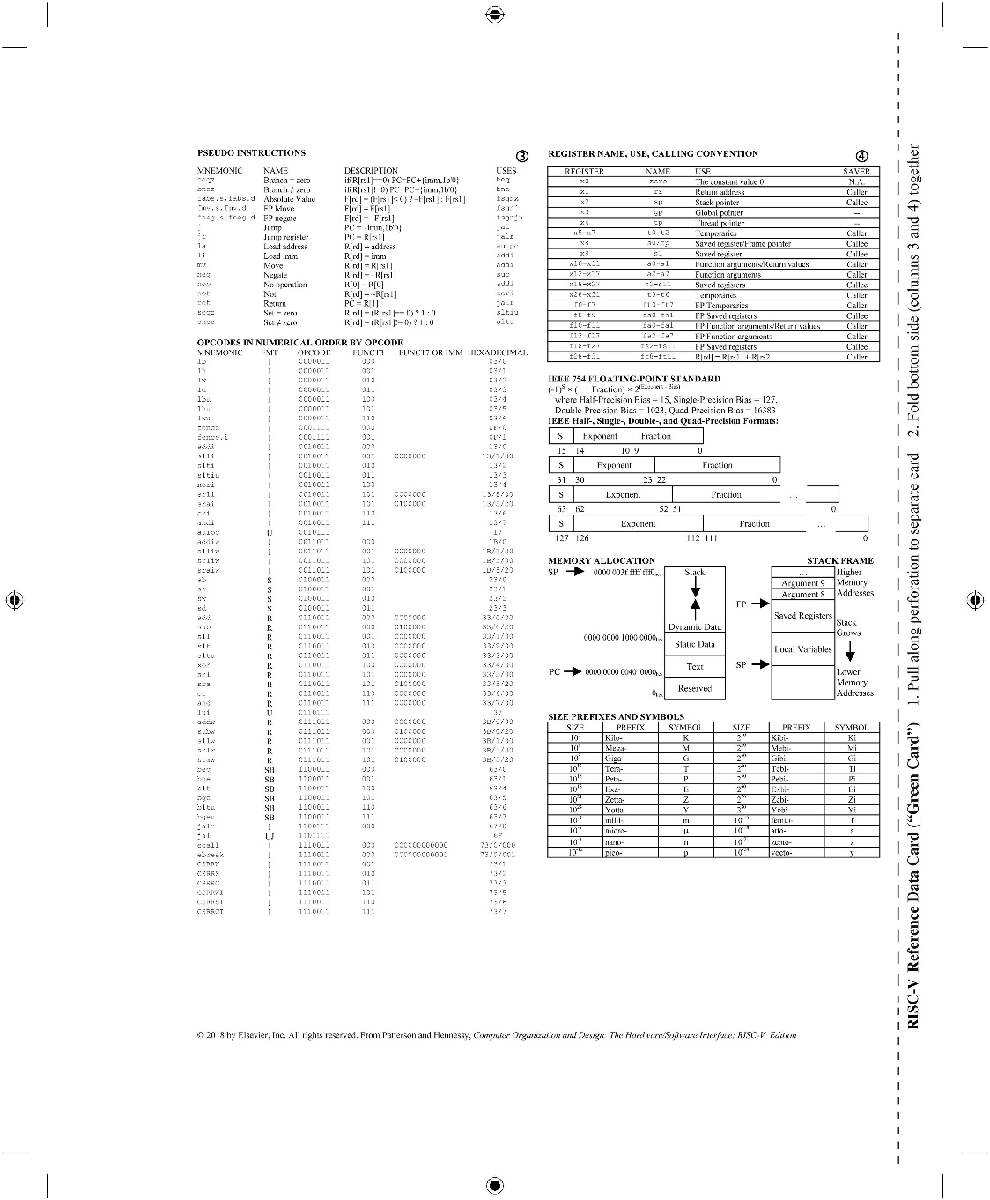
RISC-V Green Card (in textbook)
- Inspired by the IBM 360 “Green Card”

Slide 6
What is RISC-V?
Fifth generation of RISC design from UC Berkeley
A high-quality, license-free, royalty-free RISC ISA specification
Experiencing rapid uptake in both industry and academia
Both proprietary and open-source core implementations
Supported by growing shared software ecosystem
Appropriate for all levels of computing system, from microcontrollers to supercomputers
32-bit, 64-bit, and 128-bit variants (we’re using 32-bit in class, textbook uses 64-bit)
Standard maintained by non-profit RISC-V Foundation

Slide 7

































Foundation Members (60+)
Platinum:
Gold, Silver, Auditors:
Rumble
Development

Slide 8
Assembly Variables: Registers
Unlike HLL like C or Java, assembly does not have variables as you know and love them
More primitive, closer what simple hardware can directly support
Assembly operands are objects called registers
Limited number of special places to hold values, built directly into the hardware
Operations can only be performed on these!
Benefit: Since registers are directly in hardware, they are very fast (faster than 1 ns - light travels 1 foot in 1 ns!!! )

Slide 9
Registers live inside the Processor
Processor
Memory
Input
Enable?
Read/Write
Control
Program
Datapath
Address
PC
Bytes
Registers
Write Data
Arithmetic & Logic Unit
(ALU)
Data
ReadData
Output
Processor-Memory Interface
I/O-Memory Interfaces

Slide 10
Number of RISC-V Registers
Drawback: Since registers are in hardware, there are a limited number of them
Solution: RISC-V code must be carefully written to efficiently use registers
32 registers in RISC-V, referred to by number x0–x31
Registers are also given symbolic names, described later
Why 32? Smaller is faster, but too small is bad. Goldilocks principle (“This porridge is too hot; This porridge is too cold; this porridge is just right”)
Each RISC-V register is 32 bits wide (RV32 variant of RISC-V ISA)
Groups of 32 bits called a word in RISC-V ISA
P&H CoD textbook uses the 64-bit variant RV64 (explain differences later)
x0 is special, always holds value zero
So really only 31 registers able to hold variable values

Slide 11
C, Java Variables vs. Registers
In C (and most HLLs):
Variables declared and given a type
Example:
int fahr, celsius; char a, b, c, d, e;
Each variable can ONLY represent a value of the type it was declared (e.g., cannot mix and match int and char variables)
In Assembly Language:
Registers have no type;
Operation determines how register contents are interpreted

Slide 12
RISC-V Instruction Assembly Syntax
Instructions have an opcode and operands
E.g., add x1, x2, x3 # x1 = x2 + x3
# is assembly comment syntax
Destination register
Second operand register
Operation code (opcode)
First operand register

Slide 13
Addition and Subtraction of Integers
Addition in Assembly
Example:
add x1,x2,x3 (in RISC-V)
Equivalent to:
a = b + c (in C)
where C variables ⇔ RISC-V registers are:
a ⇔ x1, b ⇔ x2, c ⇔ x3
Subtraction in Assembly
Example:
sub x3,x4,x5 (in RISC-V)
Equivalent to:
d = e - f (in C)
where C variables ⇔ RISC-V registers are: d ⇔ x3, e ⇔ x4, f ⇔ x5

Slide 14
Addition and Subtraction of Integers Example 1
How to do the following C statement?
a = b + c + d - e;
Break into multiple instructions
add x10, x1, x2 # a_temp = b + c
add x10, x10, x3 # a_temp = a_temp + d
sub x10, x10, x4 # a = a_temp - e
A single line of C may turn into several RISC-V instructions

Slide 15
Immediates
Immediates are numerical constants
They appear often in code, so there are special instructions for them
Add Immediate:
addi x3,x4,-10 (in RISC-V)
f = g - 10 (in C)
where RISC-V registers x3,x4 are associated with C variables f, g
Syntax similar to add instruction, except that last argument is a number instead of a register
add x3,x4,x0 (in RISC-V)
f = g (in C)

Slide 16
Data Transfer: Load from and Store to memory
Processor
Memory
Input
Enable?
Read/Write
Control
Program
Datapath
Address
Bytes
Much larger place
To hold values, but slower than registers!
PC
Write Data = Store to memory
Registers
Arithmetic & Logic Unit
(ALU)
Data
Read Data = Load from
memory
Output
Fast but limited place
To hold values
Processor-Memory Interface
I/O-Memory Interfaces
3/19/2021
16

Slide 17
Memory Addresses are in Bytes
Data typically smaller than 32 bits, but rarely smaller than 8 bits (e.g., char type)–works fine if everything is a multiple of 8 bits
8 bit chunk is called a byte (1 word = 4 bytes)
Memory addresses are really in bytes, not words
Word addresses are 4 bytes apart
Word address is same as address of rightmost byte – least-significant byte (i.e. Little-endian convention)
Least-significant byte in a word
…
…
…
…
…
3
12
13
14
15
2
8
9
10
11
1
4
5
6
7
0
0
1
2
3
7 0
15 8
23 16
31 24
Least-significant byte gets the smallest address
17

Slide 18
Transfer from Memory to Register (load)
C code
int A[100];
g = h + A[3];
Using Load Word (lw) in RISC-V:
lw x10,12(x13) # Reg x10 gets A[3]
add x11,x12,x10 # g = h + A[3]
Note: x13 – base register (pointer to A[0])
12 – offset in bytes
Offset must be a constant known at assembly time

Slide 19
Transfer from Register to Memory (store)
C code
int A[100];
A[10] = h + A[3];
Using Load Word (lw) in RISC-V:
lw x10,12(x13) # Reg x10 gets A[3]
add x10,x12,x10 # g = h + A[3]
sw x10,40(x13) # A[10] = h + A[3]
Note: x13 – base register (pointer to A[0])
12, 40 – offset in bytes
x13+12 and x13+40 must be multiples of 4

Slide 20
Loading and Storing Bytes
In addition to word data transfers (lw, sw), RISC-V has byte data transfers:
load byte: lb
store byte: sb
Same format as lw, sw
E.g., lb x10,3(x11)
contents of memory location with address = sum of “3” + contents of register x11 is copied to the low byte position of register x10.
RISC-V also has “unsigned byte” loads (lbu) which zero extend to fill register. Why no unsigned store byte sbu?
zzz zzzz
x10:
xxxx xxxx xxxx xxxx xxxx xxxx
x
byte loaded
…is copied to “sign-extend”
This bit

Slide 21
Your turn
addi x11,x0,0x3f5
sw x11,0(x5)
lb x12,1(x5)
Answer | x12
RED | 0x5
GREEN | 0xf
ORANGE | 0x3
YELLOW | 0xffffffff

Slide 22
Your turn
addi x11,x0,0x3f5
sw x11,0(x5)
lb x12,1(x5)
Answer | x12
RED | 0x5
GREEN | 0xf
ORANGE | 0x3
YELLOW | 0xffffffff

Slide 23
Speed of Registers vs. Memory
Given that
Registers: 32 words (128 Bytes)
Memory (DRAM): Billions of bytes (2 GB to 8 GB on laptop)
and physics dictates…
Smaller is faster
How much faster are registers than DRAM??
About 100-500 times faster!
in terms of latency of one access

Slide 24
RISC-V Logical Instructions
Useful to operate on fields of bits within a word
e.g., characters within a word (8 bits)
Operations to pack /unpack bits into words
Called logical operations
Logical operations | C operators | Java operators | RISC-V instructions
Bit-by-bit AND | & | & | and
Bit-by-bit OR | | | | | or
Bit-by-bit XOR | ^ | ^ | xor
Shift left logical | << | << | sll
Shift right logical | >> | >> | srl

Slide 25
Logical Shifting
Shift Left Logical: slli x11,x12,2 #x11=x12<<2
Store in x11 the value from x12 shifted 2 bits to the left (they fall off end), inserting 0’s on right; << in C
Before: 0000 0002_{hex} 0000 0000 0000 0000 0000 0000 0000 0010_{two}
After: 0000 0008_{hex} 0000 0000 0000 0000 0000 0000 0000 1000_{two}
What arithmetic effect does shift left have?
Shift Right Logical: srli is opposite shift; >>
Zero bits inserted at left of word, right bits shifted off end

Slide 26
Arithmetic Shifting
Shift Right Arithmetic (srai) moves n bits to the right (insert high-order sign bit into empty bits)
For example, if register x10 contained
1111 1111 1111 1111 1111 1111 1110 0111_{two}= -25_{ten}
If execute sra x10, x10, 4, result is:
1111 1111 1111 1111 1111 1111 1111 1110_{two}= -2_{ten}
Unfortunately, this is NOT same as dividing by 2^{n}
Fails for odd negative numbers
C arithmetic semantics is that division should round towards 0

Slide 27
Computer Decision Making
Based on computation, do something different
In programming languages: if-statement
RISC-V: if-statement instruction is
beq register1,register2,L1
means: go to statement labeled L1 if (value in register1) == (value in register2)
….otherwise, go to next statement
beq stands for branch if equal
Other instruction: bne for branch if not equal

Slide 28
Types of Branches
Branch – change of control flow
Conditional Branch – change control flow depending on outcome of comparison
branch if equal (beq) or branch if not equal (bne)
Also branch if less than (blt) and branch if greater than or equal (bge)
Unconditional Branch – always branch
a RISC-V instruction for this: jump (j)

Slide 29
Example if Statement
Assuming translations below, compile if block
f → x10 g → x11 h → x12
i → x13 j → x14
if (i == j) bne x13,x14,Exit
f = g + h; add x10,x11,x12
Exit:
May need to negate branch condition

Slide 30
Example if-else Statement
Assuming translations below, compile
f → x10 g → x11 h → x12
i → x13 j → x14
if (i == j) bne x13,x14,Else
f = g + h; add x10,x11,x12
else j Exit
f = g – h; Else: sub x10,x11,x12
Exit:

Slide 31
Magnitude Compares in RISC-V
Until now, we’ve only tested equalities (== and != in C); General programs need to test < and > as well.
RISC-V magnitude-compare branches:
“Branch on Less Than”
Syntax: blt reg1,reg2, label
Meaning: if(reg1<reg2) // treat registers as signed integers goto label;
“Branch on Less Than Unsigned”
Syntax: bltu reg1,reg2, label
Meaning: if(reg1<reg2) // treat registers as unsigned integers goto label;

Slide 32
C Loop Mapped to RISC-V Assembly
int A[20];
int sum = 0;
for (int i=0; i<20; i++)
sum += A[i];
add x9, x8, x0 # x9=&A[0]
add x10, x0, x0 # sum=0
add x11, x0, x0 # i=0
Loop:
lw x12, 0(x9) # x12=A[i]
add x10,x10,x12 # sum+=
addi x9,x9,4 # &A[i++]
addi x11,x11,1 # i++
addi x13,x0,20 # x13=20
blt x11,x13,Loop

Slide 33
Peer Instruction
Which of the following is TRUE?
RED: add x10,x11,4(x12) is valid in RV32
GREEN: can byte address 8GB of memory with an RV32 word
ORANGE: imm must be multiple of 4 for lw x10,imm(x10) to be valid
YELLOW: None of the above

Slide 34
Peer Instruction
Which of the following is TRUE?
RED: add x10,x11,4(x12) is valid in RV32
GREEN: can byte address 8GB of memory with an RV32 word
ORANGE: imm must be multiple of 4 for lw x10,imm(x10) to be valid
YELLOW: None of the above

Slide 35
Program Execution
Processor
Memory
Read Instruction Bits
Control
Program
Datapath
PC
Instruction
Address
Bytes
Registers
Arithmetic & Logic Unit
(ALU)
Data
PC (program counter) is internal register inside processor holding byte address of next instruction to be executed
Instruction is fetched from memory, then control unit executes instruction using datapath and memory system, and updates program counter (default is add +4 bytes to PC, to move to next sequential instruction)

Slide 36
Helpful RISC-V Assembler Features
Symbolic register names
E.g., a0-a7 for argument registers (x10-x17)
E.g., zero for x0
Pseudo-instructions
Shorthand syntax for common assembly idioms
E.g., mv rd, rs = addi rd, rs, 0
E.g.2, li rd, 13 = addi rd, x0, 13

Slide 37
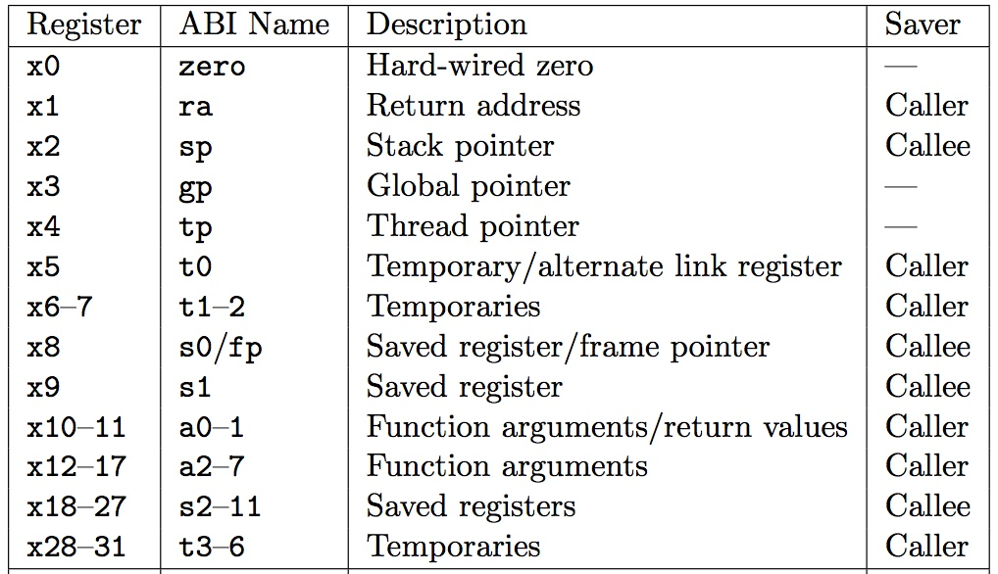
RISC-V Symbolic Register Names
Numbers hardware understands
Human-friendly symbolic names in assembly code
Notes:
非常重要, 这些函数相关是编程的根本

Slide 38
Six Fundamental Steps in Calling a Function
Put parameters in a place where function can access them
Transfer control to function
Acquire (local) storage resources needed for function
Perform desired task of the function
Put result value in a place where calling code can access it and restore any registers you used
Return control to point of origin, since a function can be called from several points in a program

Slide 39
RISC-V Function Call Conventions
Registers faster than memory, so use them
a0–a7 (x10-x17): eight argument registers to pass parameters and two return values (a0-a1)
ra: one return address register to return to the point of origin (x1)

Slide 40
Instruction Support for Functions (1/4)
... sum(a,b);... /* a,b:s0,s1 */
}
int sum(int x, int y) {
return x+y;
}
address (shown in decimal)
1000
1004
1008
1012
1016
…
2000
2004
C
In RISC-V, all instructions are 4 bytes, and stored in memory just like data. So here we show the addresses of where the programs are stored.
RISC-V

Slide 41
Instruction Support for Functions (2/4)
... sum(a,b);... /* a,b:s0,s1 */
}
int sum(int x, int y) {
return x+y;
}
address (shown in decimal)
1000 mv a0,s0 # x = a
1004 mv a1,s1 # y = b
1008 addi ra,zero,1016 #ra=1016
1012 j sum #jump to sum
1016 … # next instruction
…
2000 sum: add a0,a0,a1
2004 jr ra # new instr. “jump register”
C
RISC-V

Slide 42
Instruction Support for Functions (3/4)
... sum(a,b);... /* a,b:s0,s1 */
}
int sum(int x, int y) {
return x+y;
}
2000 sum: add a0,a0,a1
2004 jr ra # new instr. “jump register”
C
Question: Why use jr here? Why not use j?
Answer: sum might be called by many places, so we can’t return to a fixed place. The calling proc to sum must be able to say “return here” somehow.
RISC-V

Slide 43
Instruction Support for Functions (4/4)
Single instruction to jump and save return address: jump and link (jal)
Before: 1008 addi ra,zero,1016 #ra=1016 1012 j sum #goto sum
After: 1008 jal sum # ra=1012,goto sum
Why have a jal?
Make the common case fast: function calls very common
Reduce program size
Don’t have to know where code is in memory with jal!

Slide 44
Instruction Support for Functions (4/4)
Invoke function: jump and link instruction (jal)
(really should be laj “link and jump”)
“link” means form an address or link that points to calling site to allow function to return to proper address
Jumps to address and simultaneously saves the address of the following instruction in register ra
jal FunctionLabel
Return from function: jump register instruction (jr)
Unconditional jump to address specified in register: jr ra
Assembler shorthand: ret = jr ra

Slide 45
Example
int Leaf (int g, int h, int i, int j)
{
int f;
f = (g + h) – (i + j);
return f;
}
Parameter variables g, h, i, and j in argument registers a0, a1, a2, and a3, and f in s0
Assume need one temporary register s1

Slide 46
Where Are Old Register Values Saved to Restore Them After Function Call?
Need a place to save old values before call function, restore them when return, and delete
Ideal is stack: last-in-first-out queue (e.g., stack of plates)
Push: placing data onto stack
Pop: removing data from stack
Stack in memory, so need register to point to it
sp is the stack pointer in RISC-V (x2)
Convention is grow stack down from high to low addresses
Push decrements sp, Pop increments sp

Slide 47
RISC-V Code for Leaf()
Leaf: addi sp,sp,-8 # adjust stack for 2 items
sw s1, 4(sp) # save s1 for use afterwards
sw s0, 0(sp) # save s0 for use afterwards
add s0,a0,a1 # f = g + h
add s1,a2,a3 # s1 = i + j
sub a0,s0,s1 # return value (g + h) – (i + j)
lw s0, 0(sp) # restore register s0 for caller
lw s1, 4(sp) # restore register s1 for caller
addi sp,sp,8 # adjust stack to delete 2 items
jr ra # jump back to calling routine

Slide 48
Stack Before, During, After Function
Need to save old values of s0 and s1
sp
sp
Saved s1
Saved s1
sp
Saved s0
Saved s0
Before call
During call
After call

Slide 49
What If a Function Calls a Function?
Recursive Function Calls?
Would clobber values in a0-a7 and ra
What is the solution?

Slide 50
Nested Procedures (1/2)
int sumSquare(int x, int y) { return mult(x,x)+ y; }
Something called sumSquare, now sumSquare is calling mult
So there’s a value in ra that sumSquare wants to jump back to, but this will be overwritten by the call to mult
Need to save sumSquare return address before call to mult

Slide 51
Nested Procedures (2/2)
In general, may need to save some other info in addition to ra.
When a C program is run, there are three important memory areas allocated:
Static: Variables declared once per program, cease to exist only after execution completes - e.g., C globals
Heap: Variables declared dynamically via malloc
Stack: Space to be used by procedure during execution; this is where we can save register values

Slide 52
Optimized Function Convention
To reduce expensive loads and stores from spilling and restoring registers, RISC-V function-calling convention divides registers into two categories:
Preserved across function call
Caller can rely on values being unchanged
sp, gp, tp, “saved registers” s0-s11 (s0 is also fp)
Not preserved across function call
Caller cannot rely on values being unchanged
Argument/return registers a0-a7,ra, “temporary registers” t0-t6

Slide 53
Peer Instruction
Which statement is FALSE?
RED: RISC-V uses jal to invoke a function and jr to return from a function
GREEN: jal saves PC+1 in ra
ORANGE: The callee can use temporary registers (ti) without saving and restoring them
YELLOW: The caller can rely on save registers (si) without fear of callee changing them

Slide 54
Peer Instruction
Which statement is FALSE?
RED: RISC-V uses jal to invoke a function and jr to return from a function
GREEN: jal saves PC+1 in ra
ORANGE: The callee can use temporary registers (ti) without saving and restoring them
YELLOW: The caller can rely on save registers (si) without fear of callee changing them

Slide 55
Allocating Space on Stack
C has two storage classes: automatic and static
Automatic variables are local to function and discarded when function exits
Static variables exist across exits from and entries to procedures
Use stack for automatic (local) variables that don’t fit in registers
Procedure frame or activation record: segment of stack with saved registers and local variables

Slide 56
Stack Before, During, After Function
sp
sp
Saved return address (if needed)
Saved argument registers (if any)
Saved saved registers (if any)
Local variables
(if any)
sp
Before call
During call
After call

Slide 57
Using the Stack (1/2)
So we have a register sp which always points to the last used space in the stack
To use stack, we decrement this pointer by the amount of space we need and then fill it with info
So, how do we compile this?
int sumSquare(int x, int y) { return mult(x,x)+ y; }

Slide 58
Using the Stack (2/2)
int sumSquare(int x, int y) { return mult(x,x)+ y; }
sumSquare: addi sp,sp,-8 # space on stack sw ra, 4(sp) # save ret addr sw a1, 0(sp) # save y mv a1,a0 # mult(x,x) jal mult # call mult lw a1, 0(sp) # restore y add a0,a0,a1 # mult()+y lw ra, 4(sp) # get ret addr addi sp,sp,8 # restore stack jr ra mult: ...

Slide 59
Where is the Stack in Memory?
RV32 convention (RV64 and RV128 have different memory layouts)
Stack starts in high memory and grows down
Hexadecimal (base 16) : bfff_fff0_{hex}
Stack must be aligned on 16-byte boundary (not true in examples above)
RV32 programs (text segment) in low end
0001_0000_{hex}
static data segment (constants and other static variables) above text for static variables
RISC-V convention global pointer (gp) points to static
RV32 gp = 1000_0000_{hex}
Heap above static for data structures that grow and shrink ; grows up to high addresses

Slide 60
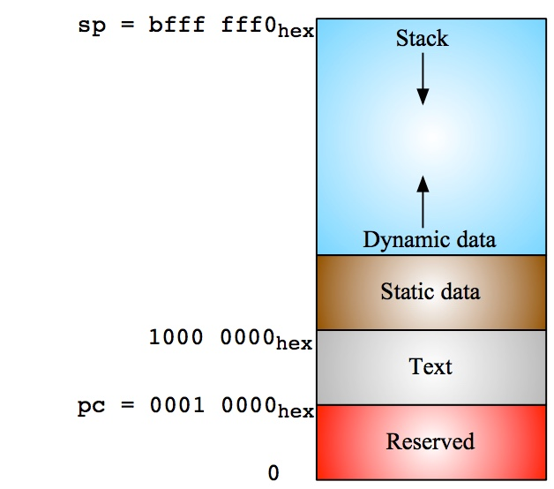
RV32 Memory Allocation

