Slide 1

计算机组成与系统结构 Computer Organization & System Architecture
Huang Kejie (黄科杰) 百人计划研究员
Office: 玉泉校区老生仪楼304
Email address: huangkejie@zju.edu.cn
HP: 17706443800

Slide 2
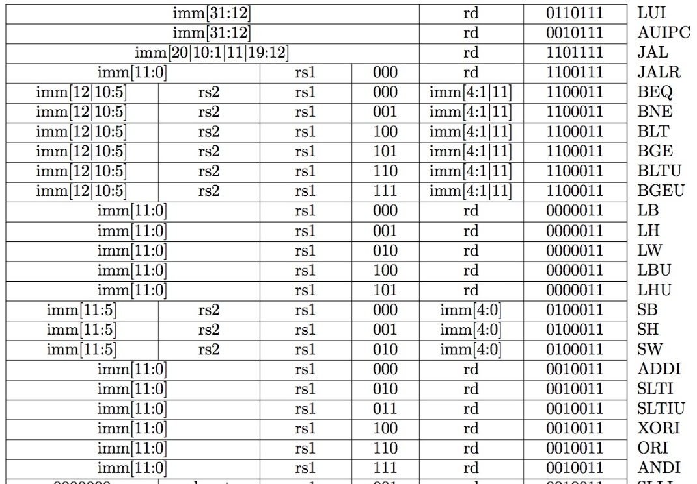
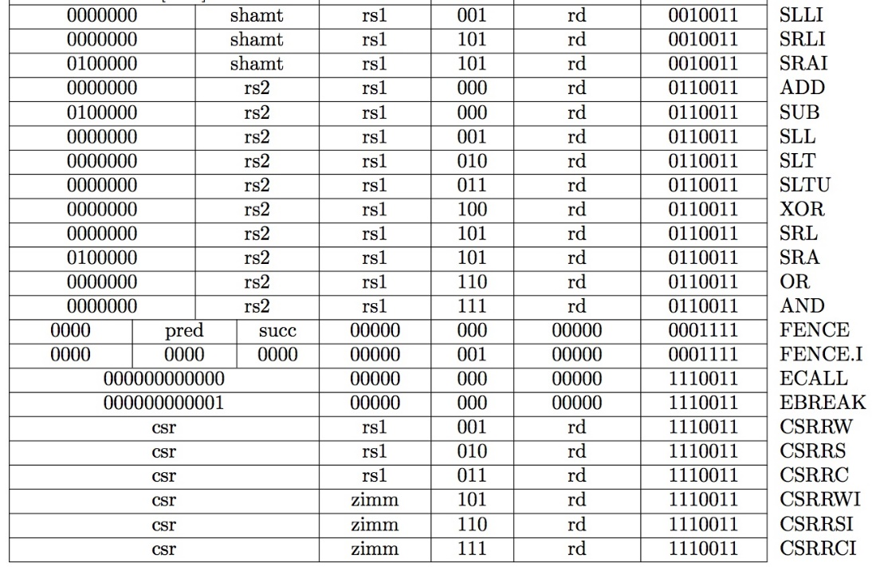
Recap: Complete RV32I ISA

Slide 3
State Required by RV32I ISA
Each instruction reads and updates this state during execution:
Registers (x0..x31)
Register file (or regfile) Reg holds 32 registers x 32 bits/register: Reg[0].. Reg[31]
First register read specified by rs1 field in instruction
Second register read specified by rs2 field in instruction
Write register (destination) specified by rd field in instruction
x0 is always 0 (writes to Reg[0] are ignored)
Program Counter (PC)
Holds address of current instruction
Memory (MEM)
Holds both instructions & data, in one 32-bit byte-addressed memory space
We’ll use separate memories for instructions (IMEM) and data (DMEM)
Later we’ll replace these with instruction and data caches
Instructions are read (fetched) from instruction memory (assume IMEM read-only)
Load/store instructions access data memory

Slide 4
One-Instruction-Per-Cycle RISC-V Machine
On every tick of the clock, the computer executes one instruction
Current state outputs drive the inputs to the combinational logic, whose outputs settles at the values of the state before the next clock edge
At the rising clock edge, all the state elements are updated with the combinational logic outputs, and execution moves to the next clock cycle
pc
Combinational Logic
clock
IMEM
Reg[]
DMEM

Slide 5
Basic Phases of Instruction Execution
rd
PC
IMEM
rs1
Reg[]
DMEM
rs2
ALU
+4
imm
mux
2. Decode/
Register
Read
1. Instruction
Fetch
3. Execute
4. Memory
5. Register
Write
Clock
time

Slide 6
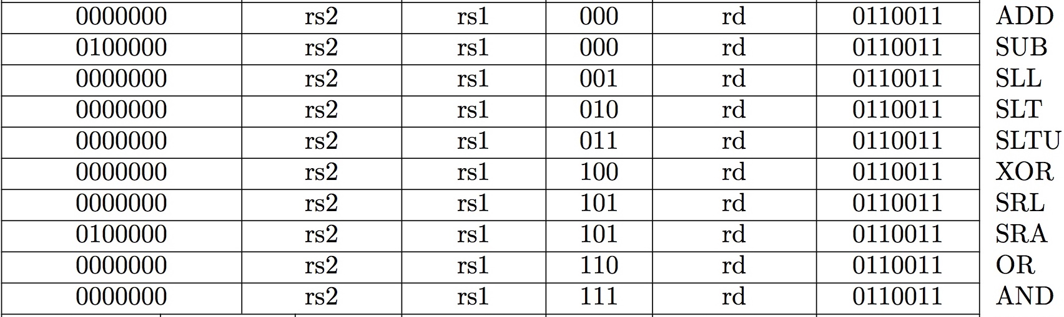
Implementing the add instruction
RISC-V Assembly Instruction:
add rd, rs1, rs2
Instruction makes two changes to machine’s state:
Reg[rd] = Reg[rs1] + Reg[rs2]
PC = PC + 4

Slide 7
Datapath for add

Slide 8
Timing Diagram for add
clock
time
Clock
PC
1000
1004
PC+4
1004
1008
inst[31:0]
add x1,x2,x3
add x6,x7,x9
Reg[rs1]
Reg[2]
Reg[7]
Reg[rs2]
Reg[3]
Reg[9]
alu
Reg[2]+Reg[3]
Reg[7]+Reg[9]
Reg[1]
???
Reg[2]+Reg[3]

Slide 9
Implementing the sub instruction
RISC-V Assembly Instruction:
sub rd, rs1, rs2
Almost the same as add, except now have to subtract operands instead of adding them
inst[30] selects between add and subtract

Slide 10
Datapath for add/sub

Slide 11
Implementing other R-Format instructions
All implemented by decoding funct3 and funct7 fields and selecting appropriate ALU function

Slide 12
Implementing the addi instruction
RISC-V Assembly Instruction:
addi x15,x1,-50
111111001110
00001
000
01111
0010011
imm=-50
rs1=1
ADD
rd=15
OP-Imm

Slide 13
Datapath for add/sub

Slide 14
Adding addi to datapath
Also works for all other I-format arithmetic instruction (slti,sltiu,andi,ori,xori,slli,srli,srai) just by changing ALUSel

Slide 15
I-Format immediates
inst[31:0]
------inst[31]-(sign-extension)-------
inst[30:20]
imm[31:0]
High 12 bits of instruction (inst[31:20]) copied to low 12 bits of immediate (imm[11:0])
Immediate is sign-extended by copying value of inst[31] to fill the upper 20 bits of the immediate value (imm[31:12])
inst[31:20]
Imm.
Gen
imm[31:0]
ImmSel=I

Slide 16
Implementing Load Word instruction
RISC-V Assembly Instruction:
lw x14, 8(x2)
000000001000
00010
010
01110
0000011
imm=+8
rs1=2
LW
rd=14
LOAD

Slide 17
Adding addi to datapath

Slide 18
Adding lw to datapath

Slide 19
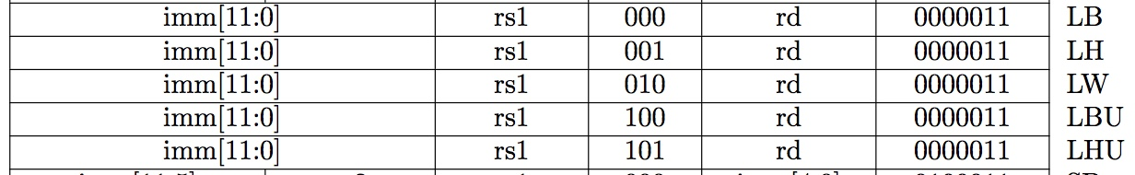
All RV32 Load Instructions
funct3 field encodes size and signedness of load data
Supporting the narrower loads requires additional circuits to extract the correct byte/halfword from the value loaded from memory, and sign- or zero-extend the result to 32 bits before writing back to register file.

Slide 20
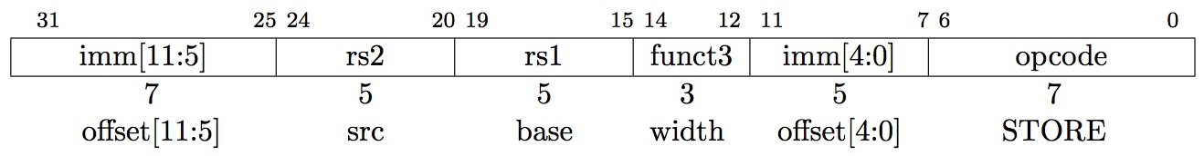
Implementing Store Word instruction
RISC-V Assembly Instruction:
sw x14, 8(x2)
0000000
01110
00010
010
01000
0100011
offset[11:5]
=0
rs2=14
rs1=2
SW
offset[4:0]
=8
STORE
0000000
01000
combined 12-bit offset = 8

Slide 21
Adding lw to datapath

Slide 22
Adding sw to datapath

Slide 23
I-Format immediates
inst[31:0]
------inst[31]-(sign-extension)-------
inst[30:20]
imm[31:0]
High 12 bits of instruction (inst[31:20]) copied to low 12 bits of immediate (imm[11:0])
Immediate is sign-extended by copying value of inst[31] to fill the upper 20 bits of the immediate value (imm[31:12])
inst[31:20]
Imm.
Gen
imm[31:0]
ImmSel=I

Slide 24
I-Format immediates
inst[31:0]
31
25
24
20
19
15
14
12
11
7
6
0
imm[11:0]
rs1
funct3
rd
I-opcode
imm[11:5]
rs2
rs1
funct3
imm[4:0]
S-opcode
5
5
1
6
I
S
inst[31](sign-extension)
inst[30:25]
inst[24:20]
I
inst[31](sign-extension)
inst[30:25]
inst[11:7]
S
31
11
10
5
4
0
imm[31:0]
Just need a 5-bit mux to select between two positions where low five bits of immediate can reside in instruction
Other bits in immediate are wired to fixed positions in instruction

Slide 25
Implementing Branches
B-format is mostly same as S-Format, with two register sources (rs1/rs2) and a 12-bit immediate
But now immediate represents values -4096 to +4094 in 2-byte increments
The 12 immediate bits encode even 13-bit signed byte offsets (lowest bit of offset is always zero, so no need to store it)

Slide 26
Adding sw to datapath

Slide 27
Adding branches to datapath

Slide 28
Branch Comparator
BrEq = 1, if A=B
BrLT = 1, if A < B
BrUn =1 selects unsigned comparison for BrLT, 0=signed
BGE branch: A >= B, if !(A<B)
A
Branch Comp.
B
BrUn
BrEq
BrLT

Slide 29
Multiply Branch Immediates by Shift?
12-bit immediate encodes PC-relative offset of -4096 to +4094 bytes in multiples of 2 bytes
Standard approach: treat immediate as in range -2048..+2047, then shift left by 1 bit to multiply by 2 for branches
s
imm[10:5]
rs2
rs1
funct3
imm[4:0]
B-opcode
sign-extension
s
imm[10:5]
imm[4:0]
S-Immediate
sign-extension
s
imm[10:5]
imm[4:0]
0
B-Immediate (shift left by 1)
Each instruction immediate bit can appear in one of two places in output immediate value – so need one 2-way mux per bit

Slide 30
RISC-V Branch Immediates
12-bit immediate encodes PC-relative offset of -4096 to +4094 bytes in multiples of 2 bytes
RISC-V approach: keep 11 immediate bits in fixed position in output value, and rotate LSB of S-format to be bit 12 of B-format
sign=imm[11]
imm[10:5]
imm[4:0]
S-Immediate
sign=imm[12]
imm[10:5]
imm[4:1]
0
B-Immediate (shift left by 1)
imm[11]
Only one bit changes position between S and B, so only need a single-bit 2-way mux

Slide 31
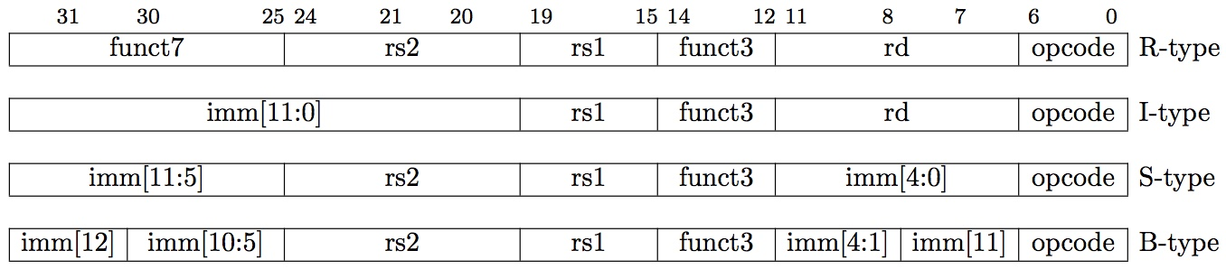
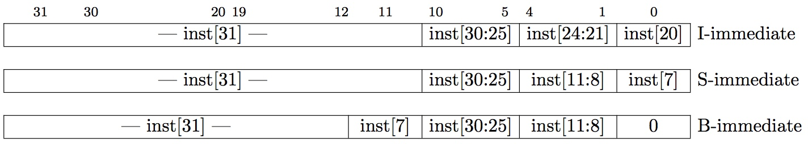
RISC-V Immediate Encoding
Instruction Encodings, inst[31:0]
32-bit immediates produced, imm[31:0]
Only bit 7 of instruction changes role in immediate between S and B
Upper bits sign-extended from inst[31] always

Slide 32
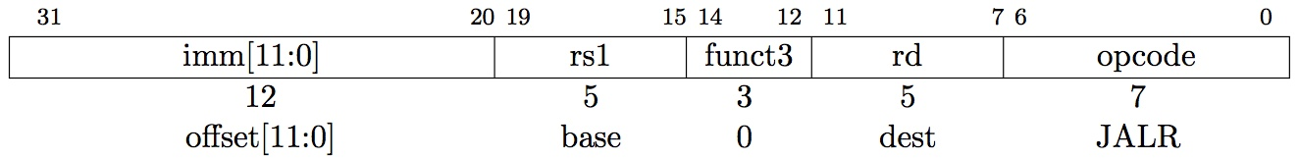
Implementing JALR Instruction (I-Format)
JALR rd, rs, immediate
Writes PC+4 to Reg[rd] (return address)
Sets PC = Reg[rs1] + immediate
Uses same immediates as arithmetic and loads
no multiplication by 2 bytes

Slide 33
Adding branches to datapath

Slide 34
Adding jalr to datapath

Slide 35
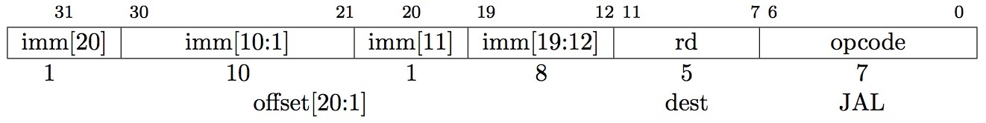
Implementing jal Instruction (I-Format)
JAL saves PC+4 in Reg[rd] (the return address)
Set PC = PC + offset (PC-relative jump)
Target somewhere within ±2¹⁹ locations, 2 bytes apart
±2¹⁸ 32-bit instructions
Immediate encoding optimized similarly to branch instruction to reduce hardware cost

Slide 36
Adding jal to datapath

Slide 37
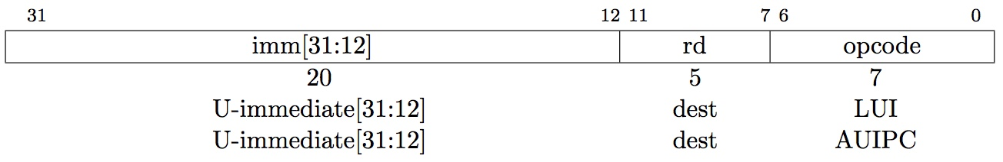
“Upper Immediate” instructions
Has 20-bit immediate in upper 20 bits of 32-bit instruction word
One destination register, rd
Used for two instructions
LUI – Load Upper Immediate (add to zero)
AUIPC – Add Upper Immediate to PC

Slide 38
Implementing lui

Slide 39
Implementing auipc

Slide 40
Single-Cycle RISC-V RV32I Datapath

Slide 41
And in Conclusion, …
Universal datapath
Capable of executing all RISC-V instructions in one cycle each
Not all units (hardware) used by all instructions
5 Phases of execution
IF, ID, EX, MEM, WB
Not all instructions are active in all phases
Controller specifies how to execute instructions
what new instructions can be added with just most control?

