Slide 1
Recitations
Homework 5-6 & Project 2
TA: Jiachen Li
2021.6.28

Slide 2
Outline
Today’s content…
Project 2
Homework 5
Homework 6

Slide 3
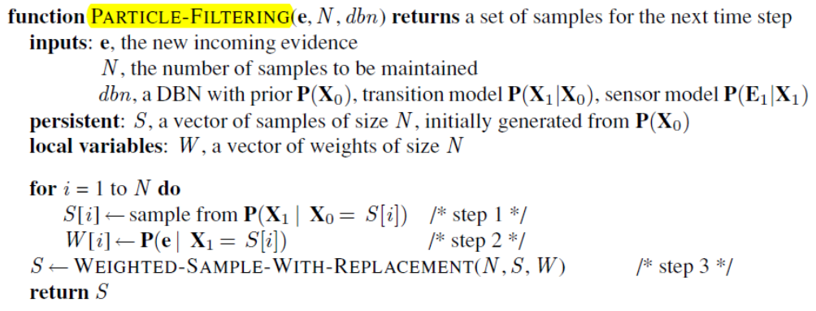
Project 2
Recall
Particle filtering idea: approximate inference
Use samples to approximate state distribution
Keep high-probability samples, discard low-probability samples
Steps
Transition
Weighting
Resampling
Notes:
回忆一下粒子滤波，本质上是用采样的方式进行状态估计，然后根据样本的概率对状态进行估计和演化
分为三步：
转换：根据给定的样本分布对状态进行转换
权重确定：根据转换结果对样本进行权重确定
根据样本权重重新进行采样

Slide 4
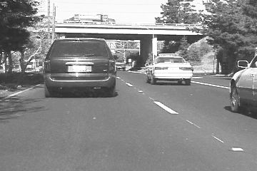
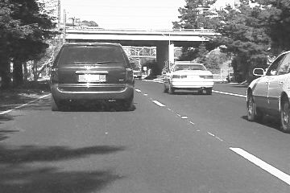
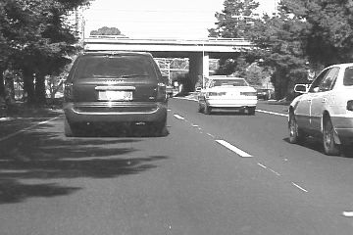
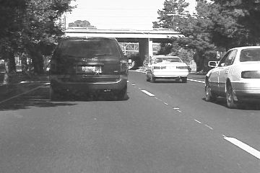




Project 2
Tracking via particle filtering
Tracking
Online: automatically detect target region
Offline: manually initialize target region
Dataset
car
David2
Notes:
prj2就是利用粒子滤波的思想进行目标追踪。
注意：这里的追踪问题是离线追踪，给定被追踪对象完整的移动轨迹，然后进行追踪，需要认为规定一个被追踪对象；不同于在线追踪（只有历史数据，需要目标检测）
测试用数据集：
car：行车记录仪拍摄的车辆行驶视频，对象运动不明显，较容易
David2：对人脸移动进行追踪，运动剧烈，背景变化大，较难

Slide 5
Project 2
Implementation
Abstraction
Particle()
Rect()
Flow
extract_feature()
transition_step()
weighting_step()
resample_step()
Notes:
在实现上，主要用到两个类：
Particle()：对粒子的抽象，每个粒子代表一个追踪框。记录框的位置和大小和一些演化数据
Rect()：对追踪框的抽象，包括如何绘制等
算法流程主要用到四个接口：
extract_feature()：用于抽取追踪框内的图像特征，用作每个粒子的可量化表征
transition_step()：完成transition步骤，对粒子属性的演化
weighting_step()：完成加权，根据相似度/距离测度分配粒子的权重
resample_step()：完成重采样，通过某些策略，基于权重对粒子划分出重采样之后的子集，保留高权重粒子
接下来对其中每一项展开解释

Slide 6
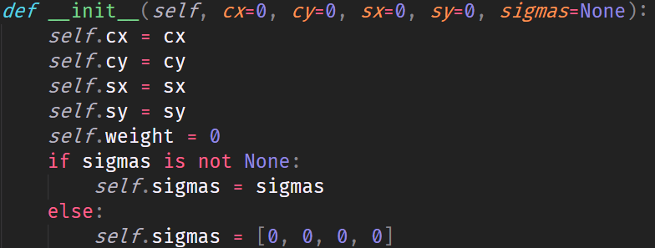
Project 2
Particle()
self.cx: center x
self.cy: center y
self.sx: width
self.sy: height
Describe a particle and its corresponding rectangle bounding box
Rect()
Describe the rectangle position and visualization

Slide 7
Project 2
extract_feature()
Extract feature for each region in the bounding box
Method
Intensity: No dimension reduction
SIFT: Dim-reduced, scale-invariant feature
HoG: Dim-reduced, histogram of oriented gradient
…
Notes:
有很多种特征来选择，prj2中默认使用框内像素灰度值作为特征，但是这种方法不是很好，很容易收到噪声影响。
有一些经典的图像特征描述子，如SIFT、HoG等，在opencv中都有封装

Slide 8
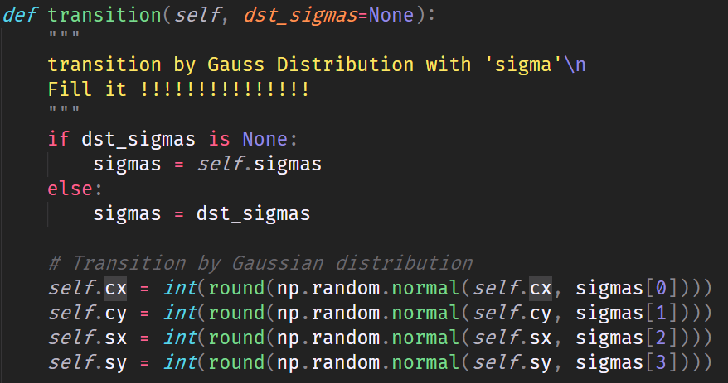
Project 2
transition_step()
Implement the transition of particles
transition() method in Particle()
Notes:
直接为Particle类的transition方法提供内部实现即可。在transition步骤中，我们为每个粒子添加一个高斯扰动，使粒子位置和对应框的大小进行高斯扰动，从而对新的一帧图像产生的运动结果进行采样。

Slide 9
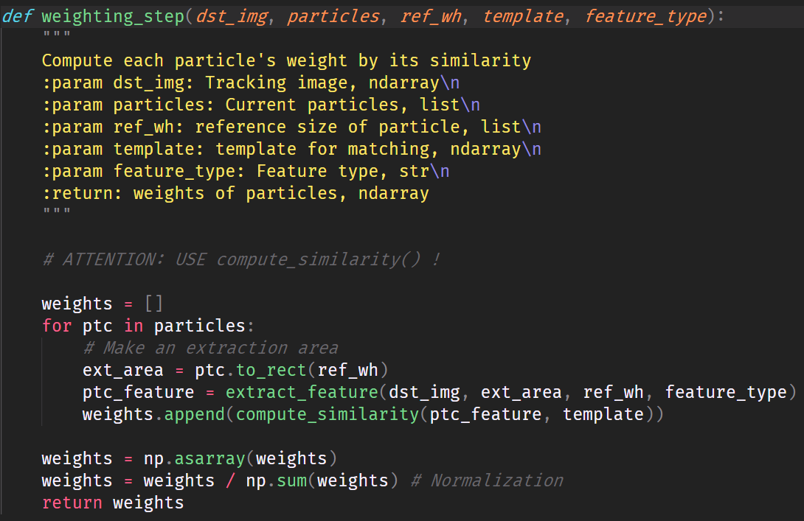
Project 2
weighting_step()
Implement the weighting of particles
Measurement
Distance metric (e.g. Euclidean distance)
Similarity metric (e.g. Cosine similarity)
How to choose measurement?
Normalization (Mapping to probability)
Notes:
weighting阶段将对transition之后的每个粒子对应的区域，提取特征，比对这些区域和上一帧模板区域的相似度，根据相似度选择最可能的新一帧图像中的目标位置。
通俗来说，这一步实现了“追踪”。
匹配相似度需要一些度量函数，例如距离度量或者是相似度度量。

Slide 10
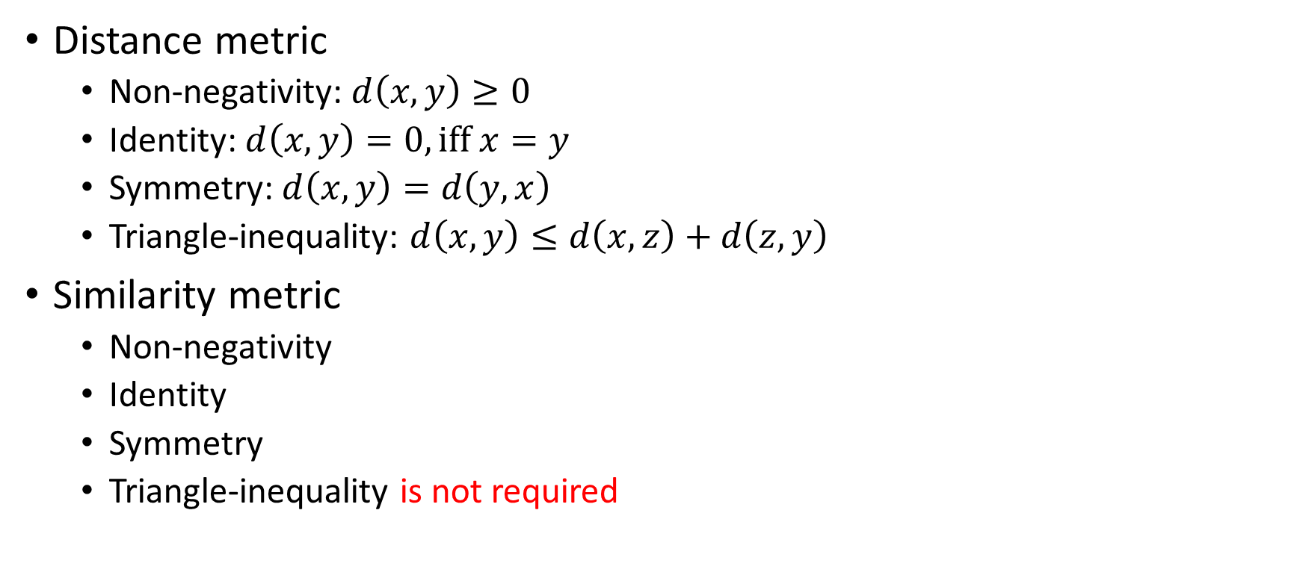
Project 2
Distance metric
Non-negativity: $d\left(x,y\right)≥0$
Identity: $d\left(x,y\right)=0, iff x=y$
Symmetry: $d\left(x,y\right)=d\left(y,x\right)$
Triangle-inequality: $d\left(x,y\right)≤d\left(x,z\right)+d\left(z,y\right)$
Similarity metric
Non-negativity
Identity
Symmetry
Triangle-inequality is not required
Notes:
距离度量和相似度度量有一些区别。

Slide 11
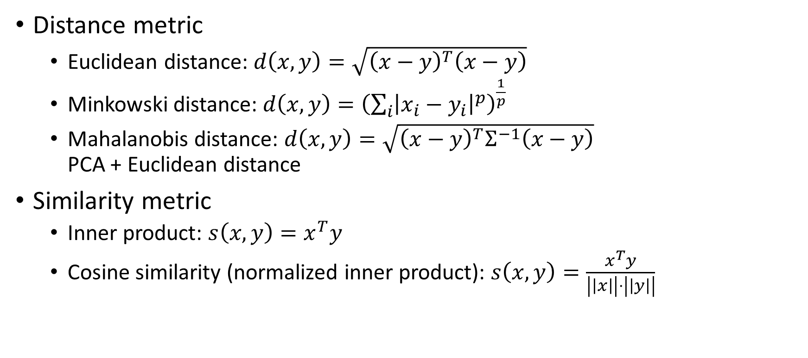
Project 2
Distance metric
Euclidean distance: $d\left(x,y\right)=\sqrt{{\left(x−y\right)}^{T}\left(x−y\right)}$
Minkowski distance: $d\left(x,y\right)={\left(\sum_{i}{{\left|x_{i}−y_{i}\right|}^{p}}\right)}^{\frac{1}{p}}$
Mahalanobis distance: $d\left(x,y\right)=\sqrt{{\left(x−y\right)}^{T}Σ^{−1}\left(x−y\right)}$ PCA + Euclidean distance
Similarity metric
Inner product: $s\left(x,y\right)=x^{T}y$
Cosine similarity (normalized inner product): $s\left(x,y\right)=\frac{x^{T}y}{\left|\left|x\right|\right|⋅\left|\left|y\right|\right|}$

Slide 12
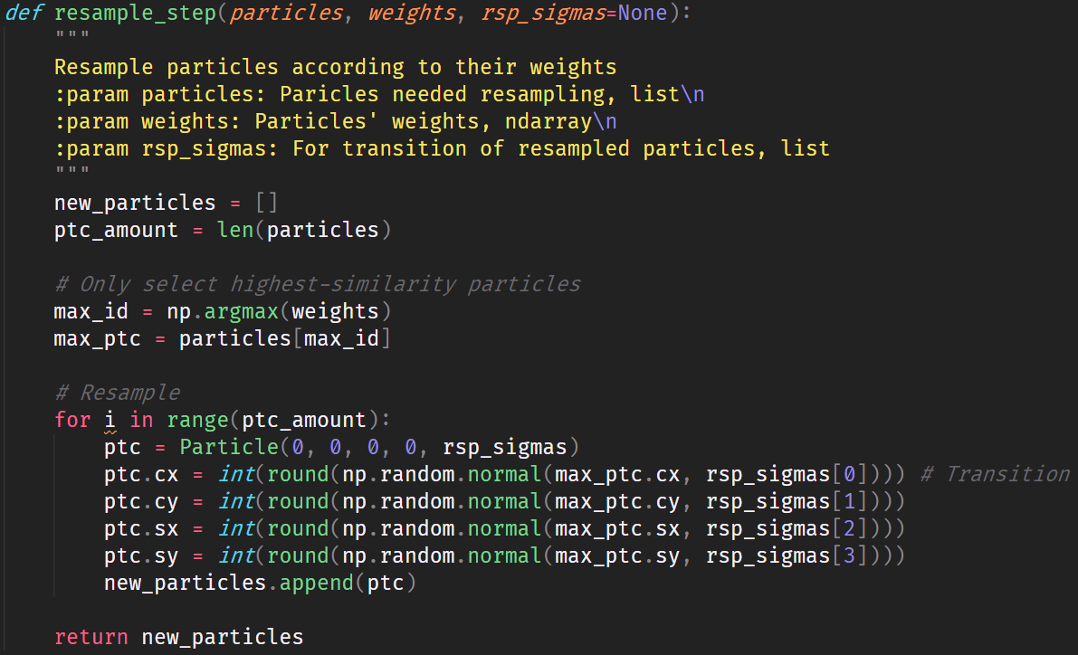
Project 2
resample_step()
Choose high-probability particles
Discard noisy regions
Methods
Simple top-k
Sample-by-weight
Notes:
重采样的目的是选择高权重的粒子，抛弃低权重的可能是噪声区域的粒子。
可以使用多种方法，例如简单的top-k方法，直接选取权重最高的k个粒子；或者一些基于权重的采样方法，例如轮盘赌，对高概率的多采样，低概率的少采样。
采样后要注意粒子总数保持不变，多退少补。

Slide 13
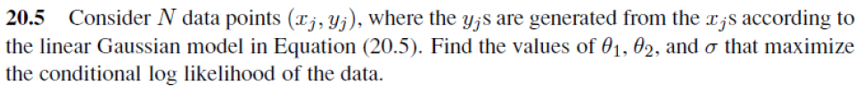
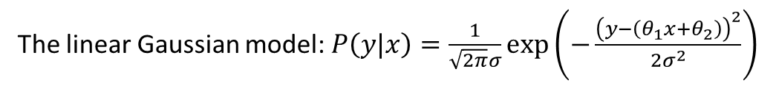
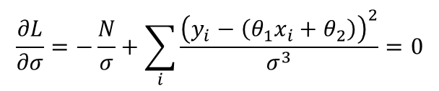
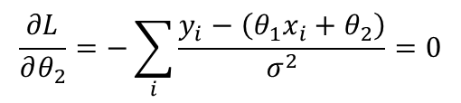
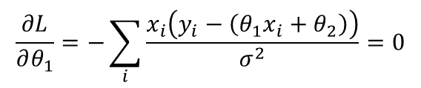

Homework 5
Problem 1
This is a classical parameter approximation problem, with the maximization of the log-likelihood.
The linear Gaussian model: $P\left(y|x\right)=\frac{1}{\sqrt{2π}σ}\exp\left(−\frac{{\left(y−\left(θ_{1}x+θ_{2}\right)\right)}^{2}}{2σ^{2}}\right)$
The log-likelihood function:
$$L=\log{∏_{i}P\left(y_{i}|x_{i}\right) } \\ =\sum_{i}{\log{P\left(y_{i}|x_{i}\right)}} \\ =\sum_{i}{\log\left(\frac{1}{\sqrt{2π}σ}\exp\left(−\frac{{\left(y_{i}−\left(θ_{1}x_{i}+θ_{2}\right)\right)}^{2}}{2σ^{2}}\right)\right)} \\ =−N\left(\log{σ}+\log{\sqrt{2π}}\right)−\sum_{i}{\frac{{\left(y_{i}−\left(θ_{1}x_{i}+θ_{2}\right)\right)}^{2}}{2σ^{2}}}$$
To get the optimal parameters, set the derivatives to 0.
$$\frac{∂L}{∂θ_{1}}=−\sum_{i}{\frac{x_{i}\left(y_{i}−\left(θ_{1}x_{i}+θ_{2}\right)\right)}{σ^{2}}}=0$$
$$\frac{∂L}{∂θ_{2}}=−\sum_{i}{\frac{y_{i}−\left(θ_{1}x_{i}+θ_{2}\right)}{σ^{2}}}=0$$
$$\frac{∂L}{∂σ}=−\frac{N}{σ}+\sum_{i}{\frac{{\left(y_{i}−\left(θ_{1}x_{i}+θ_{2}\right)\right)}^{2}}{σ^{3}}}=0$$

Slide 14
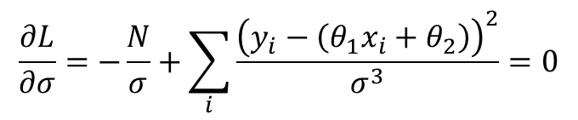
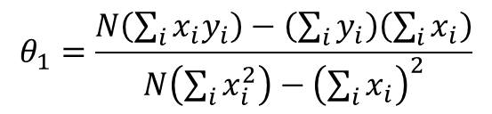
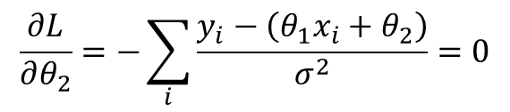
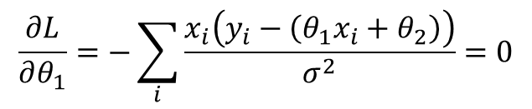
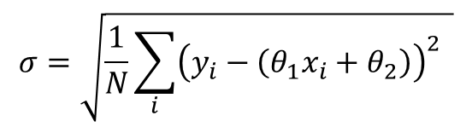
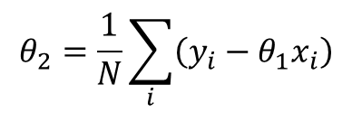
Homework 5
Problem 1
Solve the equations to get the optimal parameters.
$$θ_{1}=\frac{N\left(\sum_{i}{x_{i}y_{i}}\right)−\left(\sum_{i}{y_{i}}\right)\left(\sum_{i}{x_{i}}\right)}{N\left(\sum_{i}{x_{i}^{2}}\right)−{\left(\sum_{i}{x_{i}}\right)}^{2}}$$
$$\frac{∂L}{∂θ_{1}}=−\sum_{i}{\frac{x_{i}\left(y_{i}−\left(θ_{1}x_{i}+θ_{2}\right)\right)}{σ^{2}}}=0$$
$$\frac{∂L}{∂θ_{2}}=−\sum_{i}{\frac{y_{i}−\left(θ_{1}x_{i}+θ_{2}\right)}{σ^{2}}}=0$$
$$θ_{2}=\frac{1}{N}\sum_{i}{\left(y_{i}−θ_{1}x_{i}\right)}$$
$$\frac{∂L}{∂σ}=−\frac{N}{σ}+\sum_{i}{\frac{{\left(y_{i}−\left(θ_{1}x_{i}+θ_{2}\right)\right)}^{2}}{σ^{3}}}=0$$
$$σ=\sqrt{\frac{1}{N}\sum_{i}{{\left(y_{i}−\left(θ_{1}x_{i}+θ_{2}\right)\right)}^{2}} }$$

Slide 15
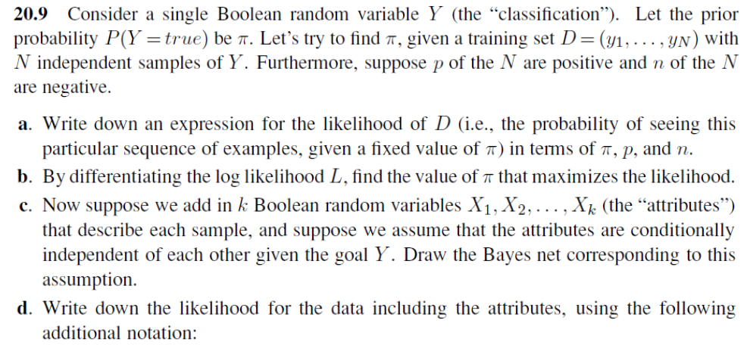


Homework 5
Problem 2
The random variable $Y$ follows Bernoulli distribution under the IID assumption.
Likelihood function: $l=π^{p}{\left(1−π\right)}^{n}$

Slide 16

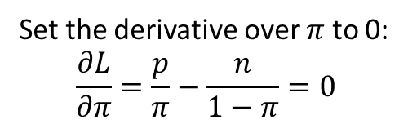
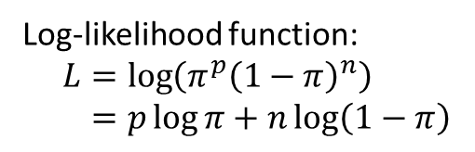
Homework 5
Problem 2
The random variable $Y$ follows Bernoulli distribution under the IID assumption.
Log-likelihood function:
$$L=\log\left(π^{p}{\left(1−π\right)}^{n}\right) \\ =p\log{π}+n\log\left(1−π\right)$$
Set the derivative over $π$ to 0:
$$\frac{∂L}{∂π}=\frac{p}{π}−\frac{n}{1−π}=0$$
Thus, $π=\frac{p}{p+n}$

Slide 17





Homework 5
Problem 2
Each $X_{i}$ is independent with others, so
$$Y$$
$$X_{1}$$
$$X_{2}$$
…
$$X_{k}$$

Slide 18

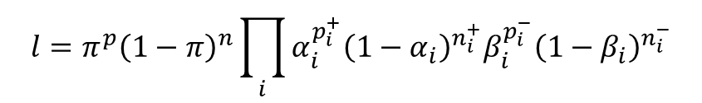

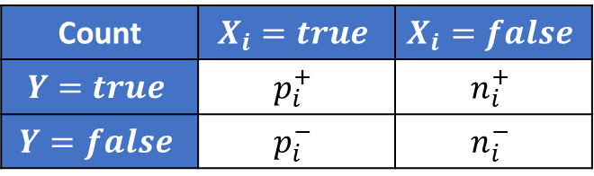
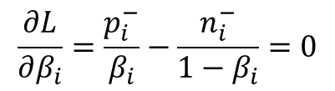

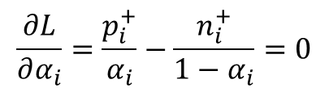

Homework 5
Problem 2
Count | $$X_{i}=true$$ | $$X_{i}=false$$
$$Y=true$$ | $$p_{i}^{+}$$ | $$n_{i}^{+}$$
$$Y=false$$ | $$p_{i}^{−}$$ | $$n_{i}^{−}$$
$$P\left(X_{i}=true|Y=true\right)=α_{i}$$
$$P\left(X_{i}=true|Y=false\right)=β_{i}$$
$$l=π^{p}{\left(1−π\right)}^{n}\prod_{i}{α_{i}^{p_{i}^{+}}{\left(1−α_{i}\right)}^{n_{i}^{+}}β_{i}^{p_{i}^{−}}{\left(1−β_{i}\right)}^{n_{i}^{−}}}$$
$$L=p\log{π}+n\log\left(1−π\right)+\sum_{i}{p_{i}^{+}\log{α_{i}}+n_{i}^{+}\log\left(1−α_{i}\right)+p_{i}^{−}\log{β_{i}}+n_{i}^{−}\log\left(1−β_{i}\right)}$$
$$\frac{∂L}{∂α_{i}}=\frac{p_{i}^{+}}{α_{i}}−\frac{n_{i}^{+}}{1−α_{i}}=0$$
$$\frac{∂L}{∂β_{i}}=\frac{p_{i}^{−}}{β_{i}}−\frac{n_{i}^{−}}{1−β_{i}}=0$$
$$α_{i}=\frac{p_{i}^{+}}{p_{i}^{+}+n_{i}^{+}}$$
$$β_{i}=\frac{p_{i}^{−}}{p_{i}^{−}+n_{i}^{−}}$$

Slide 19
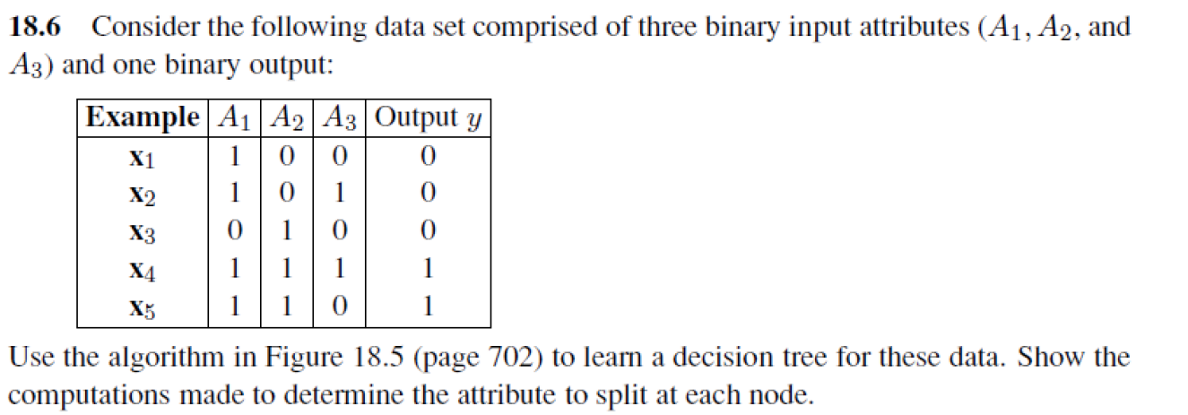
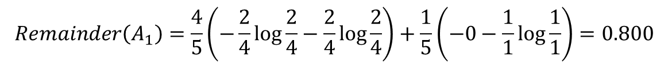
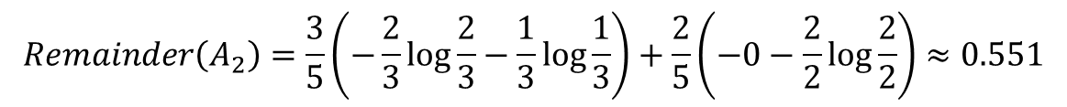
Homework 6
Problem 1
Decision tree splitting
First split
$$Remainder\left(A_{1}\right)=\frac{4}{5}\left(−\frac{2}{4}\log{\frac{2}{4}}−\frac{2}{4}\log{\frac{2}{4}}\right)+\frac{1}{5}\left(−0−\frac{1}{1}\log{\frac{1}{1}}\right)=0.800$$
$$Remainder\left(A_{2}\right)=\frac{3}{5}\left(−\frac{2}{3}\log{\frac{2}{3}}−\frac{1}{3}\log{\frac{1}{3}}\right)+\frac{2}{5}\left(−0−\frac{2}{2}\log{\frac{2}{2}}\right)≈0.551$$
$$Remainder\left(A_{3}\right)=\frac{2}{5}\left(−\frac{1}{2}\log{\frac{1}{2}}−\frac{1}{2}\log{\frac{1}{2}}\right)+\frac{3}{5}\left(−\frac{1}{3}\log{\frac{1}{3}−\frac{2}{3}\log{\frac{2}{3}}}\right)≈0.951$$
Choose $A_{2}$ to split because of the minimum remaining information (maximum gain).

Slide 20
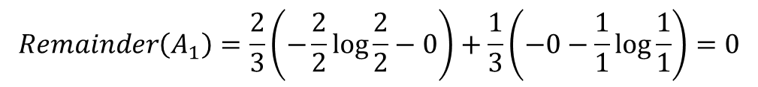
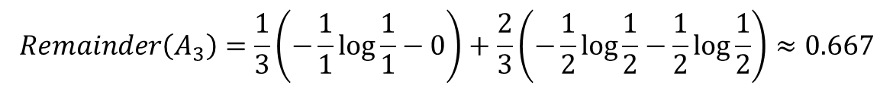
Homework 6
Problem 1
Decision tree splitting
Second split
$$Remainder\left(A_{1}\right)=\frac{2}{3}\left(−\frac{2}{2}\log{\frac{2}{2}−0}\right)+\frac{1}{3}\left(−0−\frac{1}{1}\log{\frac{1}{1}}\right)=0$$
$$Remainder\left(A_{3}\right)=\frac{1}{3}\left(−\frac{1}{1}\log{\frac{1}{1}−0}\right)+\frac{2}{3}\left(−\frac{1}{2}\log{\frac{1}{2}}−\frac{1}{2}\log{\frac{1}{2}}\right)≈0.667$$
Choose $A_{1}$ to split because of the minimum remaining information (maximum gain).

Slide 21





Homework 6
Problem 1
Decision tree splitting
$$A_{2}=?$$
0
1
$$y=0$$
$$A_{1}=?$$
0
1
$$y=0$$
$$y=1$$

Slide 22
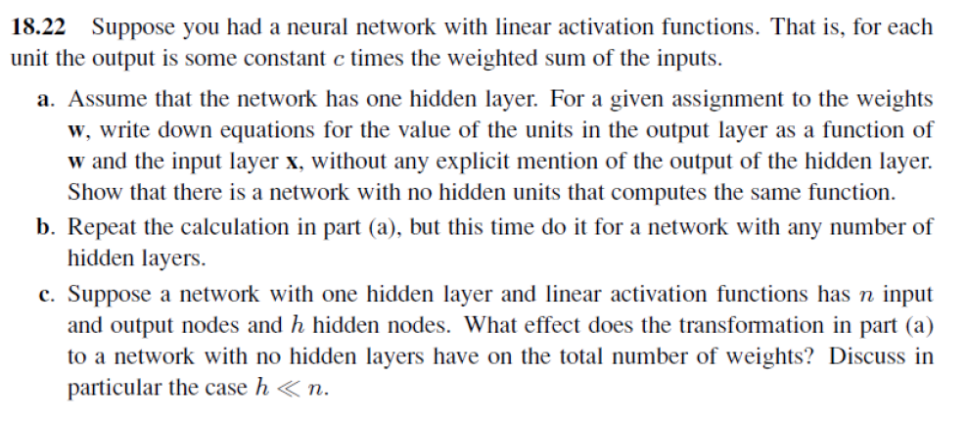




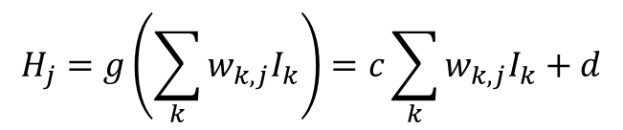



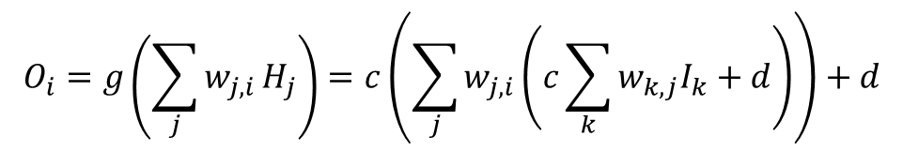


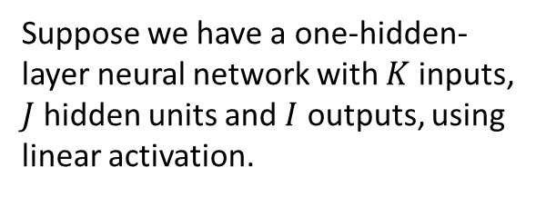

Homework 6
Problem 2
Suppose we have a one-hidden-
layer neural network with $K$ inputs,
$J$ hidden units and $I$ outputs, using
linear activation.
$$g\left(x\right)=cx+d$$
$$I_{1}$$
$$g$$
$$H_{1}$$
Output Layer
$$O_{1}$$
$$H_{j}=g\left(\sum_{k}{w_{k,j}I_{k}}\right)=c\sum_{k}{w_{k,j}I_{k}}+d$$
…
…
…
…
$$O_{i}=g\left(\sum_{j}{w_{j,i}}H_{j}\right)=c\left(\sum_{j}{w_{j,i}\left(c\sum_{k}{w_{k,j}I_{k}}+d\right)}\right)+d$$
$$I_{K}$$
$$g$$
$$H_{J}$$
$$O_{J}$$
$$w_{k,j}$$

Slide 23

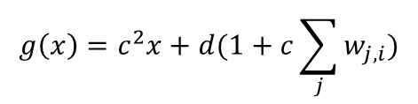








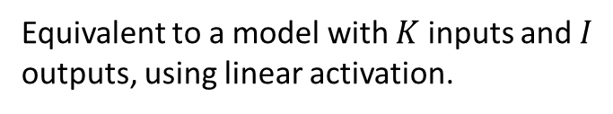
Homework 6
Problem 2
Equivalent to a model with $K$ inputs and $I$
outputs, using linear activation.
$$g\left(x\right)=c^{2}x+d(1+c\sum_{j}{w_{j,i}})$$
The same as a one-layer perceptron with
$w_{k,i}=\sum_{j}{w_{k,j}w_{j,i}}$.
$$O_{i}=c\left(\sum_{j}{w_{j,i}\left(c\sum_{k}{w_{k,j}I_{k}}+d\right)}\right)+d \\ =c^{2}\sum_{k}{I_{k}}\sum_{j}{w_{k,j}w_{j,i}}+d\left(1+c\sum_{j}{w_{j,i}}\right)$$
$$I_{1}$$
$$g$$
$$O_{1}$$
…
…
…
$$I_{K}$$
$$g$$
$$O_{I}$$
$$w_{k,i}$$

Slide 24
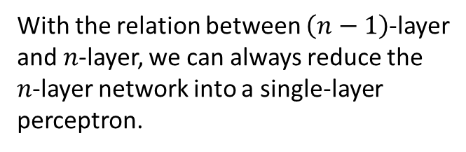

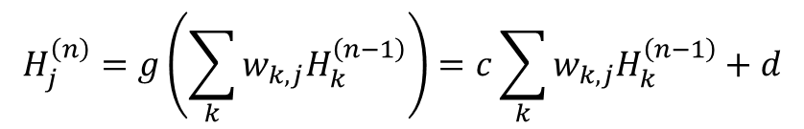
Homework 6
Problem 2
Linear activation
$$g\left(x\right)=cx+d$$
With the relation between $\left(n−1\right)$-layer
and $n$-layer, we can always reduce the
$n$-layer network into a single-layer
perceptron.
$$H_{j}^{\left(n\right)}=g\left(\sum_{k}{w_{k,j}H_{k}^{\left(n−1\right)}}\right)=c\sum_{k}{w_{k,j}H_{k}^{\left(n−1\right)}}+d$$

Slide 25
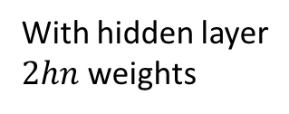







Homework 6
Problem 2
$$n$$
$$n$$
$$h$$
With hidden layer
$2hn$ weights
…
…
…
$$n$$
$$n$$
When $h≪n$, $\frac{2hn}{n^{2}}→0$.
Thus, the network with hidden layer has much fewer weights,
which helps to learn faster.
Without hidden layer
$n^{2}$ weights
…
…

