Slide 1
CYBEX CONSULTING
GROUP 9
Hollie King, Trey Hawkins, Jean-charles hekamanu, Dinh Cao Dat NguYen

Slide 2
Introduction
Cybex Consulting is a cybersecurity firm dedicated to providing modern security solutions for businesses.
As cyber threats continue to evolve, organizations struggle to protect their systems, maintain compliance, and train their teams effectively.
Cybex Consulting addresses these challenges by offering expert-driven services from penetration testing and system hardening to compliance advisory and security awareness training
All accessible through a web platform.

Slide 3
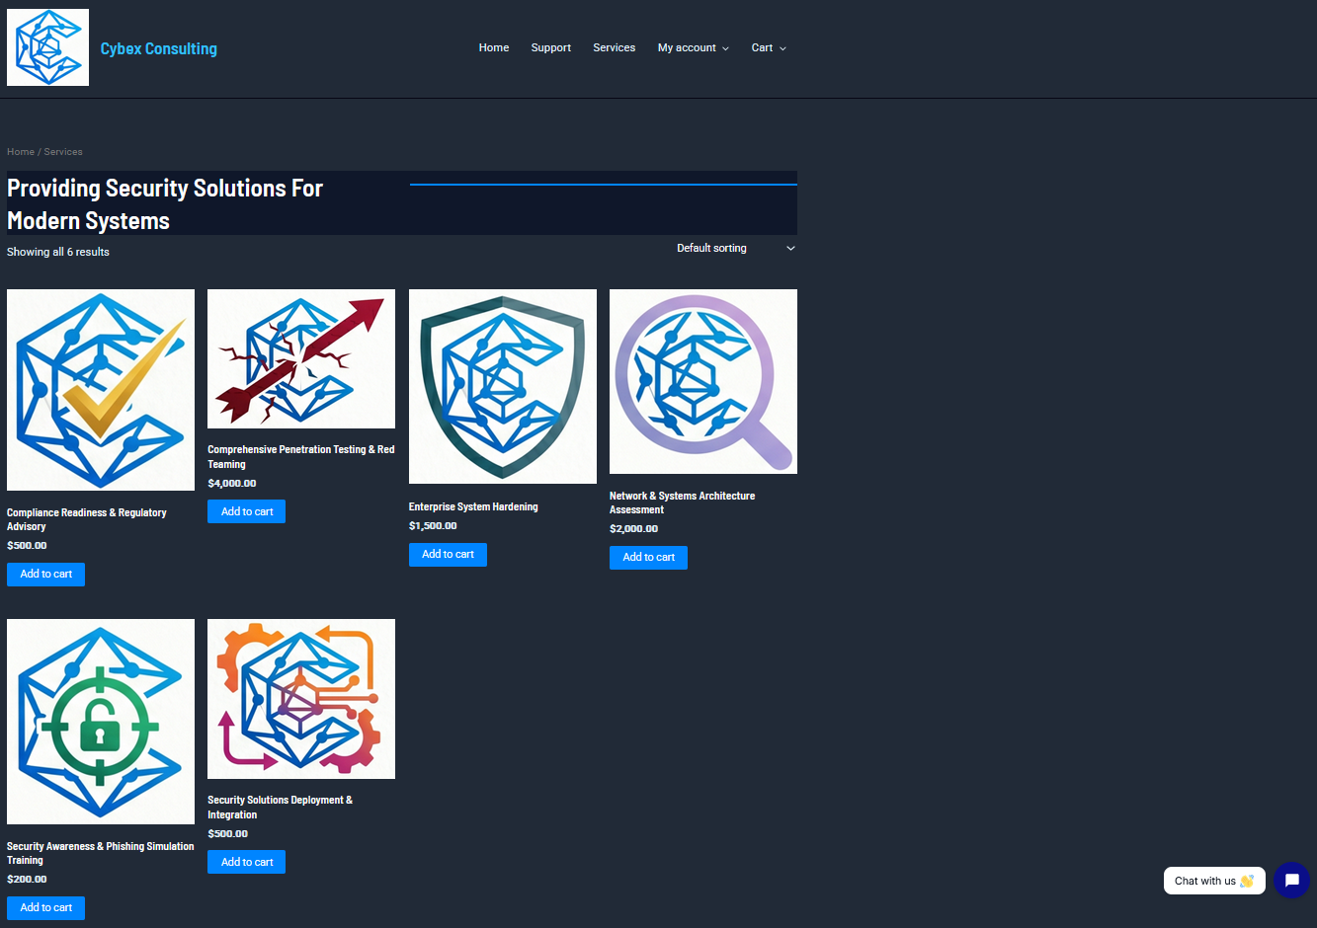
Concept

Slide 4
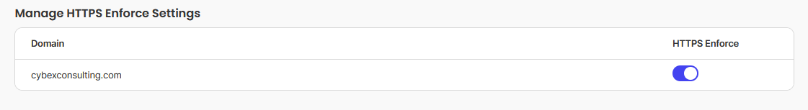
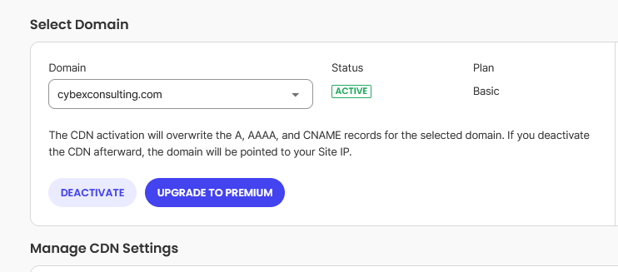
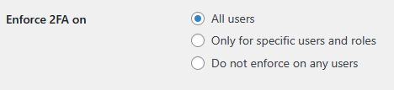
Site Configuration
Hosted on SiteGround with Security Optimizer
Using WordPress
MySQL DB
SSL enabled, HTTPS enforced
WAF enabled
CDN enabled
MFA enforced
Role Based Access Management
Wp-admin login URL protected
Admin email alerts
Email included

Slide 5
DataFlow Diagram
CDN
WAF
SiteGround
Stripe Gateway
Woo Commerce
Customers
SSL Certs
WP 2FA
WordPress
TDIO Chat
MySQL
DB
Employees
SupportCandy

Slide 6
WordPress Plugins
SiteGround Security Optimizer – Lock & Protect System Folders, Disable XML-RPC, Advanced XSS Protection, and more
JetPack – Backups, WAF, monitoring, and more
Woo Commerce – Product Management, Cart, Checkout
Stripe – Payment Gateway
WP 2FA – Enforces 2FA for all users
Tidio Chat – AI Chatbot
SupportCandy – Service Tickets for customer support

Slide 7
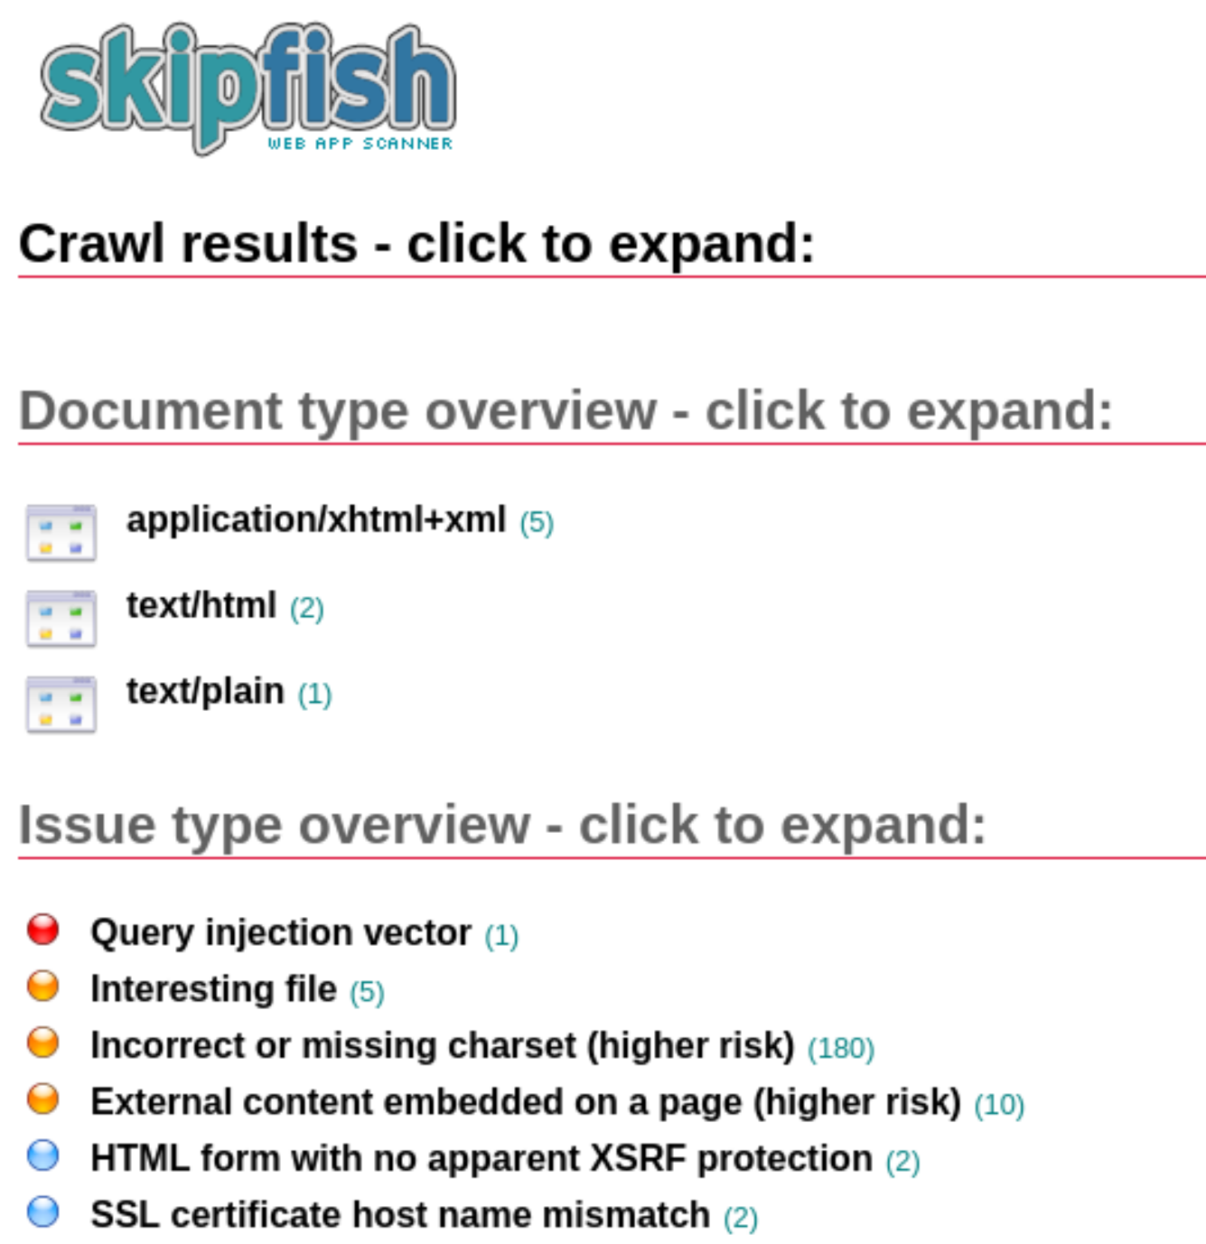
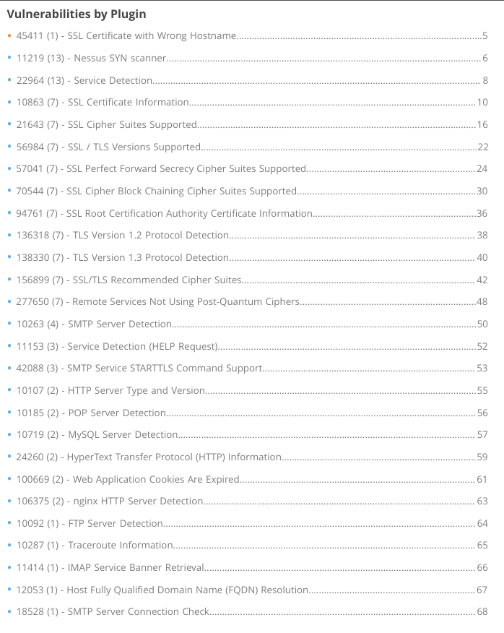
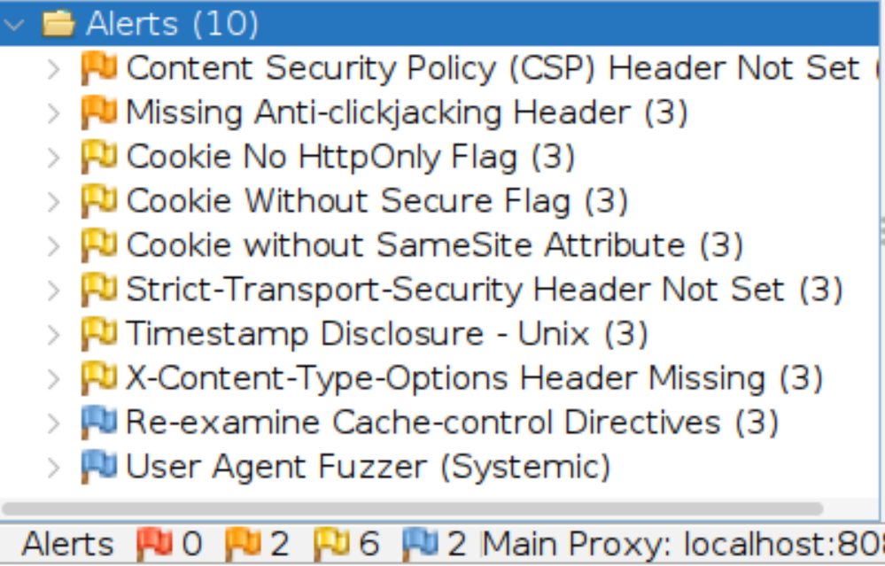
Security Testing
Nessus
OWASP ZAP

Slide 8
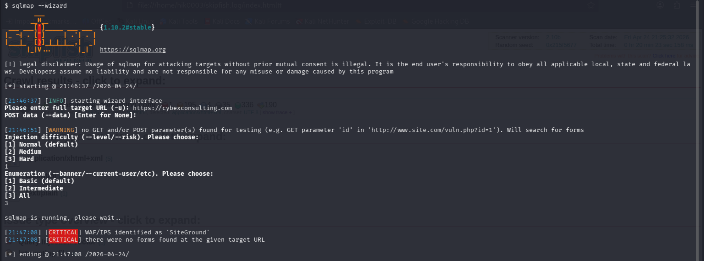
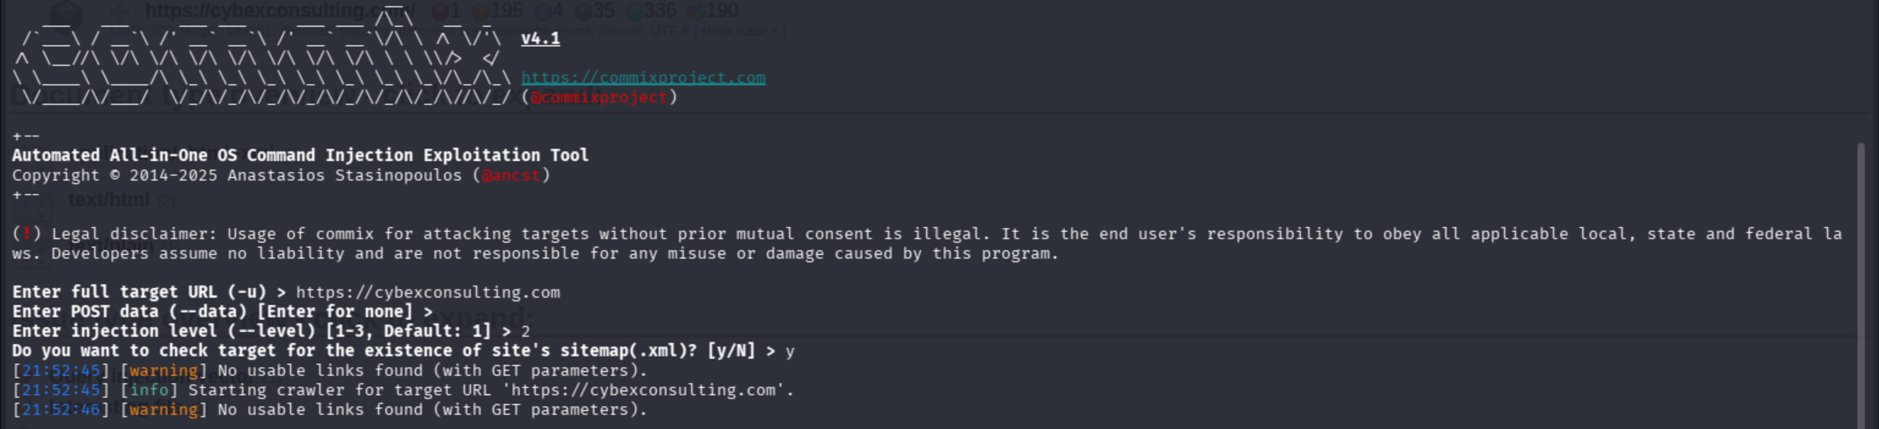
Security Testing

Slide 9
Conclusion
Some additional tools used during testing
BurpSuite
Wapiti
Penetration testing was performed using results of vulnerability scanning
1 Critical and 5 High vulnerabilities were identified, but already had remediations in place
We deemed the website is configured and performing within acceptable risk tolerances

Slide 10
References
https://cybexconsulting.com
https://www.siteground.com/kb/how_does_SiteGround_protect_my_website/
https://woocommerce.com/document/stripe/setup-and-configuration/connecting-to-stripe/
https://wordpress.org/plugins/wp-2fa/
https://help.tidio.com/hc/en-us
https://supportcandy.net/
https://portswigger.net/burp/pro

