Slide 1
Yellow Givers – Online Donation System
MOHD FAHRUL FAHLEVI BIN FUAD
MUHAMMAD SHAHZWAN BIN MOHD ZAKI
MUHAMMAD SYAHMI BIN SHAFAWI
MUHAMAD YUSOF BIN PUTEH
ISB 42303
Project

Slide 2
CM Plan
This SCM Plan is defines the configuration management policies and procedures required for this project.
This plan has been developed early in the lifecycle to ensure the control of changes as soon as the project requirements are approved.
This plan addresses activities such as identifying the items that will be placed under configuration management,the assigned responsibilities and the required resources including staff, SCM tools to be used and workspace facilities.
As the project progresses through the lifecycle stages, the plan is expanded to reflect platform specific activities.

Slide 3
Organization Chart
MOHD FAHRUL FAHLEVI BIN FUAD
Project Manager & Design Leader
MUHAMAD YUSOF BIN PUTEH
Requirement Leader & Configuration Manager
MUHAMMAD SHAHZWAN BIN MOHD ZAKI
Change Control Manager & Implmentation Leader
MUHAMMAD SYAHMI BIN SHAFAWI
Quality Assurance Leader & Maintenance

Slide 4
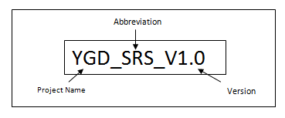
Tools, Environment, and Infrastructure
All project source code and baseline document will be stored in a GitHub Repository
Configuration Identification
Each of product artifacts / baseline produce each after development stage are to be named following this rule:

Slide 5
SOFTWARE CONFIGURATION ITEMS & BASELINE
System Requirements Specification
System Design Document
Software Test Plan
Source Code & Executable Code
Data Dictionaries
Operation& Maintenance Manual
User Manual
Notes:
Configuration identification is the basis for subsequent control of the software configuration
The configuration identification process involves the selection,designation,and description of the software configuration items.
Baseline is the documentation and software that make up a CI at a given point in its life cycle .
Each baseline serves as a point reference for the next development stage and traceability among configuration items
Developmental baseline(SDD,STP)
To coordinate engineering activities.
Functional baseline (SRS & Prototype)
To describe the function that the system should have for customer satisfaction
Product baseline (product)
To deliver complete software product for system integration.

Slide 6
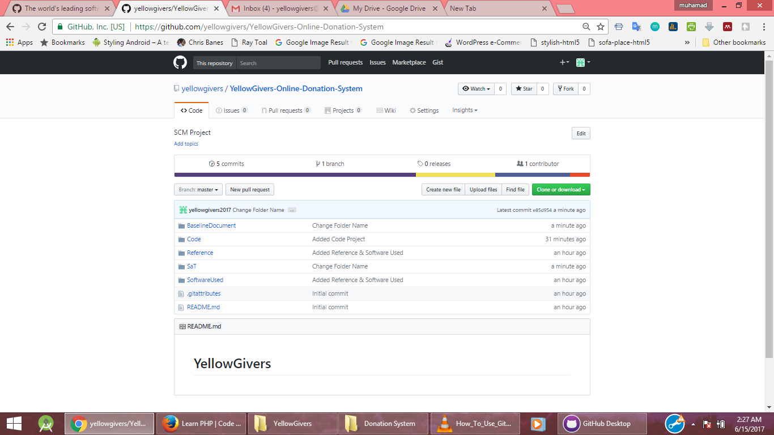
SCM Tools – GITHUB (Workspace)

Slide 7
Change Request Processing and Approval
Responsible for Configuration Manager to :
Quickly revise the Change Request document
Put the document in the “ToBeRevise” folder (External to the referential)
Alert and advice all team member that a Document Review are required (mostly using email or telephone). Reviews will take place mostly on Friday between 8:30am and 2:30pm.
Document modifications are iterative and distributed among team members.
When the document is accepted by all reviewers, Configuration Manager will transfers the softcopy of document in its associated folder to the project referential (GitHub)

Slide 8
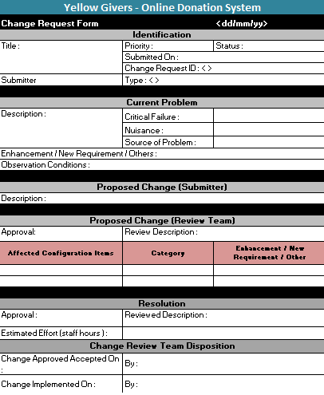
Reports and Audits

