Slide 1
















Material Safe
Postings
Radiation Area Boundary
100 cm² Smears
1
2
3
4
5
6
7
8
9
10
11
12
13
14
15
16
17
18
19
20
21
22
23
24
Rad Waste
LSC Smears
1
2
3
4
5
6
7
8
µR/hr
Bricks / Shielding
mR/hr
Dose rates in µR/hr
#
= smear location
= LSC Smears
#

Slide 2
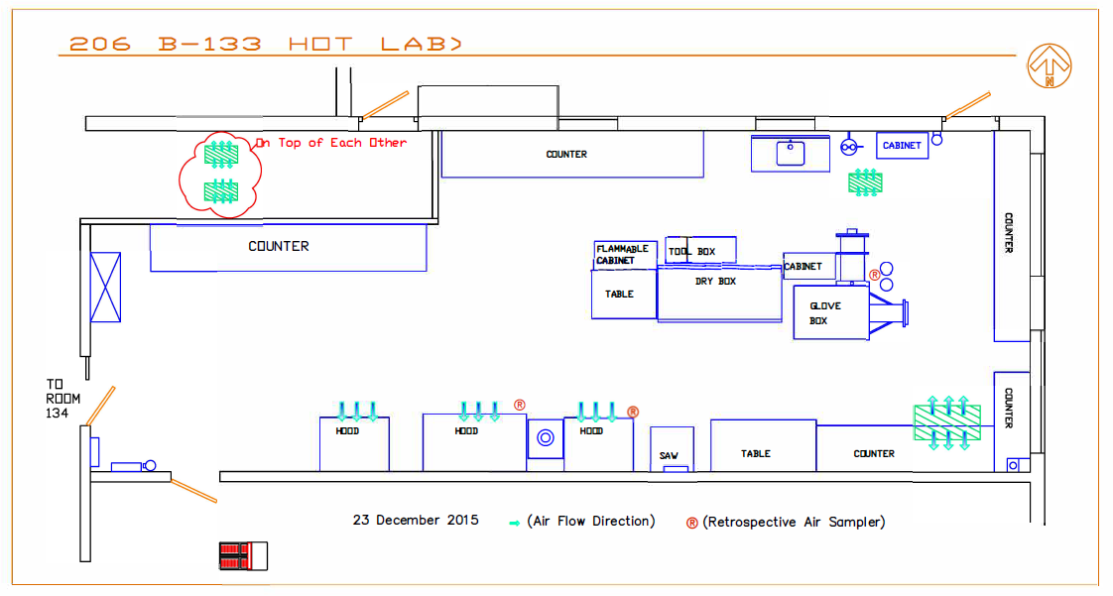
Survey: 20240823 E_W 206 RSM 01
25
20
18
*15
23
19
*31
24
22
29
28
21
17
*19
16
26
*18
27
*12
9
13
12
15
30
*12
14
*12
7
*74
3
5
2
4
6
8
11
*12
10
1
#
= SMEAR
*#= Dose rate in μR/hr

Slide 3
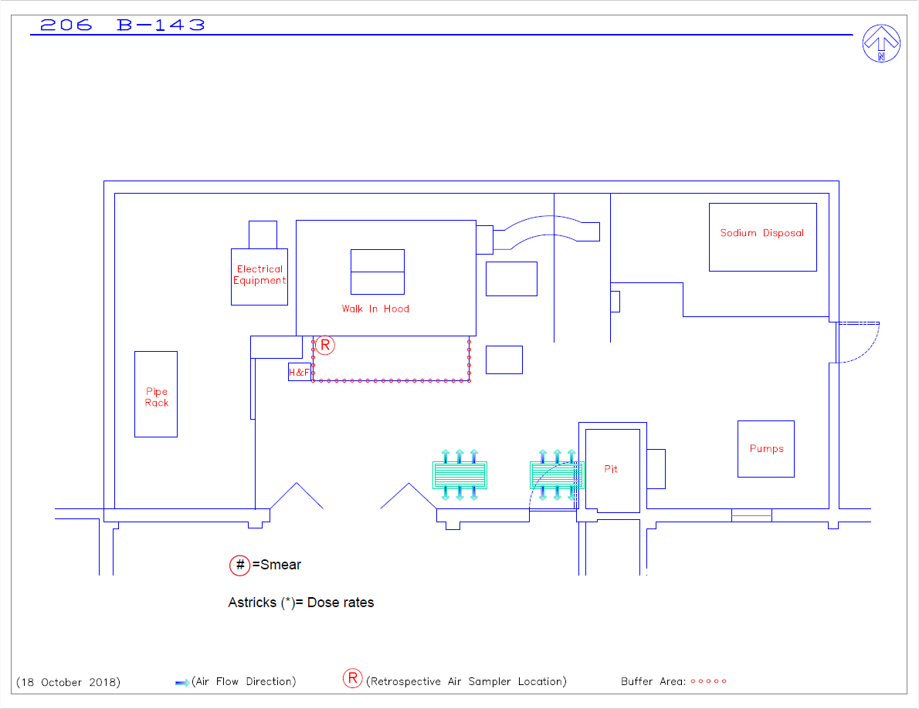
Survey #: 20241119 E_W 206 RSQ 02
*7
24
23
10
9
11
1
22
15
*7
2
3
4
5
12
*10
7
*10
19
18
*8
17
16
6
*7
20
13
*7
21
*7
8
*11
14

Slide 4
Survey: 20240823 E_W 206 RSQ 02
10
6
5
14
13
*12
*15
*11
4
9
15
3
*12
12
2
1
8
7
11
18
17
*14
16

Slide 5
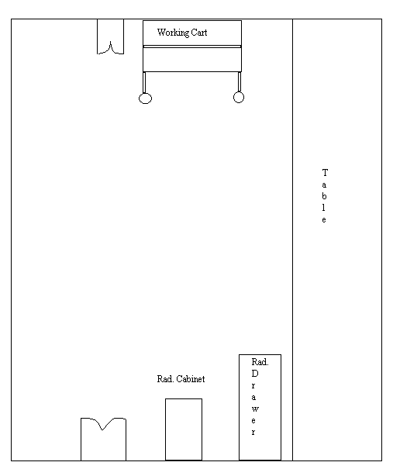
206 B134
#
= SMEAR
*# = Dose rate in μR/hr
Survey: 20240823 E_W 206 RSM 01
34
35
*121
380
550
37
36
33
161
32
*109
38
*250
39
*210
31
*139
40

Slide 6
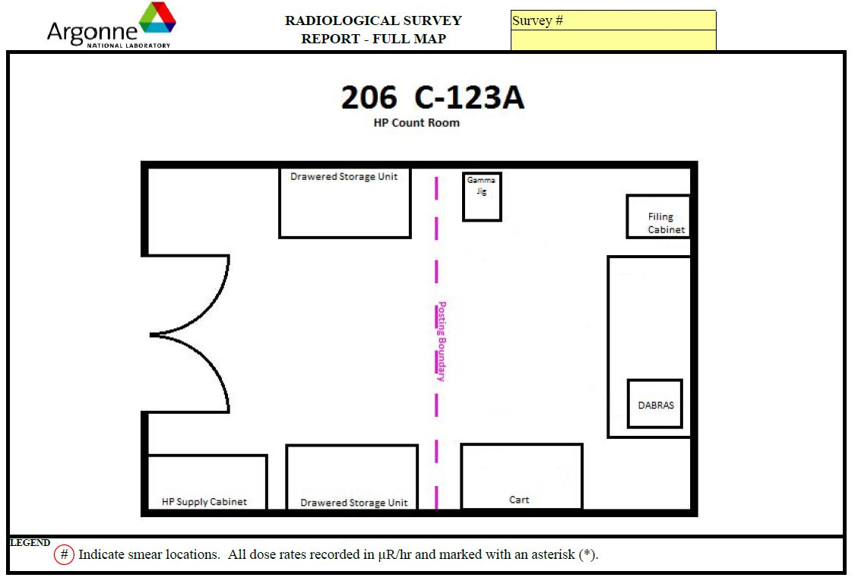
20250814 E_W 206 RSQ 02
1
10*
2
6
3
8​*
8*
4
8​*
5

