Slide 1
















Material Safe
Postings
Radiation Area Boundary
100 cm² Smears
1
2
3
4
5
6
7
8
9
10
11
12
13
14
15
16
17
18
19
20
21
22
23
24
Rad Waste
LSC Smears
1
2
3
4
5
6
7
8
µR/hr
Bricks / Shielding
mR/hr
Dose rates in µR/hr
#
= smear location
= LSC Smears
#

Slide 2
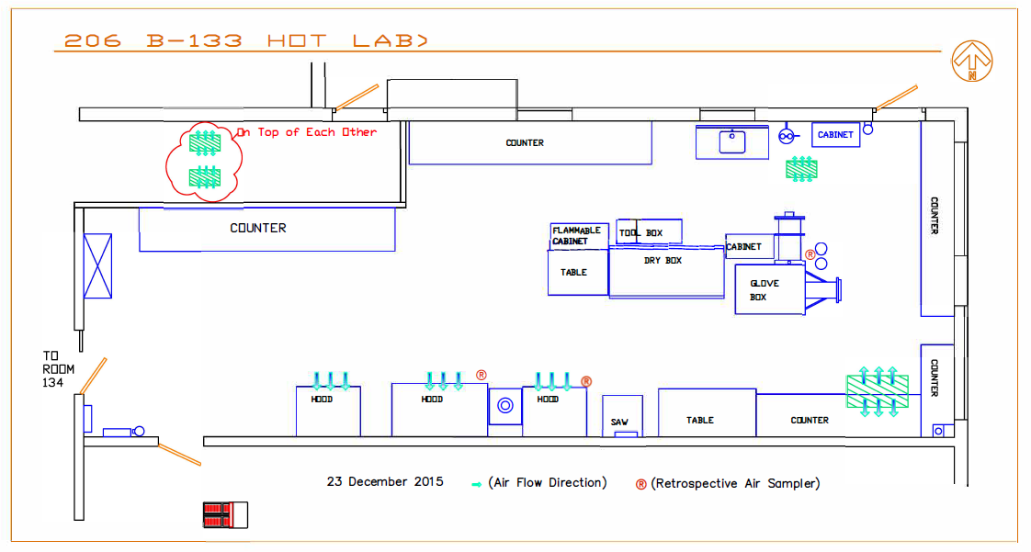
24
19
*11
23
20
*12
17
22
21
18
28
27
*45
25
*11
*23
29
26
10
11
16
*15
30
*17
*11
15
*14
5
*11
9
*79
3
7
12
*45
*19
1
2
4
6
8
13
14
*23
#
= SMEAR
*#= Dose rate in μR/hr

Slide 3
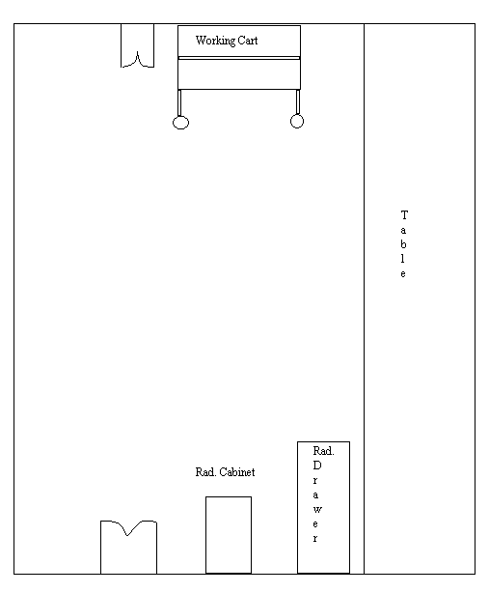
206 B134
#
= SMEAR
*# = Dose rate in μR/hr
*104
34
35
33
*804
*255
36
32
*226
37
*86
38
*284
39
31
*344
*174
40

Slide 4
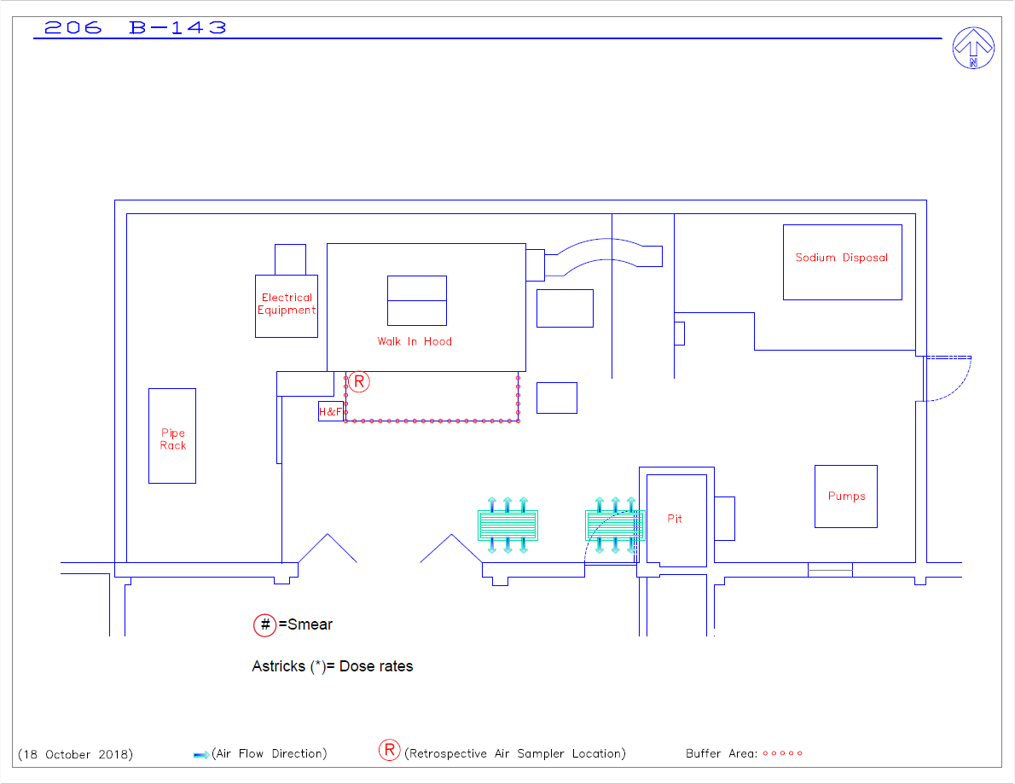
*8
*10
12
13
*14
14
15
6
7
11
16
17
18
*8
5
4
8
9
10
3
2
*8
1

Slide 5
*9
24
10
9
23
11
5
6
15
*12
4
3
2
1
22
n/a
*10
*9
17
16
12
21
*12
19
18
7
*12
8
*9
20
*9
13
*9
*9
14

Slide 6
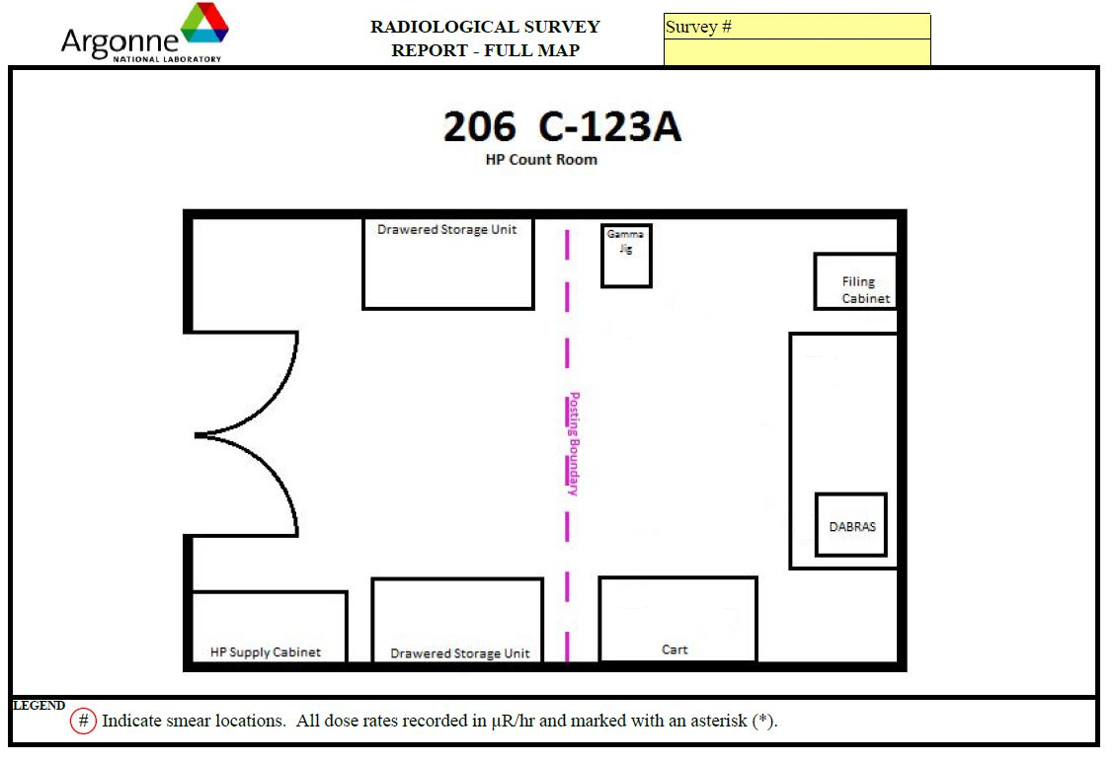
20250814 E_W 206 RSQ 02
1
10*
2
6
3
8​*
8*
4
8​*
5

