Slide 1
MFPE Topic
Policy Administration System
COHORT: INTCDE22ID013
POD no.5
MENTOR: PARDEEP KUMAR
TRAINER: T DeVI
COACH : Kanchan nilkanthrao Bhise

Slide 2
TEAM MEMBERS
KAJAL SHARMA :2135961
DEVISH LNU :2134422
BELLARY YASMEEN SHADAB :2134720
KUTALA VEDAVATHI :2136845

Slide 3
INDEX
Overview
Scope
Hardware and software requirements
Software architecture diagram
Usecase diagram
Flow chart
Class diagram
Work distribution
Individual components of the system
Cloud deployment requirement
Unit testing
References

Slide 4
Overview
A leading Insurance Management Organization offers Business insurance that protects businesses from losses due to events that may occur during the normal course of business. There are many types of insurance it provides for businesses including coverage for property damage, legal liability and employee-related risks.
Companies evaluate their insurance needs based on potential risks, which can vary depending on the type of environment in which the company operates.
Quotes will get generated based on the consumer business and if the consumer is fine with the quote, then the policy will be issued.
In this ,we focus only on the Business Property Insurance that covers building, equipment, signage, inventory, and furniture in the event of a fire, storm or theft.
Insurity is the Portal that allows any Agents to Login and create Policies for the consumers.
This Portal in turn interacts with the Middleware system of the Organization which will allow the Agents to create policies based on quotes.

Slide 5
SCOPE
Below are the core modules that needs to be developed part of the Project:
Consumer module
Consumer Module is a Middleware Microservice that perfors following operations: i.Create Consumer Business ii.Update Consumer business iii.View Consumer business iv. Create Business Property v.Update Business Property vi.View business Property
Policy module
Policy Module is a Middleware Microservice that perfors the following operations: i.Create Policy ii.View Policy iii.Issue Policy
Quotes module
Quotes Module is a Middleware Microservice that performs the following operations: i.Get Quotes
Insurity agent portal
An Web Portal that allows an Agent to Login and allows to do following operations: i.Login ii.Create Policy iii.Issue Policy

Slide 6
Hardware and Software Requirement
Hardware Requirement:
1.Developer Desktop PC with 8GB RAM
Software Requirement (Dotnet)
1.Visual studio 2022 enterprise edition
2. In memory database
3.Postman Client in Chrome
4.AWS cloud access

Slide 7
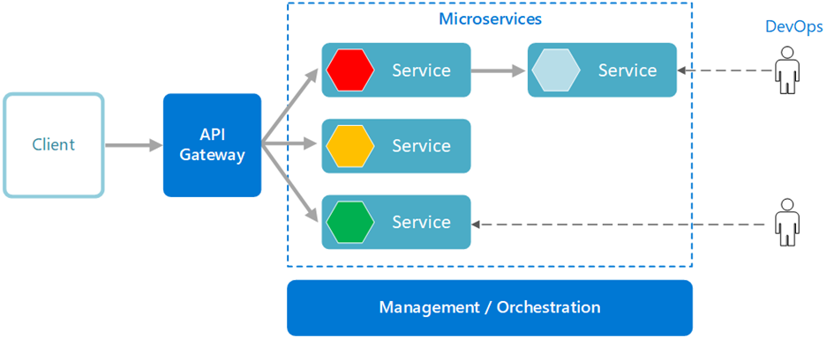
System Architecture Diagram
A microservices architecture consists of a collection of small, autonomous services. Each service is self-contained and should implement a single business capability within a bounded context.
The microservice architecture enables the continuous delivery/deployment of large, complex applications.
It enables an organization to evolve its technology stack.

Slide 8
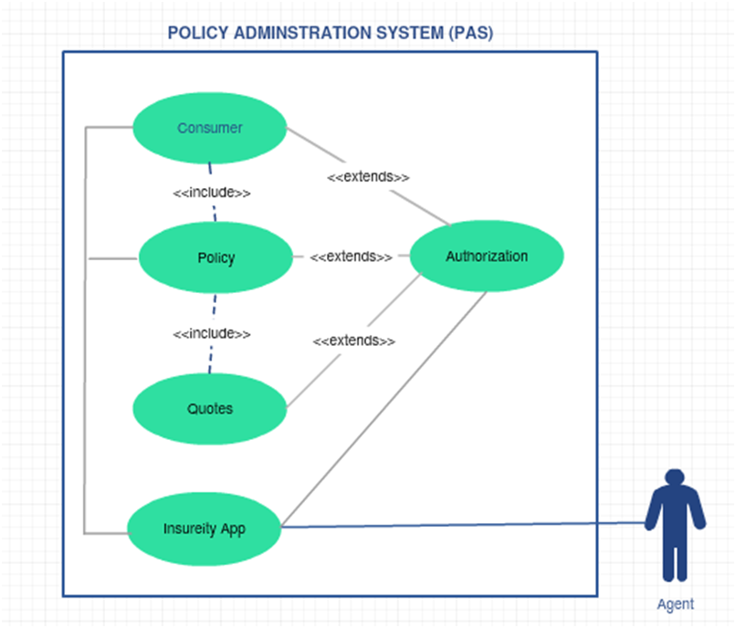
Use Case Diagram

Slide 9
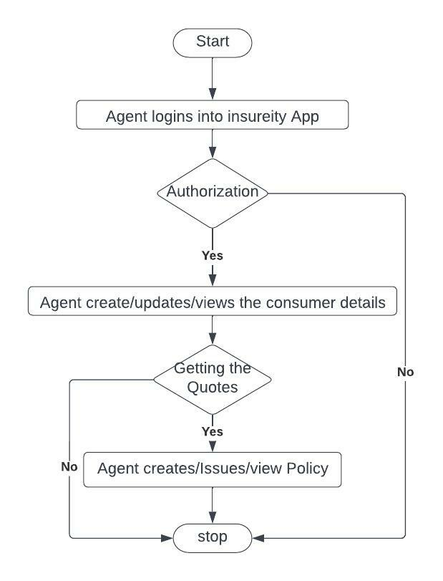
Flow chart

Slide 10
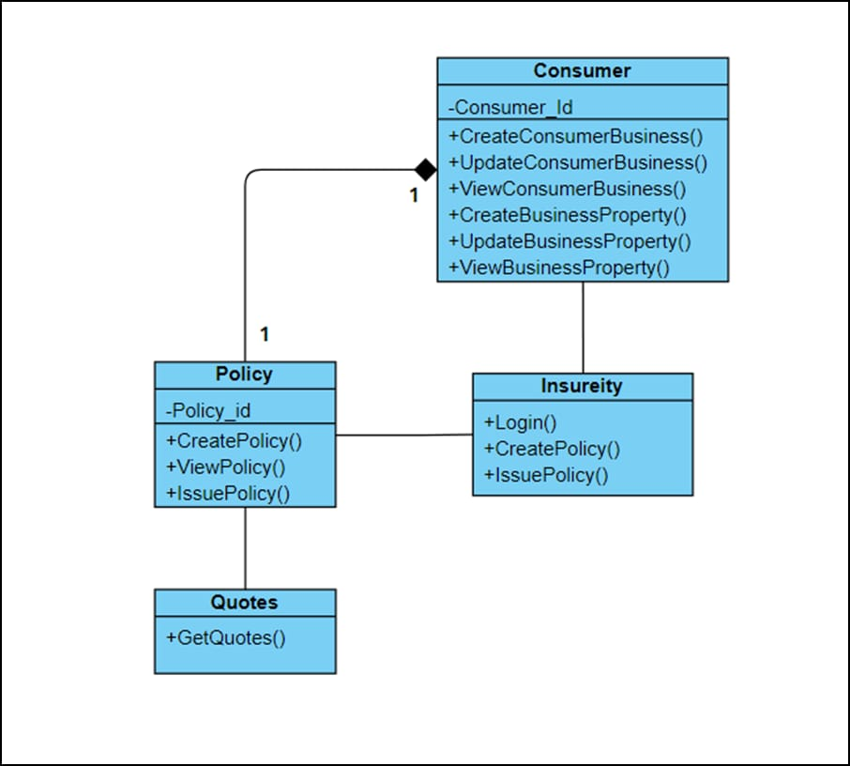
class diagram

Slide 11
work distribution
Kajal sharma -------------------------Angular
Devish LNU --------------------------Cloud deployment, Policy Microservice
Bellary yasmeen shadab---------------Entity framework and web API
Kutala vedavathi----------------------Testing

Slide 12
Individual Components of the System
Authorization microservice
Consumer microservice
policy microservice
Quote microservice
Swagger
Insurity portal
Cloud deployment
Unit testing

Slide 13
authorization microservice
Security Requirements
Service to Service communication has to happen using JWT
Pass End User Context across Microservices
Have the token expired after specific amount of time say 15 minutes.
Have this service configured in the cloud along with other services

Slide 14
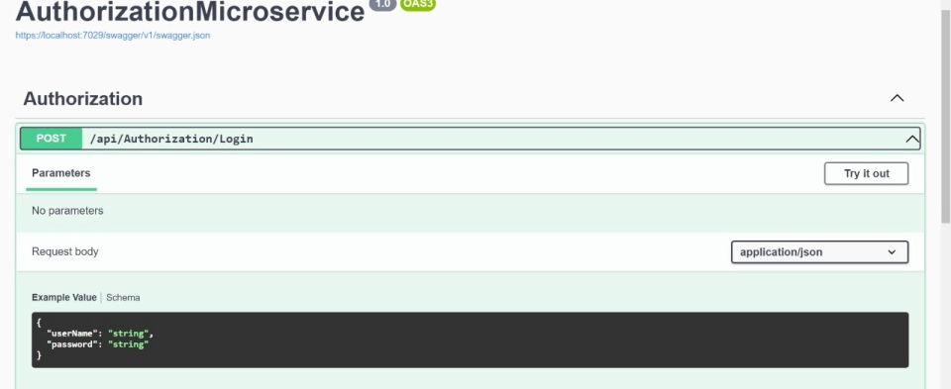
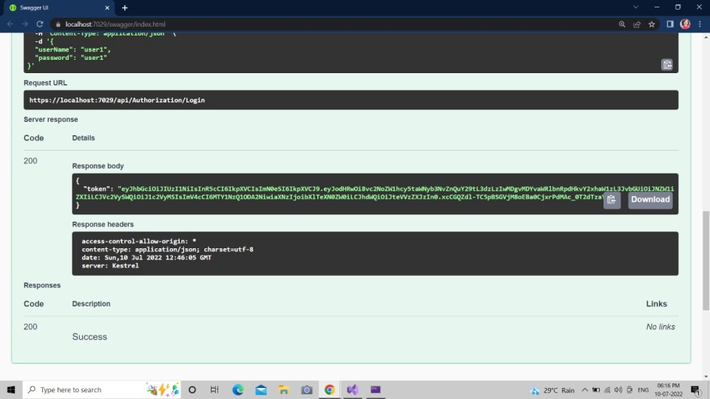
authorization microservice(output)

Slide 15
Consumer Microservice
An Agent through Insurity App can interact with Consumer Service to create new consumer / update consumer details. Consumer is the customer here who wishes to subscribe to a Business Property Insurance with the Insurance Company. In this project we are restricting to Property Insurance that means the land/building in which the business is operated will be covered.
The Consumer Microservice has to interact with Policy Microservice to create a policy and as well as to view the policy status

Slide 16
consumer microservice(entities)
1.Consumer
<Details of Consumer, Personal Details, Business Overview, Validity of Consumer, Agent Details who subscribes the Consumer>
2.Business
<Details of Business including, Business Type, Annual Turnover, Total Employees, etc.>
3.Property
<Business ID, Building Sq.ft, Building Type (Owned/Rental), Building Storeys Building Age>
4.Property Master
<Has Property types, rules permissible for Insurance>
5.Business Master
<Has Business types, rules permissible for Insurance>

Slide 17

consumer microservice(steps and actions)
1. Authorization has to be performed
2. Basic Input Validations have to be performed. Every Consumer Business must be in the Permissible Business Category and Propertymust be in permissible Property Category
>>> Example, Business Owner must be operatingbusiness in the Property for minimum of 2 years for a Theft Cover
3. Business Value and Property Values will be calculated based on the rules configured in Master Entities. Rules are given below
>>>Business value will be given an index from 0 to 10, 0 being lowest and 10 being highest based on the annual turnover vs.capital invested
>>>Property Value will be given an index from 0 to 10 based on its depreciation value like below:
Where Cost of the asset is the purchase price of the asset,
Salvage value is the value of asset at the end of its useful life
Useful Life of the Asset represents the number of years in which the asset is used by the Business Consumer

Slide 18
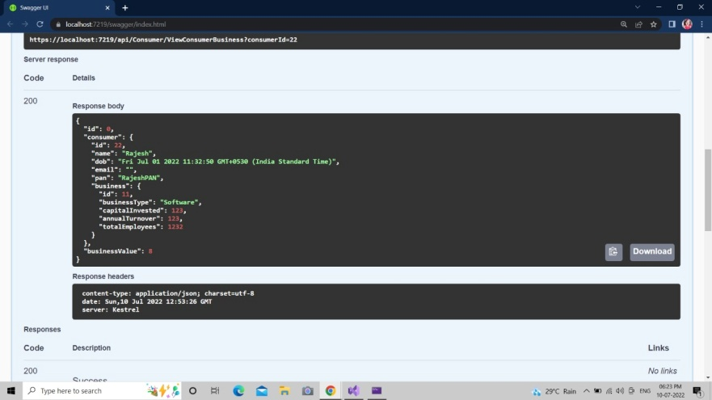
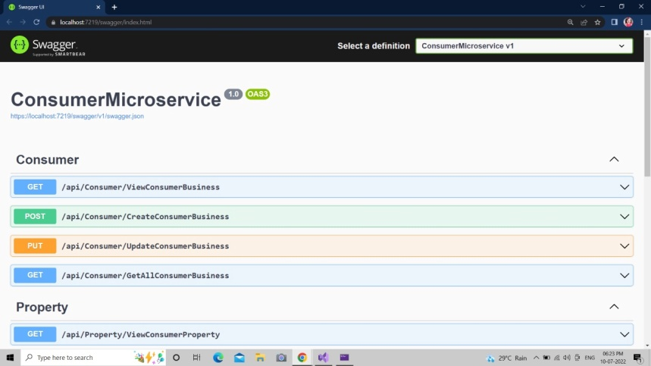
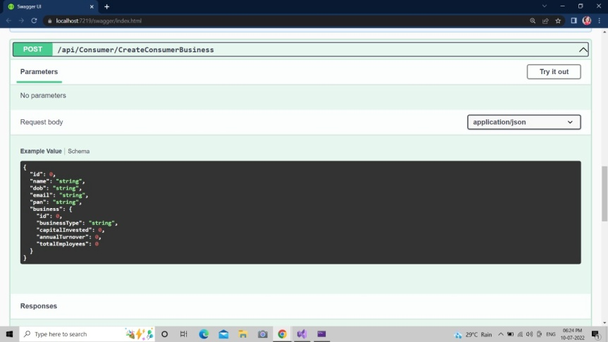
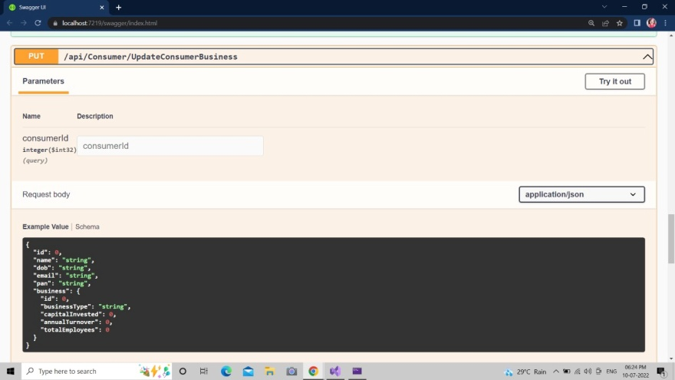
consumer microservice(output)

Slide 19
policy service
Policy Microservice interacts with Consumer Microservice and Quotes Microservice, but it gets invoked from Insureity Portal (MVC app). Post authorization of request, Policy Microservice allows the following operations:
>>>Creates Policy based on Business and Property Value from Consumer Service. For these values, the service will validate the permissible Policies of type “Property Insurance” and for the coverage the Agent has quoted, and get the quotes from Quotes service.
>>>Issue Policy willissue a policy to the consumer based on the payment and acceptance status fromconsumer, for the quoted insurance cover.
>>>View Policy allows to view the Policy Details

Slide 20
policy microservice (entities)
1.Policy Masaster: <Types of permissible Policies for the type of business and the type of business value>
Example:
2.Consumer Policy:<Policies created for every consumer>
ID | Property tpe | Consumer type | Assumed sum | Tenure | Business value | Property value | Base location | Type
po1 | Building | Owner | 2,00,00,000 | 3years | 8 | 5 | Chennai | Replacement
po2 | Factory equipment | Owner | 4,00,000 | 1year | 9 | 10 | Chennai | Replacement
po3 | Property in transmit | Owner | 2,00,000 | 1year | 7 | 8 | Pune | Payback

Slide 21
policy microservice(steps and actions)
Create Policy
● For the Consumer and Business Details, get the concrete details from Consumer Microservice
● For the Business Value find appropriate policy based on policy rules in Policy Master Entity
● Request Quotes from Quote Service for the Business Value
● Create Policy with Status “Initiated”
● Assume that Agent details / Consumer Business Details will not be verified in the scope of this Policy Microservice.
Issue Policy:
● Invoked from Insureity App when Agent clicks on Issue Policy in the Portal, with Payment Status and Policy Acceptance Status by Business
● Policy Status will get updated as “Issued”, Update the Quote on which the Policy wasapproved
● Policy Effective Date, Covered Sum, Duration gets updated.
● Assume that Payment of Policy Premium happens outside the portal and Agent
View Policy:
● Policy Details will be returned for the given Business and Consumer ID.

Slide 22
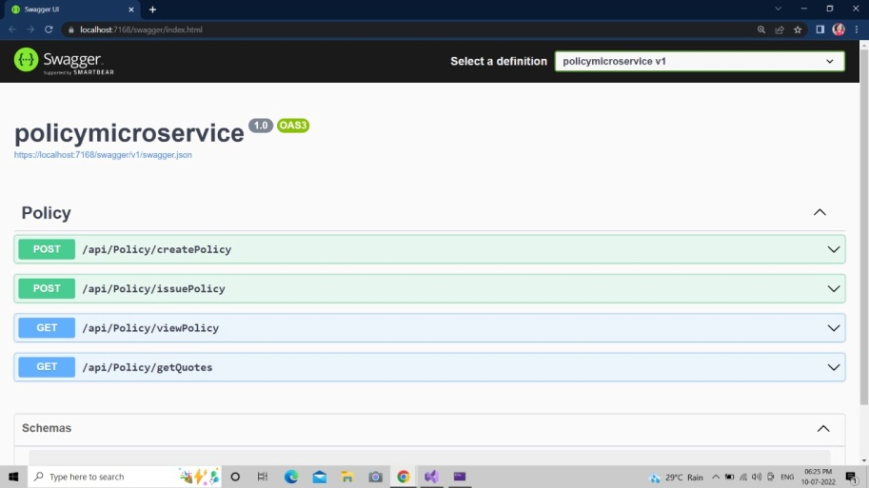
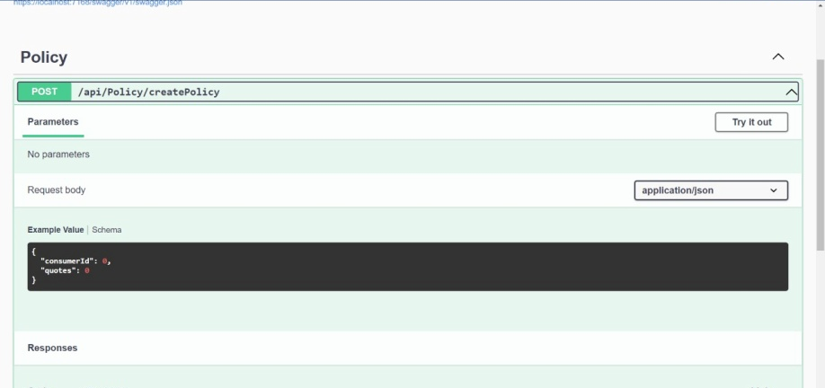
policy microservice(output)

Slide 23
quotes microservice
Quotes Microservice will be invoked only from Policy Service. Post authorization of request; based on the business value and property value, for the opted policy quotes will be calculated. The service exposes the following operation:
Get Quotes – for the given consumer business and property value, policy type, policy covered sum etc.

Slide 24
quotes microservice(entities)
Quotes Master
Holds the Quote values for the different policies, for different ranges of Business Value and Property Value
Ex.: If Business value is 0-2 AND Property Value is 0-2, and Property Type is “Equipment” then quotes can be 80,000 INR | If Business value is 3-5 AND Property Value is 3-5 and Proerty Type is “Equipment” then quotes can be 50,000 INR
Note: Always the quotes are for the insurance period given in the Policy Table

Slide 25
quote microservice(steps and actions)
The policy directly hits the Quotes Table and returns quotes
>>> If no quotes are available, then an appropriate response will be returned with description “No Quotes, Contact Insurance Provider”.

Slide 26
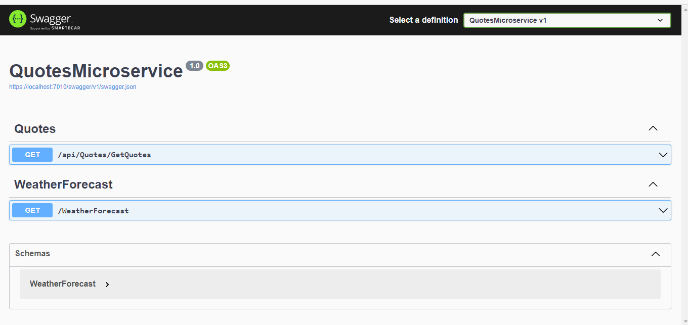
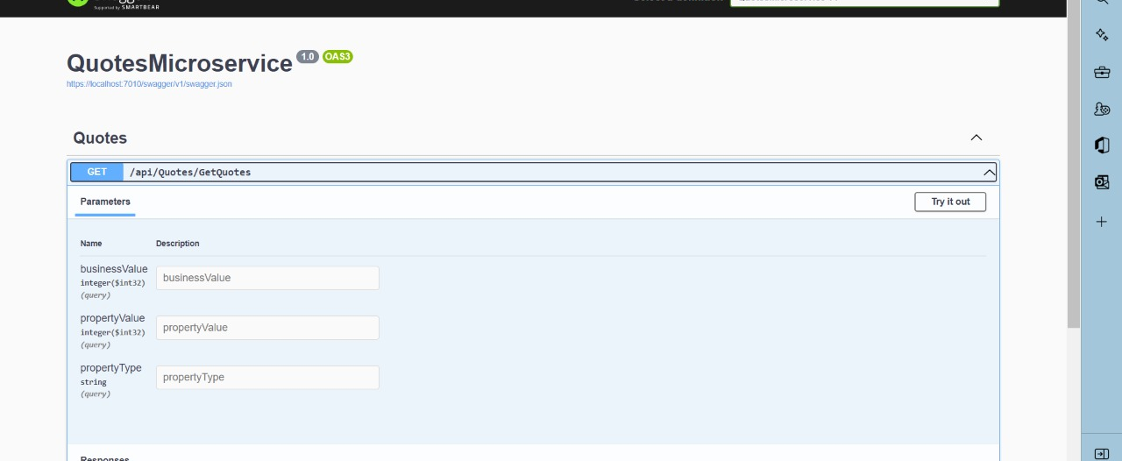
quote microservice(output)

Slide 27
swagger
All the Microservices must be configured with Swagger for documentation
Register the swagger resources in the Swagger Microservice and enable them as REST end points
Configure this service along with other services in the cloud

Slide 28
insurity portal
Insureity Portal Requirements
Portal must allow the Agents to Login. Once successfully logged in, the member do the following operations:
>>>Create / Edit / View Consumer Businessesand Properties
>>>Create Policy
>>>Issue Policy – Based on Payment Information and Acceptance by Customer, policy will be issued. However Payment and Acceptance is outside the system boundary. Authorized Agents will get the information and that will be fed into the Portal by the agents
>>View Policy
Each of the above operations will reach out to the middleware Microservices that are hosted in cloud.

Slide 29
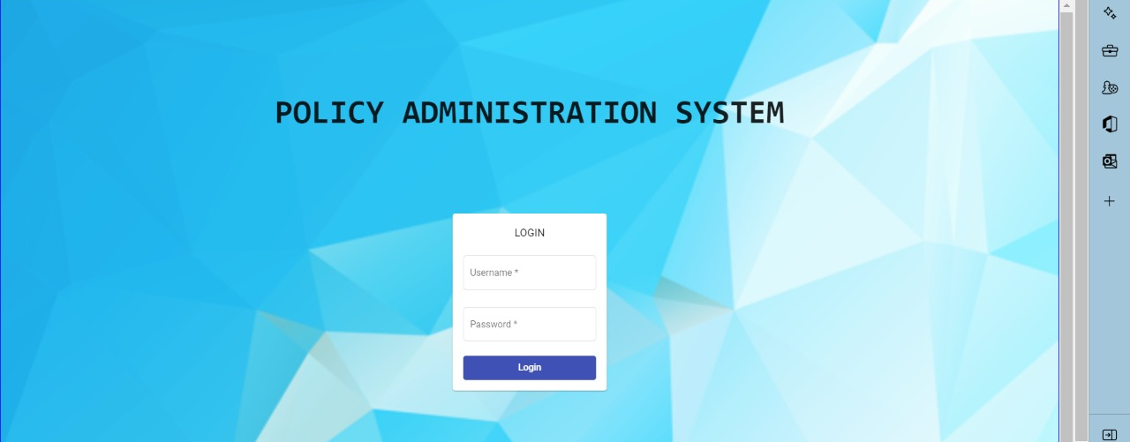
insurity portal(output)

Slide 30
Cloud Deployment requirements
● All the Microservices must be deployed in Cloud
● All the Microservices must be independently deployable. They have to use In-memory database or user sessions wherever applicable
● The Microservices has to be dockerized and these containers must be hosted in Cloud using CI/CD pipelines
● The containers have to be orchestrated using AWS/Azure Kubernetes Services.
● These services must be consumed from an MVC app running in a local environment.

Slide 31
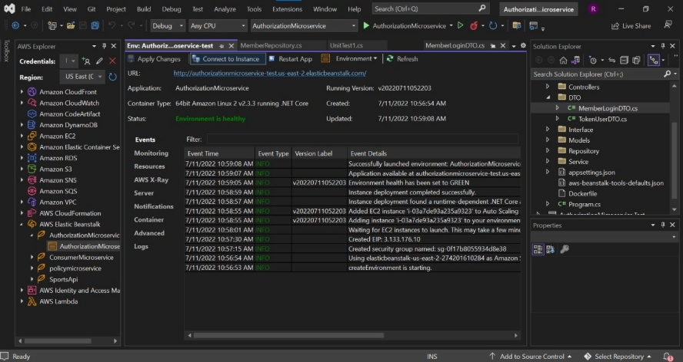
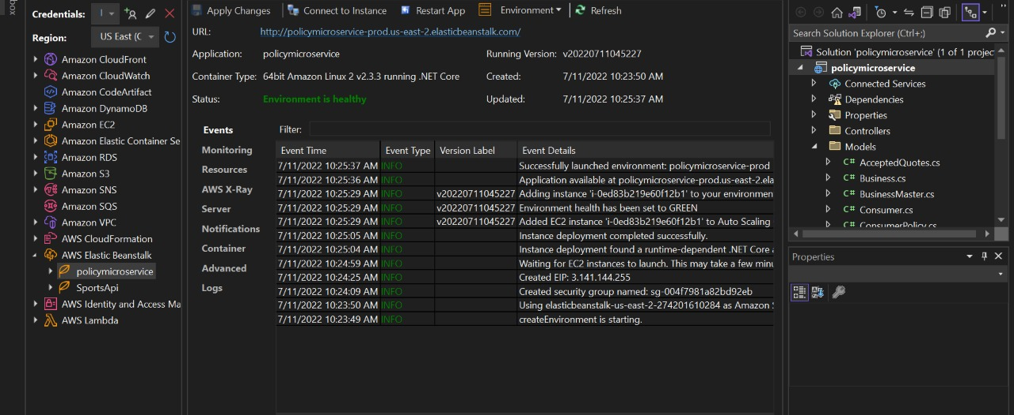
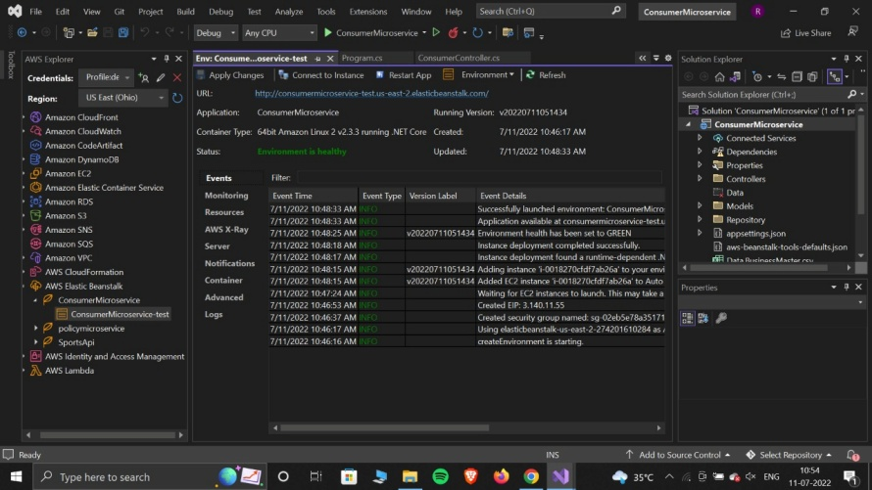
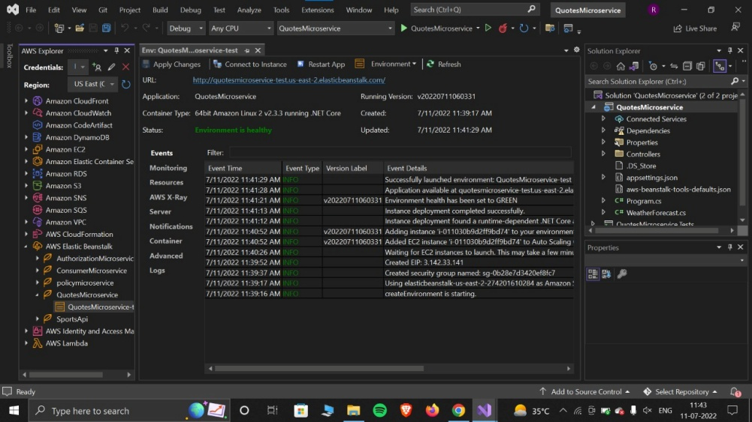
cloud deployment (output)

Slide 32
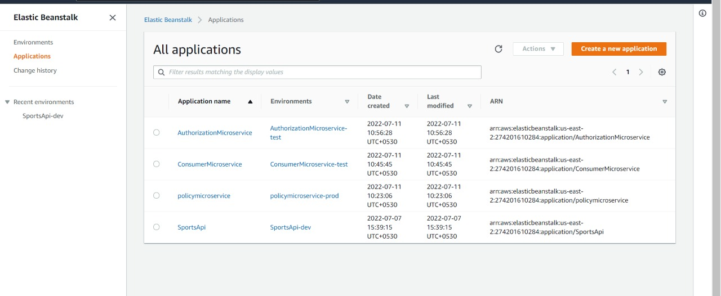
cloud deployment

Slide 33
unit testing
Unit testing is a test used to test a unit of application without external dependencies
Where external depencies is an input from an external source that is required before a task can proceed.
In this we have three parts like
>>>arrage: here we initialize object
>>>act: here we can act on the initialized object.
>>>assert: finally here we verify the results whether it is true or false.
Unit testing is cheap to write and it will execute fastly.

Slide 34
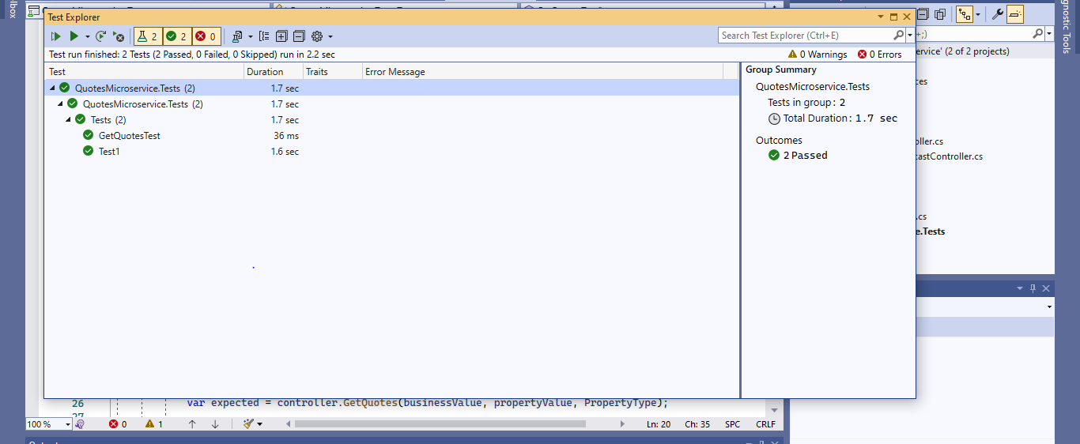
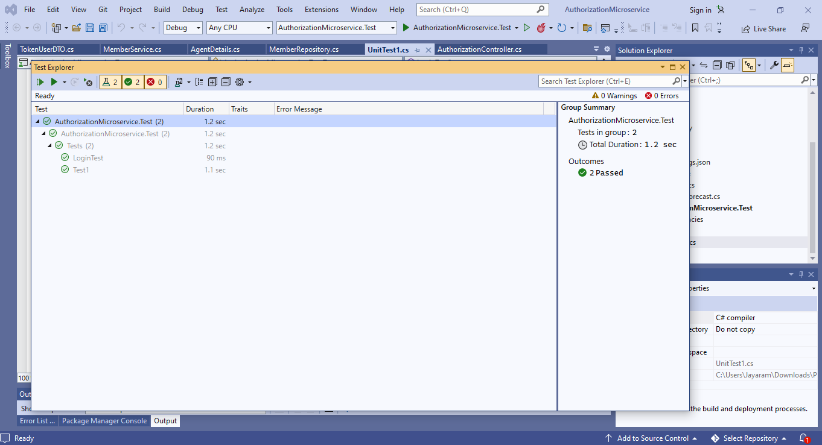
unit testing(output)

Slide 35
references
shorturl.at/kluV0

Slide 36
thank you

