Slide 1
Portfolio Optimization With
Sentimental Analysis
Zijian Huang & Lubing Wang
Dec. 16. 2021

Slide 2

Math 5670
Agenda
Motivation
Strategy - Sentimental Analysis
Strategy – Optimization
Backtesting

Slide 3
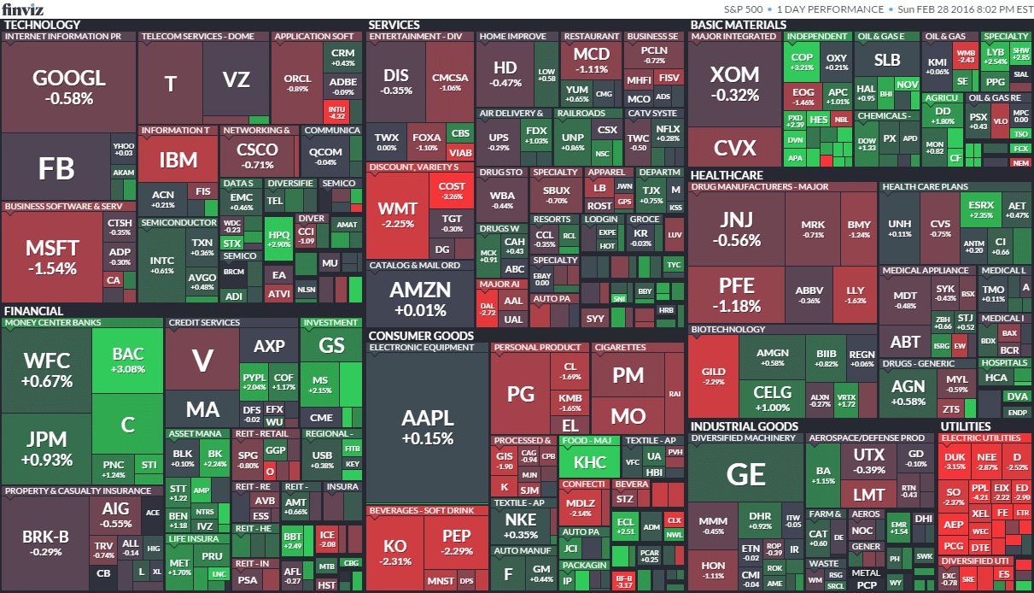
Math 5670
Motivation

Slide 4

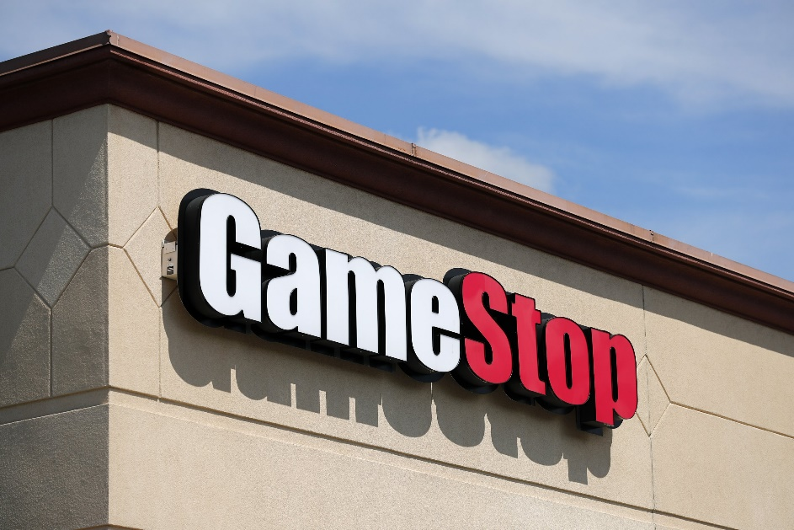
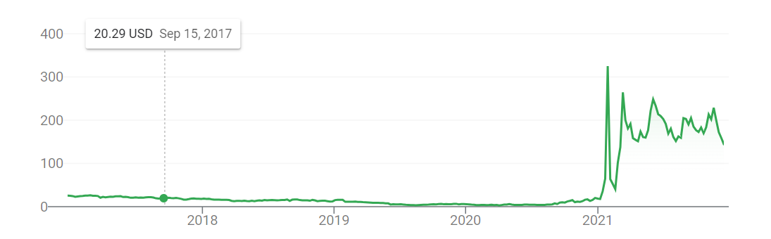
Math 5670
Motivation

Slide 5
Math 5670
Sentimental Analysis

Slide 6
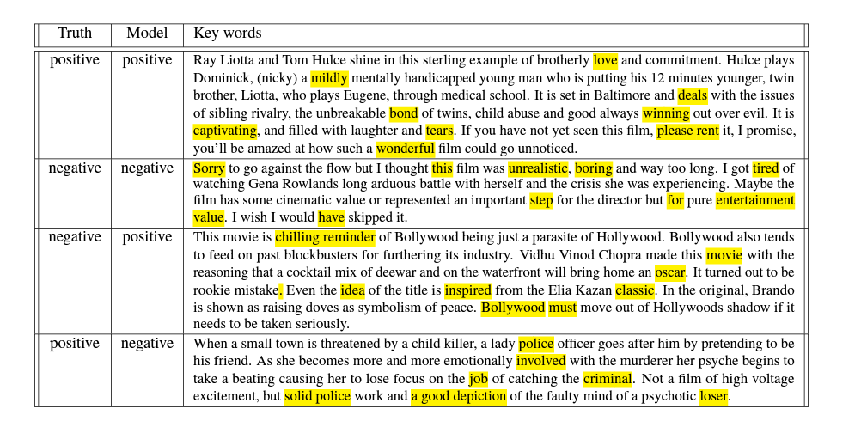
Math 5670
Sentimental Analysis - Example
IMDB Movie Review Example

Slide 7
Math 5670
Sentimental Analysis - VADER
VADER ( Valence Aware Dictionary for Sentiment Reasoning)
Word/Phrase | Sentiment
Love, Enjoy | Positive
Did not love | Negative
ENJOY | Strong Positive
Notes:
VADER sentimental analysis relies on a dictionary that maps lexical features to emotion intensities known as sentiment scores. The sentiment score of a text can be obtained by summing up the intensity of each word in the text.
It also understands the emphasis of capitalization and punctuation, such as “ENJOY”

Slide 8
Math 5670
Sentimental Analysis -Data
Reddit: wallstreetbets, stocks and investing.
Certain posts that have this flare, such as Daily Discussion, Weekend Discussion and Discussion.
500 hottest posts with more than 70% upvote ratio.
Comments in each post: at least 2 upvotes.
Overall, 11289 comments in 179 posts.

Slide 9
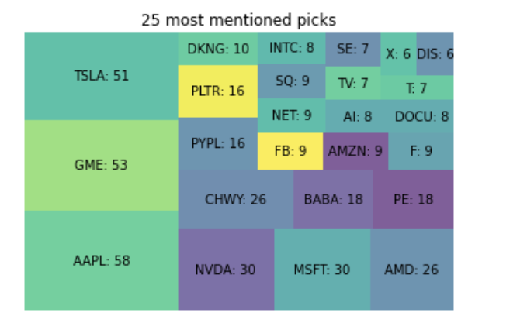
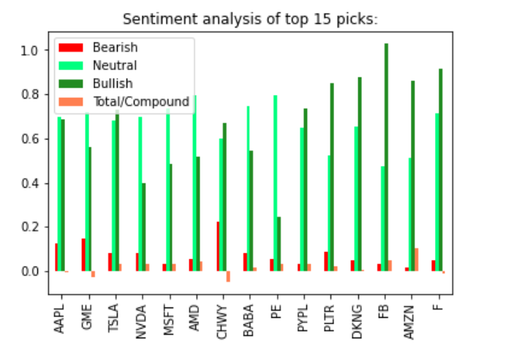

Math 5670
Sentimental Analysis – Result

Slide 10
Math 5670
Optimization Analysis

Slide 11
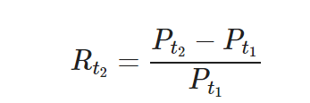

Math 5670
Optimization
Simple Return
Log return

Slide 12

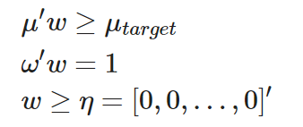
Math 5670
Optimization
Efficient Frontier Optimization
Subject to:

Slide 13

Math 5670
Optimization
Sortino Ratio: Downside risk.
Variance of negative returns only.

Slide 14
Math 5670
Backtesting

Slide 15
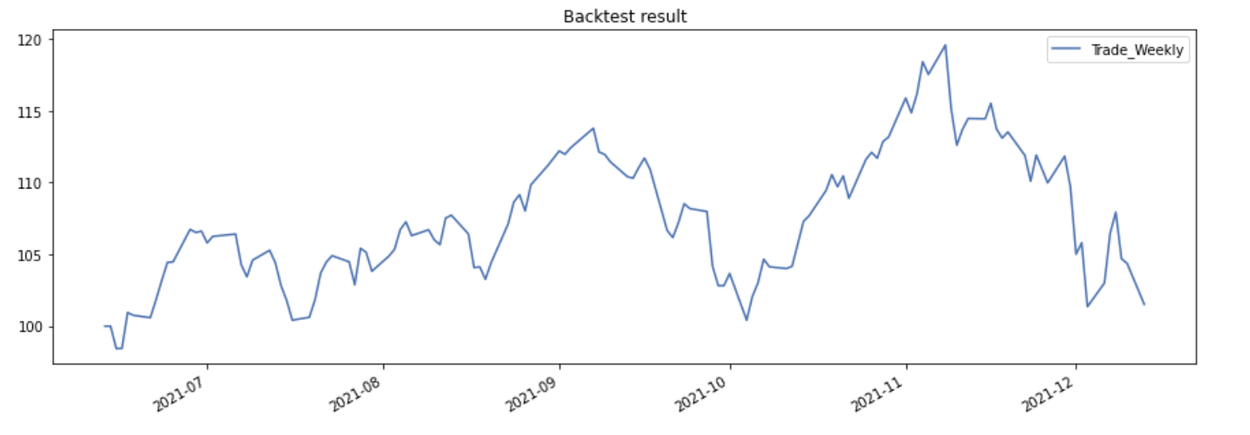
Math 5670
Backtesting - Benchmark
Benchmark: 10 stocks with equal weight:
Trade weekly from 6/13/2021 to 12/13/2021

Slide 16
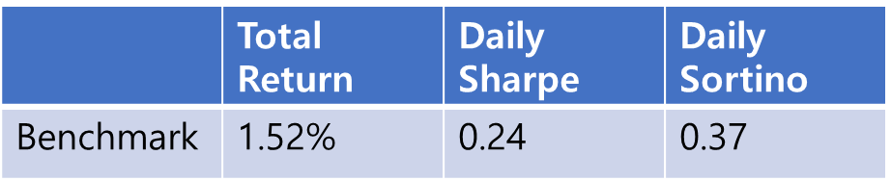
Math 5670
Backtesting - Benchmark
Benchmark: 10 stocks with equal weight:
Trade weekly from 6/13/2021 to 12/13/2021

Slide 17
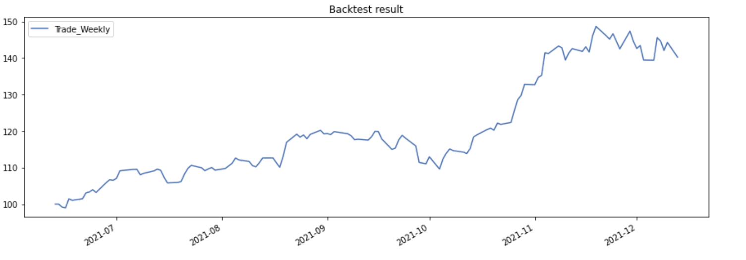
Math 5670
Backtesting – Normal mean and variance
Using normal calculated mean and variance:
66.455% MSFT and 33.545% NVDA

Slide 18
Math 5670
Backtesting – Normal mean and variance
Using normal calculated mean and variance:
66.455% MSFT and 33.545% NVDA
 | Total Return | Daily Sharpe | Daily Sortino
Benchmark | 1.52% | 0.24 | 0.37
Normal | 40.22% | 2.96 | 5.72

Slide 19
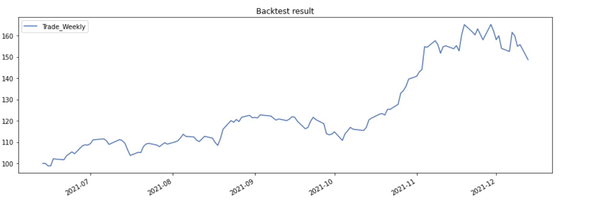
Math 5670
Backtesting – Exponential mean and variance
Using exponential weighted calculated mean and variance:
34.813% MSFT, 58.744% NVDA and 6.443%TSLA

Slide 20
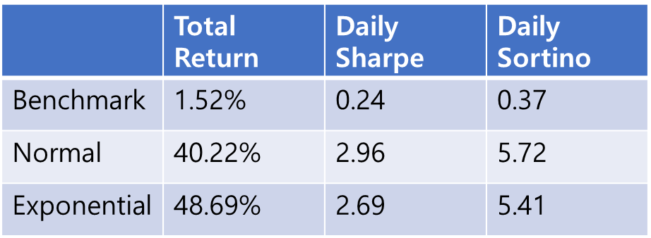
Math 5670
Backtesting – Exponential mean and variance
Using exponential weighted calculated mean and variance:
34.813% MSFT, 58.744% NVDA and 6.443%TSLA

Slide 21
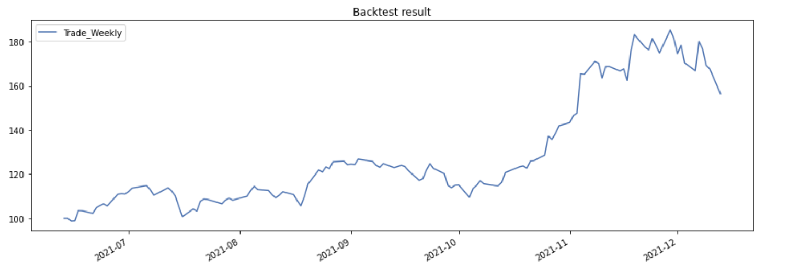
Math 5670
Backtesting – Exponential mean and semi-covariance
Using exponential weighted calculated mean and semi-covariance :
NVDA

Slide 22
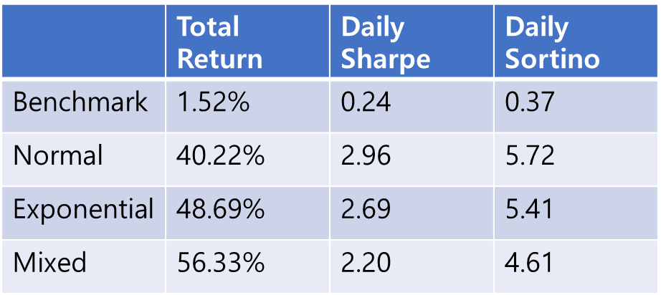
Math 5670
Backtesting – Exponential mean and semi-covariance
Using exponential calculated mean and semi-covariance :
NVDA

Slide 23
Math 5670
Thank you

