Slide 1
Number Plate Detection & OCR

Slide 2
Introduction
This project focuses on developing a robust system to accurately detect and recognize car number plates. The system utilizes advanced technologies in computer vision, deep learning, and optical character recognition.

Slide 3
Key Motives:
Ability to identify and manage traffic violations efficiently.
Automated Toll Collection and enhancing the efficiency and accuracy of toll collection.
Law Enforcement and Security:
Facilitating the identification of stolen or wanted vehicles.
Enhancing surveillance and security in high-risk areas.
Parking Management:
Improving the management of parking spaces in urban areas.

Slide 4


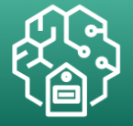


Project Architecture
Train Images
image
Train Deep Learning Model
Model Artifacts
image
images
Data Preprocessing
OCR- Extract Text
Label image
Project Ready
Make Object Detection
image
image
images
Validation Images
Labeling
Training
Save Model
OCR & Pipeline

Slide 5
Dataset Overview
Dataset Description:
Total images: 228
Images contain cars with visible number plates.
Variety of angles and lighting conditions to ensure robustness.

Slide 6
Data Preprocessing Workflow
Overview of the preprocessing steps:
Data labeling with Label Studio
Exporting annotations in XML format
Converting XML files to CSV format
Read & Verify Labeled Data
Data Preprocessing using Scikit-learn
Splitting the dataset into training and testing sets

Slide 7
Data Labeling with Label Studio
Label Studio is an open-source data labeling tool that supports multiple data types.
User-friendly interface for annotating images with bounding boxes.

Slide 8
Data Annotation Process
Step-by-Step Process:
Import Images:
Import the dataset of 228 car images into Label Studio.
Supported formats include JPEG, PNG, etc.
Annotation:
Use the bounding box tool to draw rectangles around the car number plates.
Assign a label called "Number Plate" to each annotation.
Review and Edit:
Review annotations for accuracy and consistency.
Edit annotations if necessary.

Slide 9
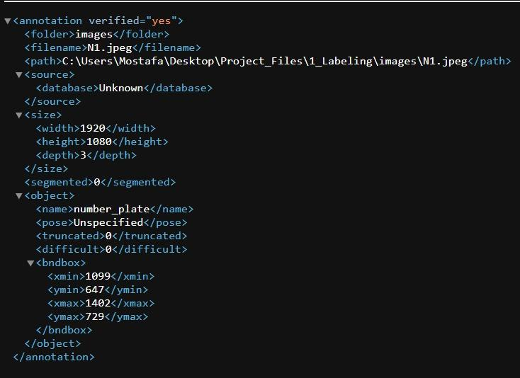
Exporting Annotations
After labeling all images, export the annotations.
Choose the XML file format for exporting.
XML format includes details about bounding boxes and image file paths.

Slide 10
Converting XML to CSV
Why Convert to CSV:
CSV format is easier to manipulate and use in model training.
Simplifies data loading and preprocessing in machine learning pipelines.
Conversion Process:
Use a Python script to convert XML files to a CSV format.
The CSV file includes columns for image file paths and bounding box coordinates (xmin, ymin, xmax, ymax).

Slide 11
Splitting the Dataset
Importance of Splitting the Dataset:
Ensures the model is trained on one subset of data and tested on another to evaluate performance.
Prevents overfitting and provides a measure of how the model generalizes to unseen data.
Splitting Process:
Split the dataset into 80% training and 20% testing sets.
Use the train_test_split function from sklearn.model_selection.

Slide 12
Model Architecture
Pre-trained InceptionV3 Model:
InceptionV3 used for feature extraction.
Pre-trained on ImageNet dataset.
Include top layer removed to adapt for new task.
Custom Head for Bounding Box Regression:
Flattening the output of InceptionV3.
Adding dense layers for predicting bounding box coordinates.

Slide 13
Model Training Setup
Training Configuration:
Optimizer: Adam with a learning rate of 1e-6
Loss function: Mean Squared Error (MSE)
Batch size: 10
Number of epochs: 100

Slide 14
Model Performance
Evaluation Metric:
Mean Squared Error (MSE)
Results:
Training vs. validation performance

Slide 15
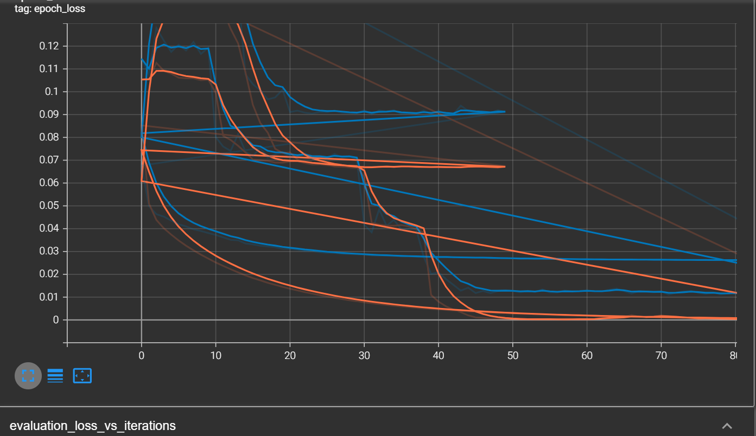


Model Training Performance Analysis
First Epoch :
Final Epoch:
TensorBoard snapshot

Slide 16
Initial Training Phase:
At the beginning (initial epochs), both training and validation loss start relatively high and begin to decrease quickly.
The model rapidly improves during the initial epochs, which is expected as it learns the fundamental patterns in the data.
Convergence:
As training progresses, both the training and validation loss continue to decrease.
The training loss tends to decrease more smoothly, whereas the validation loss has some fluctuations.
Towards the end of the training (final epochs), the losses start to stabilize, indicating the model is converging.
Notes:
The graph shows no signs of overfitting and underfitting since >There does not seem to be a significant overfitting issue since the validation loss does not start to increase while the training loss continues to decrease.
>The training loss and validation loss curves do not diverge significantly, suggesting the model generalizes reasonably well to unseen data.

Slide 17
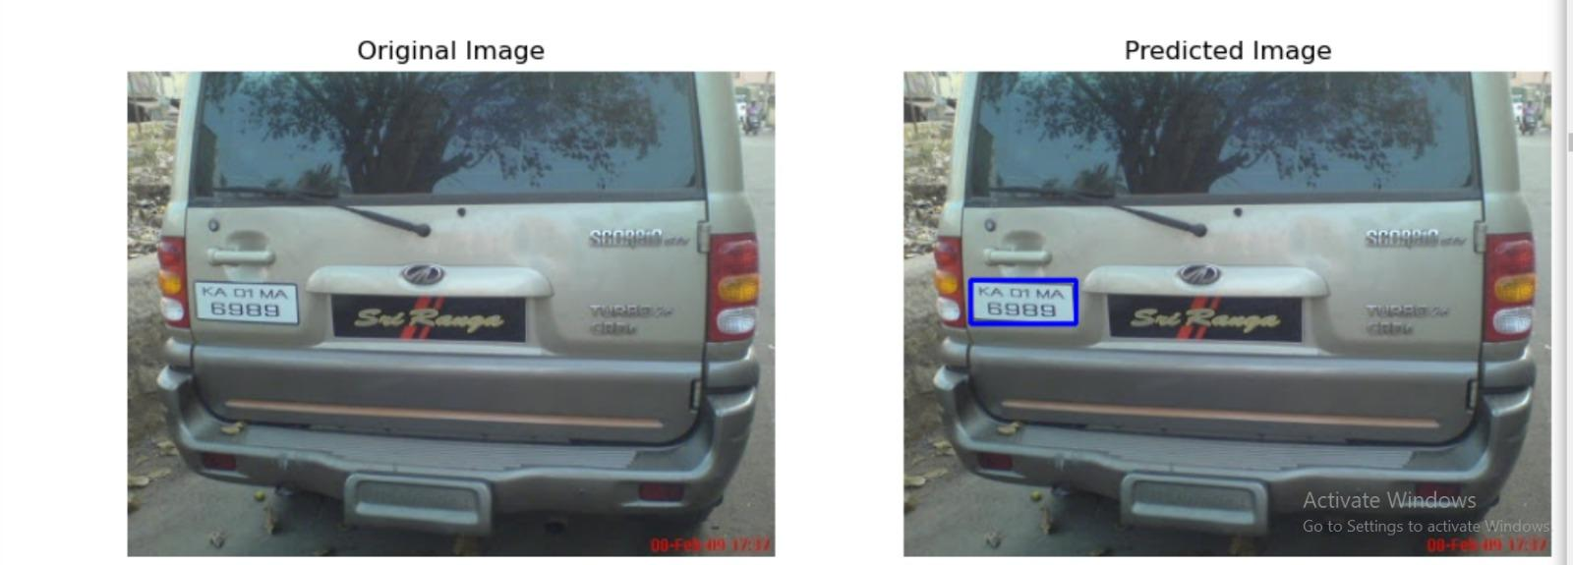
Predictions
Our model demonstrated excellent performance in detecting the number plate, even when the plate was not in the regular position.
This example highlights the robustness and accuracy of our model in diverse conditions.

Slide 18
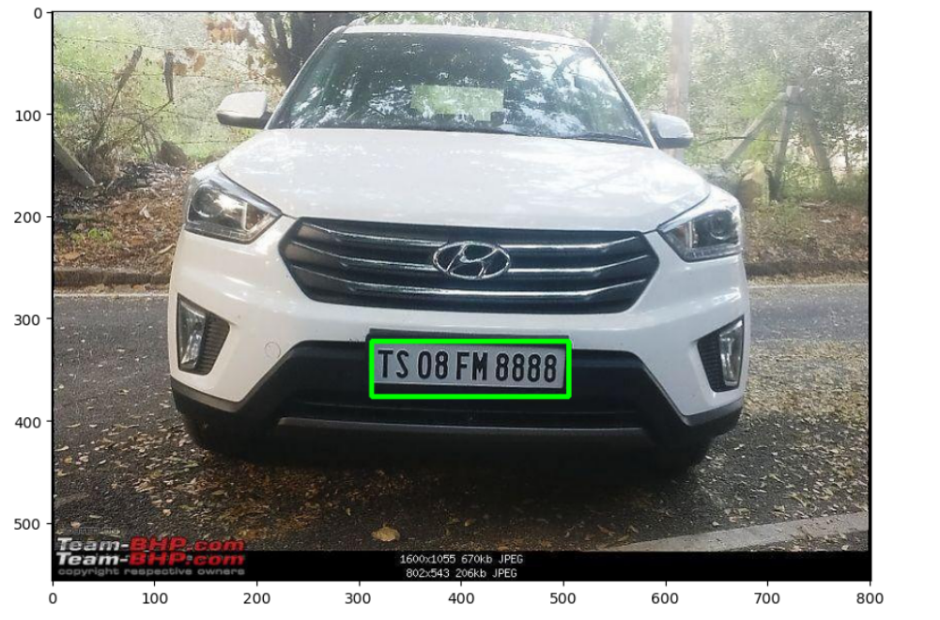
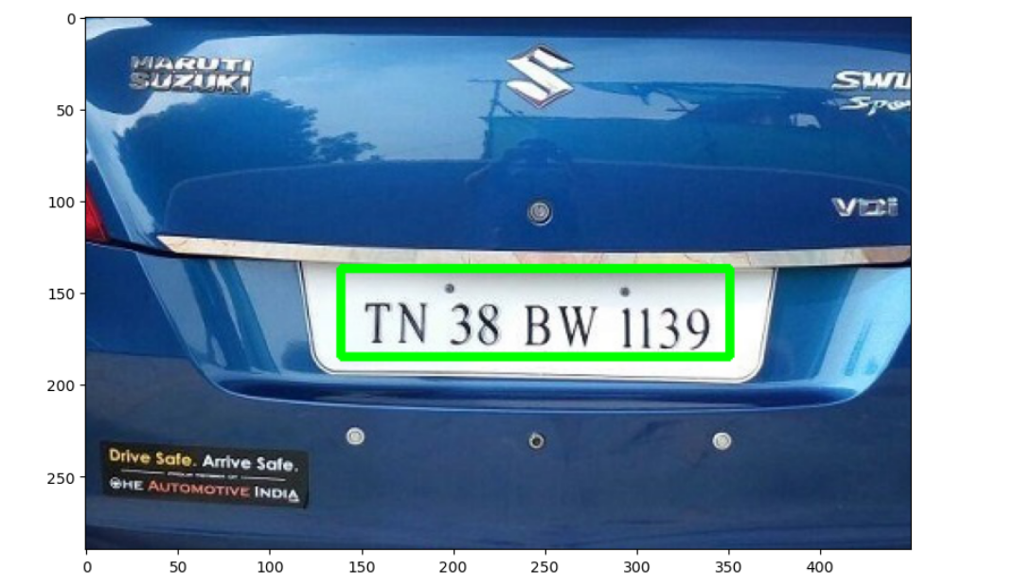
Other Examples of The Model Predictions

Slide 19
Integrating OCR with Tesseract
Tesseract is an open-source OCR engine that can recognize text in images.
It is highly effective for recognizing characters on number plates.
Why Tesseract:
High accuracy in text recognition.
Supports multiple languages and scripts.
Easy to integrate with Python using the pytesseract library.

Slide 20
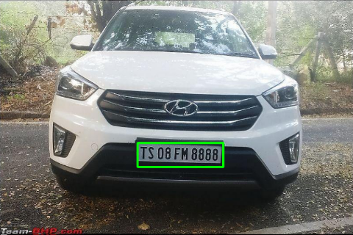
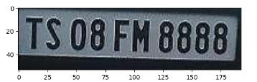
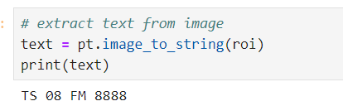
Example of Extracting the Numbers of a plate

Slide 21
Limitations of Tesseract OCR
Common Limitations:
Image Quality:
Varied Fonts and Styles:
Complex Backgrounds:
Lighting Conditions:
Inconsistent results under different lighting conditions
Technical Limitations:
Processing Speed:
Slower processing times compared to some commercial OCR solutions, especially for large batches of images.

