Slide 1
5 Tool’s That I’m Interest In
5 farmimg tool’s

Slide 2
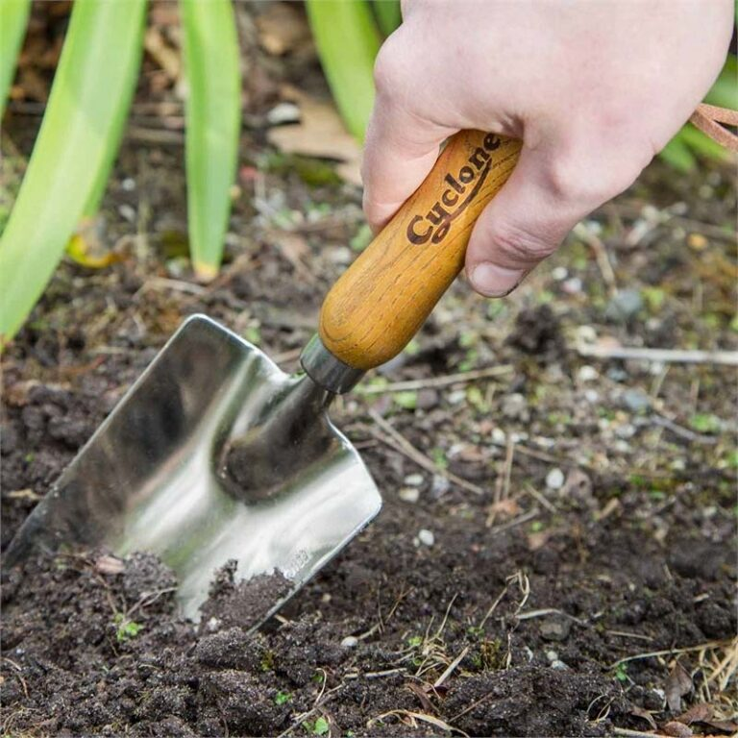
1 TROWEL
The trowel is a versatile tool in agriculture, used for various tasks such as digging holes for planting, transplanting, weeding, and cultivating soil. It is particularly useful in tight spaces and for handling delicate items like seedlings and bulbs. The trowel's pointed blade allows for precise and controlled movements, making it an essential tool for both novice and experienced farmers.

Slide 3
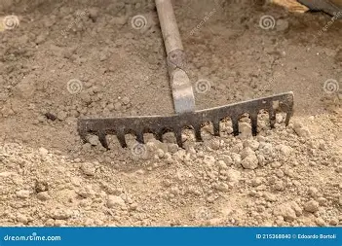
2 RAKE
Rakes are essential agricultural tools used for soil preparation, weed management, and gathering debris, contributing significantly to efficient farming practices.

Slide 4
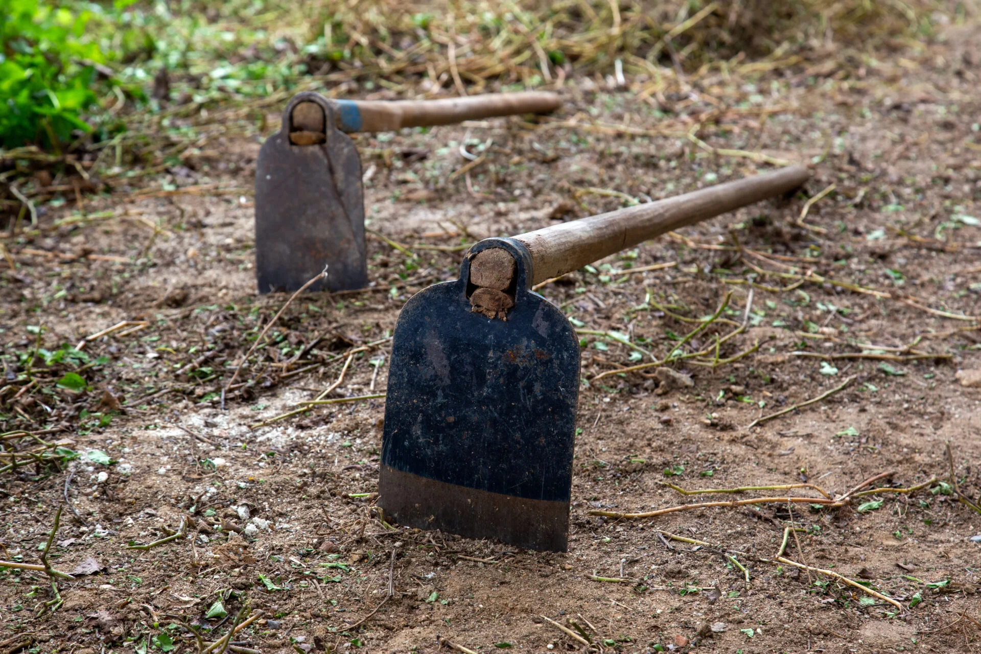
3 HOE
A hoe is a versatile agricultural tool used for shaping soil, removing weeds, and harvesting root crops, with various types designed for specific tasks.

Slide 5
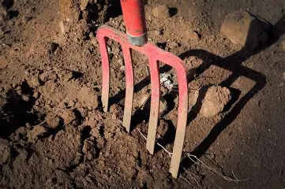
4 GARDEN FORK
Loosening and turning over soil: Garden forks are designed with sturdy tines to penetrate the ground effectively, making them ideal for aerating soil and preparing it for planting

Slide 6
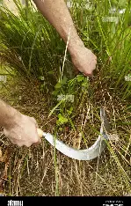
5 SICKLE
A sickle is a handheld tool featuring a curved blade, typically made of metal, attached to a short handle. The design allows the user to cut through crops by swinging the blade in a sweeping motion. The inside of the curve is sharp, enabling efficient cutting of stems and grasses. This tool is particularly effective for harvesting cereal crops such as wheat and rice, as well as for cutting grass for hay.

Slide 7
Thank you for time to see my 5 curious agriculture tool

