Slide 1
Course Project
Yelyzaveta Yaroshchuk

Slide 2
Agenda
Use Case
Pipeline
Dive into pipeline steps
Results
Improvements & Ideas

Slide 3
Use case
Define what is critical feedbacks, find and prioritized them
Do not lose driver as an employee
Do no lose client loyalty

Slide 4
Pipeline
Exploratory analysis
Labeling
Create dummy variable for critical cases
Preprocessing
Sentiment analysis
Data cleaning
Spell correction
Lemmatization
Topic Modeling
LDA model
Regression Model
Built prioritization with regression model
Results

Slide 5
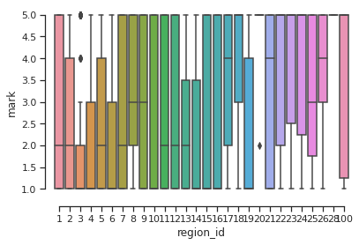
Exploratory Analysis
60 % of feedbacks are negative
Sentiment analysis added 5% to negative feedbacks with positive marks
Some region have significant low median mark

Slide 6
Exploratory Analysis
I got insulted by the driver ,driver seems to be drunk, music very loud,was not safe drive,told me to hung up my call
he went by a weird road, he took another ride with me
Critical cases – low frequent group ( 5% of negative feedbacks)
another car
another person in the car
violence
weapon mentioned
driver found personal info( number, place of living etc.)
dropped off far away from final way
driver is drunk
Stole my phone. Uklon said he didn’t have the phone. Demanded money to return my phone
He took my number without my permission and he texting me what’s app
Dangerous. we almost crashed, the driver drove so fast and swerving I felt sick. no seatbelts either. worst taxi ride

Slide 7
Preprocessing
Sentiment analysis with Hugging Face
Main data set – mark is in (1,2,3) or negative sentiment
Extend stop words list and remove it from feedbacks
Remove special signs and emoji
Lower Case
Spell correction with TextBlob
Word tokenization
Lemmatization ('NOUN', 'ADJ', 'VERB', 'ADV’)

Slide 8
Topic Modeling: Latent Dirichlet Allocation
0:'car_broken',
1:'driving_style',
2:'aggresive_behaviour',
3:'point_of_start',
4:'speed_limit',
5:'use_phone_while_driving',
6:'extra_money_paid',
7:'language_conflict',
8:'not_optimal_way',
9:'passanger_disagree',
10:'aggresive_behaviour',
11:'missundertanding',
12:'not_optimal_way',
13:'luggage_help',
14:'too aggresive behaviour',
15:'rasism_covid',
16:'personal_safety',
17:'wrong_way',
18:'wrong_drop_location',
19:'dirty_car'
[(0, '0.011*"seat" + 0.011*"put" + 0.008*"behave" + 0.008*"front" + 0.004*"star" + 0.004*"belt"'),
(1, '0.094*"drive" + 0.029*"road" + 0.021*"fast" + 0.017*"shout" + 0.015*"music" + 0.010*"safe"'),
(2, '0.159*"rude" + 0.027*"taxi" + 0.016*"much" + 0.007*"bit" + 0.006*"scream" + 0.006*"disrespectful"'),
(3, '0.051*"arrive" + 0.041*"idle" + 0.039*"late" + 0.038*"start" + 0.029*"wait" + 0.027*"time"'),
(4, '0.014*"attitude" + 0.011*"speed" + 0.008*"poor" + 0.004*"city" + 0.004*"fraud" + 0.002*"limit"'),
(5, '0.048*"phone" + 0.041*"driving" + 0.035*"use" + 0.022*"talk" + 0.009*"fight" + 0.007*"testing"'),
(6, '0.048*"trip" + 0.047*"take" + 0.042*"money" + 0.028*"pay" + 0.016*"behavior" + 0.015*"ride"'),
(7, '0.034*"time" + 0.033*"call" + 0.017*"speak" + 0.011*"customer" + 0.008*"russian" + 0.005*"arrival"'),
(8, '0.077*"address" + 0.033*"go" + 0.027*"wrong" + 0.020*"take" + 0.019*"need" + 0.017*"way"'),
(9, '0.022*"slow" + 0.017*"feel" + 0.015*"aggressive" + 0.012*"listen" + 0.007*"comfortable" + 0.006*"issue"'),
(10, '0.023*"passenger" + 0.019*"driver" + 0.013*"polite" + 0.011*"yell" + 0.011*"think" + 0.005*"item"'),
(11, '0.019*"ask" + 0.017*"cold" + 0.013*"entrance" + 0.013*"number" + 0.007*"stupid" + 0.007*"theater"'),
(12, '0.013*"arrogant" + 0.012*"follow" + 0.010*"map" + 0.006*"side" + 0.003*"begin" + 0.003*"needless"'),
(13, '0.016*"help" + 0.014*"smoke" + 0.013*"bag" + 0.012*"client" + 0.006*"heavy" + 0.006*"carry"'),
(14, '0.015*"well" + 0.011*"understand" + 0.007*"abusive" + 0.004*"throw" + 0.003*"respectful" + 0.003*"expel"'),
(15, '0.033*"good" + 0.026*"racism" + 0.019*"mask" + 0.013*"service" + 0.012*"terrible" + 0.011*"dirty"'),
(16, '0.019*"ride" + 0.013*"insult" + 0.010*"recommend" + 0.008*"mean" + 0.004*"general" + 0.004*"safety"'),
(17, '0.121*"bad" + 0.026*"route" + 0.025*"behaviour" + 0.025*"long" + 0.011*"navigation" + 0.007*"choose"'),
(18, '0.047*"wrong" + 0.043*"location" + 0.040*"drop" + 0.035*"change" + 0.032*"give" + 0.030*"pick"'),
(19, '0.031*"smell" + 0.012*"person" + 0.011*"nice" + 0.006*"unfriendly" + 0.004*"cigarette" + 0.004*"seatbelt"')]
Hyper parameter tunninig: Grid Search
Coherence Score: 0.49
Perplexity: -7.5

Slide 9
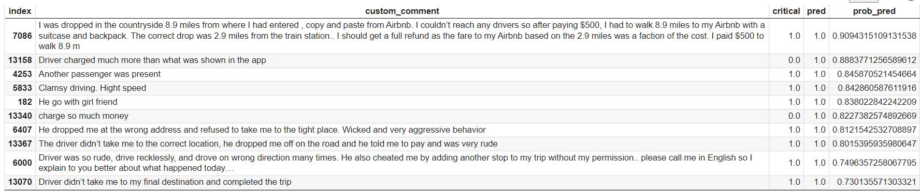
Regression Modeling
Split test/train
Balance data
Current solution : decrease number of non critical cases
Logistic Regression
LogisticRegression Has a training score of 63.0 % accuracy score

Slide 10
Pipeline improvements
Instead of dummy variables for topic use topic probability
Add rules that describe critical cases
Use boosting for critical cases class
Add labeling for each topic and Mix Topic Modeling with Classification
Exploratory analysis
Labeling
Create dummy variable for critical cases
Preprocessing
Sentiment analysis
Clean data
Spell correction
Lemmatization
Topic Modeling
LDA model
Rule Base
Find all cases related to price
Boosting for group of critical cases
Find rule for critical cases
Regression Model
Built prioritization with regression model
Results
New Features: whether feedback topic was tagged for the driver in last day/month/3 month;
Ratings;
Most frequent topic complain

