Slide 1

Team Verse Proposal
By Jase, Travis, and Asher

Slide 2
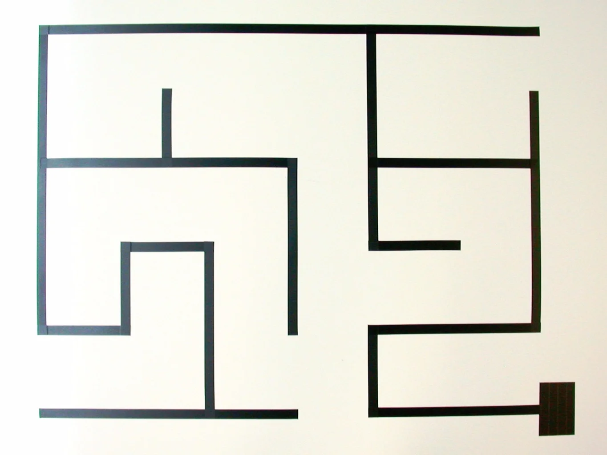
What is the idea?
We want to make a robot that can solve a line maze, like the one seen in the photo.

Slide 3
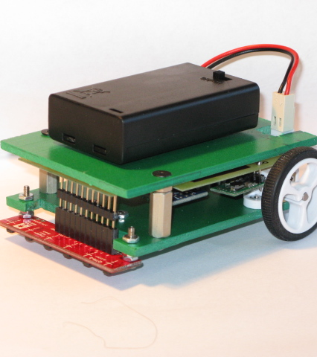
How can we achieve this?
There are a few ways we can achieve this, but currently we are thinking about a small robot like the example photo. Two wheels, motors, a line sensor, and a power source of course!

Slide 4
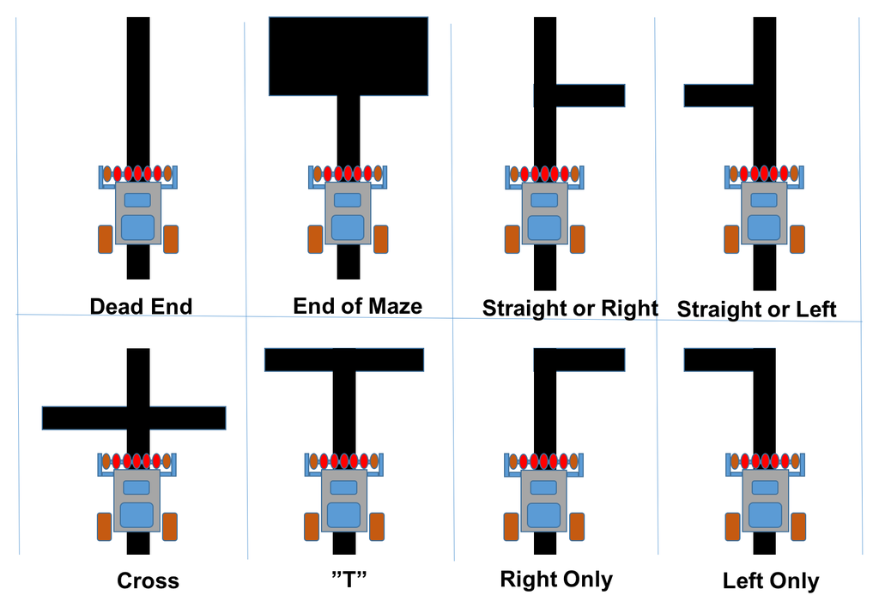
What would the robot have to do?
As is the nature of a maze, there are hundreds, if not thousands, of combinations of paths the robot would have to figure out. The photo shows just a few paths it could encounter in the maze.

Slide 5

The tricky part.
What happens if we have a maze where the robot cannot find it’s way out and repeats the same path over and over?

Slide 6
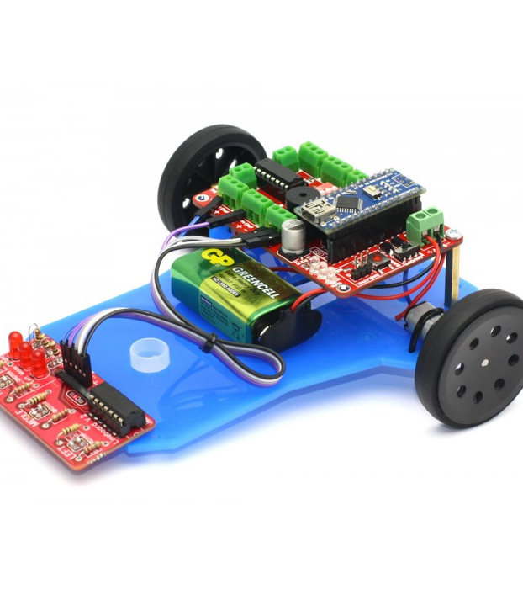
The solution!
We could put three line-sensors on the front to see if there’s a path left and right. Theoretically we could then have it coded where it could know it already went right so now it will go left.

Slide 7
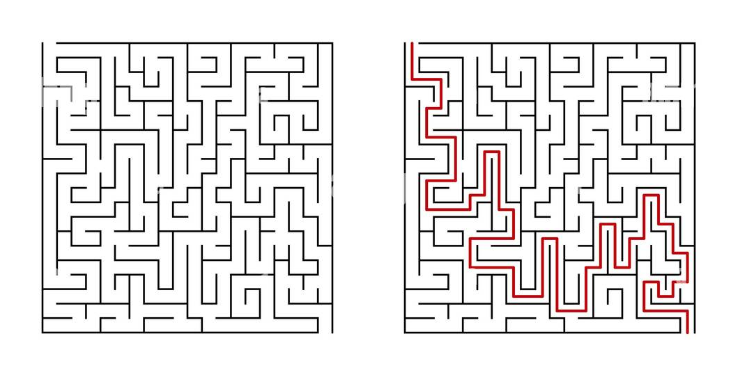
Optimization
We could possibly make it go even faster by potentially keeping track of the maze layout, the first run being it figuring out the layout with future runs knowing the optimal way through.

Slide 8
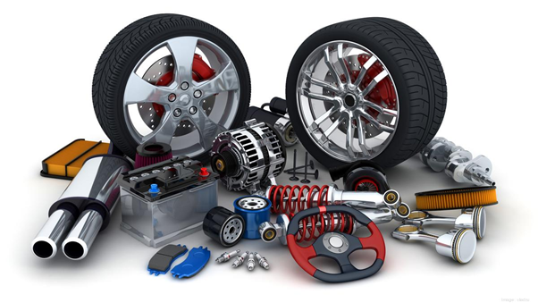
Parts List
Now to create this, we roughly estimate we will need the following, with a full parts list being uploaded to MyClasses.
Two Wheels
Arduino Nano Microcontroller
Three Line-Sensors
Two motors
Breadboard
Power source
Frame can be 3D printed

Slide 9

Thank you!

