Slide 1




Bookstore E-commerce API (Laravel)
present by : Yem Davit

Slide 2
Overview
What the project is about?
Whast problem does it solve?
Any difficulty and challange during development?
Future plan

Slide 3
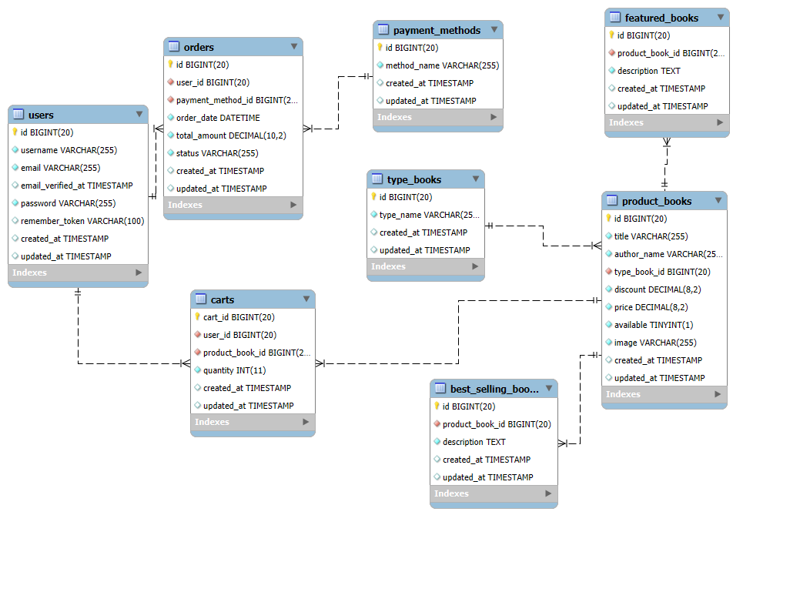
What the project is about?
An API-only backend for an online bookstore built using Laravel.
Supports managing users, books, carts, orders, and payments.
Designed to allow easy integration with a frontend or mobile app.
ERD

Slide 4

What Problem Does It Solve?
Modern bookstores need digital platforms to expand reach.
This API enables:
Efficient inventory management.
Easy user shopping experience.
Reliable order and payment tracking.
Backend is scalable and RESTful, suitable for web/mobile clients.

Slide 5
Challenges Faced
Authentication: Implementing secure token-based (e.g., Sanctum).
Validation: Input checks for user/cart/order endpoints.
Image Upload Handling: Book image storage and retrieval.
Order Status Handling: Keeping track of order stages.

Slide 6

Future Plan
Add Admin Panel to manage books, orders, and users.
Integrate real payment gateway APIs (e.g., PayPal SDK).
Add ratings & reviews for books.

Slide 7
DEMO
API
https://github.com/yemdavit/Final-wct_BookStore.git

Slide 8
Thank You

