Slide 1

CLEAN WASTE MANAGEMENT STRATEGY

Slide 2
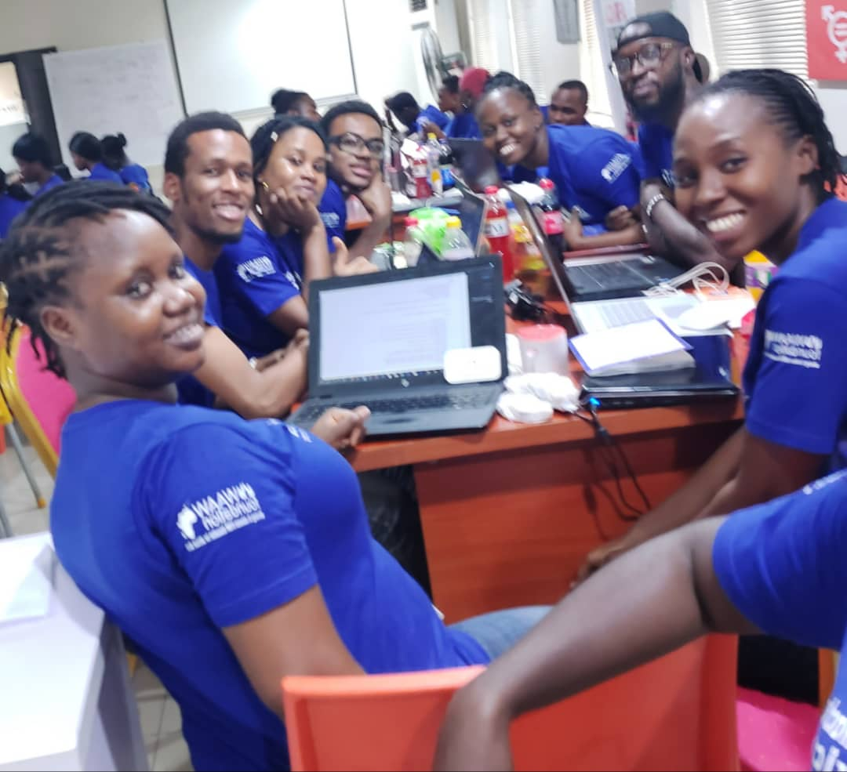
Hello!
We are TEAM DYNAMIX

Slide 3
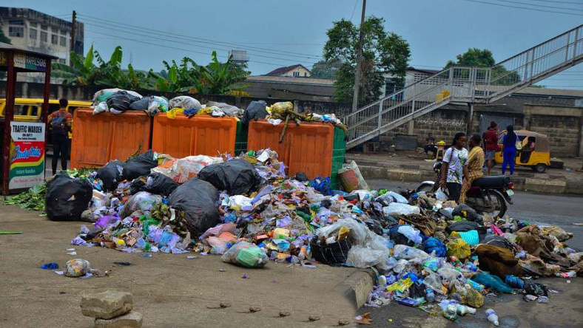
INTRODUCTION
WASTE MANAGEMENT
is the collection, transport, disposal of waste, together with monitoring and relation of the waste management process

Slide 4

PROBLEM DEFINITION
Poor Waste Management Infrastructure In Lagos
Indiscriminate Dumping of Refuse by Lagosian residents.
Increase Environmental Degradation
|
|
|
Notes:
According to NPC’s report, Lagos is a city with a population of over 20 million people.
Lack of Proper waste management infrastructure.
Lack of properly managed waste disposal, resulting to a city with an increasingly terrible environmental degradation.
The dump sites have, over time, become health hazards to residents.
Residents dump waste indiscriminately into drainage channels, gutters and on the streets.
According to NPC’s report, Lagos is a city with a population of over 20 million people.
Lack of Proper waste management infrastructure.
Lack of properly managed waste disposal, resulting to a city with an increasingly terrible environmental degradation.
The dump sites have, over time, become health hazards to residents.
Residents dump waste indiscriminately into drainage channels, gutters and on the streets.

Slide 5
WHY CLEAN
At CLEAN, it’s not the “what we do” that sets us apart, but “how we do it” that makes us special.
We are environmentally responsible and committed.
We follow all local, state and federal laws with regards to environmental protection.
We have developed a technology that brings waste managers closer to their consumers
|
|
|

Slide 6
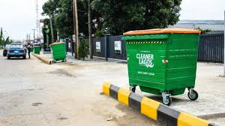
Our business model is designed for both individuals and corporate organizations where you can ‘‘CLICK TO TRASH’’.
|
|
|

Slide 7
CLEAN BUSINESS MODEL
KEY ACTIVITIES
Waste Collection
Disposal Services
KEY RESOURCES
Website
Online Portal
Supply Chains
Partnership & Personnel
KEY PARTNERS
VENDOR
NGO
CHANNEL
Operate Via Website
Online Customer Portal
Awareness Through Adverts
Feedbacks
Discount on first 30 days Usage
REVENUE STREAMS
The revenue is 25% of services rendered
CUSTOMER RELATIONSHIP
Automated Services through an online Portal
COST STRUCTURE
Its Dependent on our operative Cost

Slide 8

VALUE PROPOSITION
Bringing reliable and prompt services right to your doorstep.
Easy and secure way to connect with consumers with just a CLICK of a button.
Committing to ensuring a clean and safe environment.

Slide 9

COMPETITION
Wecyclers
Agoa waste management
Lagos state waste management agency

Slide 10

MARKETING AND SALES
Use of social media and google ads
Partnerships and collaboration
Flyers distribution
Offline adverts
Generating traffic --- we make ads on the website

Slide 11

FINANCIAL PROJECTIONS

Slide 12
PROJECTED INCOME STATEMENT
YEAR 1
Users | Price | Unit | Total
Individual | 200 | 20,000 | 4,000,000
Corporate | 1,000 | 1,200 | 1,200,000
Total |  |  | 5,200,000
YEAR 2
Users | Price | Unit | Total
Individual | 200 | 50,000 | 10,000,000
Corporate | 1,000 | 3,000 | 3,000,000
Total |  |  | 13,000,000
YEAR 3
Users | Price | Unit | Total
Individual | 300 | 100,000 | 30,000,000
Corporate | 1,200 | 5,000 | 6,000,000
Total |  |  | 36,000,000

Slide 13
Projected Initial Investment
Working Capital | Total(NGN)
Office-Space, Computer Accessories and Staff | 1,600,000
Others;
Utility Bills/Transportation | 300,000
Total | 1,900,000
EXPECTED INCOME
25% of the projected income; since Vendors would be using our platform | Income (NGN)
YEAR 1 | 1,300,000
YEAR 2 | 3,250,000
YEAR 3 | 9,000,000

Slide 14
CURRENT STATUS / TIMELINE
At the moment CLEAN is a start-up. Our status projection for the next three years is to be among the leading cutting-edge technologies.

Slide 15

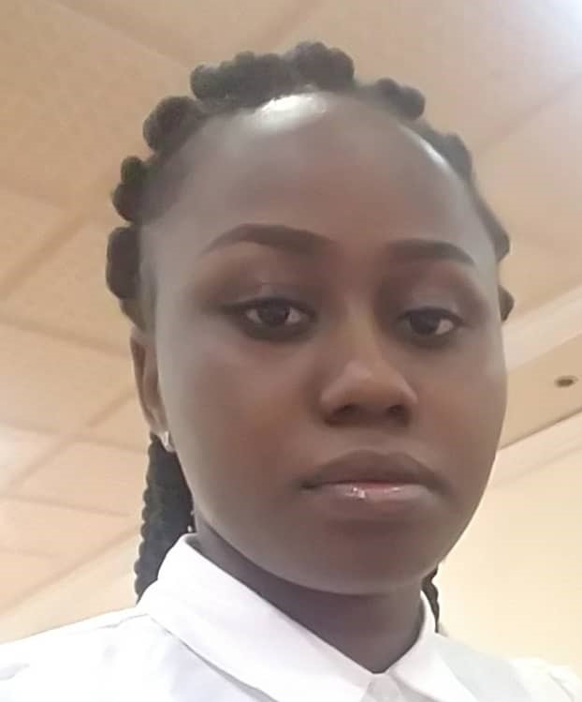
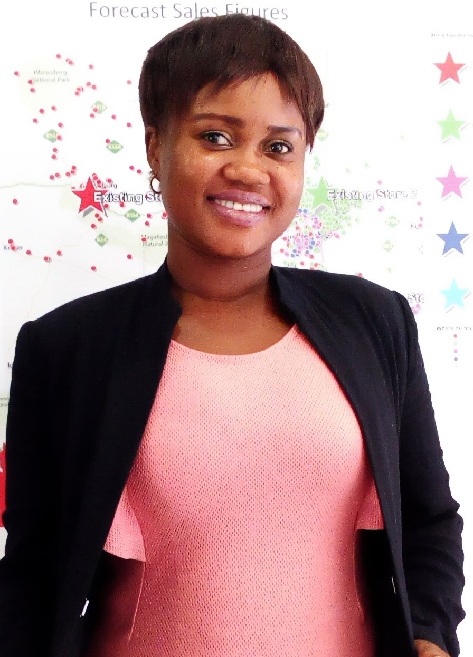
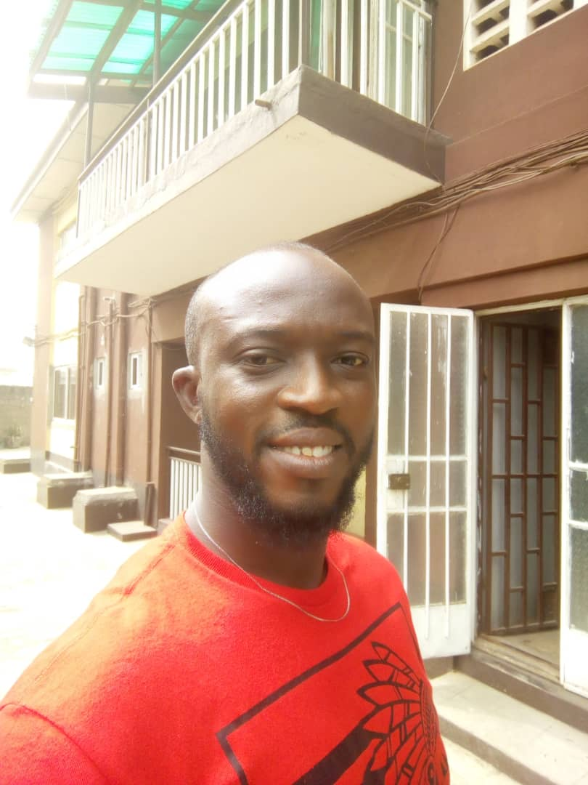






Slide 16
Thank you!
Any questions?
|
|
|

