Slide 1
Project 0
The Diurnal Pattern of Cortisol & DHEA Hormones
Name: Opeyemi (Yemi) Jegede
Date: 02/04/2026

Slide 2
Research Question
Q1: Is there a relationship between saliva sample collection time reported in the booklet vs captured electronically?
  Hypothesis: No relationship vs some relationship between both times
Q2: What is the adherence rate to sample collection at 30 and 600 minutes after waking up
  Descriptive analysis of adherence rates
Q3: For cortisol and DHEA, Is there an increase in hormonal levels between waking and 30 minutes, and what is the rate of decline beyond 30 minutes
  Hypothesis 1: The average hormonal level is similar at 30 minutes and baseline.
  Hypothesis 2: Hormonal levels remain the same beyond 30 minutes after waking

Slide 3
Data Overview
Thirty-one (31) healthy controls; samples at 4 time points daily; 3 days. This represents 372 observations; no exclusions.
Based on the (right) skew distribution of these markers, they were log transformed for analysis.
Box plots for graphical display of distribution, means/SD for location/spread, and frequency/proportion for categorical variables

Slide 4
Analysis
Q2: Adherence
  A categorical variable grouping subjects into one of good (7.5 minutes), adequate (15 minutes), or poor (beyond 15 minutes) adherence was described using frequency/proportion, with 95% exact CI estimated.
Q1 & Q3: Pattern, association, and rates
  Univariable random-intercept linear mixed effect model was fitted
  Q1: inference based on the t-test statistic for intercept and slope
  Q2: Piecewise linear model with change point at 30-minutes
    Expected hormonal level at 30 minutes vs waking, using a contrast and Wald test
    Rate of decline after 30 minutes based on t-test statistic for the coefficient

Slide 5
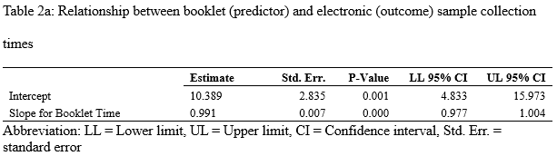
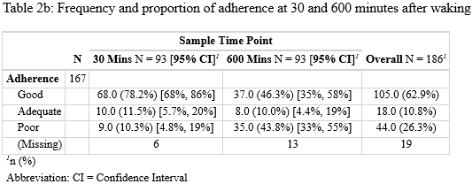
Results
Q1: Pattern and association
Q2: Adherence

Slide 6
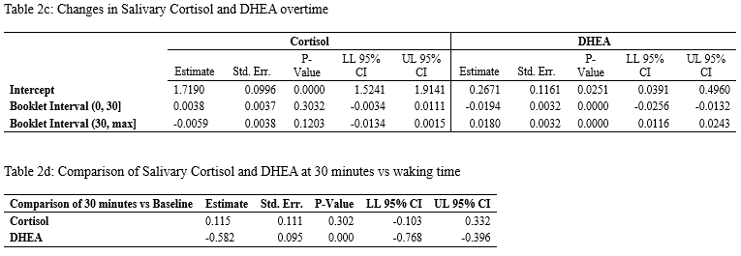
Results (cont’d)
Q3: Changes in salivary cortisol and DHEA overtime

Slide 7
Discussion
Q1: Pattern and association
  There was significant bias between both sample collection times
  There is a significant and strong linear relationship between both collection times
Q2: Adherence
  A higher proportion of subjects had Good adherence at 30 minutes compared to 600 minutes, and vice versa for Poor adherence category
Q3: Changes in salivary cortisol and DHEA overtime
  The increase in cortisol at 30 minutes compared to waking was not significant, nor was the rate of decline.
  The (diurnal) pattern of DHEA was significant but opposite of what was expected.

