Slide 1
Project 1 Secondary Analysis of the Multicenter AIDS Cohort Study (MACS)
Name: Opeyemi (Yemi) Jegede
Date: 03/02/2026

Slide 2
Research Question
For each of the four outcome measures
Q1: Does the outcome at 2 years after HAART differ by hard drug use status at baseline?
Q2: Is this difference explained by adherence (to medications taken since last visit) status at year 2
Variables
Outcomes: aggregate physical QoL, mental QoL, CD4+ T-cell counts, and standardized viral load (copies/mL of blood)
Key predictor: baseline hard drug use status
Covariates: body mass index (BMI), age, race/ethnicity, education and smoking status

Slide 3
Data Overview
Demographic, laboratory, and quality of life (QoL) measures on 715 unique study participants (men) for up to 8 years
Comprising 3935 observations
Data was limited to the baseline (unique n=715) and year 2 follow-up timepoints (unique n=506)
Treatment response variables include aggregate physical QoL score, mental QoL score, and CD4+ T-cell counts (cells/ml), and log10 standardized viral load (in copies/mL of blood)
Based on the (right) skew distribution of standardized viral load, it was log10 transformed for analysis.
43 of 506 observations with missing values for predictors and outcomes of interest were excluded for analysis, the remaining samples (n=463) was used for frequentist and Bayesian analysis
Box plots for graphical display of distribution, means/SD for location/spread, and frequency/proportion for categorical variables

Slide 4
Analysis
Q1:Does the outcome at 2 years after HAART differ by hard drug use status at baseline?
Posterior mean and credible interval of the posterior distribution
Posterior probability of a clinically meaning effect
Primarily Bayesian analysis in Stan; compared to frequentist results
Normal likelihood, non-informative priors from N(0, 100^2), half-normal for residual variance
Q2: Is this difference explained by adherence (to medications taken since last visit) status at year 2?
Univariable, crude, and adjusted models
Informal test, mean (credible interval) of the difference in posterior draws for the coefficient corresponding to hard drug use between the crude and adjusted models
Compare against investigator-provided clinically meaning effect threshold
Primarily Bayesian analysis in Stan; compared to frequentist results
Same methods as above

Slide 5
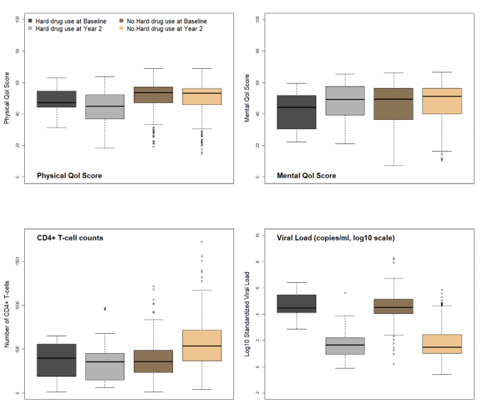
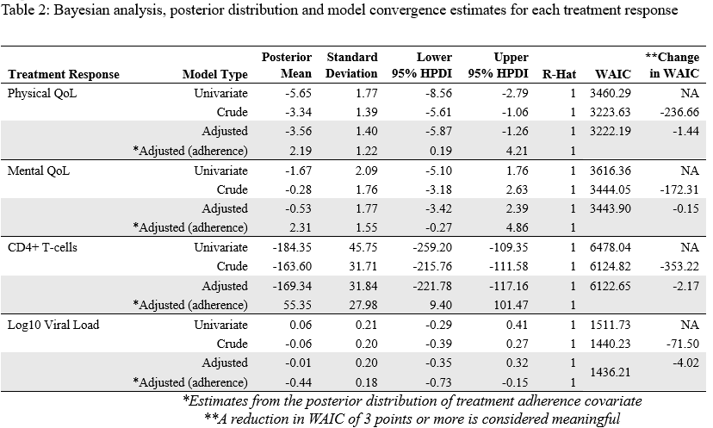
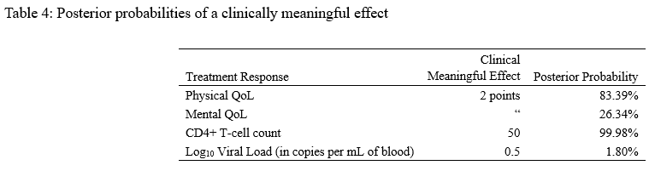
Results
Fig. 1: Treatment response by hard drug use and study period
Q1: Outcome by HAART Status
Posterior probabilities

Slide 6
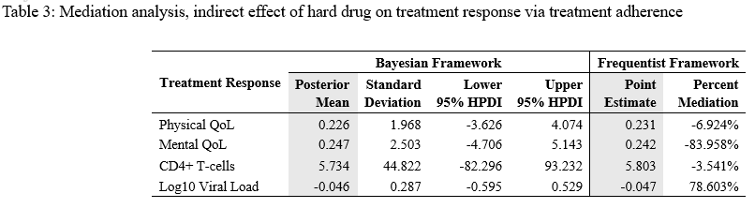
Results
Q2: Mediation analysis

Slide 7
Discussion
Q1: Outcome at year 2 by HAART status
The adjusted models was not generally better than the crude model
In the crude model, there is a 95% probability that the true effect of hard drug use at baseline on Physical QoL is between -5.61 and -1.06 with posterior mean of 3.34.
The same is true for CD4+ T-cells with posterior mean and 95% HPDI of -163.60 (-215.76, -111.58)
Q2: Mediation analysis
Based on the indicated criteria, there was no substantial difference in the point estimates between the crude and adjusted models. Therefore, treatment adherence is not a mediator
Limitations:
Loss to follow-up, especially for hard drug users at baseline
Evidence of a change in patient population between baseline and year 2
For example BMI, CD4+ T-cell count

