Slide 1
Project 2 Analysis and Sample Size Calculation for a Grant Application: Relationship between inflammation, AD pathology and Cognitive decline
Name: Opeyemi (Yemi) Jegede
Date: 03/30/2026

Slide 2
Research Aims and Hypothesis
Aim 1: Evaluate markers of inflammation, cognition and brain structure
1a (hypothesis): Higher baseline inflammation markers will predict decline in cognition and brain structure
1b (hypothesis): Higher change in inflammation markers will be associated with higher decline in outcomes
Aim 2: Examine how markers of inflammation impact AD pathology & progression of cognitive impairment
Hypothesis: There is an interaction between inflammation markers and amyloid deposition

Slide 3
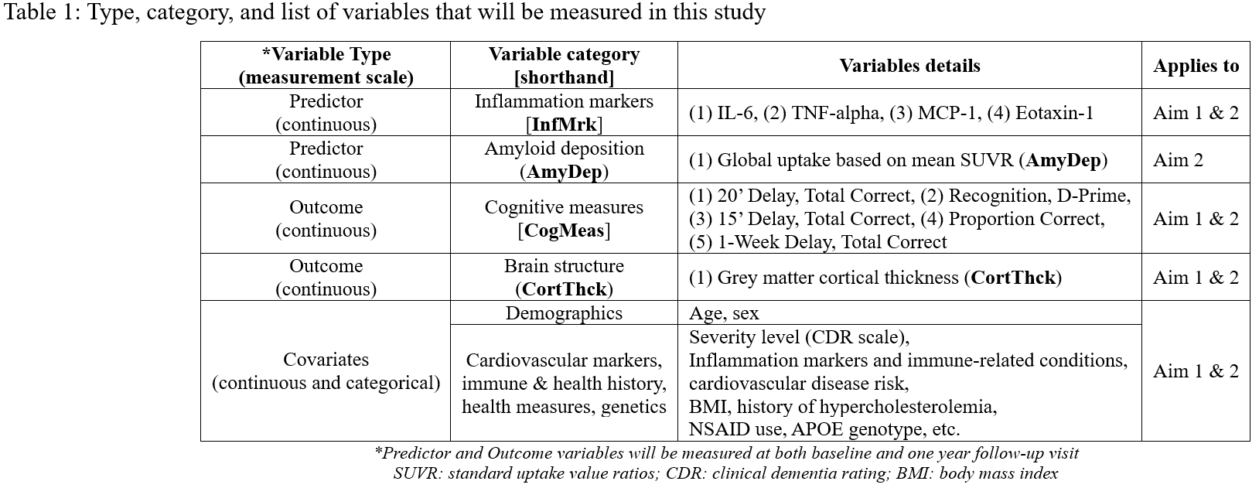
Data (expected) Overview

Slide 4
Analysis Plan
Descriptive analysis:
Mean/SD for continuous, and frequency proportion for categorical
Tabulate estimates and stratify by time period (baseline vs one-year)
Graphical assessments to check skweness
Primary analysis:
Planned enrollment/eligible is 194/175 subjects with MCI (138/125) and HCs (56/50)
Multivariable linear regression model for pairwise combination of predictor and outcomes
Hypothesis testing based on the partial F-test statistic for a reduced vs full model
Covariate selection
Relationship between covariate pairs will guide selection choice
Selection based on strength of correlation, for example
Includes assessment of confounding and precision variables

Slide 5
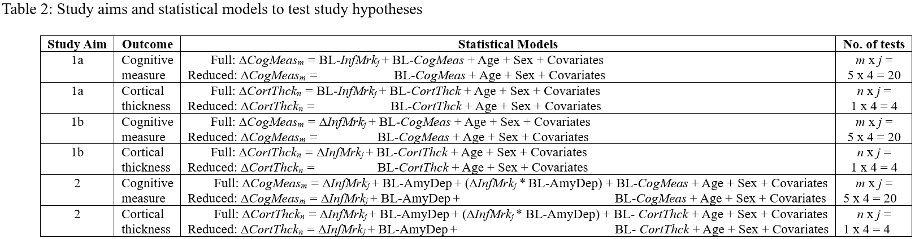
Power Calculation
Aim 1 | Aim 2
powertools::mlrF.partial() | InteractionPoweR::power_interaction_r2()
Hommel’s method to control FWER at 5%
p.adjust(p, method = “hommel”), p is vector of p-values

Slide 6
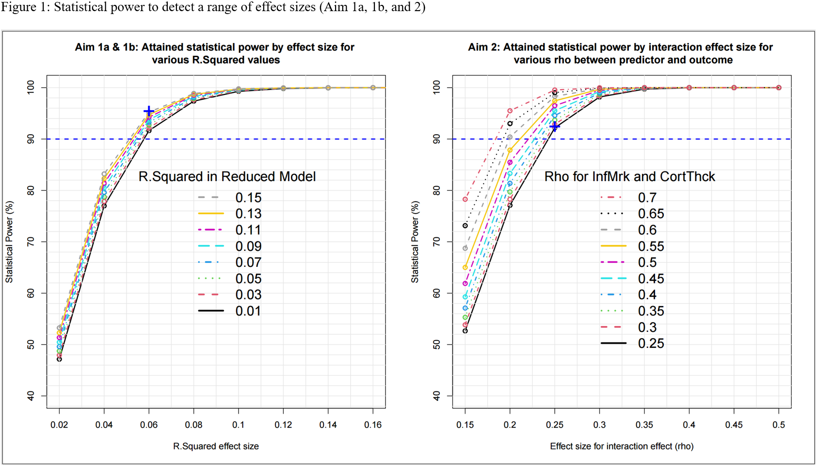
Power Calculation (contd.,)

Slide 7
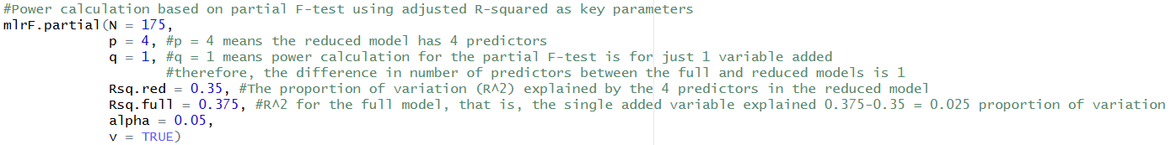
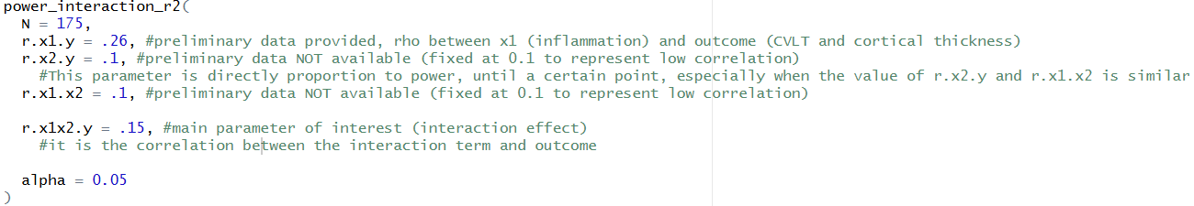
Appendix: sample power calculation code
Aim 1
Aim 2

