Slide 1
Project 3 Framingham Heart Study: Risk Factors and Probability of Stroke
Name: Opeyemi (Yemi) Jegede
Date: 04/22/2026

Slide 2
Research Question
Primary Objective
Assess risk factors (measured at baseline) associated with developing stroke
Risk factors from a pool of select variables
Separate analysis for men vs women
Estimate 10-year probabilities of developing stroke for different risk profiles
Secondary Objective
Describe time-varying changes in diabetes and systolic blood pressure (BP)
Variables
Outcomes: Time to stroke (defined from study entry)
Main predictors: Age, diabetes status, systolic BP (mmHg)
Additional predictors: use of anti-hypertensive meds, prevalent coronary heart disease (CHD), current cigarette smoking status, serum total cholesterol (mg/dL), and body mass index (kg/m²)
Identifiers: Participant ID, Sex, follow-up period

Slide 3
Data Overview
In total, 11672 observations representing 4434 unique participants
Exclusions
32 unique (60 observations with prevalent stroke at baseline)
Recoding
7 unique participants with time to stroke longer than time to death – time to stroke was recoded as time to death
Follow-up was restricted to 10-years of follow-up
383 (3.7%) stroke events before restricting follow-up, and 111 (2.5%) after restriction
After exclusion, there were 4402 unique participants
Analysis populations
Clean dataset (n=4402; 1930 men, 2472 women)
Model/variable selection dataset (n=4275; 1897 men, 2378 women)
Final dataset (n=4298; 1908 men, 2390 women)

Slide 4
Analysis
Primary objective: Risk factors associated with developing stroke
Univariable analysis using Kaplan-Meier plots, and logrank test to compare curves
Assessment of PH assumption based on Schoenfeld residual PH test
Model building, 2-step process
Backwards selection
Assessment of pairwise interaction with key predictors (age, diabetes, and high systolic BP)
10-year probability of stroke, and 95% CI, for different risk profiles
Estimated using the fitted Cox PH object, for each sex
Secondary objective: Characterize the change in diabetes and systolic BP over time
Transition probabilities:
Between states of positive and negative for diabetes and high systolic BP (≥160 mmHg)
Scatter plot
For continuous systolic BP only, plotting change against a reference timepoint

Slide 5
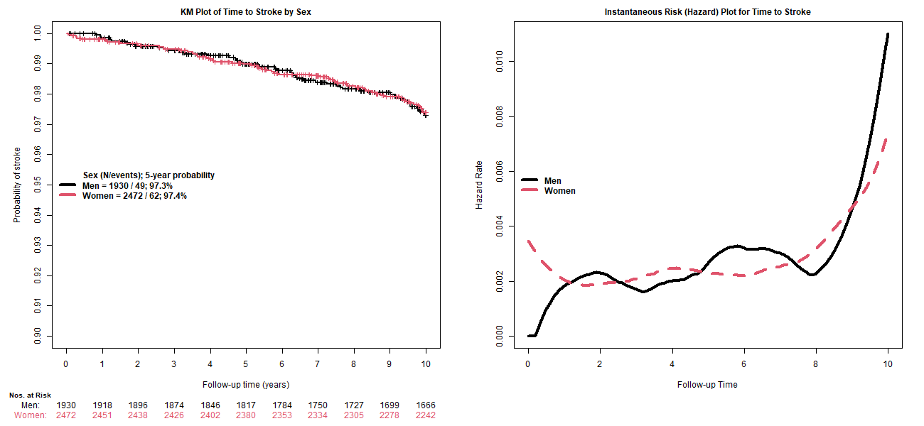
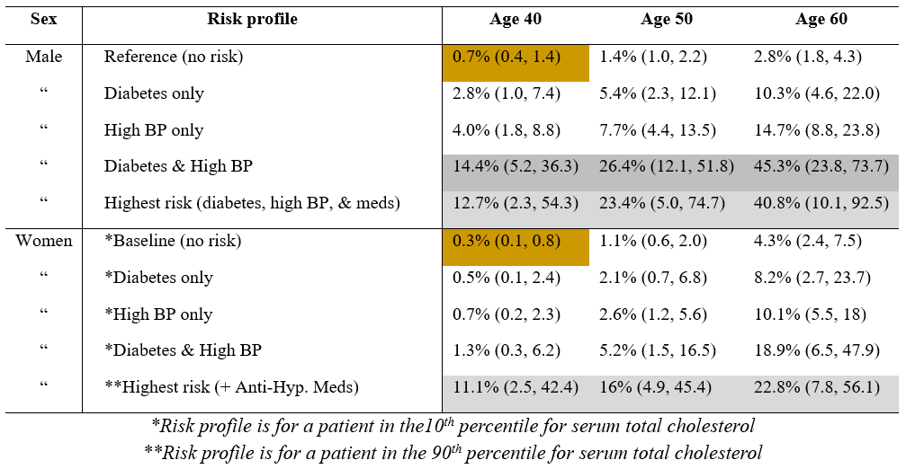
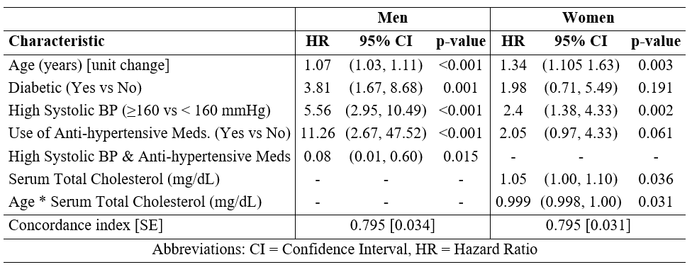
Results
10-year stroke probabilities by risk profile
Kaplan-Meier and hazard plot of time to stroke
Primary objective: Predictors of stroke

Slide 6
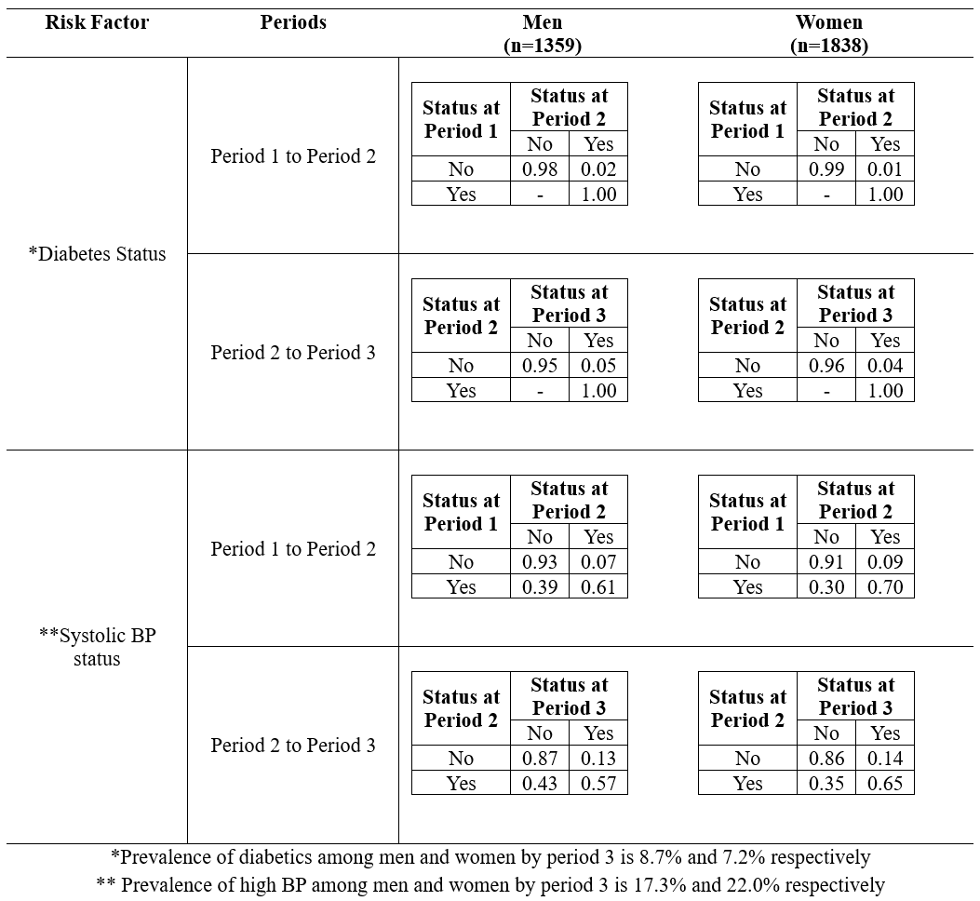
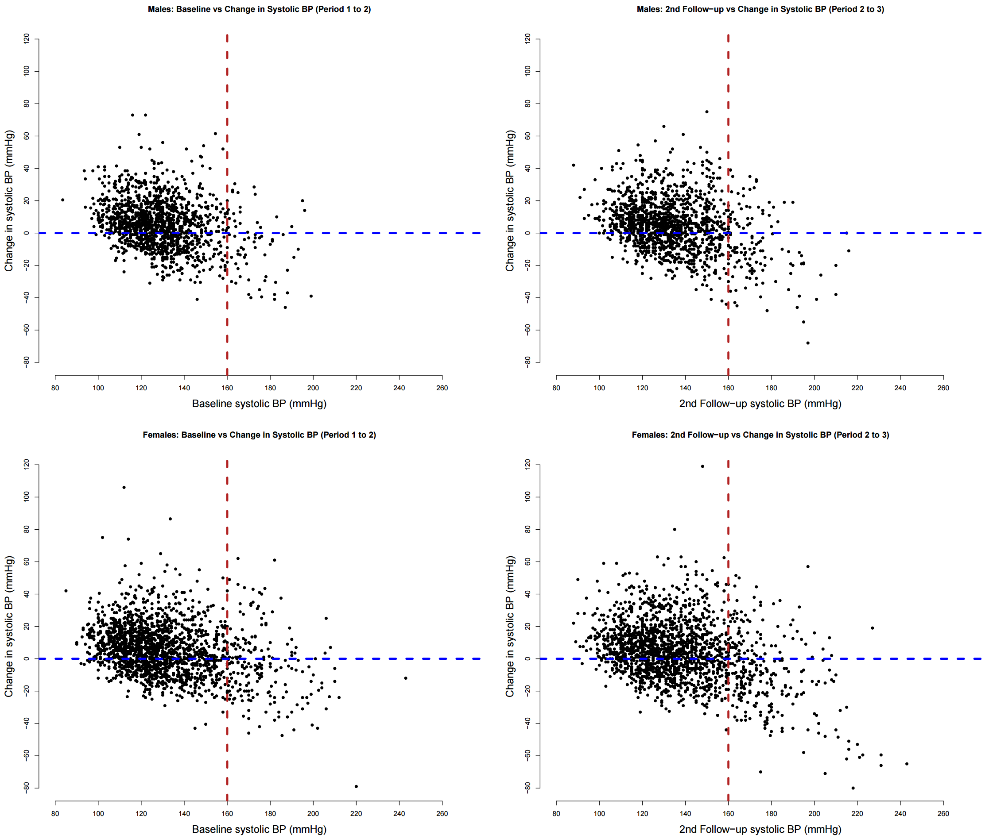
Results
Secondary Analysis: Characterization of change over time
Diabetes & high systolic BP transition probabilities
Change in systolic BP between periods

Slide 7
Discussion
Primary Objective: Risk factors of stroke by sex
Four and 5 risk factors were identified for men and women respectively
The models have good discrimination, C-index = 0.795
There was an interaction between risk factors that lowers risk of stroke
Secondary objective: Characterization of change over time
There was a shift towards increasing proportion of diabetes status
Participants with low BP saw increase in BP between successive timepoints
The prevalence of high BP and diabetes status increased over time. A time-varying analysis is warranted.
Limitations:
The frequency of stroke events is low (2.5%); this limits the model complexity
There was a substantial reduction in follow-up from baseline to period 3

