Slide 1
SENIOR STAFF ASSOCIATION OF NIGERIAN UNIVERSITIES, SSANU EKSU BRANCH
A PAPER PRESENTED AT THE ACADEMIC SUMMIT WITH THE
THEME: “THE CHALLENGES OF BUILDING A WORLD CLASS
AND SERVICE – INTENSIVE UNIVERSITY”

Slide 2
DEFINITION
A world – class University is the University built on the quality and diversity of a society. The staff always place value on excellence and creativity, supporting independence of thought and the freedom to challenge existing knowledge and beliefs through critical research and scholarship.
The Universities that feature among the top 100 in world rankings have been labeled “World Class Universities’ Salmi (2009), after analyzing the various ranking methods for universities, using a three-factor categorization of the characteristics of such universities (see table one).

Slide 3
DEFINITION
They are known to have a concentration of talent, abundant resources, and appropriate governance. These factors combine to making the universities ‘research-intensive’, a feature that accounts for their influence, prestige and world class status.
According to a business development group (RO – Realizing Opportunities), research intensive universities, are research intensive universities where:
New discoveries are being made
Facilities are cutting edge
Research is being carried out to help address problems in the wider world
Researchers are experts in their fields and their enthusiasm and passion is shared with students studying at the university.
Teaching at all levels is research-led or research-informed.
Students have opportunities to develop skills in research environment, which are of value to employers.
There are strong links with businesses.

Slide 4
DEFINITION
Students at research intensive universities benefit from:
Research-led teaching which creates vibrant learning environments.
Opportunities to develop transferable skills which are valuable for employment and further study.
Investment in cutting edge facilities

Slide 5
A Three-Factor Characterization of World Class Universities
FACTOR | FEATURES
Concentration of Talent. | * Able to attract the most qualified professors and researchers. * Ability and the privilege to select the most academically qualified students. * A high proportion of carefully selected graduate students
Abundant Resources | * Four main sources of financing: * Government budget funding for operational expenditures and research, * contract research from public organizations and private firms,

Slide 6
A Three-Factor Characterization of World Class Universities
 | * the financial returns generated by endowments and gifts, and * tuition fees These abundant resources create a virtuous circle that allows the concerned institutions to attract even more top professors and researchers
Appropriate Governance | * the overall regulatory framework, * the competitive environment and * the degree of academic and managerial autonomy that universities enjoy.

Slide 7
A Three-Factor Characterization of World Class Universities
 | * Complete autonomy are also more flexible because they are not bound by cumbersome bureaucracies and externally imposed standards, * They can manage their resources with agility and quickly respond to the demands of a rapidly changing global market. * As inspiring and persistent leaders, a strong strategic vision of where the institution is going, * A philosophy of success and excellence, and

Slide 8
A Three-Factor Characterization of World Class Universities
 | * A culture of constant reflection, organizational learning and change.

Slide 9
service-intensive university
The service-intensive university paradigm is not in total disagreement with the research intensive posture of world class universities. It is instead an attempt at enhancing the social responsiveness of Universities in Africa.
This latter term simply means that the development challenges of Africa must be the core concern areas for African universities.

Slide 10
service-intensive university
Knowledge is the best tool for getting Africa out of underdevelopment, and since Knowledge is the major raison d’être of Universities, African institutions should harness their research to seriously and systematically seeking answers to three key questions:
What is it that is tying Africa down in terms of sustainable human development?
How can we direct our knowledge arsenal to understanding and addressing our major ‘tying-us-down’ challenges?
What methodologies, systems, processes and tools should be developed for applying our knowledge arsenal to demonstrable and replicable solutions to these ‘tying-us-down’ challenges?

Slide 11
service-intensive university
It is worth recalling that the knowledge arsenal of a University should spring from the strength of its core functions that are centred on Knowledge:
Knowledge generation (or Research), extending the frontiers of knowledge
Knowledge transmission (or Teaching),inculcating knowledge acquisition knowledge application skills)
Knowledge transfer (or responsive social engagement), providing and supporting the application of knowledge for evidence-based strategies for addressing society’s development concerns

Slide 12
The customary view of the core functions of Universities considers 1 (Knowledge generation) plus 2 (knowledge transmission), plus 3 Knowledge transfer) as three distinct activities. On the other hand, the responsive social engagement view considers 1+1+1 as equal to one.
In other words, each of the components taper into the others and remains realty inseparable from the others. Their combined synergy should help to energise the knowledge arsenal of an institution. They may act independently, but all end up sharing and upholding a single goal.

Slide 13
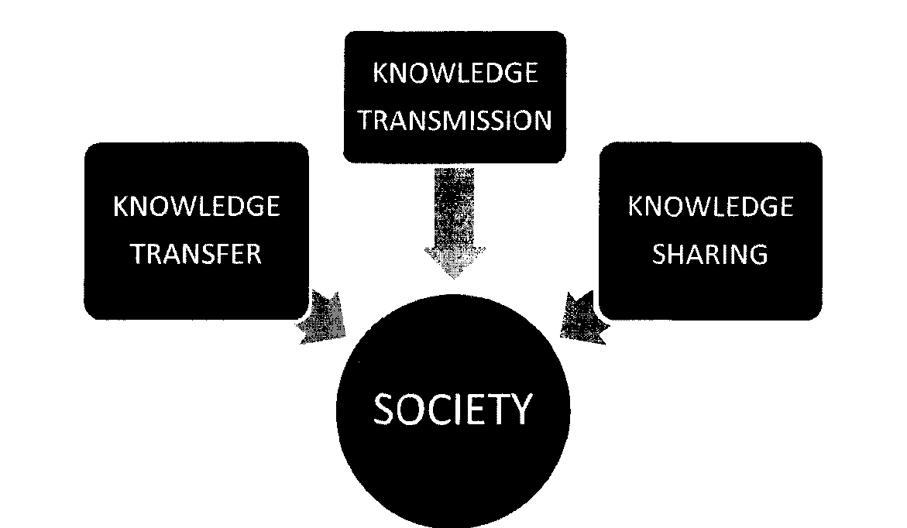
Fig. 1: Knowledge Arsenal for Society

Slide 14
Knowledge Arsenal for Society
In the responsive social responsiveness model, the three dimensions are fused (as in figure two) and a service intensive university would weave all the three elements of its knowledge arsenal in pursuit of societal progress by systematically researching into, teaching about and society’s development challenges, in addition to being practically involved in developing and applying knowledge-based solutions to these challenges. The application of knowledge to tackling society’s development challenges in itself become a participatory action research process, the results of which should become valuable in terms of
extending the frontiers of knowledge, through the Lessons Learnt in the course of application
providing materials and enriching teaching by giving new perspectives (resulting from a above) to the content of teaching
providing new perspectives to social engagement from the Lessons of prior experiences, thus enhancing the social responsiveness of the institution

Slide 15
A coalescing of the three core functions of a University
Knowledge generation
Knowledge transmission
Knowledge sharing

Slide 16
A coalescing of the three core functions of a University
It can thus be seen that a service-intensive university is a learning institution in more ways than one.
It is an institution that is continuously Learning, constantly adding to the stock of knowledge, systematically improving its knowledge generation and knowledge transmission and even knowledge sharing functions in the light of new knowledge learnt from on-the-ground application of knowledge
It is an institution to learn from, since it is capable of transmitting and sharing societally-relevant knowledge
It is an institution to Learn with, since its knowledge sharing activities are carried out through participatory action research

Slide 17
A coalescing of the three core functions of a University
This is the three-dimensional service-learning concept as illustrated in figure three. The institution is learning, society is learning and students are learning. In conventional universities, the emphasis is on student [earning, with perhaps some insistence on lecturers learning. In a service-intensive university, on the other hand, there is greater emphasis in learning by the institution and learning with students and with the wider society to address societal development challenges in the process of which knowledge is generated on a continuous basis for enhanced social responsiveness of the institution.

Slide 18
A coalescing of the three core functions of a University
In a service-intensive university, on the other hand, there is greater emphasis in learning by the institution and learning with students and with the wider society to address societal development challenges in the process of which knowledge is generated on a continuous basis for enhanced social responsiveness of the institution.
We are suggesting that African universities can attain the much-envied world class status by aiming at research-intensiveness with a slightly different focus that invests their knowledge arsenals to the resolution of the sustainable human development challenges facing the region. Suggestions on how this can lead to ‘making the difference’ are discussed in the section that follows

Slide 19
ENHANCING SERVICE INTENsIVENESS IN UNIVERSITIES
Learning, from and with ‘the world out there’ (the Social Laboratory Concept)
What is needed is a strategic re-posturing that seeks to transform universities from ivory towers to social laboratories. This is in fact a twenty-first century evolutionary imperative of higher education requiring transformation in the directions indicated in table four.
The new directions for higher institutions (summarized in table four) lead to a proper characterization of the social laboratory that higher educational institutions should become, if they are to fit into the requirements of the twenty-first century. Society-its structures and feature, its needs and aspirations, its natural, social and intellectual resources, its belief systems and organizational structures, its processes for meeting its needs, keeping life going, effecting and managing change - must become the determiner and the determinant of the foci of attention of higher education.

Slide 20
This implies opening the intellectual tower gates to extra-academic actors, interacting systematically with these actors for mutual enrichment in the course of knowledge management for the continuing development of Society and the continuous growth of knowledge

Slide 21
SERVICE INTENSITY
IVORY TOWER ORIENTATION | DESIRED SOCIAL LABORATORY ORI ENTATION
Disconnect from practical concerns of everyday Life | • Embedded in the practical concerns of everyday Life
• Esoteric and over-specialised focus | Easy to understand procedures, accessible to the average person
• Useless (not easy to use) research | Useable research, applicable to genuine societal challenges
• Academic elitism | Participatory academic Processes
• Outright condensation | • Ready acceptance of other knowledge practitioners
• No Lingua franca with laymen | • Closer link and mutual intelligibility of ‘academic’ and ‘practical’ language
• Living in intellectual isolation | • Opening up to wider society 4 • Working in concert with ‘extra- academic’ actors

Slide 22
summary
In summary, the social laboratory approach means that Society (of which the campus should be an integral part) should become the source from which relevant academic and intellectual engagements spring and the theatre in which the practical applications of academic-intellectual pursuits are translated into action for the sustained development of society.
The staff of the University should be up and doing in their primary assignments, thereby making students’ learning easy and friendly. The students, staff and the system should be kept in the safe hands of seasoned administrators, who should make the environment friendly to actualise a world class and service-intensive University.

Slide 23
CONCLUSION
God bless you
FALADE I. KOLAWOLE
SSANU CHAIRMAN.

