Slide 1
Persona Finance Overview
Data from: expense_data_1.xlsx

Slide 2
Financial Summary
Total Income: $54,754.00
Total Expenses: $59,024.00
Net Balance: $-4,270.00

Slide 3
Income vs Expenses

Slide 4
Spending by Category

Slide 5
Top 5 Expense Categories
Food: $24,502.48
Household: $12,188.00
Transportation: $9,203.80
Other: $5,117.00
Apparel: $3,388.00

Slide 6
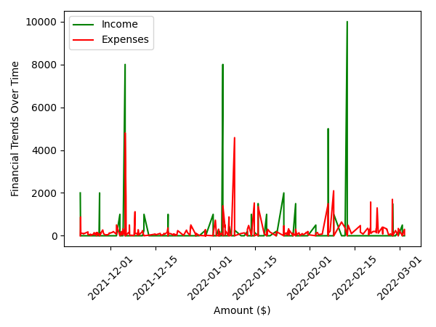
Financial Trends Over Time

Slide 7
Key Notes and Observations
Brownie
To lended people
Dinner
Metro
Snacks
From vicky
From dad
Pizza
From kumara
Lunch
From dad
To karthi
Snacks
Tea lights
Creamstone
Tamen
Hoodie for gobi
Eggs
Earphone
Auto to laxmi mills
It better be worth it
Travel to koyambedu
Stuffs
Train cbe to chn
Lunch
Random stuff for drinks
Snacks
Bus ticket
Took from sbi
Ramen with gobi
Metro
To auto anna
To egmore
Kfc dinner
Lunch
Side dishes
Kfc
Games
Dinner with aravind and buddies
Mirror
Lunch
From dad
Dinner with aravind
Kfc dinner
From dad
Bean bag
Auto to Gobi's place
Cakepark
To kumara
To chennai
Salary from dad
To gobi
Shawarma
Good soup
To gowdham
Parotta
From dad
Vnr to apk
To vicky
To ksr station
Dinner
Cycle gap
Brunch
Rapido to pg
Sent to barath
Banana
Lunch with company
Rapido to pg
To vicky
To vishnu
Zinger box meal
From vicky
From dad
Snacks
Vishnu 100 gowdham 25
Paani poori
Kfc date with myself
Lemon tea
Train to vnr
Snack
Lunch with company
Pepsi
Dinner
Sent to vicky
Lunch
From vicky
Snacks with preethi and azar
Badminton
From dad
Lunch with company
Snacks
From vicky
Lunch + chocolate for preethi
Dinner
Snack with preethi
Lunch with company
To kumara
From dad
Eve snack
Bus to Bangalore
From dad
Snacks
Kumara
Siva + 100 cash
Gundan + prasanna
Dinesh and maddy + 100 cash
From gowdham
Lunch pongal
Dinner
From dad
Rapido to pg
Recharge by gowdham
Pizza
From kumara
Lunch with not preethi
Friday snacks with preethi gang
From gowdham
Lunch with gowdham
Rent
Coffee + biscuit
From barath and shakur
Ketch up
Dinner with roommate
Bingo
Rapido to pg
McDonald's with company
Lended money returned to vishnu
Lended money returned to kumara
Jan 2nd with shakur and barath
To gobi 1st 1/4th
To abijith and to vicky lend money returned
Refund for bus ticket
Lunch with company
Arrear and reval fee
Salary
Lunch with company
To vicky
Sent to preethi
Dairy milk
From barath
From gpay
From shakur
Lunch unlimited nv
From abi
Tablet to gowdham
Dinner with barath
Train to vnr
Snacks
From dad
To barath
Pg to office
From kumara
Horlicks + kolakattai
Bommasandra to pg
From Deepak
Water
From abi
Rapido + toll
From Deepak
Coffee and thattai
Lunch with barath
From vicky
From ganesan
Coconut water with stu
Dinner with barath
Cab
Books
Corn
Water
Milk with bharath
Beer
Lunch with company
Lemon tea with company
Puffs and coffee
Dinner with barath
Puffs
Bun
Milk with bharath
Taxi
Snacks
Water
Lunch with barath
Milk with bharath
To siva
To kumara
To abijith
To rahul
From dad
Lended money
Spiderman
Lunch
Milk with bharath
Lunch with company
Gave to gowdham
Egg
Panipoori
Lunch
Milk with bharath
Lunch
Snacks
Panipoori
Snacks
Milk with bharath
Milk with bharath
From dad
From stu
Shopping
Momos
Snack with bharath
Lunch with company
Milk with bharath
Breakfast with stu
Lunch with stu
5 star
Milk
Milk with bharath
Horlicks
Milk with bharath
Shoe
Cap
Lunch with stu
Milk with bharath
Full hand and a hoodie
Rent
From dad
Dinner
Snack
For company
Breakfast
Milk with bharath
Belt
Mask
Snack
From dad
Ice cream
Vadapaav
Showergel
Lunch with company
Bharath birthday
Lunch with company
Breakfast
Lunch with company
Dinner
Panipoori
Breakfast
Snack
Zomato
Dinner with gowdham
Dinner with gowdham
Rapido
Lunch with company
From dad
Breakfast
Beer
Snack
Panipoori
Cashback
Lunch with company
Breakfast
Lunch with company
Rapido
Dinner
Snack
Dinner
Panipoori
Rapido
Rapido
Dinner
Dinner
Lunch with company
Rapido
Lunch
Got from gobi

