Slide 1
Developing a Machine Learning Pipeline for Predicting IBD Types Using Metabolomics Data
Yena An
CID 02058047
BIDS
Notes:
A title could be something like:
“Machine Learning Uncovers Potential [Type of Variables] Biomarkers of [Disease] Prediction”
“Development of a Machine Learning Pipeline to Predict [Disease]”
Have a look at different papers for inspiration, you can also base it on the research question.
You don’t have to read your title word-for-word but please do consider introducing yourself and broadly mention what you’ll discuss as ‘introduction’. E.g. “I am […] and I will talk about my data analysis pipeline to create a machine learning model to predict […]”

Slide 2
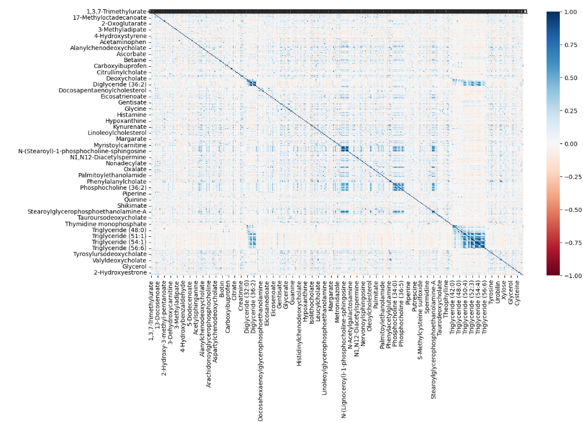
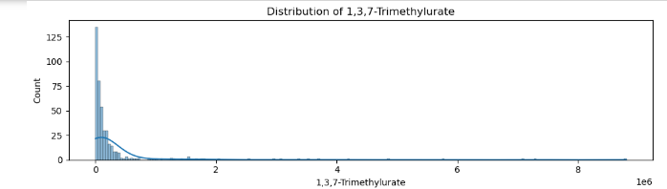
Methods – Explanatory data analysis
Training data set
1. Correlation matrix
2. Outlier detection
475 variables have > 20 outliers
282 variables have > 40 outliers
528 Variables
(522 Metabolites)
3. Histogram
424 Samples
6 Meta data columns → .iloc[:, 6:]
PID
group (numeric), group_ab (text)
sex, antibiotics_use
years_since_diagnosis
Figure 2. Histogram depicting the distribution of 1,3,7-Trimethylurate. Plot shows a highly skewed distribution with a long tail.
Figure 1. Heatmap visualising the correlation coefficients between metabolites. The scale ranges from -1 (strong negative correlation, red) to 1 (strong positive correlation, blue).
91.1% of correlation coefficients < 0.2
“Not normally distributed”
“Non-linear”
Notes:
Explain the data set (type of data, size, training/validation/test)
Explain any processing of the dataset
Detail how you optimised parameters for the dimension reduction, clustering and/or classification/regression algorithms
Don’t forget to cite the methods you used, either find the original paper or cite the package (incl. version) and function(s) used

Slide 3
Methods – Pipeline
MinMaxScaler
random_state = 517
UMAP
GMM
XGBoost
to preserve the global structure
showed better-separated clusters when compared to DBSCAN
MinMaxScaler+XGBoost combination showed the highest accuracy applying GridSearchCV()
Rationale
“Parameter Optimisation:
10-fold Cross-Validation Grid Search”
shap.TreeExplainer()
: Feature Importances for each class
Notes:
You don’t need to have 2 slides for methods or a figure, this depends on how much space you need.
You don’t need the full reference here if you have a separate reference slide (but will need time to show this), if you choose not to have the reference slide do ensure the complete reference is shown on each slide.

Slide 4
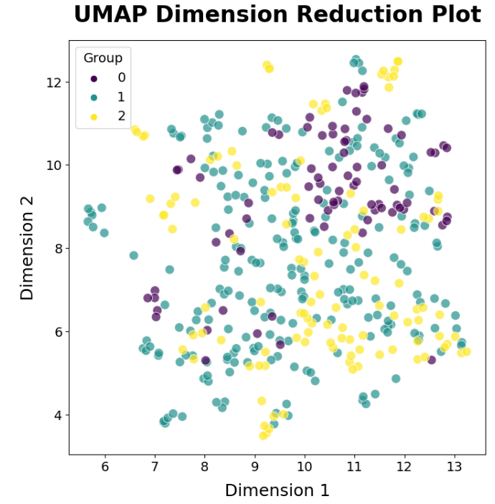
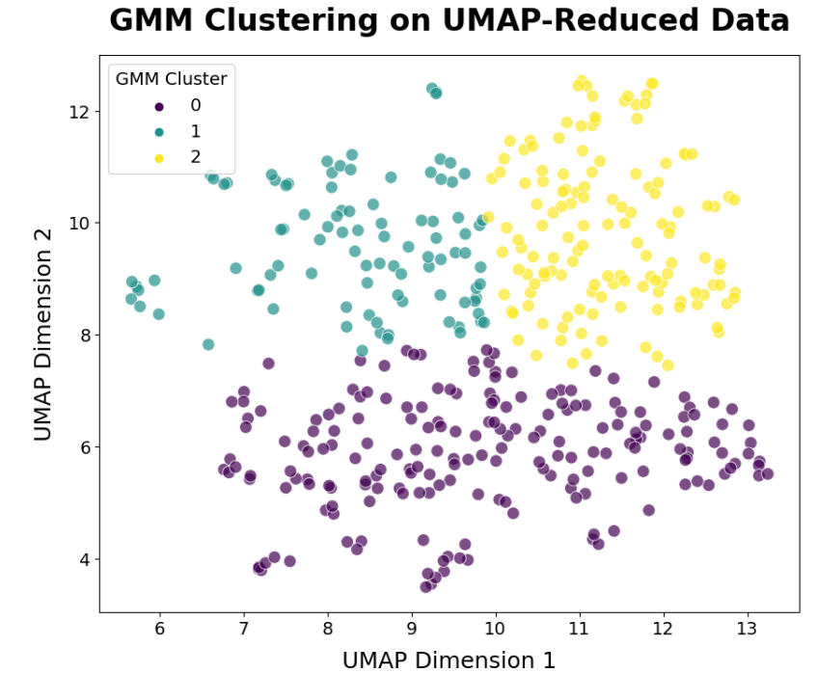
Results – Visualisation
 | Group
GMM cluster | 0 | 1 | 2
0 | 12 | 119 | 64
1 | 11 | 59 | 24
2 | 56 | 54 | 25
Table 1. Contingency table showing the number of points from the original group 0, 1, 2 in the GMM cluster 0, 1, 2.
Figure 3. UMAP plot of IBD Metabolomics data. Overlapping and scattered plot suggests there are no distinct boundaries between the microbiome profiles of these groups. Group 0 = ‘non-IBD’, 1 = Crohn’s Disease (CD)’, 2 = ‘Ulcerative Colitis (UC).
Figure 4. GMM plot of UMAP-reduced Metabolomics data. Three distinct clusters are clearly separated.
n_components= 2, min_dist= 0.3, n_neighbors= 5, metric= "euclidean"
n_components= 3, covariance_type= "diag"

Slide 5
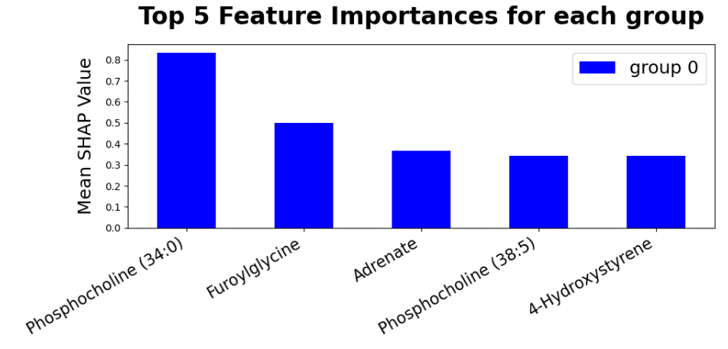
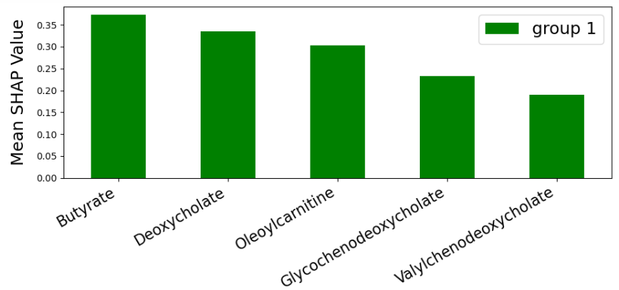
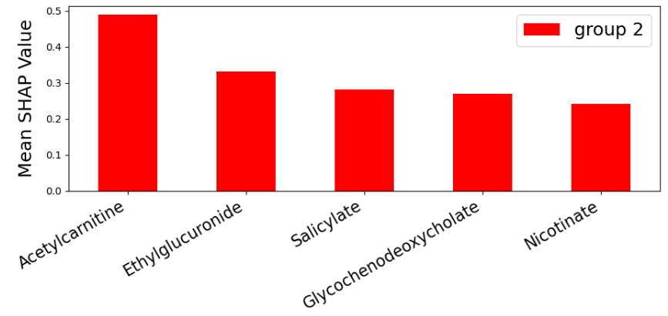
Results – XGBoost
Parameter | Value
colsample_bytree | 0.1
learning_rate | 0.35
max_depth | 1
n_estimators | 160
subsample | 0.8
random_state | 42
tree_method | "approx"
enable_categorical | False
use_label_encoder | False
predictor | 'cpu_predictor'
Table 2. Parameters used for XGBClassifier. Optimal parameters were decided after a series of cross-validated grid searches.
Mean cross-validated score = 0.911
Accuracy on independent test data = 0.965
F1-score = 0.964
Figure 5. The plot of the top 5 feature importances for each group. The mean SHAP value for each value indicates the importance of the variable for the model’s predictions. Group 0 = ‘non-IBD’, 1 = Crohn’s Disease (CD)’, 2 = ‘Ulcerative Colitis (UC).

Slide 6
Discussion
Main findings
High accuracy score for both validation (91%) and test data(96%)
non-IBD: highly dependent on Phosphocoline (34:0) (around 0.8)
Crohn’s Disease: Butyrate and Deoxycholate are the top two predictive variables
Ulcerative colitis : Acetylcarnitine have the greatest impact (around 0.5)
Feature importances significantly vary between groups
Strengths and limitations of methods
UMAP: preserves global structure <-> sensitive to parameter tuning
GMM: flexible to various cluster shapes <-> assumes Gaussian distributions
XGBoost: high accuracy and handles missing data <-> sensitive to parameter tuning
Notes:
You could add here a comparison with other work, e.g. if you have found a paper in which they aim to predict the same disease with more/less data with better/worse predictive ability – how do their methods compare to yours?

Slide 7
Future work and conclusion
Future work
- One major limitation: different random_state used for XGBClassifier (random_state=42)
Model stacking with other models (e.g., LightGBM)
Resolve class imbalance (e.g., over-sampling the minority class by SMOTE algorithm)
Conclusion
91% performance on validation data
96% on independent test data
non-IBD: Phosphocoline (34:0), Furoylglycine, Adrenate
Crohn’s Disease: Butyrate, Deoxycholate, Oleoylcarnitine
Ulcerative colitis: Acetylcarnitine, Ethylglucuronide, Salicylate
Notes:
The aim is to finish your presentation in 5 minutes, not going over 5 minutes means a question can be asked on the future work so this can be detailed in an answer rather than on slide, if you go over means there is less time for questions so more information needs to be clear from the slides

Slide 8
References
Van Rossum, G., & Drake, F. L. (2009). Python 3 Reference Manual. Scotts Valley, CA: CreateSpace.
Harris, C. R., Millman, K. J., van der Walt, S. J., et al. (2020). Array programming with NumPy. Nature, 585, 357-362. https://doi.org/10.1038/s41586-020-2649-2
The pandas development team. (2024). pandas-dev/pandas: Pandas (v2.2.2). Zenodo. https://doi.org/10.5281/zenodo.10957263
The Matplotlib Development Team. (2024). Matplotlib: Visualization with Python (v3.9.0). Zenodo. https://doi.org/10.5281/zenodo.11201097
Waskom, M. L. (2021). seaborn: statistical data visualization. Journal of Open Source Software, 6(60), 3021. https://doi.org/10.21105/joss.03021
Pedregosa, F., Varoquaux, G., Gramfort, A., et al. (2011). Scikit-learn: Machine learning in Python. Journal of Machine Learning Research, 12, 2825-2830.
McInnes, L., Healy, J., Saul, N., & Grossberger, L. (2018). UMAP: Uniform manifold approximation and projection. Journal of Open Source Software, 3(29), 861. https://doi.org/10.21105/joss.00861
Chen, T., & Guestrin, C. (2016). XGBoost: A scalable tree boosting system. In Proceedings of the 22nd ACM SIGKDD International Conference on Knowledge Discovery and Data Mining (pp. 785-794). New York, NY, USA: ACM. https://doi.org/10.1145/2939672.2939785
Gillies, S., et al. (2007). Shapely: manipulation and analysis of geometric objects. Retrieved from https://github.com/Toblerity/Shapely
Notes:
You can list references on each slide and/or list them at the end, ensure it is clear why each source is cited (and where)
E.g. don’t include a list here without context, can use a numbered list to refer back to slides.
There is no format you have to use, feel free to use your own but ensure any person can reasonably find which article you are referring to (e.g. “Johnson et al (2010) BMC Genomics” is not specific enough…)

