Slide 1
Dynamics in Magnetic Mirrors
Sidney Williams

Slide 2
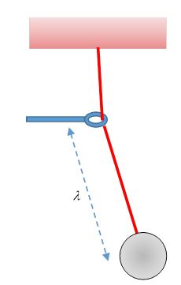
Adiabatic Invariants
Figure From: https://galileoandeinstein.phys.virginia.edu/7010/CM_13_Adiabatic_Invt_Actn_Angl.html

Slide 3

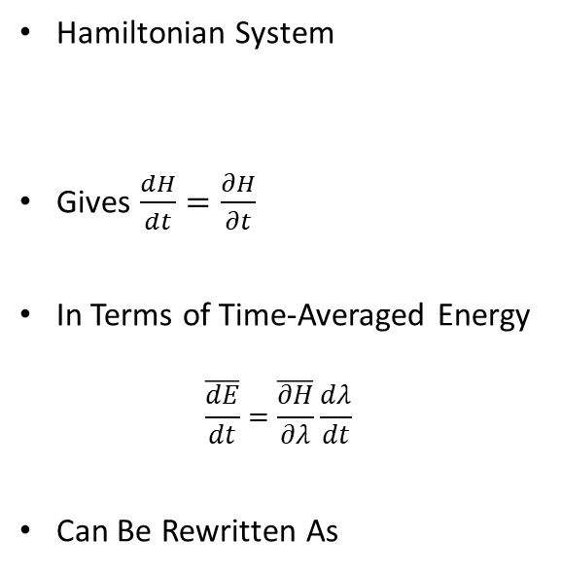


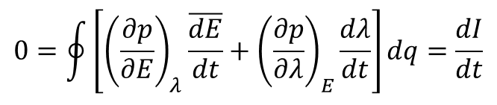
Adiabatic Invariants
Hamiltonian System
Gives $\frac{dH}{dt}=\frac{∂H}{∂t}$
In Terms of Time-Averaged Energy
$$\frac{\overline{dE}}{dt}=\frac{\overline{∂H}}{∂λ}\frac{dλ}{dt}$$
Can Be Rewritten As
$I$ is the Adiabatic Invariant
$$I=\oint{pdq}\sim mvL$$
Where p is the momentum
Plasma systems have several adiabatic invariants
$$\dot{q}=\frac{∂H}{∂p}$$
$$\dot{p}=−\frac{∂H}{∂q}$$
$$0=\oint{\left[{\left(\frac{∂p}{∂E}\right)}_{λ}\frac{\overline{dE}}{dt}+{\left(\frac{∂p}{∂λ}\right)}_{E}\frac{dλ}{dt}\right]dq=\frac{dI}{dt}}$$

Slide 4
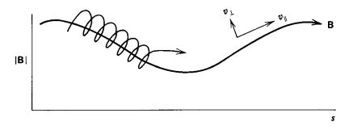
The Simple Magnetic Mirror
Figure From: Fusion An Introduction to the Physics and Technology of Magnetic Confinement Fusion 2nd Ed, Weston Stacey

Slide 5






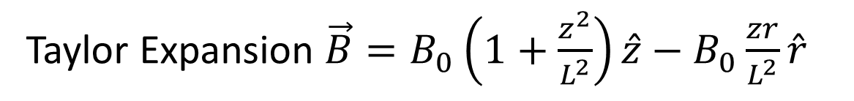
Magnetic Fields
From a Coil
$$\frac{∂^{2}B}{∂z^{2}}\left(0,0\right)\sim \frac{B_{0}}{L^{2}}$$
Taylor Expansion $\vec{B}=B_{0}\left(1+\frac{z^{2}}{L^{2}}\right)\hat{z}−B_{0}\frac{zr}{L^{2}}\hat{r}$
Equations From: Fusion An Introduction to the Physics and Technology of Magnetic Confinement Fusion 2nd Ed, Weston Stacey

Slide 6
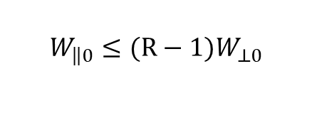
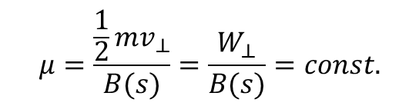
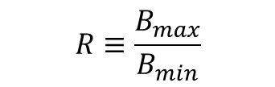
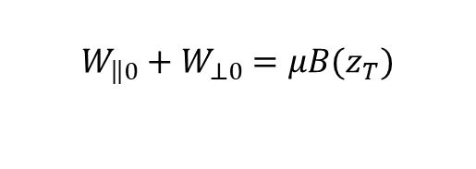
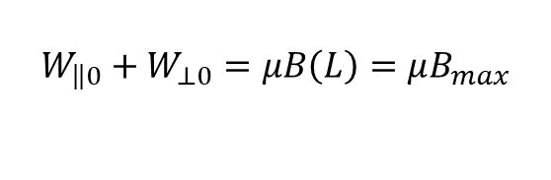
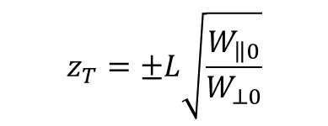

The Simple Magnetic Mirror
First Adiabatic Invariant
Energy Balance
$$μ=\frac{\frac{1}{2}mv_{⊥}}{B(s)}=\frac{W_{⊥}}{B(s)}=const.$$
$$W_{\left\|\left.0\right.\right.}+W_{⊥0}=μB(z_{T})$$
Using Given Magnetic Field
Maximum Turning Point (Trapping Condition)
$$W_{\left\|\left.0\right.\right.}=μB_{0}\frac{z_{T}^{2}}{L^{2}}=W_{⊥0}\frac{z_{T}^{2}}{L^{2}}$$
$$W_{\left\|\left.0\right.\right.}+W_{⊥0}=μB\left(L\right)=μB_{max}$$
$$z_{T}=±L\sqrt{\frac{W_{\left\|\left.0\right.\right.}}{W_{⊥0}}}$$
$$W_{\left\|\left.0\right.\right.}≤(R−1)W_{⊥0}$$
$$R≡\frac{B_{max}}{B_{min}}$$

Slide 7
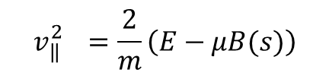
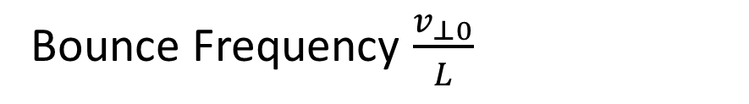
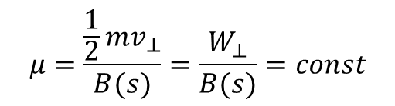
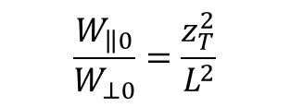

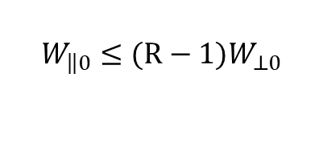
The Simple Magnetic Mirror
First Adiabatic Invariant
Rearranged Energy Balance
Trapping Condition
Turning Points
$$μ=\frac{\frac{1}{2}mv_{⊥}}{B(s)}=\frac{W_{⊥}}{B(s)}=const$$
$$W_{\left\|\left.0\right.\right.}≤(R−1)W_{⊥0}$$
$$R≡\frac{B_{max}}{B_{min}}$$
$$v_{\left\|\left.\right.\right.}^{2}=\frac{2}{m}\left(E−μB(s)\right)$$
$$\frac{W_{\left\|\left.0\right.\right.}}{W_{⊥0}}=\frac{z_{T}^{2}}{L^{2}}$$
Bounce Frequency $\frac{v_{⊥0}}{L}$

Slide 8
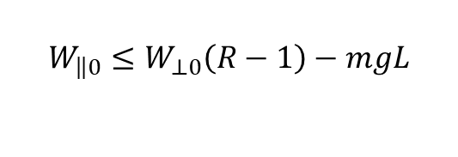
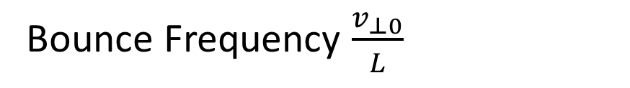
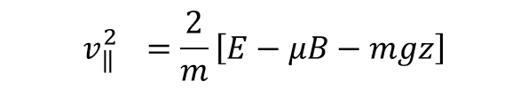
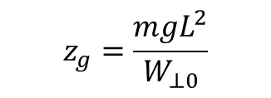
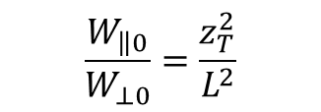
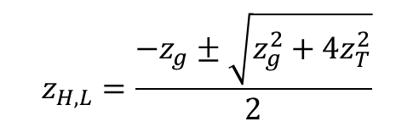
Introducing Gravity
Rearranged Energy Balance
Trapping Condition
Turning Points
$$v_{\left\|\left.\right.\right.}^{2}=\frac{2}{m}\left[E−μB−mgz\right]$$
$$z_{H,L}=\frac{−z_{g}±\sqrt{z_{g}^{2}+4z_{T}^{2}}}{2}$$
$$\frac{W_{\left\|\left.0\right.\right.}}{W_{⊥0}}=\frac{z_{T}^{2}}{L^{2}}$$
$$W_{\left\|\left.0\right.\right.}≤W_{⊥0}\left(R−1\right)−mgL$$
$$z_{g}=\frac{mgL^{2}}{W_{⊥0}}$$
Bounce Frequency $\frac{v_{⊥0}}{L}$

Slide 9
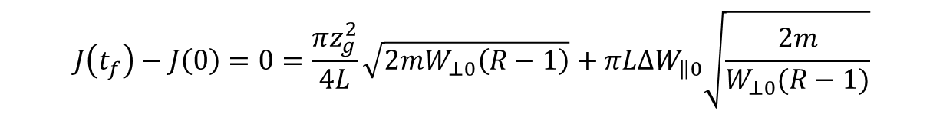
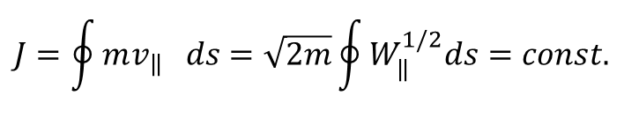

Detrapping Due to Gravity
Second Adiabatic Invariant
$$J=\oint{mv_{\left\|\left.\right.\right.}ds=\sqrt{2m}\oint{W_{\left\|\left.\right.\right.}^{1/2}ds}}=const.$$
$$J\left(t_{f}\right)−J\left(0\right)=0=\frac{πz_{g}^{2}}{4L}\sqrt{2mW_{⊥0}\left(R−1\right)}+πL∆W_{\left\|\left.0\right.\right.}\sqrt{\frac{2m}{W_{⊥0}(R−1)}}$$
Rearranged
$$∆W_{\left\|\left.0\right.\right.}=−\frac{z_{g}^{2}W_{⊥0}(R−1)}{4L^{2}}$$

Slide 10
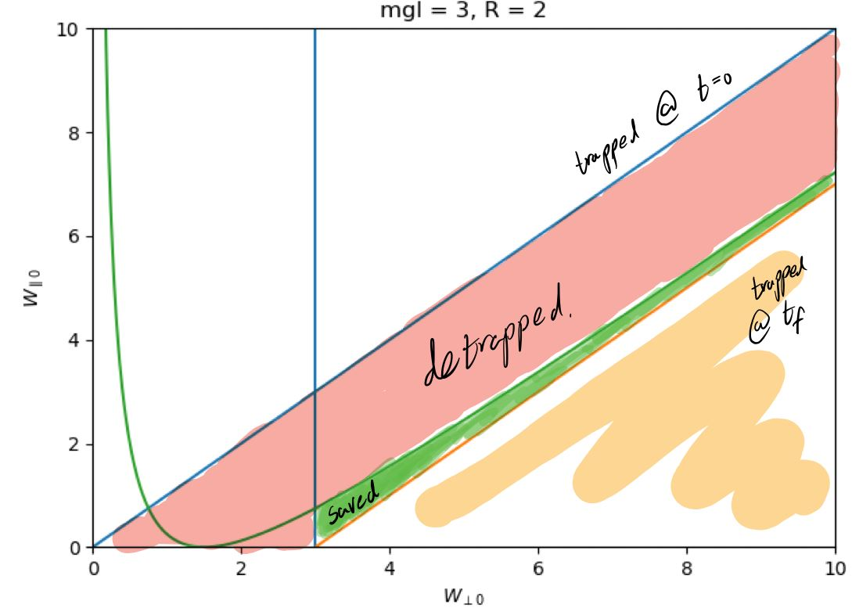
Figure Curtesy of Tal Rubin

Slide 11

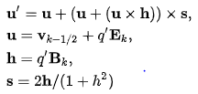
Boris Algorithm
Equations From: https://en.wikipedia.org/wiki/Particle-in-cell

Slide 12
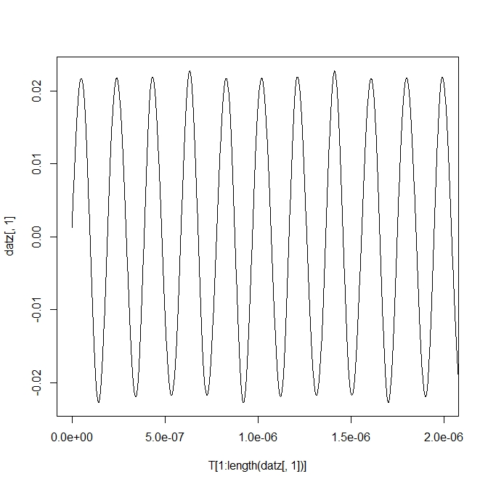
Numeric Difficulties: Time Step
Large Timestep Caused Unphysical Detrapping
624KeV Particle, dt=1e-09, trapped for at least 1e-04s
Same Particle detrapped after a single time step for dt=1e-07

Slide 13
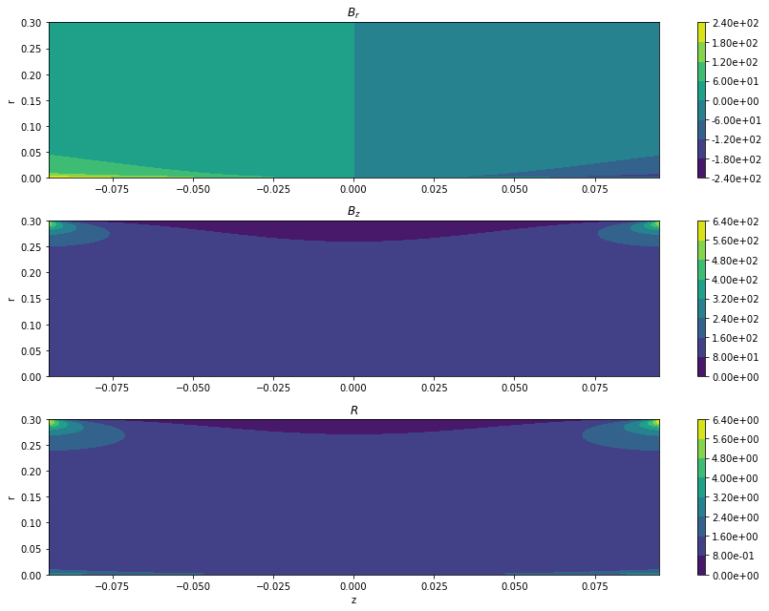
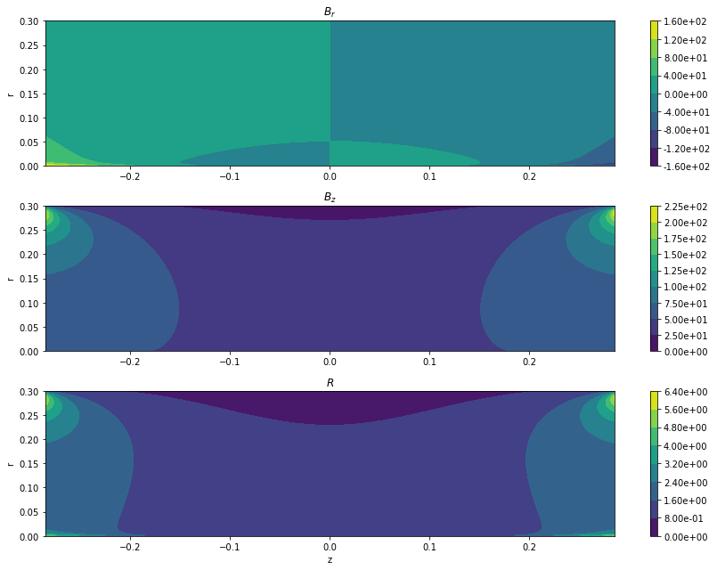
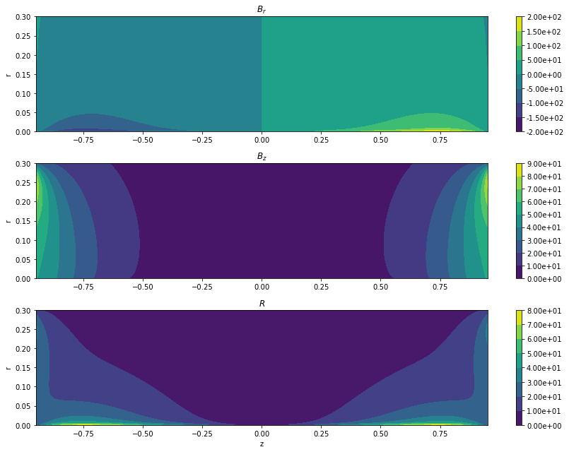

Numeric Difficulties: R
$$R≡\frac{B_{max}}{B_{min}}$$
Radial Dependence

Slide 14
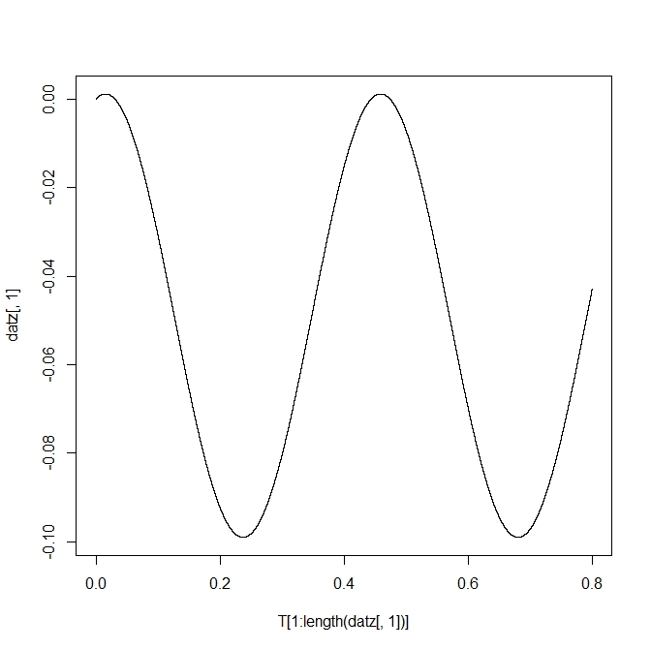
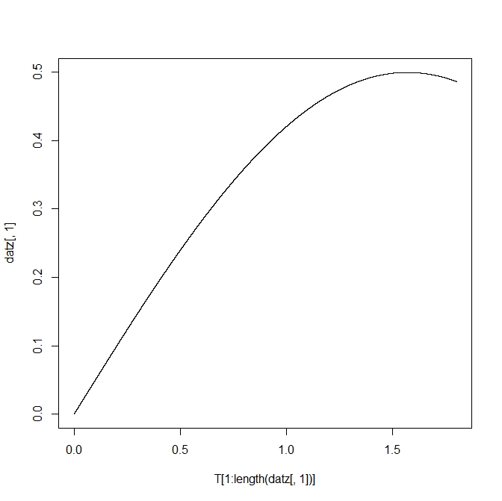
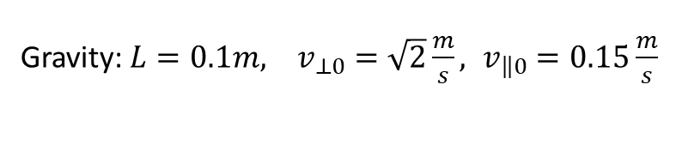
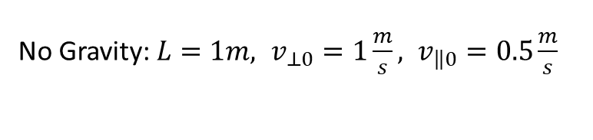
Verification
No Gravity: $L=1m, v_{⊥0}=1\frac{m}{s}, v_{\left\|\left.0\right.\right.}=0.5\frac{m}{s}$
Gravity: $L=0.1m, v_{⊥0}=\sqrt{2}\frac{m}{s}, v_{\left\|\left.0\right.\right.}=0.15\frac{m}{s}$

Slide 15
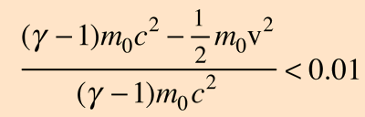
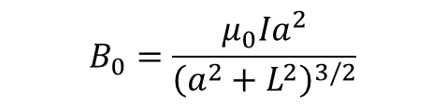


Full Simulation
Want to Break the First Adiabatic Invariant, So Want Fast Varying B
$$B_{0}=\frac{μ_{0}Ia^{2}}{{\left(a^{2}+L^{2}\right)}^{3/2}}$$
$\frac{q}{m}B_{0}L=v_{⊥0}$ Near Relativistic
Maximum of $1e−10J=624MeV$
Equation From: http://hyperphysics.phy-astr.gsu.edu/hbase/Relativ/rellim.html

Slide 16
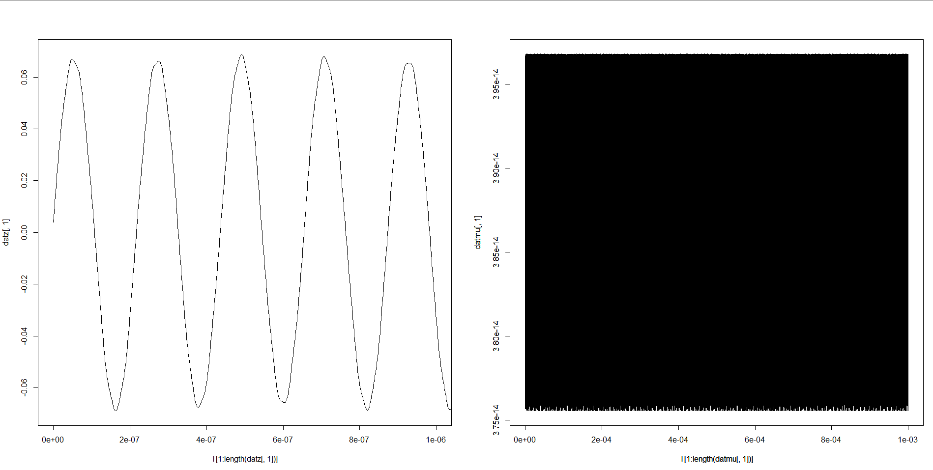
Full Simulation
L=0.1m $I=50∗{10}^{7}A$ $a=0.3m$ $\frac{W_{\left\|\left.0\right.\right.}}{W_{⊥0}}=0.875$ Expected Turning Point: 0.071 Actual Turning Point: 0.06895

Slide 17
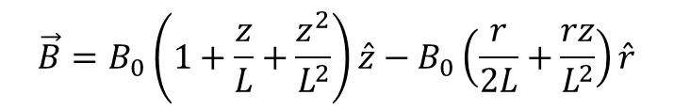
Future Work
Introducing Asymmetries
$$\vec{B}=B_{0}\left(1+\frac{z}{L}+\frac{z^{2}}{L^{2}}\right)\hat{z}−B_{0}\left(\frac{r}{2L}+\frac{rz}{L^{2}}\right)\hat{r}$$
Working with True Coil Fields
Large-Scale Multiparticle Simulation
Adding Particle Interactions
Relativistic Effects

Slide 18
Questions?

