Slide 1
NLP Final Project Demo Generation of semantic patterns in WriteAhead & Linggle
104065502 ERIC
104065510 JAMIE

Slide 2
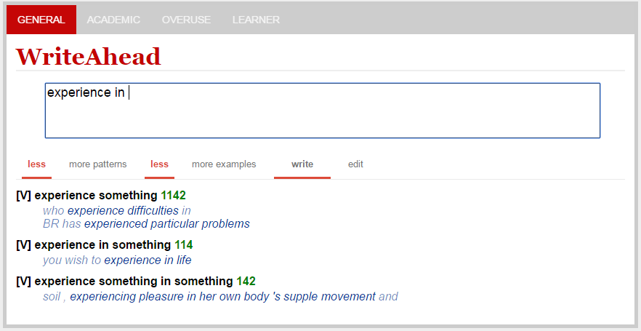
Goal
To correct the following situation in WriteAhead
Experience in something ==> experience in ACT(?%) | substance(?%)
Provide corresponding example for each patterns

Slide 3
Framework
WriteAhead
Disambiguate
(WordNet)
word
sense
Get new pattern
Sentence
Map/ Reduce
Map/ Reduce
Get pattern & sentence
Pattern Json
Colls & frequency
Get new pattern
Get pattern & sentence
Query
Choose top two high frequency class
Linggle
Map/ Reduce

Slide 4
Framework
WriteAhead
Disambiguate
(WordNet)
word
sense
Get new pattern
Sentence
Map/ Reduce
Map/ Reduce
Get pattern & sentence
Pattern Json
Colls & frequency
Get new pattern
Get pattern & sentence
Query
Choose top two high frequency class
Linggle
Map/ Reduce

Slide 5
Framework
WriteAhead
Disambiguate
(WordNet)
word
sense
Get new pattern
Sentence
Map/ Reduce
Map/ Reduce
Get pattern & sentence
Pattern Json
Colls & frequency
Get new pattern
Get pattern & sentence
Query
Choose top two high frequency class
Linggle
Map/ Reduce

Slide 6
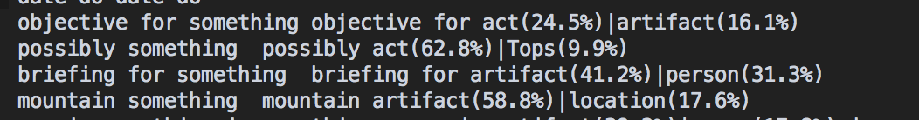
Framework
WriteAhead
Disambiguate
(WordNet)
word
sense
Get new pattern
Sentence
Map/ Reduce
Map/ Reduce
Get pattern & sentence
Pattern Json
Colls & frequency
Get new pattern
Get pattern & sentence
Query
Choose top two high frequency class
Linggle
Map/ Reduce

Slide 7
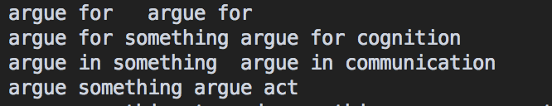
Framework
WriteAhead
Disambiguate
(WordNet)
word
sense
Get new pattern
Sentence
Map/ Reduce
Map/ Reduce
Get pattern & sentence
Pattern Json
Colls & frequency
Get new pattern
Get pattern & sentence
Query
Choose top two high frequency class
Linggle
Map/ Reduce

Slide 8
Framework
WriteAhead
Disambiguate
(WordNet)
word
sense
Get new pattern
Sentence
Map/ Reduce
Map/ Reduce
Get pattern & sentence
Pattern Json
Colls & frequency
Get new pattern
Get pattern & sentence
Query
Choose top two high frequency class
Linggle
Map/ Reduce

Slide 9
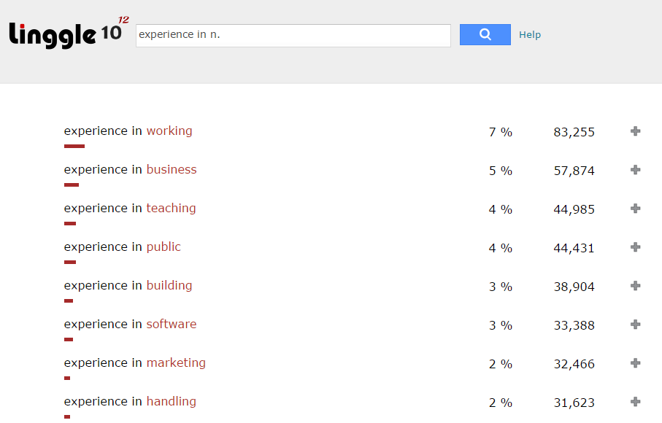
How to get Linggle dataset

Slide 10
Framework
WriteAhead
Disambiguate
(WordNet)
word
sense
Get new pattern
Sentence
Map/ Reduce
Map/ Reduce
Get pattern & sentence
Pattern Json
Colls & frequency
Get new pattern
Get pattern & sentence
Query
Choose top two high frequency class
Linggle
Map/ Reduce

Slide 11
Demo Time

