Slide 1
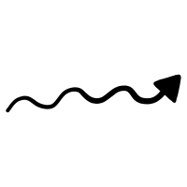
Extended wind
up to 10¹⁶ cm
Accelerating
e⁺
v_{CSM}
Dense CSM
e⁻
H
e⁺
H
Progenitor
A’
e⁺
H
a few 10¹⁴ cm
Shock
H
H
H

