Slide 1
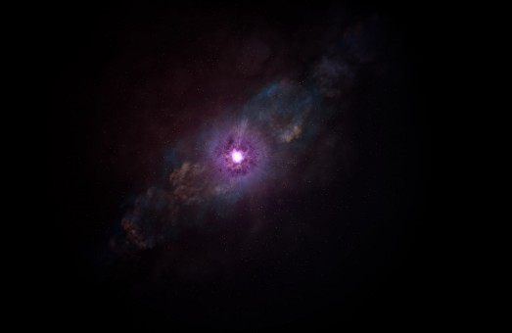
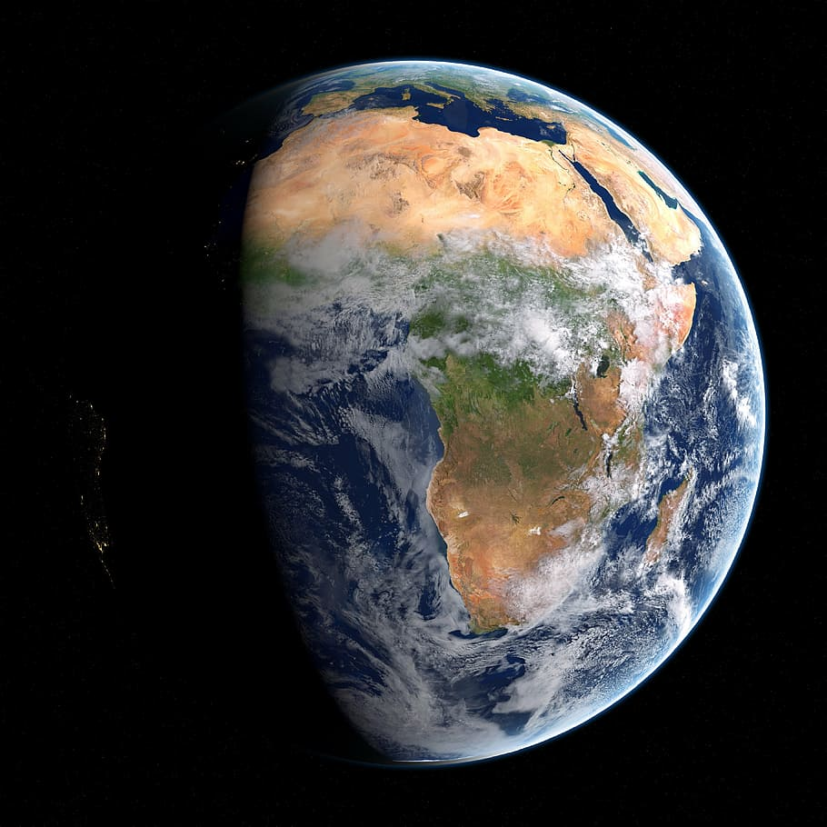
SNν
BDM Afterglow
0 s
~10 s
t > 10 s
χ
ν
ToF
χ
ν
χ
ν
ν

Slide 2
Supernova neutrino (ν) burst
Boosted dark matter (χ) afterglow
0 s
~10 s
t > 10 s
χ
ν
Time of Flight
γ
χ
ν
χ
ν
ν
Supernova burst
γ
γ

