Slide 1
G: GC
E: Earth
S: SN
B: Boosted point
β: off-centered angle
θ: open-angle (will be integrated out)
α: the deflection angle (θ-dependent)
D = ct (SNν propagtion length)
r′: the distance from B to G, will be used to calcu-late n_{χ}(r′). This term varies with φ. When
φ = 0, it is special
with r′ = r.
z
ψ
d
=
D
π − ψ
d
h
B
θ
Θ
θ
dcosθ
R_{s}
r
h
d
D
r′
r′
hcosφ
S
hcosφ
dcosθ
E
x
hsinφ
a
a
R_{e}
G
dcosθ
E
G
y
R_{e}
In the limit of SN at GC (S = G), we have β = 0 and R⋆ = R⊕. Thus we recover
G
as desired!
as desired!

Slide 2
B
ψ
B′
B
D
d
=
D
d
π − ψ
r
h
h
Θ
θ
Θ
θ
B′
d
S
dcosθ
E
R_{s}
D
ϕ
r′
S
hcosϕ
dcosθ
E
ϕ
hsinϕ
dcosθ
E
r′
hcosϕ
a
R_{e}
hsinϕ
a
R_{e}
G
G
G

Slide 3
B
ψ
B′
B
D
d
=
D
d
π − ψ
r
h
h
Θ
θ
Θ
θ
B′
d
S
dcosθ
E
R_{s}
D
ϕ
r′
S
hcosϕ
dcosθ
E
ϕ
hsinϕ
dcosθ
E
r′
hcosϕ
a
R_{e}
hsinϕ
a
R_{e}
G
G
G

Slide 4
SNν sphere
B
ψ
S
E
D
d
G
S
r
θ
E
R_{s}
β
R_{e}
G

Slide 5
SNν sphere
B
B
S
G
S
G

Slide 6


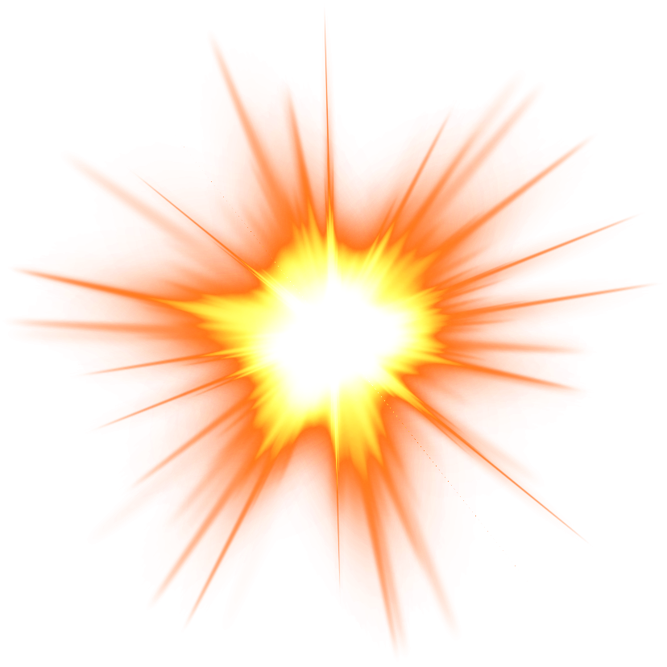
GC
R_{e}
Earth
β
R_{s}
SN

